Slide 1
Prepping for PROGRESS: Adding New Tools to Your Backpack (Toolbox) for the Start of School
August 2022
Notes:
I

Slide 2
Welcome

Slide 3
Where are you from?
Use the Annotate feature at the top of your screen to indicate where you are from. Can’t find it? Feel free to drop your response in the chat!

Slide 4
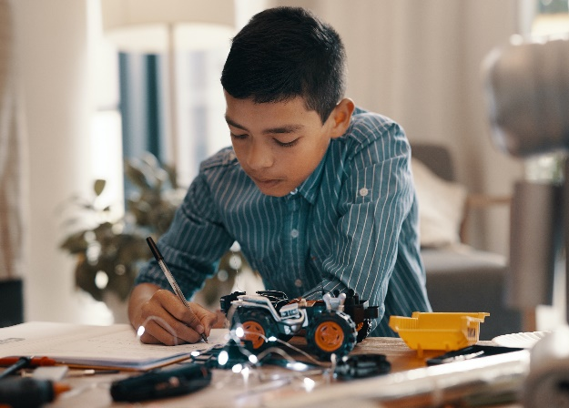
Welcome to the PROGRESS Center!
The PROGRESS Center provides information, resources, tools, and technical assistance services to support local educators in developing and implementing high-quality educational programs that enable children with disabilities to make progress and meet challenging goals.
HOW WILL WE HELP IMPROVE OUTCOMES FOR STUDENTS WITH DISABILITIES?
Share current research,
policies, guidance, success stories, and experiences from students, parents, educators, and
other stakeholders.
Partner with selected
local educators to develop and implement high-quality educational programs.​
Provide tools, resources, and
training materials for ALL educators, leaders, and families.
Visit us at www.promotingPROGRESS.org to learn more!
≈

Slide 5
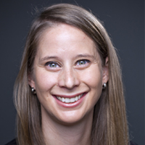
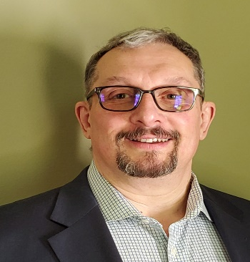
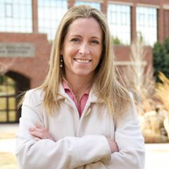
Introductions
Amy Peterson, Senior Researcher, PROGRESS Center Universal Technical Assistance Lead, American Institutes for Research
David Emenheiser, PhD, PROGRESS Center Project Officer, Office of Special Education Programs, U.S. Department of Education
Tessie Bailey, PhD, Principal Consultant, PROGRESS Center Director, American Institutes for Research

Slide 6
Welcome from David Emenheiser
David Emenheiser, PhD, PROGRESS Center Project Officer, Office of Special Education Programs, U.S. Department of Education

Slide 7
Event Orientation
During the Event you will have the opportunity to:
hear from PROGRESS Center experts and stakeholder panels.
join a strand focused on building better individualized education programs (IEPs) or preparing educators to support students with disabilities.
network with others working with students with disabilities.
access concurrent sessions focused on implementation fidelity, belonging, family engagement, and special education law.

Slide 8
Event Schedule Overview
Day 1 (Today, August 3)
Day 2 (Tomorrow, August 4)
Reminder! You must register for each session independently. Haven’t registered for a session you would like to attend? Don’t worry, there is still time.
Time (ET) | Session
11:00 a.m.-12:20 p.m. | This session!
12:20-1:00 p.m. | BREAK
1:00-2:00 p.m. | Strand Sessions (Part 1)
2:00-2:20 p.m. | BREAK
2:20-3:20 p.m. | Strand Sessions (Part 2)
3:20-3:30 p.m. | BREAK
3:30-4:00 p.m. | Optional Networking Discussion
Time (ET) | Session
10:15-10:45 a.m. | Optional Networking Discussion
10:45-11:00 a.m. | BREAK
11:00 a.m.-12:00 p.m. | General Session: Panel Discussion
12:00-12:40 p.m. | BREAK
12:40-1:40 p.m. | Concurrent Sessions
1:40-2:00 p.m. | BREAK
2:00-3:00 p.m. | Concurrent Sessions
3:00-3:20 p.m. | BREAK
3:20-4:00 pm | Closing Session

Slide 9
Day 1: Strand Options
Strand 1: Making Connections! Ensuring the Parts of the IEP Work Together to Promote Progress
Strand 2: Expanding Your Toolbox for Preparing Educators to Promote Progress!

Slide 10
Day 2: Concurrent Sessions
Start the School Year Right by Promoting Belonging of All Students
Collaboration Compass: Engaging Parents on a Path to PROGRESS
Did We Do What We Said We Would? Why Developing a High-Quality IEP Isn’t Enough!
Providing a Free Appropriate Public Education (FAPE): Lessons From the Due Process Hearing Front
These same sessions will occur from 12:40-1:40 p.m. and 2:00-3:00 p.m., so you can choose to attend 2 of the 4 available sessions live. If you are interested in the other sessions, you can listen to their archived recordings after the event!

Slide 11
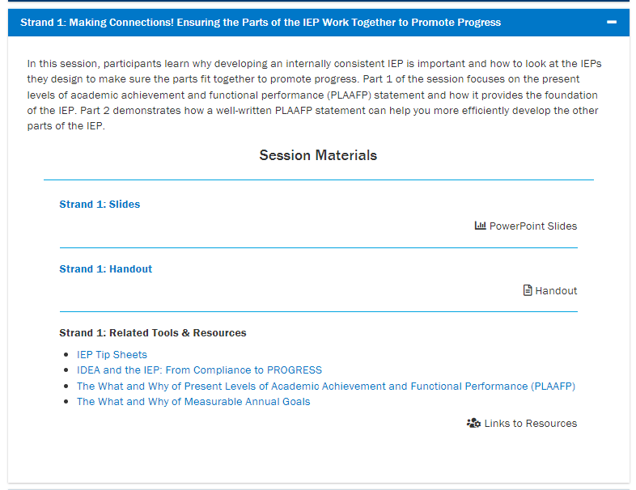
Where can I find event materials and recordings after the event?
https://promotingprogress.org/news-events/prepping-progress-event-2022

Slide 12
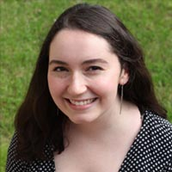
Technical Support
Do you have a question about the technology?
Do you need support in accessing a session?
Do you have questions about accessing materials?
Reach out to Mia Mamone at mmamone@air.org with any challenges! She will do her best to address any needs throughout the event.

Slide 13
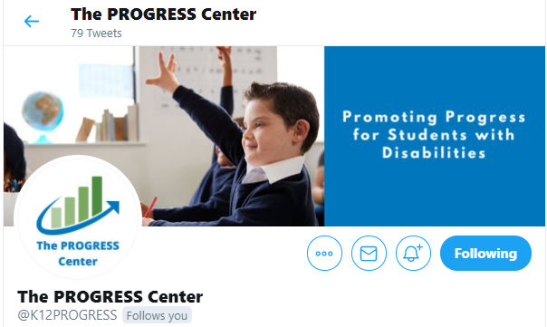
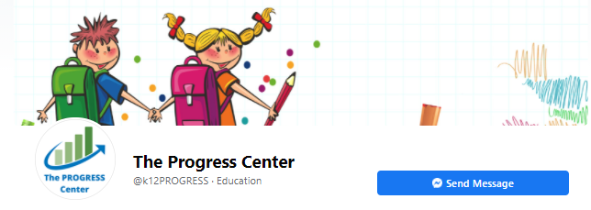
Connect With the PROGRESS Center
Connect to us on Facebook and Twitter @k12progress
Share your learning about the event at #promotingprogress2022

Slide 14
Path to PROGRESS:
What does it take to develop and implement high-quality educational programming for students with disabilities?
Tessie Bailey, PhD
August 2022

Slide 15
How do we ensure that every student is on the path to PROGRESS?
Progress

Slide 16
Currently, SWDs continue to have significantly lower academic performance levels than their peers without disabilities.
11.7%
Demonstrate proficiency on 8th grade ELA state assessments.
8.1%
Demonstrate proficiency on 8th grade math state assessments.
https://sites.ed.gov/idea/files/43rd-arc-for-idea.pdf

Slide 17
Our beliefs and expectations often determine the path we take or provide for our students.

Slide 18
What about students with disabilities (SWDs)?
68%
Spend 80% or more in the general education classroom
95%
Spend some portion of their day in the general education classroom
https://content.govdelivery.com/accounts/USED/bulletins/311f842

Slide 19
Remember!
All students are general education students first.
Some students require special education aids and services to access and benefit from general education similarly to their peers.

Slide 20
Buffman et al. Quote
system
There is no way a single teacher
has all the time,
all the knowledge,
and all the skills
to meet all the needs
of every child in his or her class(es).
Buffman, Mattos, & Webber 2009
every school or district.

Slide 21
Need for a Sustainable Ecosystem
We need a sustainable ecosystem with capacity to develop and implement high-quality educational programming for all, including students with disabilities.
We NEED collective efficacy.

Slide 22
Collective Teacher Efficacy
Collective Teacher Efficacy is the collective belief of educators in their ability to positively affect students, including students with disabilities.
It is built on evidence of impact.
Collective belief that you can make a difference.
Evidence you are making a difference.
ES = 1.57*
X
=
(Eells, 2011; Hattie, 2017)

Slide 23
Collective efficacy starts with the right questions!
What do we want for our students and families?
In the chat, share some of the things you want for your students and families.

Slide 24
Collective efficacy starts with the right questions!
What do we want for our students and families?
What is the current reality and who are the players?
What do our students and families need to be successful?
How can we maximize our resources to support students and families?

Slide 25
Ensuring Appropriate Progress
Endrew F. v. Douglas County School District RE-1 (2017)
“To meet its substantive obligation under the IDEA, a school must offer an IEP reasonably calculated to enable a child to make progress appropriate in light of the child’s circumstances.” (emphasis added)

Slide 26
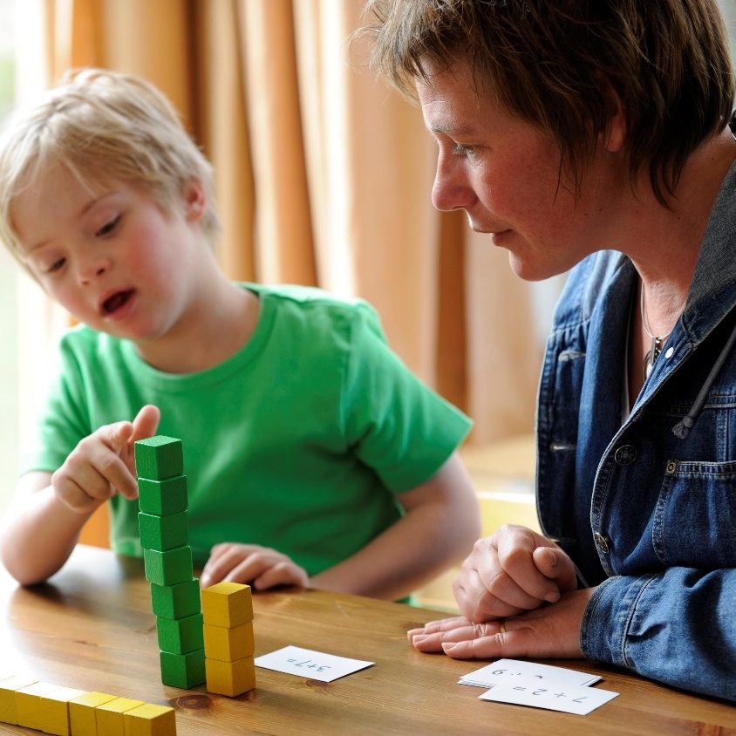
Development times implementation equals improved access and outcomes
Development of high-quality educational programming
Implementation of high-quality educational programming
Improved access and outcomes - FAPE

Slide 27
IDEA FAPE Requirements
Procedural
In the development of an IEP, has the IEP team complied with the procedures set forth in IDEA? (Rowley)
Substantive
Is the IEP reasonably calculated to enable the child to make progress that is appropriate in light of the child’s circumstances? (Endrew F.)
Implementation
In implementing the IEP, were the instructional services and supports outlined in the IEP provided as agreed on during the IEP process?
FAPE Requirements

Slide 28
Program Development: Procedural
Participation Outside Regular Education and in State and Districtwide Assessments
Present Levels of Academic Achievement and Functional Performance (PLAAFP)
Monitoring Plan
Statement of Special Education and Aids and Services
Date, Frequency, Duration and Location of Services
Measurable Goals

Slide 29
Program Development: Substantive
PLAAFP:
Provide an assessment and data-driven baseline
Specially designed instruction (SDI):
Addresses unique needs and ensures access to and progress in the general curriculum
Monitoring Plan:
Informs us if services are leading to progress or if changes are needed
Measurable Goals: Connects to our PLAAFP, SDI, and progress monitoring

Slide 30
IEPs: Same Essential Ingredients but Individualized Based on Student Need

Slide 31
What good is a great IEP if it doesn’t guide implementation?

Slide 32
FAPE and Implementation: Breaking Down Findings from Case Law
Fidelity of Implementation
Capacity to Implement

Slide 33
Implementing High-Quality Educational Programming: Building a Sustainable Ecosystem
Ongoing Teaming
Progress
Family Engagement
Effective Instruction
Educator Support
IEP
Belonging

Slide 34
MTSS can support the sustainable ecosystem necessary for the PROGRESS of students with disabilities.
MTSS can support the sustainable ecosystem necessary for the PROGRESS of students with disabilities.
SWDs, GT, ELs
Receive services at all levels, depending on need
Tier 3: Intensive Level of Prevention
Tier 2: Targeted Level of Prevention
Tier 1: Universal Level of Prevention

Slide 35
Collective efficacy starts with the right questions! 2
What do we want for our students and families?
What is the current reality and who are the players?
What do our students and families need to be successful?
How can we maximize our resources to support students and families?
The PLAAFP statement outlines the answers!!

Slide 36
Questions
Questions?
Notes:
Monitor chat for any questions.

Slide 37
Don’t forget
Time (ET) | Session
11:00 a.m.-12:20 p.m. | This session!
12:20-1:00 p.m. | BREAK
1:00-2:00 p.m. | Strand Sessions (Part 1) Strand 1: Making Connections! Ensuring the Parts of the IEP Work Together to Promote Progress Strand 2: Expanding Your Toolbox for Preparing Educators to Promote Progress!
2:00-2:20 p.m. | BREAK
2:20-3:20 p.m. | Strand Sessions (Continued)
3:20-3:30 p.m. | BREAK
3:30-4:00 p.m. | Optional Networking Discussion

Slide 38
Staying Connected With the PROGRESS Center
Connect to us on Facebook and Twitter @k12progress
https://promotingprogress.org/news/connect-progress-center

Slide 39
Reminder! Where can I find event materials and recordings after the event?
https://promotingprogress.org/news-events/prepping-progress-event-2022

Slide 40
Disclaimer
This material was produced under the U.S. Department of Education, Office of Special Education Programs, Award No. H326C190002. David Emenheiser serves as the project officer. The views expressed herein do not necessarily represent the positions or policies of the U.S. Department of Education. No official endorsement by the U.S. Department of Education of any product, commodity, service, or enterprise mentioned in this presentation is intended or should be inferred.

Slide 41
PROGRESS Center
progresscenter@air.org
1400 Crystal Drive, 10th Floor
Arlington, VA 22202-3289
202.403.5000
progresscenter@air.org
promotingprogress.org | www.air.org
https://www.facebook.com/k12PROGRESS/
https://twitter.com/K12PROGRESS
Notice of Trademark: “American Institutes for Research” and “AIR” are registered trademarks. All other brand, product, or company names are trademarks or registered trademarks of their respective owners.
This material was produced under the U.S. Department of Education, Office of Special Education Programs, Award No. H326C190002. David Emenheiser serves as the project officer. The views expressed herein do not necessarily represent the positions or policies of the U.S. Department of Education. No official endorsement by the U.S. Department of Education of any product, commodity, service, or enterprise mentioned in this presentation is intended or should be inferred.

