Slide 1
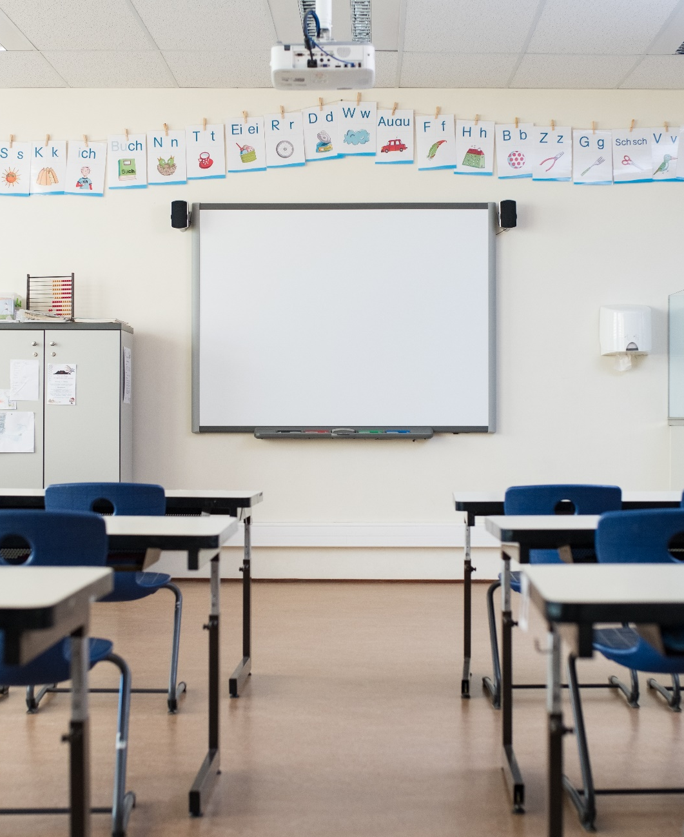
Providing a FAPE: Lessons from the Due Process Hearing Front
Mitchell L. Yell, PhD | David F. Bateman, PhD
August 4, 2022

Slide 2
IDEA Requirements FAPE
The primary requirement of the IDEA and the crucial obligation of special educators is to provide a special education that confers a free appropriate public education (FAPE).

Slide 3
Free Appropriate Public Education (FAPE)
Special education and related services that:
  Are provided at public expense
  Meet the standards of the state education agency
  Include preschool, elementary, or secondary education
  Are provided in conformity with the individualized education program (IEP)
IDEA, 20 U.S.C. § 1401 (a)(18

Slide 4
According to Senator Robert Stafford (1978), Congressional authors “did not attempt to define ‘appropriate’ but instead we established a base-line mechanism, a written document called the Individualized Education Program (IEP)” (Stafford, 1978, p. 75).

Slide 5
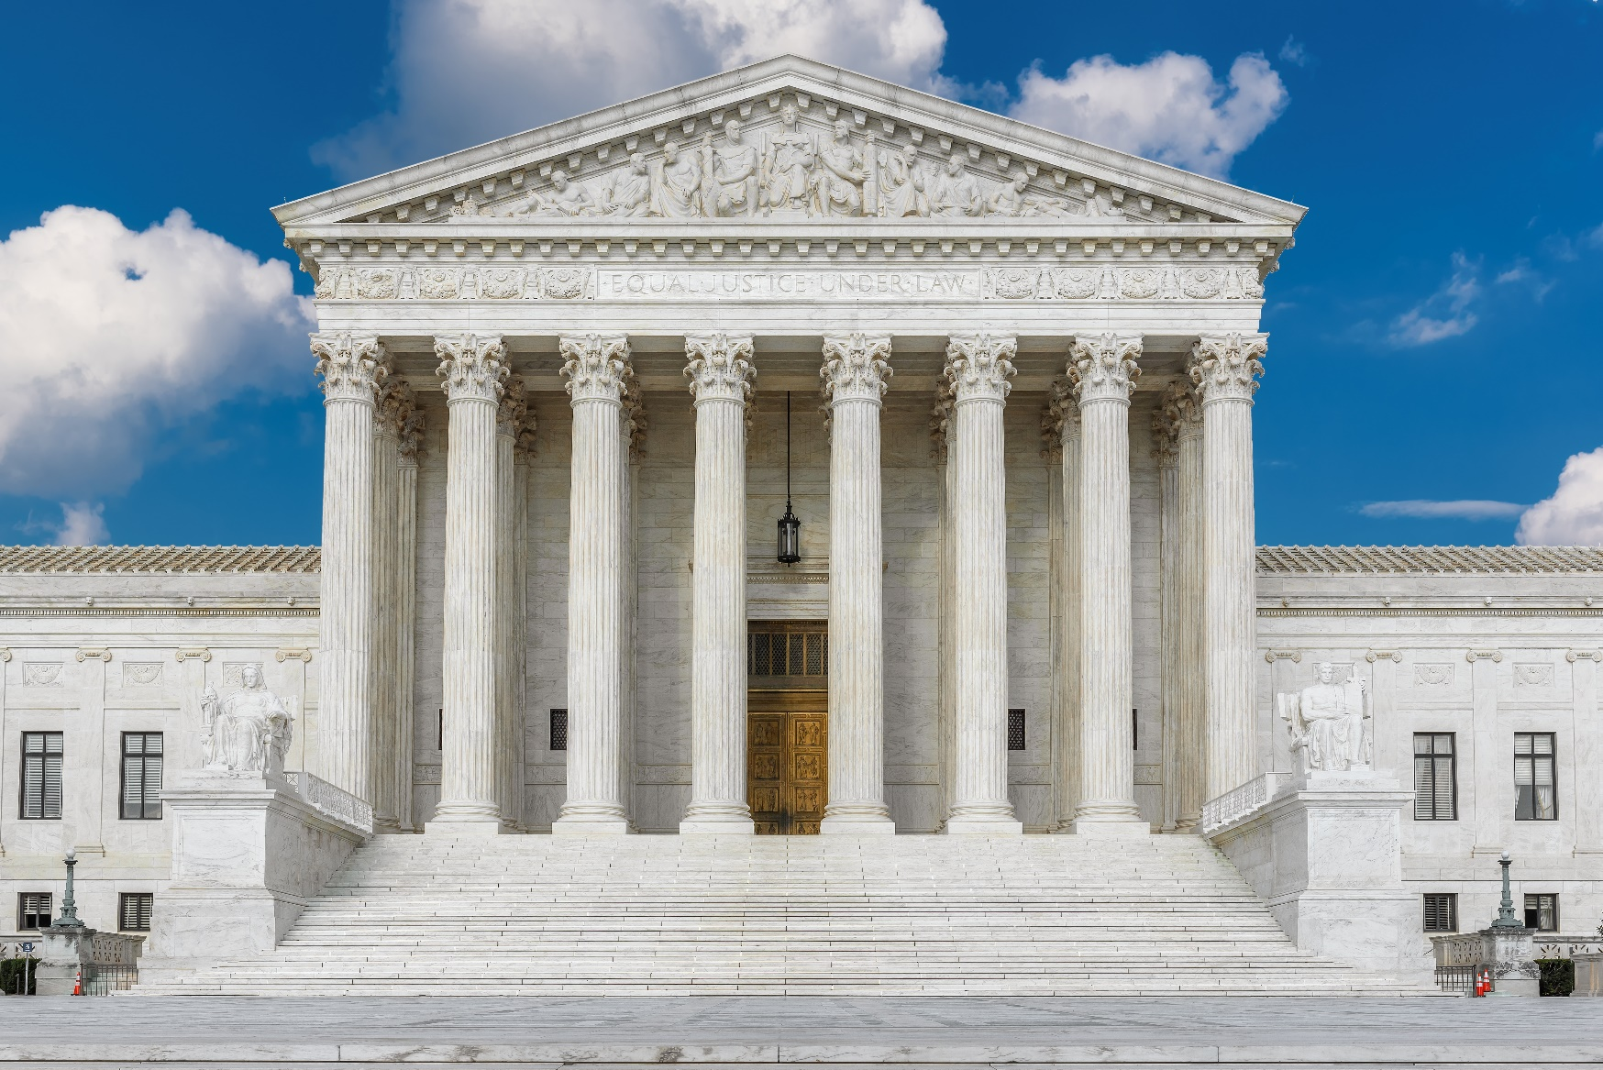
Board of Education v. Rowley, 1982
458 U.S. 176 (1982)

Slide 6
Appeal to the U.S. Supreme Court
Question Presented:
What is the level of educational benefit school districts must confer on children with disabilities to provide them with the free appropriate public education guaranteed by the Individuals with Disabilities Education Act?

Slide 7
The Rowley Two-Part Test
Has the state complied with the procedures set forth in the law?
Is the resulting IEP reasonably calculated to enable the student to receive educational benefit?

Slide 8
FAPE Standards
FAPE Standards
Lower
Standard-7th & 8th
Higher
Standard-6th
Lower
Standard-2nd
Confused-9th
Lower
Standard-10th
Higher
Standard-3rd
Lower
Standard-4th
Higher
Standard-5th
Lower
Standard-11th

Slide 9
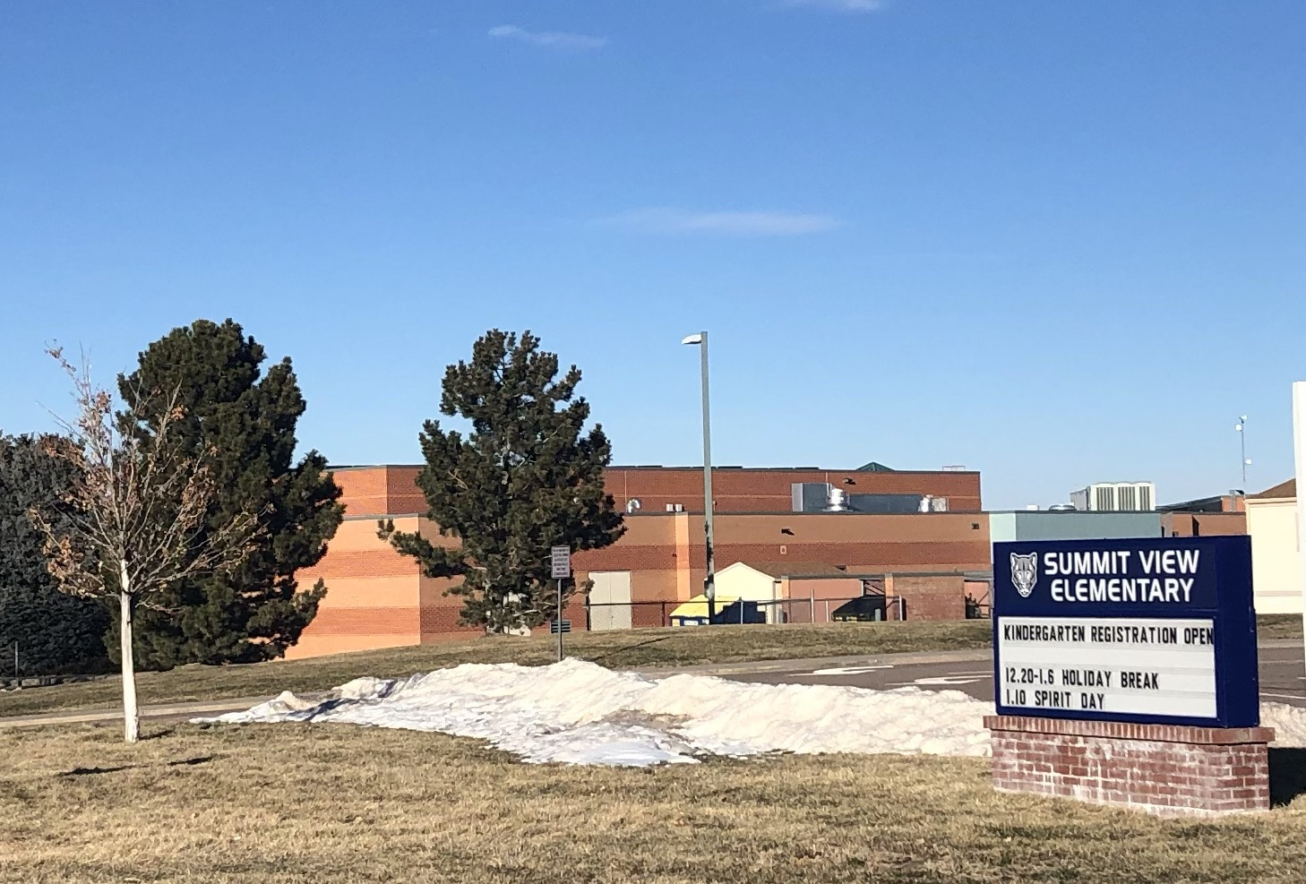

Endrew F. v. Douglas County School District R1 (10th Cir. 2014)

Slide 10
The Tenth Circuit’s Educational Benefit Standard
“The educational benefit mandated by the IDEA must merely be more than de minimis” (Endrew, 2015, p.17)

Slide 11
Appeal to the U.S. Supreme Court Endrew
Question Presented:
What is the level of educational benefit school districts must confer on children with disabilities to provide them with the free appropriate public education guaranteed by the Individuals with Disabilities Education Act?
Oral arguments heard on January 11, 2017

Slide 12
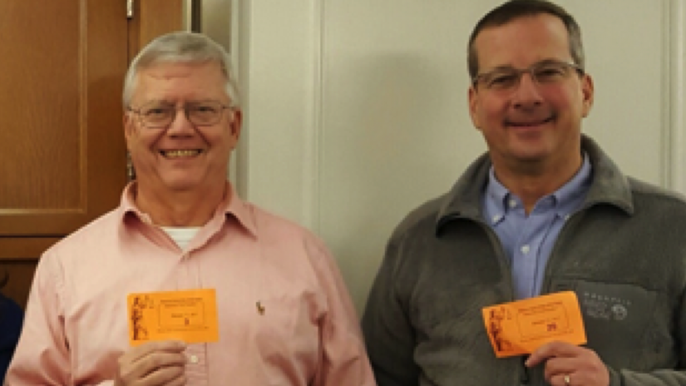
Mitch Yell and David Bateman

Slide 13
Supreme Court Ruling: March 22, 2017
The High Court rejected the “merely more than de minimis” standard, vacating the decision and remanding the case back to the 10th Circuit to apply the new standard.
“To meet its substantive obligation under the IDEA, a school must offer an IEP reasonably calculated to enable a child to make progress appropriate in light of the child’s circumstances.’

Slide 14
“The IEP must aim to enable the child to make progress. After all, the essential function of an IEP is to set out a plan for pursuing academic and functional advancement.”
- Endrew F., 2017, p. 11.

Slide 15
The Rowley/Endrew Two-Part Test
Has the state complied with the procedures set forth in the law?
Is the resulting IEP reasonably calculated to enable the student to make progress appropriate in light of his or her circumstances?

Slide 16
The Final Chapter of Endrew F.
U.S. Circuit Court of Appeals for the 10th Circuit - 2017
U.S. District Court for the District of Colorado – 2018
  Endrew’s “IEP was not appropriately ambitious because it did not give (Endrew) the chance to meet challenging objectives” (Endrew, 2018, p. 20).
After 7 years of litigation, the Douglas County School District paid $1.3 million from the District’s general fund to settle the case (Denver Post, 2/12/18).

Slide 17
Litigating a FAPE

Slide 18
Litigation:
The typical way
U.S District Courts: 94
U.S Courts of Appeals: 13
U.S Supreme Court: 1

Slide 19
Geographic Boundaries of United States Courts of Appeals and United States District Courts

Slide 20
Litigation in Special Education: It is Special!

Slide 21
Litigation:
The “special” way
Local Due Process Hearing-Tier 1
State Review Hearing-Tier 2 (7 states)
U.S District Court
U.S Courts of Appeal
U.S Supreme Court

Slide 22
Why Should We Pay Attention to Due Process Hearings?
Our background in hearings
Do hearings set precedent?
Why should we pay attention to hearings?
How much do hearings cost? Average $10,000 to $50,000
Remedies: Tuition reimbursement, Compensatory education

Slide 23
What Have We Found to Be the Most Serious School District Errors? Procedural
Procedural
  Failing to involve a student’s parents in IEP formulation and monitoring
  Predetermining program and/or placement
  Failing to properly conduct child find activities

Slide 24
What Have We Found to Be the Most Serious School District Errors? Substantive
Substantive
  Internal consistency of the IEP
    Failing to address needs identified in the PLAAFP statements in the services, goals, or both services and goals.
  Failing to craft measurable annual goals
  Failing to collect and/or report data on a student’s progress toward the goals.

Slide 25

Kathleen Mehfoud Quote
Kathleen Mehfoud (Attorney with Reed & Smith and Consultant to LRP): “When I have a school district with a FAPE case, the first thing I do is go to the teacher and say: ‘Give me information on your student’s progress.’ If the teacher doesn’t have data, I consider advising the school district to settle.”

Slide 26
What Have We Found to Be the Most Serious School District Errors? Implement
Implementation
  Failing to implement the IEP as agreed upon
“The IEP, like a contract…embodies a binding commitment and provide notice to both parties as to what services will be provided to a student” (M.C. v. Antelope Union School District, 2017, p. 1197).

Slide 27
Based on our DPH Experiences, What Do We Recommend?

Slide 28
Recommendation #1
Understand and avoid procedural violations in the development of the IEP that could, in and of themselves, constitute a denial of FAPE.

Slide 29
Recommendation #2
When developing the content of a student’s IEP and subsequently reviewing and revising it, be sure that the present levels of performance and annual goals are based upon evaluations and other relevant data that are current.

Slide 30
Recommendation #3
Ensure that annual IEP goals are appropriate, ambitious, and measurable.

Slide 31
Recommendation #4
Continuously monitor and measure a child’s progress on annual goals (and objectives/benchmarks, if applicable) and maintain specific data to demonstrate that progress has been made.

Slide 32
Recommendation #5
Provide frequent and systematic data-based reports to a student’s parents on their child’s advancement toward their goals.

Slide 33
Recommendation #6
When progress report and other data do not reflect that an annual goal will be met, reconvene the IEP team to determine why and make academic/functional changes!

Slide 34
Additional Resources

Slide 35
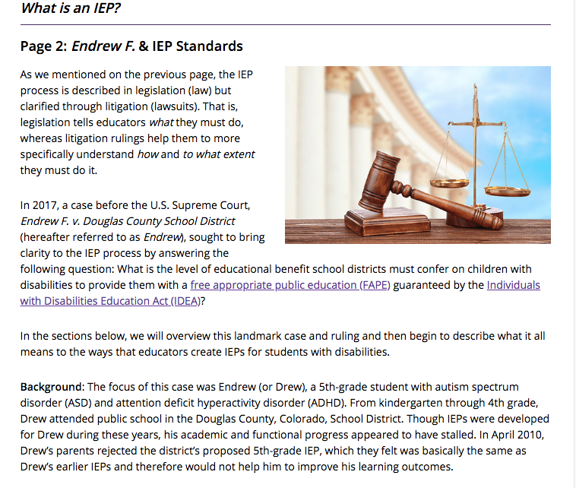
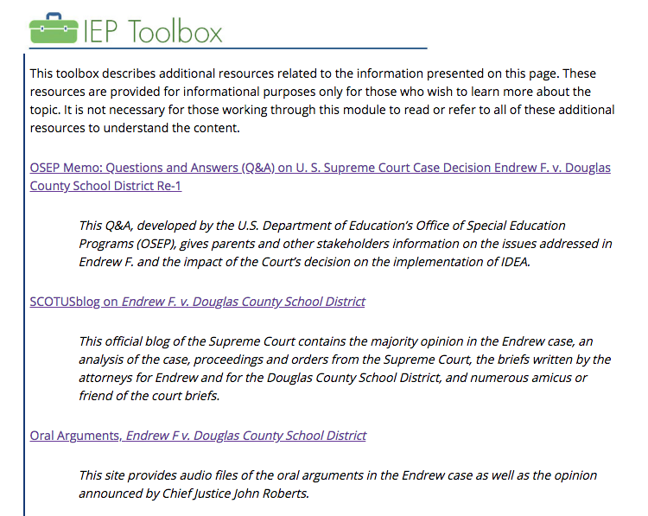
IEPs: Developing High-Quality IEPs
The IRIS Center
Overview of high-quality IEPs
Explanation of the Endrew F. Supreme Court case and implications for IEP development
IEP process guidelines and common errors
Detailed development steps for IEP content, substantive guidelines, and common errors
https://iris.peabody.vanderbilt.edu/module/iep01/

Slide 36

IEPs: How Administrators Can Support the Development and Implementation of High-Quality IEPs
The IRIS Center
Explains the administrator’s role in overseeing the IEP process
Describes actions that school leaders should take before, during, and after the IEP meeting
Explains legal implications of Endrew
Includes specially developed info briefs on IEP team member roles, determining LRE, monitoring student progress, and common errors and how to avoid them
https://iris.peabody.vanderbilt.edu/module/iep02/

Slide 37
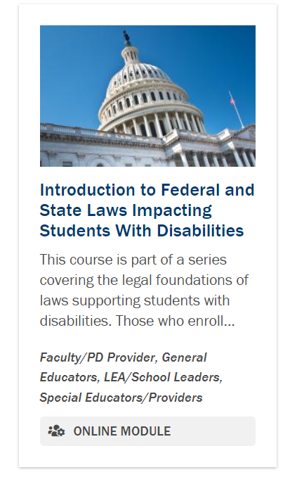
Introduction to Federal and State Laws Impacting Students With Disabilities PROGRESS Center Module
Explain the difference between civil rights laws and funding laws.
Identify where the Individuals with Disabilities Education Act, or IDEA, fits within the continuum of federal laws.
Identify other federal laws that have direct implications for students with disabilities.
Understand how state laws may expand federal laws impacting students with disabilities.
Additional modules in this series related to sources of the law and IDEA are coming soon
https://promotingprogress.org/training/federal-state-laws-students-with-disabilities

Slide 38
Where can I find additional resources?
PROGRESS Center
http://promotingprogress.org
IRIS Center
https://iris.peabody.vanderbilt.edu/
Special Education Law Blog
http://spedlawblog.com/
National Center on Intensive Intervention
www.intensiveintervention.org
The Individuals with Disabilities Education Act (OSEP)
https://sites.ed.gov/idea/
Understood
http://understood.org

Slide 39
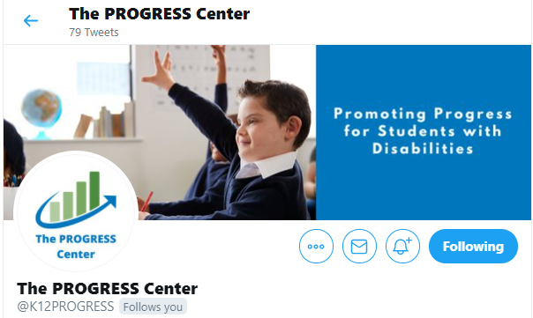


Staying Connected With the
PROGRESS Center
Connect with us on Facebook and Twitter @k12progress.
https://promotingprogress.org/news/connect-progress-center

Slide 40
Disclaimer
This material was produced under the U.S. Department of Education, Office of Special Education Programs, Award No. H326C190002. David Emenheiser serves as the project officer. The views expressed herein do not necessarily represent the positions or policies of the U.S. Department of Education. No official endorsement by the U.S. Department of Education of any product, commodity, service, or enterprise mentioned in this webinar is intended or should be inferred.

Slide 41
contact
1400 Crystal Drive, 10th Floor
Arlington, VA 22202-3289
202.403.5000
progresscenter@air.org
promotingprogress.org | www.air.org
https://www.facebook.com/k12PROGRESS/
https://twitter.com/K12PROGRESS
Notice of Trademark: “American Institutes for Research” and “AIR” are registered trademarks. All other brand, product, or company names are trademarks or registered trademarks of their respective owners.
This material was produced under the U.S. Department of Education, Office of Special Education Programs, Award No. H326C190002. David Emenheiser serves as the project officer. The views expressed herein do not necessarily represent the positions or policies of the U.S. Department of Education. No official endorsement by the U.S. Department of Education of any product, commodity, service, or enterprise mentioned in this presentation is intended or should be inferred.

