Slide 1
Start the School Year Right by Promoting Belonging of All Students
Tessie Bailey, Ph.D.| Gail Ghere, Ph.D.
August 4, 2022

Slide 2
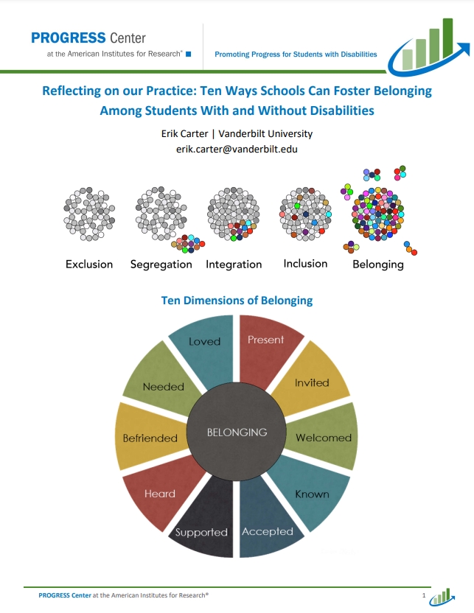
Session Outcomes and Materials
Describe the dimensions of promoting belonging for educators and students.
Explain why promoting belonging is essential for progress for students with disabilities.
Share resources to promote belonging in schools and districts.

Slide 3
Meet the Team
Tessie Bailey, PhD
Gail Ghere, PhD
Chrissy Brown, PhD
Riley O’Donnell
Director, PROGRESS Center at AIR
Principal Investigator, TIES Center
Co-Lead of Intensive TA, PROGRESS Center at AIR
Technical Support, PROGRESS Center at AIR

Slide 4
Welcome Activity
Think about a time when you really felt like you fit it. What are some words that describe how you felt?
Share in the chat.

Slide 5
Finding Belonging

Slide 6
Implementing High-Quality Educational Programming: Building a Sustainable Ecosystem
Ongoing Teaming
Progress
Family Engagement
Effective Instruction
Educator Support
IEP
Belonging

Slide 7
What is Belonging?

Slide 8
10 Dimensions of Belonging

Slide 9
Quote from Secretary Cardona
Now — more than ever — students need to feel supported, seen, heard, and understood by adults in their schools and communities. - U.S. Secretary of Education Miguel Cardona

Slide 10
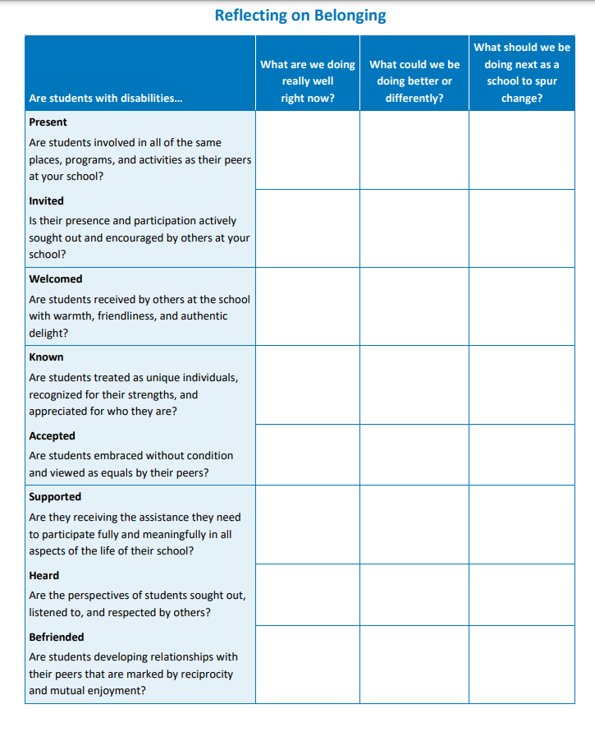
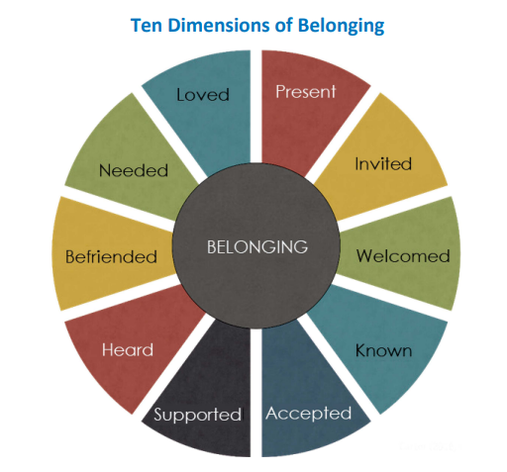
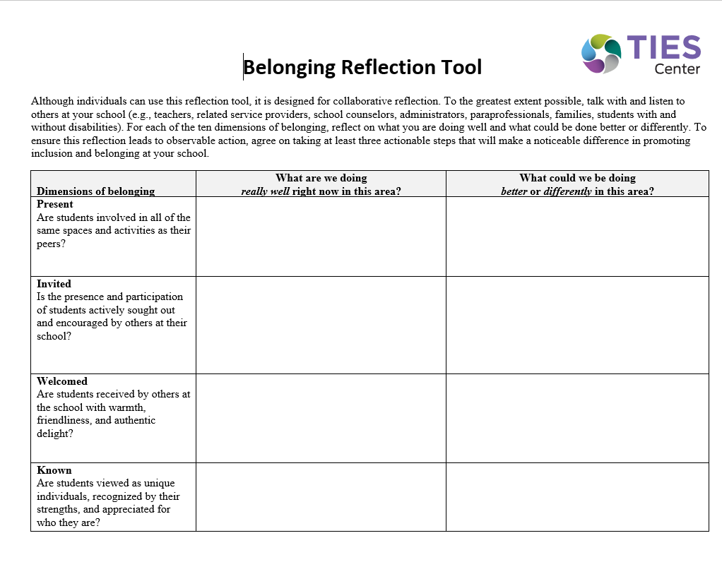
Reflecting on our Community
What are we doing well right now?
What should we be doing better or entirely differently?
What should we begin doing next?

Slide 11
Ten Dimensions of Belonging
Carter (2021, in press); Carter & Biggs (2021)

Slide 12
present
to be
1. to be

Slide 13
1 in 7 children in
your school
has a disability

Slide 14
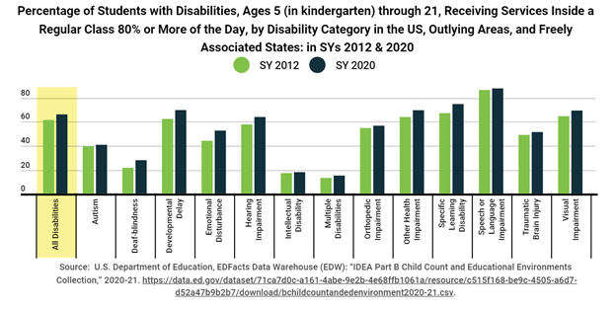
LRE Part B Data

Slide 15
Reflection: Present
Are students present, or involved in, in the same places, programs, and activities as their peers at your school?

Slide 16
Invited
to be
2. to be

Slide 17
Percent of Students Not Invited to Social Activities in the Past 12 Months by Disability Category
Autism | 51%
Intellectual Disability | 25%
Physical Disabilities | 30%
Visual Impairment | 22%
Emotional Disturbance | 17%
Learning Disability | 11%
Other Health Impairment | 12%
Source: www.nlts2.org

Slide 18
Are we providing students the skills and opportunities to participate in social activities?

Slide 19
Reflection: Invited
Is their presence and participation actively sought out and encouraged by others at your school?

Slide 20
welcomed
to be
3. to be

Slide 21
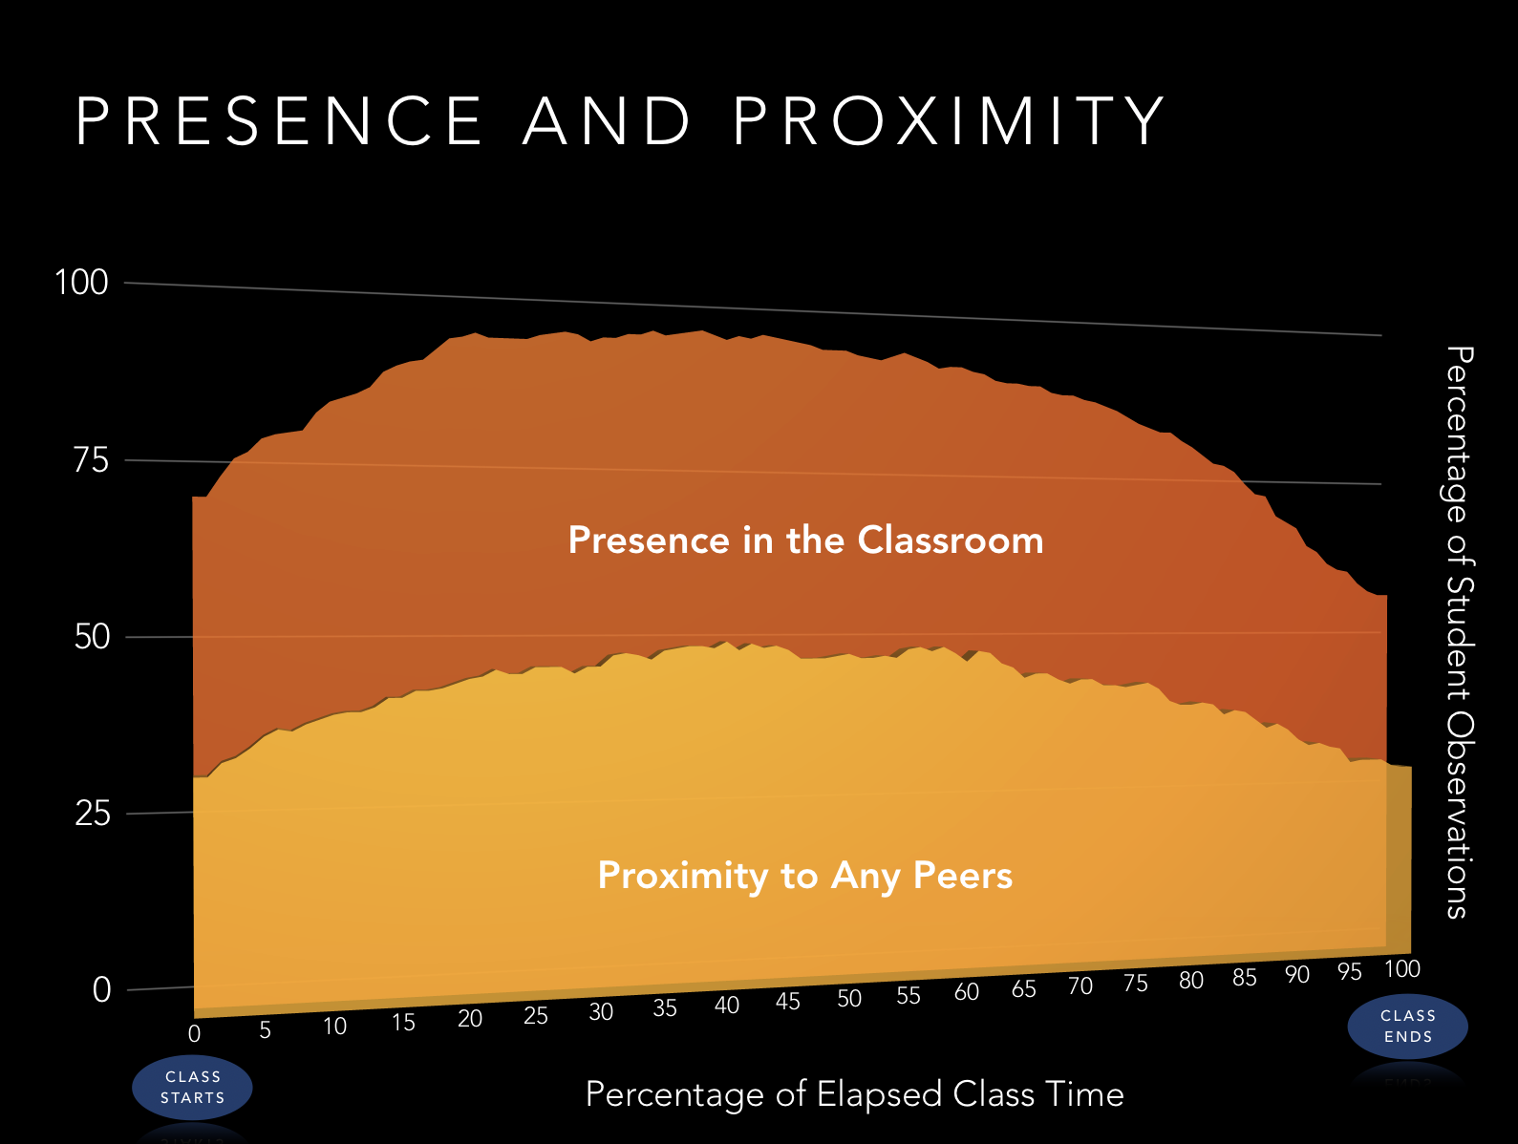
Presence and Proximity
M = 84.2%
Range, 20-100%
M = 42.3%
Range, 0-100%
Source: Feldman et al. (2016)

Slide 22
Everybody Welcome?
Source: Feldman et al. (2016)

Slide 23
Reflection: Welcomed
Are students received by others at the school with warmth, friendliness, and authentic delight?

Slide 24
Known
to be
4. to be

Slide 25
How are students known in your community?
Do you hear?
“Tier 2 or 3 kid”
“Special education student”
“By their disability
Avoid grouping students by negative attributes resulting from needs.
Intellectual disability is “characterized by SIGNIFICANT LIMITATIONS both in intellectual functioning and in adaptive behavior, which covers many everyday social and practical skills.”
American Association on Intellectual and Developmental Disabilities

Slide 26
Considerations: Known
Students should be treated as unique individuals, recognized for their strengths, and appreciated for who they are.
What opportunities are provided for students to be known by their peers?
Notes:
This slide has animations.

Slide 27
Accepted
to be
5. to be

Slide 28
Did you Know?
Teachers and parents hold significantly lower educational expectations for adolescents labeled with disabilities than they do for similarly achieving and behaving adolescents not labeled with disability, and these lower expectations contribute to labeled adolescents’ lower educational expectations for themselves.
Shifrer, 2013

Slide 29
Quotes
“We don’t really do inclusion here.”
“We just are not equipped to serve your child.”
“Perhaps you’d feel more comfortable at a place with a ‘special program’ for her."
“We aren’t really sure he will get much out of being in our typical classes.”
“Her behaviors are a bit of a distraction.”
“Students like her are served in our self-contained classrooms.”

Slide 30
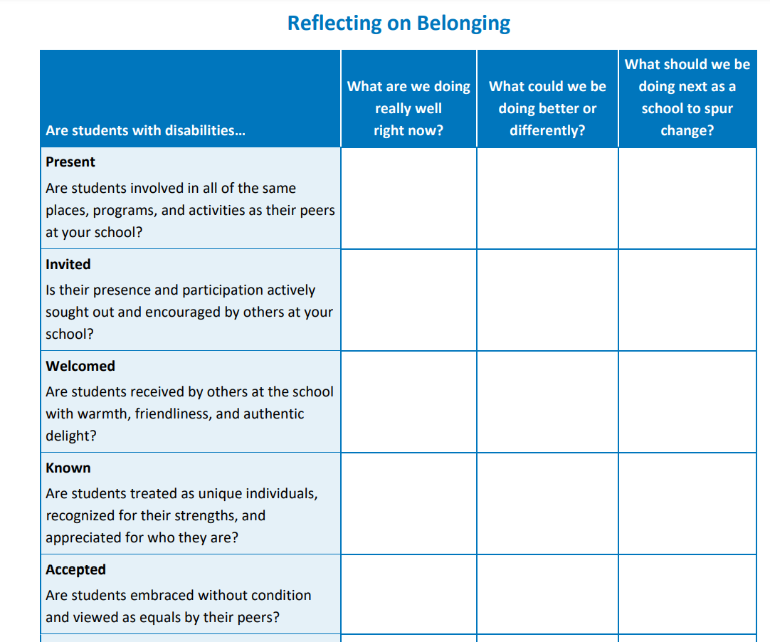
Reflection: Accepted
Are students embraced without condition and viewed as equals by their peers?

Slide 31
Supported
to be
6. to be

Slide 32
Reflection: Supported
Are they receiving the assistance they need to participate fully and meaningfully in all aspects of the life of their school?

Slide 33
Power of Peers
www.tiescenter.org

Slide 34
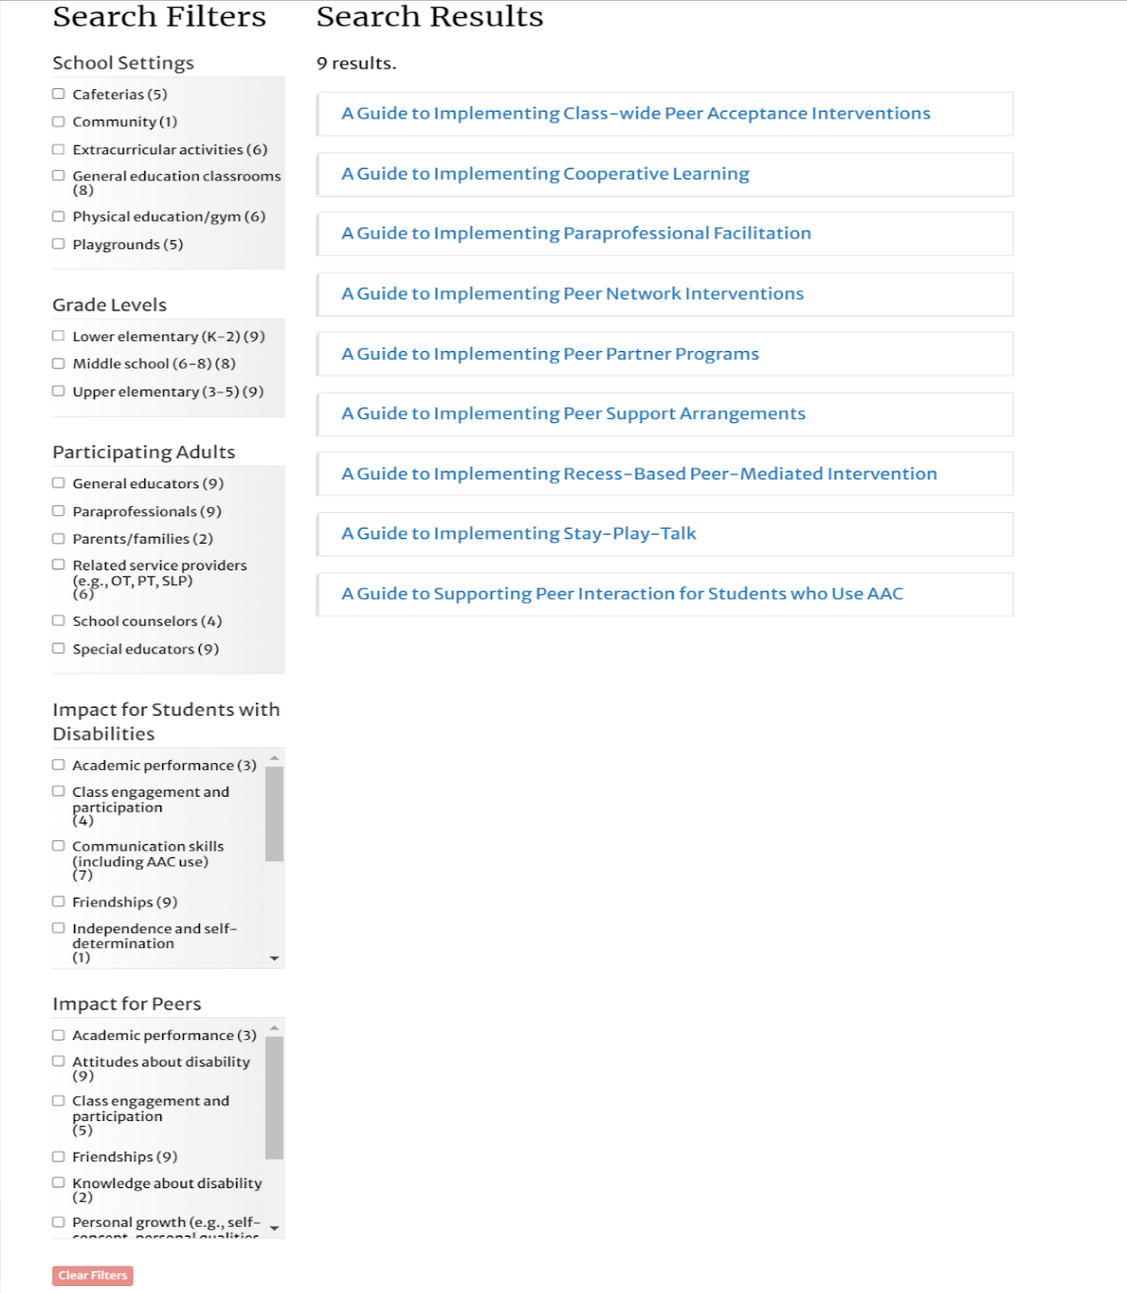
Decision-Making Guide for Choosing a Peer Engagement Strategy
School Settings
Grade-levels
Participating Adults
Impact on Students with Disabilities
Impact on Peers

Slide 35
CADRE’S Your Journey to Self-determination Series
Course 1: Your Journey to Self-determination
Course 2: Finding Your Voice
Course 3: Listening for Understanding
Course 4: Managing Emotion and Conflict
Course 5: Collaborative Problem Solving
Course 6: Educational Planning Meetings
A Facilitator Guide with supplemental activities and resources has been developed to assist teachers, parents/guardians, and mentors to support student learning.

Slide 36
heard
to be
7. to be

Slide 37
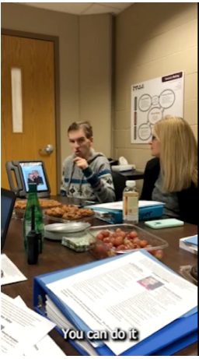
Being Heard
Secondary student in inclusive high school classes
Uses multiple modalities to communicate.
Sharing his input during his IEP meeting

Slide 38
Reflection: Heard
Are the perspectives of students sought out, listened to, and respected by others?

Slide 39
Befriended
to be
8. to be

Slide 40
Can we name people the student can...
Eat with?
Walk with?
Celebrate with?
Cry with?
Play with?
Shop with?
Catch a movie with?
Just hang out with?

Slide 41
“... alone we are poor,
together we are rich.”
–Sue Mosteller

Slide 42
Experiences of Students with Disabilities
 | Never or rarely receive phone calls often from friends (%) | Never got together with friends in past 12 months (%)
Autism | 74% | 44%
Intellectual Disability | 33% | 16%
Physical Disabilities | 34% | 20%
Visual Impairment | 24% | 15%
Emotional Disabilities | 18% | 11%
Learning Disability | 11% | 7%
Other Health Impairment | 13% | 6%
Source: www.nlts2.org

Slide 43
The “Friendship Formula”
Friendship = Proximity x (Frequency + Duration) x Intensity
Do we provide students opportunities to develop relationships with their peers that are marked by reciprocity
and mutual enjoyment?
Schafer, 2019

Slide 44
Needed
to be
9. to be

Slide 45
Reflection: Needed
Are students valued by others and considered to be indispensable members of the school community?

Slide 46
Loved
to be
10. to be

Slide 47
Reflection: Loved
Are students experiencing the deep and gracious love of others?

Slide 48
What would it take for your school to move from inclusion to belonging?

Slide 49
Final Word…Chatterfall
Don’t press enter until I say go!
In the chat, share the dimension that really resonated with you or will be the focus of your work this school year.
GO!

Slide 50
Resources to Promote Belonging

Slide 51
TIES Center belonging resource
Find this resource on Tiescenter.org

Slide 52
TIES series of 10 mini-guides focused on each dimension
Define the dimension
Give snapshot of what the dimension looks like
Provide steps schools can take to create change in the dimension

Slide 53
Accompanying Reflection Tool
Gives areas of reflection for members of school community
What are we doing really well right now in this area?
What could we be doing better or differently in this area?
What actionable steps can we take next to ensure all students experience belonging in our school?

Slide 54
Belonging Resources from PROGRESS Center

Slide 55
References
Brock, M. E., Carter, E. W., & Biggs, E. E. (2020). Supporting peer interactions, relationships, and belonging. In F. Brown, J. McDonnell, & M. E. Snell (Eds.), Instruction of students with severe disabilities (9th ed.). Merrill.
Carter, E. W., Travers, H. E., & Tuttle, M. (in press). Enhancing the social lives of students with disabilities: Effective practices and improved outcomes. In K. L. Lane, C. Lemons, & S. Powell (Eds.), Handbook of special education research: Research-based practices and intervention innovations. Routledge.
Carter, E. W. (2021). Dimensions of belonging for individuals with intellectual and developmental disabilities. In A. W. Harrist & S. M. Wilson (Series Eds.), J. L. Jones & K. L. Gallus (Vol. Eds.), Belonging and resilience in individuals with intellectual and developmental disabilities: Community and family engagement (pp. 13-34). Springer.
Carter, E. W., & Biggs, E. E. (2021). Creating communities of belonging for students with significant cognitive disabilities. University of Minnesota, TIES Center. https://publications.ici.umn.edu/ties/peer-engagement/belonging/introduction
Ziegler, M., Matthews, A., Mayberry, M., Owen-De Schryver, J., & Carter, E. W. (2020). From barriers to belonging: Promoting inclusion and relationships through Peer to Peer programs. TEACHING Exceptional Children, 52(6), 426-434.
*This slide deck was adapted from a PROGRESS Center webinar conducted by Dr. Eric Carter, Ten Ways Schools Can Foster Belonging Among Students With and Without Disabilities (2022, February).

Slide 56
Disclaimer
This material was produced under the U.S. Department of Education, Office of Special Education Programs, Award No. H326C190002. David Emenheiser serves as the project officer. The views expressed herein do not necessarily represent the positions or policies of the U.S. Department of Education. No official endorsement by the U.S. Department of Education of any product, commodity, service, or enterprise mentioned in this presentation is intended or should be inferred.

Slide 57
Contact
1400 Crystal Drive, 10th Floor
Arlington, VA 22202-3289
202.403.5000
progresscenter@air.org
promotingprogress.org | www.air.org
https://www.facebook.com/k12PROGRESS/
https://twitter.com/K12PROGRESS
Notice of Trademark: “American Institutes for Research” and “AIR” are registered trademarks. All other brand, product, or company names are trademarks or registered trademarks of their respective owners.
This material was produced under the U.S. Department of Education, Office of Special Education Programs, Award No. H326C190002. David Emenheiser serves as the project officer. The views expressed herein do not necessarily represent the positions or policies of the U.S. Department of Education. No official endorsement by the U.S. Department of Education of any product, commodity, service, or enterprise mentioned in this presentation is intended or should be inferred.

