Slide 1
Making Connections! Ensuring the Parts of the IEP Work Together to Promote Progress
Chrissy Brown, Tessie Bailey, and Amy Peterson
August 2022
18711_07/22

Slide 2
Meet the Team
Chrissy Brown
Tessie Bailey
Amy Peterson
Sacha Cartagena
PROGRESS Center
Technical Assistance Consultant
PROGRESS Center Director, Principal Consultant
PROGRESS Center
Universal Technical Assistance Lead
PROGRESS Center, Learning Module Coordinator

Slide 3
Welcome
In the chat, share your name, role, and where you come from!

Slide 4
Session Objectives
By the end of this session, participants will be able to do the following:
Explain why the internal consistency of an individualized education program (IEP) is important and how it promotes progress.
Learn and practice how to review existing IEPs to determine internal consistency.
Access resources to support the development of high-quality IEPs.

Slide 5
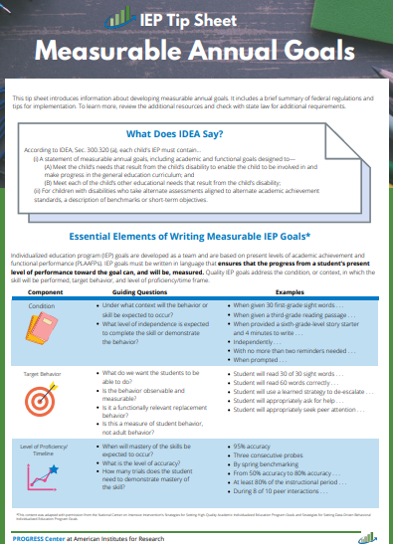
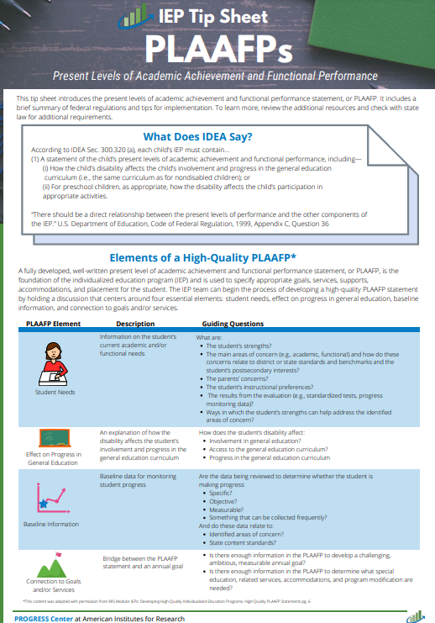
Participation Materials
Materials
A copy of at least one IEP (do not bring original copies)
Highlighters of three to five different colors
Handouts
IEP Tip Sheet: PLAAFPs
IEP Tip Sheet: Measurable Annual Goals
IEP Tip Sheet: Overview of Services & Aids

Slide 6
Session Agenda
Role of PLAAFP Statement and Ensuring Internal Consistency
PLAAFP Development in Action
Break (2:00)
Using the PLAAFP to Develop Services and Aids and Measurable Annual Goals
Wrap-Up and Next Steps

Slide 7
Collective Teacher Efficacy
The collective belief of educators in their ability to positively affect students, including students with disabilities.
It is built on evidence of impact.
Collective belief that you can make a difference.
Evidence you are making a difference.
ES = 1.57*
×
=
Note. ES = effect size. Based on work of Eells (2011) and Hattie (2018).

Slide 8
Where Do We Start? Collective Efficacy Starts With the Right Questions!
What do we want for our students and families?
What is the current reality and who are the players?
What do our students and families need to be successful?
How can we maximize our resources to support students and families?
The present levels of academic achievement and functional performance statement, or PLAAFP statement, outlines the answers!

Slide 9
Are your teams asking the right questions for our students? Let’s find out!

Slide 10
Role of PLAAFP Statement and Ensuring Internal Consistency

Slide 11
Per the IDEA, How Many Requirements Does an IEP Have?
5
7
9
11
Present Levels of Academic Achievement and Functional Performance (PLAAFP)
Explanation of Education Setting
Participation in Assessment
Date, Frequency, Duration, and Location of Services
Statement of Special Education and Aids and Services
Measurable Annual Goals
Measuring Progress Toward Annual Goals
IDEA = Individuals with Disabilities Education Act.

Slide 12
Program Development: Procedural
Participation Outside Regular Education and in State and Districtwide Assessments
Present Levels of Academic Achievement and Functional Performance (PLAAFP) Statement(s)
Monitoring Plan
Statement of Special Education and Aids and Services
Date, Frequency, Duration, and Location of Services
Measurable Goals

Slide 13
IEPs: Same Essential Ingredients but Individualized Based on Student Need

Slide 14
Breakout Activity
ACTIVITY (5 minutes individually)
1. Identify and highlight each need in the IEP with a different highlighter.
2. Identify and highlight the service, supplementary aid or service, related service, or program modification related to each need identified in the PLAAFP (use the same color highlighter associated with the highlighted need).
REFLECT and DISCUSS (10 minutes in a small group)
1. To what extent were the needs clearly identified in the PLAAFP statement? How do you identify student needs?
2. To what extent does each need have a clearly aligned service, aid, or program modification?
What do you need?
Copy of an IEP (not an original)
4-5 different-colored highlighters

Slide 15
What Does the U.S. Department of Education Say?
A district cannot lawfully prepare IEPs with the same statement of current levels of performance for all students in a specific program.
It is impermissible for districts to have the IEP for each student in a class/disability category contain identical statements of present levels of educational performance.
Source: Letter to New, 211 IDELR 464 (OSEP 1987).

Slide 16
In Other Words
Present levels and needs are
not based on the disability category.
based on the individual needs that a child experiences because of the disability.
In the chat, share some of the ways your small groups discussed identifying needs!

Slide 17
What Does the U.S. Department of Education Say? 2
“There should be a direct relationship between the present levels of performance and the other components of the IEP. Thus, if the statement describes a problem with the child’s reading level and points to a deficiency in reading skills, the problem should be addressed under both goals and specific special education and related services provided to the child.” [emphasis added]
Source: U.S. Department of Education, Code of Federal Regulations, 1999, Appendix C, Question 36.

Slide 18
Successful development and implementation of special education depends on the quality of the PLAAFP statement!

Slide 19
PLAAFP Development in Action

Slide 20
What Is the Big Deal About the PLAAFP Statement?
If designed well, it prevents us from experiencing the dreaded and harmful
Assumacide is when we make decisions about programming or identify practices or supports based on our assumptions, rather than evidence.
“Assumacide”

Slide 21
What Does IDEA Say About the PLAAFP Statement?
(1) A statement of the child’s present levels of academic achievement and functional performance, including—
(i) How the child’s disability affects the child’s involvement and progress in the general education curriculum (i.e., the same curriculum as for nondisabled children); or
(ii) For preschool children, as appropriate, how the disability affects the child’s participation in appropriate activities.
Source: IDEA, Sec. 300.320 (a)(1); emphasis added.

Slide 22
What Is Meant by Present Levels of Academic Achievement?
“Academic achievement” generally refers to a child’s performance in academic areas. It could vary depending on a child’s circumstance or situation; therefore, a definition of academic achievement is not included in the IDEA regulations.
Academic Achievement
Writing
Science
History
Math
Reading
Source: 71 F.R. at 46662.

Slide 23
What Is Meant by Present Levels of Functional Performance?
Functional Performance
Eating
Behavior
Social Skills
Toileting
Dressing
Communication Skills
Mobility
Executive Functioning
“Functional performance” generally refers to activities that are not considered academic or related to a child’s academic achievement.
“Functional” often is used in the context of routine activities of everyday living.
Source: 71 F.R. at 46661.

Slide 24
What If a Student Doesn’t Require Functional Annual Goals?
The PLAAFP must still include a statement about the student’s current functional performance and its impact on progress in the general education curriculum.
Stop and Reflect: Do your PLAAFP statements always address both academic and functional present levels?

Slide 25
What Are the Four Essential Elements of a High-Quality PLAAFP?
Student Needs
Baseline Information
Effect on Progress in General Education
Connection to Goals and/or Services
This content was adapted with permission from the IRIS Center module titled IEPs: Developing High-Quality Individualized Education Programs. High-Quality PLAAFP Statements (p. 6).

Slide 26
Applying the Four Questions for IEP Development and Implementation
What do we want for our student?
What is the child’s current reality and unique circumstances (PLAAFP statement)?
What does the student need to be successful (described in PLAAFP and outlined in IEP aids/services)?
How can we maximize our resources to support our student (placement and implementation of IEP)?
Essential for collaborative development with family, student, related service providers, and educators.

Slide 27
Sample PLAAFP Structure With Key Ingredients
Data [includes source] indicate Student [objective data performs in this way—objective data] _______________ which affects _________________ [must include impact on involvement and progress in the general education curriculum]. As a result, he needs _____________________ [justifies proposed services and supports].

Slide 28
Identifying Circumstances That Impact Access From Special and General Education
In January 2019, G.H. was identified as a student with a learning disability in the areas of mathematical calculation (insert data from evaluation report). Current data indicate that G.H. continues to need specially designed instruction in the areas of mathematical calculation. G.H. would like to graduate with his peers and attend college.
What circumstances—attendance, behavior, second language learner, homelessness, childhood trauma, learning needs, attention, prior learning experiences—might impact a child’s access to and benefit from special and general education?

Slide 29
Nature of Mathematics Need: Example
On recent standardized math benchmark tests conducted in January 2022, G.H. scored at the 9th percentile, which is well below average. On three standardized measures of mixed-math fact fluency administered on 2/7 and 2/8, G.H. accurately recalled, on average, 18 facts compared with grade-level expectations of 75 facts in 2 minutes [objective data describing the nature of the math need]. Specifically, G.H. recalled about three multiplication mixed facts (0–9), 15 addition facts (0–9), and 0 division and subtraction facts (0–9) in the 2 minutes. This affects his ability to complete sixth-grade math assignments at the same rate as his peers and efficiently use mental math calculation skills to complete word problems [impact]. To complete grade-level math assignments, G.H. currently benefits from shortened assignments, peer support, and the use of a calculator. Increasing his math fact proficiency would increase his ability to independently access and benefit from grade-level math instruction. Review of current intervention implementation data suggests that G.H. benefits from daily direct one-on-one instruction distributed across the school day [rationale for proposed service].

Slide 30
Example Continued
G.H.’s progress in math also is impacted by his engagement in general education math instruction. Three formal classroom observations conducted in February 2022 [data source] indicate G.H. is academically engaged 32% of the math class periods compared with 76% of the time for class peers [objective data describing performance]. His lower engagement results in him missing core math instruction and failing to complete 85% of math assignments on time [impact]. On average, peers submit 94% of assignments on time. Interviews with the student in February 2022 indicate that G.H. is feeling increasingly frustrated and overwhelmed with math. As a result, G.H. would benefit from strategies to manage his frustration and completion of math assignments, especially as they become more challenging [justifies proposed services and supports].

Slide 31
Guiding Questions: Connection to Goals and Services
Is there enough information in the PLAAFP statement to develop challenging, ambitious, and measurable annual goals?
Is there enough information in the PLAAFP statement to determine what special education, related services, accommodations, and program modifications are needed?

Slide 32
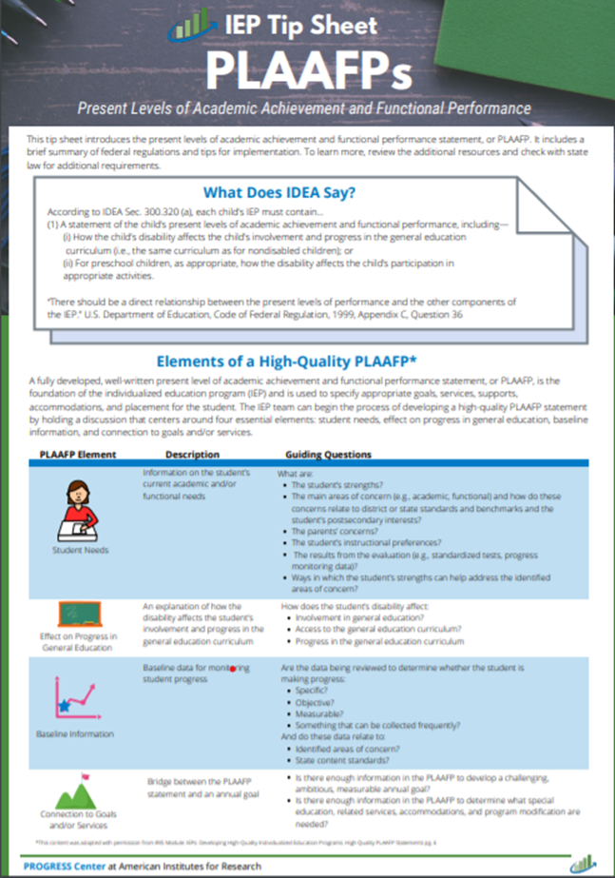
Tips for Developing PLAAFP Statements
Address all the student’s educational needs identified in the evaluation.
Include a description of changes in student functioning since the last IEP was developed.
Include objective, measurable data to describe current performance.
Explain how specific accommodations and modifications are needed and will be used by the student.

Slide 33
Tips for Developing PLAAFP Statements 2
Structure the baseline statement using the same structure as the annual goal.
Compare the student’s baseline performance to grade-level expectations.
Include administration dates and names of measurement tools to the extent possible.

Slide 34
The Power of Teams to Develop High-Quality PLAAFP Statements
Tip for PROGRESS!
Collect and summarize data for the development of the PLAAFP statement prior to the IEP meeting to help facilitate more robust discussion.

Slide 35
Using the PLAAFP to Design Services and Aids and Measurable Annual Goals

Slide 36
Connecting the PLAAFP Statement to Goals, Statement of Special Education, and Aids and Services
PLAAFP
Annual Goals
Measuring Progress Toward Annual Goals
Date, Frequency, Duration, and Location of Services
Participation Outside Regular Education and in State and Districtwide Assessments
Statement of Special Education and Aids and Services

Slide 37
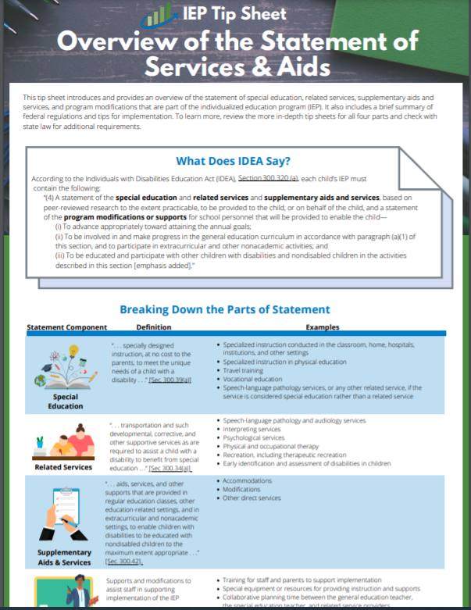
What Does IDEA Say About the Statement of Services and Aids?
According to IDEA, Section 300.320 (a), each child’s IEP must contain the following:
“(4) A statement of the special education and related services and supplementary aids and services, based on peer-reviewed research to the extent practicable, to be provided to the child, or on behalf of the child, and a statement of the program modifications or supports for school personnel that will be provided to enable the child—…”
Source: IDEA, Sec. 300.320(a)(4); emphasis added.

Slide 38
What Does IDEA Say About the Statement of Services and Aids? 2
“(i) To advance appropriately toward attaining the annual goals;
(ii) To be involved in and make progress in the general education curriculum in accordance with paragraph (a)(1) of this section, and to participate in extracurricular and other nonacademic activities; and
(iii) To be educated and participate with other children with disabilities and nondisabled children in the activities described in this section.”
Source: IDEA, Sec. 300.320(a)(4); emphasis added.

Slide 39
When Developing the Statement, Teams Must Consider the Following
Statement of special education and aids and services
Related services
Supplementary aids and services
Program modifications and supports
Special education

Slide 40
To Learn More About the Statement of Services and Aids
Supplemental Tip Sheets focused on
Statement of Special Education or Specially Designed Instruction (SDI)
Related Services
Supplementary Aids and Services
Program Modifications and Supports

Slide 41
Pause and Reflect
To what extent are the needs identified in your IEPs aligned to the services, aids, or program modification?

Slide 42
Tips for Choosing and Implementing Services and Aids
Ensure that the PLAAFP statement justifies the IEP team’s selection of special education, aids, and services to be provided to the student.
Avoid identifying specific programs.
Identify special education, aids, and services based on the unique needs of the student versus a disability label or the location of services.
Consider what knowledge and skills school personnel will need to successfully implement the IEP.
For students who are nonresponsive to evidence-based programs, consider using a research-based process, such as data-based individualization, to individualize supports.
Review the research and resources from the Office of Special Education Programs–funded centers.

Slide 43
What Does IDEA Say About Goals?
According to IDEA Sec. 300.320(a)(2), each child’s IEP must contain the following:
(i) “A statement of measurable annual goals, including academic and functional goals designed to—
(A) Meet the child’s needs that result from the child’s disability to enable the child to be involved in and make progress in the general education curriculum; and
(B) Meet each of the child’s other educational needs that result from the child’s disability.”
Did you know?
Benchmarks, or short-term objectives, are required only for children with disabilities who take alternate assessments aligned to alternate achievement standards [§300.320(a)(2)(ii)].
Source: IDEA, Sec. 300.320(a)(2)(i-ii).

Slide 44
Why Are Measurable Annual Goals Important?
Address academic and functional individual needs outlined in the PLAAFP statement.
Ensure high expectations and grade-level alignment, in light of the child’s circumstances.
Assess whether the special education program is providing meaningful educational benefit (free appropriate public education).
44

Slide 45
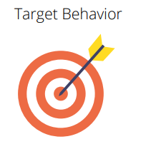
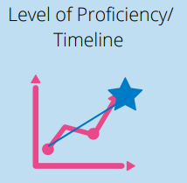
What Are the Three Essential Elements of Measurable Annual Goals?
Measurable
45

Slide 46
Did You Know?
A single goal can address multiple needs!

Slide 47
What Information Do We Need to Create an Annual Goal?
What are the primary needs?
How is each target need being described?
What are expected target goals for these behaviors? Unique circumstances impacting this student in achieving grade-level expectations?
What is the measurable baseline for each target goal?

Slide 48
Nature of Math Need: G.H. Example
On recent standardized math benchmark tests conducted in January 2022, G.H. scored at the 9th percentile, which is well below average. On three standardized measures of mixed-math fact fluency administered on 2/7 and 2/8, G.H. accurately recalled, on average, 18 facts compared with grade-level expectations of 75 facts in 2 minutes. Specifically, G.H. recalled about three multiplication mixed facts (0–9), 15 addition facts (0–9), and 0 division and subtraction facts (0–9) in the 2 minutes. This affects his ability to complete sixth-grade math assignments at the same rate as his peers and efficiently use mental math calculation skills to complete word problems. To complete grade-level math assignments, G.H. currently benefits from shortened assignments, peer support, and the use of a calculator. Increasing his math fact proficiency would increase his ability to independently access and benefit from grade-level math instruction. Review of current intervention implementation data suggests that G.H. benefits from daily direct one-on-one instruction distributed across the school day.

Slide 49
Example IEP Goal
Okay: When given subtraction fluency fact probes with minuends up to 18, G.H. will accurately complete 75 problems in 2 minutes on three consecutive probes.
Better: When presented with mixed-fact fluency probes including subtraction, addition, division, and multiplication facts, G.H. will accurately complete 75 problems in 2 minutes on three consecutive probes.

Slide 50
G.H.’s progress in math also is impacted by his engagement in general education instruction. Three formal classroom observations conducted in February 2022 indicate G.H. is academically engaged 32% of the math class periods compared with 76% of the time for class peers. His lower engagement results in him missing core math instruction and failing to complete 85% of the math assignments. Interviews with the student in February 2022 indicate that G.H. is feeling increasingly frustrated and overwhelmed with math. As a result, G.H. would benefit from strategies to manage his frustration and completion of math assignments, especially as they become more challenging.
Example
IEP Goal Need
Target Behavior
Target Goal
Baseline

Slide 51
How the Four Essential Elements of a High-Quality PLAAFP Guide Goal Setting!
Student Needs
Baseline Information
Effect on Progress in General Education
Connection to Goals and/or Services
This content was adapted with permission from the IRIS Center module titled IEPs: Developing High-Quality Individualized Education Programs. High-Quality PLAAFP Statements (p. 6).

Slide 52
Breakout Activity 2
ACTIVITY (3–5 minutes individually)
1. Using the same highlighted needs, identify the corresponding goal.
DISCUSS (5 minutes as a small group)
1. To what extent do your goals address the primary needs of the student?
What do you need?
Copy of an IEP (not an original) and highlighter markers.

Slide 53
Standards-Based IEP Goal Writing?
“We expect annual IEP goals to be aligned with State academic content standards for the grade in which a child is enrolled” (OSEP, 2015, p. 4 [emphasis added]).
For students significantly below grade-level expectations, “the annual goals need not necessarily result in the child’s reaching grade-level within the year covered by the IEP, but the goals should be sufficiently ambitious to help close the gap” (OSEP, 2015, p. 5 [emphasis added])
Goals should not duplicate the standard all students are expected to achieve.
Source: Office of Special Education and Rehabilitative Services. (2015).

Slide 54
How Much Progress Is Enough Progress?
“To meet its substantive obligation under the IDEA, a school must offer an IEP that is reasonably calculated to enable a child to make progress appropriate in light of the child’s circumstances” (Endrew F., v. Douglas County School District RE-1, 2017, p. 16).

Slide 55
Caution: Unambitious Goals
“The IEP prepared on May 1, 1985, did not provide Shannon with a free appropriate public education as required by the EHA [Education of the Handicapped Act]. Even if all of the goals of the document had been met, Shannon would continue to fall behind her classmates at an alarming rate. The stated progress of only four months in her reading and math skills over an entire school year ensured the program’s inadequacy from its inception” (Carter v. Florence County Four, District Court Opinion, 17 EHLR 452, 1991, p. 5).
“The essential function of an IEP is to set out a plan for pursuing academic and functional advancement” (Endrew F. v. Douglas County School District RE-1, 2017, p. 11).

Slide 56
Caution: Goals That Are Not Measurable
“The student’s annual goals and objectives in each IEP simply do not contain objective criteria which permit measurement of Student’s progress. . . . A goal of ‘increasing’ reading comprehension skills or ‘improving decoding skills’ is not a measurable goal . . . . Even if [present levels of performance] were clearly stated, an open-ended statement that the student will ‘improve’ does not meet the requirement . . . for a ‘measurable’ goal” (Rio Rancho Public Schools, 2003, p. 563).
Measurable goals should pass the stranger test (different evaluators can agree if the goal has been achieved.)

Slide 57
Caution: Goals That Are Not Measurable 2
A goal that called for a student to “develop writing skills by monitoring usage of rubrics provided in class” was not measurable nor was it verifiable (Northville Public Schools, SEA MI 2015)
Carefully consider the words you use in goals and make sure they can be measured.
If you can’t graph it, it is not measurable.

Slide 58
Caution: Goals That Are Not Measurable 3
“Annual goals that contain [a] percentage of accuracy are not helpful where the IEP fails to define a starting point, an ending point, or the curriculum in which student will achieve 80 to 85% accuracy” (Rio Rancho Public Schools, 2003, p. 563).
Percentages, by themselves, are meaningless!

Slide 59
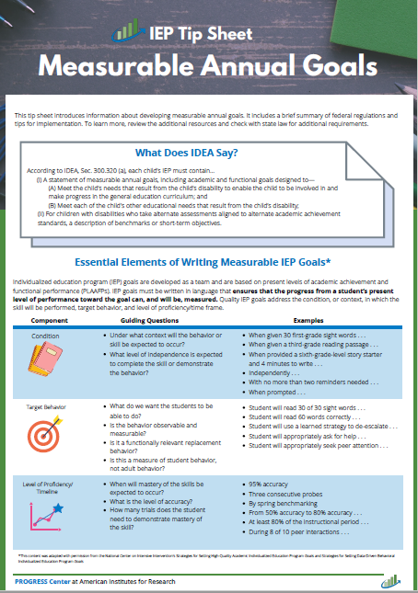
Where Can I Learn More?

Slide 60
Most Importantly, Keep Your Annual IEP Goals FAIR
Feasible | Is the goal appropriately ambitious given the student’s unique circumstances? Can the goal realistically be achieved during the school year and reflected in the IEP?
Acceptable | Is the goal acceptable to the student, family, and educators on the IEP team?
Impactful | Will achieving the goal positively impact the student access and benefit from the general curriculum and other educational outcomes?
Relevant | Does the goal connect to a meaningful outcome for the student and his or her family?

Slide 61
Closing and Next Steps

Slide 62
Remember! The Power of Teams to Develop High-Quality PLAAFP Statements
Tip for PROGRESS!
Collect and summarize data for the development of the PLAAFP statement prior to the IEP meeting to help facilitate more robust discussion.

Slide 63
What Is on Your Mind?

Slide 64
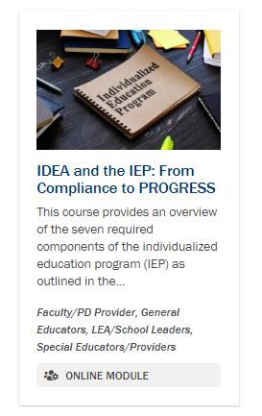
Interested in Going Deeper? PROGRESS Center Self-Paced Training Modules

Slide 65
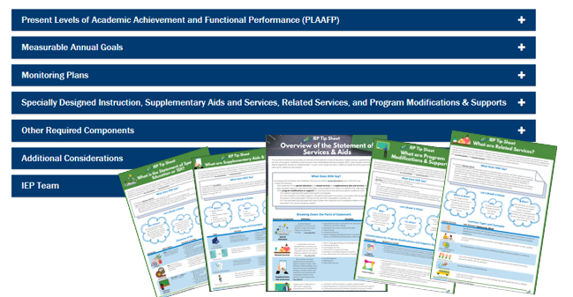
PROGRESS Resources to Support the Development of High-Quality Educational Programming

Slide 66
Suggested Next Steps
Complete IDEA and the IEP: From Compliance to PROGRESS module (if needed).
Complete The What and Why of Present Levels of Academic Achievement and Functional Performance (PLAAFP) module.
Evaluate the internal consistency of at least two or three additional IEPs.

Slide 67
Staying Connected With the PROGRESS Center
Connect to us on Facebook and Twitter @k12progress
https://promotingprogress.org/news/connect-progress-center

Slide 68
Reminder: Event Schedule for Tomorrow
Time (ET) | Session
10:15–10:45 a.m. | Optional Networking Discussion
10:45–11:00 a.m. | BREAK
11:00 a.m.–12:00 p.m. | General Session: Panel Discussion
12:00–12:40 p.m. | BREAK
12:40–1:40 p.m. | Concurrent Sessions
1:40–2:00 p.m. | BREAK
2:00–3:00 p.m. | Concurrent Sessions
3:00–3:20 p.m. | BREAK
3:20–4:00 p.m. | Closing Session
Reminder! You must register for each session independently. Haven’t registered for a session you would like to attend? Don’t worry, there is still time.

Slide 69
References
Assistance to states for the education of children with disabilities and preschool grants for children with disabilities; Final Rule. 71 F.R. 46539–46845 (to be codified at 34 C.F.R. Parts 300 and 301). https://www.govinfo.gov/content/pkg/FR-2006-08-14/html/06-6656.htm
Carter v. Florence County Four, District Court Opinion, 17 EHLR 452 (1991). https://www.wrightslaw.com/law/caselaw/case_carter_usdist_sc.htm
Eells, R. (2011). Meta-analysis of the relationship between collective efficacy and student achievement. Unpublished doctoral dissertation. Loyola University of Chicago. https://ecommons.luc.edu/cgi/viewcontent.cgi?article=1132&context=luc_diss
Endrew F., v. Douglas County School District RE-1, 580 U.S. ___ (2017). https://www.supremecourt.gov/opinions/16pdf/15-827_0pm1.pdf
Hattie, J. (2018). Hattie Ranking: 252 Influences And Effect Sizes Related To Student Achievement https://visible-learning.org/hattie-ranking-influences-effect-sizes-learning-achievement/

Slide 70
References
Individuals with Disabilities Education Act of 2004, Pub. L. No. 101-476, 104 Stat. 1142, Part 300 (2018). https://sites.ed.gov/idea/regs/b
IRIS Center (2019). IEPs: Developing high-quality individualized education programs: High-quality PLAAFP statements. https://iris.peabody.vanderbilt.edu/module/iep01/
Letter to New, 211 IDELR 464 (OSEP 1987)
Northville Public Schools, 65 IDELR 281, (SEA MI 2015).
Office of Special Education and Rehabilitative Services. (2015). OSERS policy guidance on free appropriate public education. https://sites.ed.gov/idea/files/policy_speced_guid_idea_memosdcltrs_guidance-on-fape-11-17-2015.pdf
Rio Rancho Public Schools, 40 IDELR 140, (SEA NM, 2003)​
U.S. Department of Education, Code of Federal Regulations, 1999, Appendix C, Question 36.

Slide 71
Disclaimer
This material was produced under the U.S. Department of Education, Office of Special Education Programs, Award No. H326C190002. David Emenheiser serves as the project officer. The views expressed herein do not necessarily represent the positions or policies of the U.S. Department of Education. No official endorsement by the U.S. Department of Education of any product, commodity, service, or enterprise mentioned in this presentation is intended or should be inferred.

Slide 72
PROGRESS Center
progresscenter@air.org
1400 Crystal Drive, 10th Floor
Arlington, VA 22202-3289
202.403.5000
progresscenter@air.org
promotingprogress.org | www.air.org
https://www.facebook.com/k12PROGRESS/
https://twitter.com/K12PROGRESS
Notice of Trademark: “American Institutes for Research” and “AIR” are registered trademarks. All other brand, product, or company names are trademarks or registered trademarks of their respective owners.
This material was produced under the U.S. Department of Education, Office of Special Education Programs, Award No. H326C190002. David Emenheiser serves as the project officer. The views expressed herein do not necessarily represent the positions or policies of the U.S. Department of Education. No official endorsement by the U.S. Department of Education of any product, commodity, service, or enterprise mentioned in this presentation is intended or should be inferred.

