Slide 1
Prepping In-Service and Pre-Service Teachers for PROGRESS
Alex Marken | Steven Prater | Stacy Hirt
August 2023

Slide 2
Introduce Yourself!
In the chat, please give your name, role, and where you are from.
Name
Role
Where you are from
Notes:
Please add your name, your role, and where you are from so that we can get to know our audience today.

Slide 3
Welcome and Introductions
Alex Marken
Stacy M. Hirt
Steven Prater
PROGRESS Center
Technical Assistance Provider
PROGRESS Center
Knowledge and Development Lead
PROGRESS Center
Intensive Technical Assistance Lead

Slide 4
Why did you choose to join us today?
Notes:
Mention how to use Jamboard: https://jamboard.google.com/d/1JpZcHkjvRqKWHkNFUeO-QPAemtUiKe2h7sC90Gw2M18/edit?usp=sharing

Slide 5
Objectives
Identify PROGRESS resources for developing and implementing IEPs that promote progress.
Learn practical activities to use with in-service and pre-service teachers to build their knowledge and capacity for developing and implementing high-quality educational programming.
Source: Placeholder for sources and permissions (if needed).
Notes:
Marken

Slide 6
What Did Educator Focus Group Participants Share?
Professional Learning
47% percent of focus group participants shared that they did not agree that special educators and related service staff receive ongoing, high quality professional development and training on topics related to students with disabilities
“My staff receives zero PD [professional development]. If I go to a training I bring it back, and I have to try to show them the training, but most of the trainings that my district offers me are for the general ed curriculum, which I'm not totally utilizing.”
“Most training offered is not specific to students with disabilities. Any special education PD is usually out of district and I have to pay for it.”
Notes:
PROGRESS conducted focus groups with 66 participants representing special educators, general educators, administrators, and related service providers. These participants represented 13 grade levels and covered the Midwest, Northeast, Southeast, Southwest, and West
One of the questions asked participants about how they felt about professional learning. Responses were mixed with 47% sharing that they did not agree or strongly agree that special educators and related service staff received ongoing, high-quality PD focus on students with disabilities. Specifically, participants shared…quotes

Slide 7
What We Have Learned Through PROGRESS Center Professional Learning Efforts and Focus Groups
It is essential to
focus on the why not just the what and how
make no assumptions about what educators know
provide educators with space and time to reflect, so go slow to go fast!
give access to ongoing practice-based high-quality professional learning (e.g., synchronous and asynchronous training, ongoing just-in-time proactive coaching)
build educator fluency by offering multiple entry points to high-quality professional learning customized based on audience needs

Slide 8
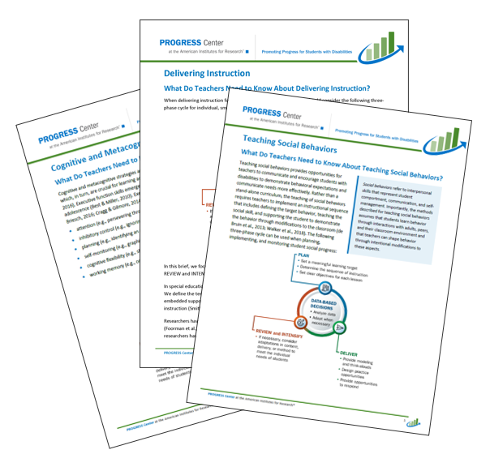
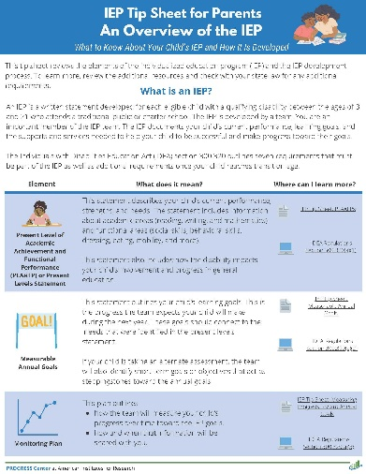
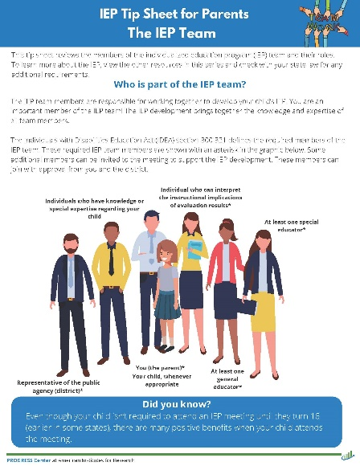
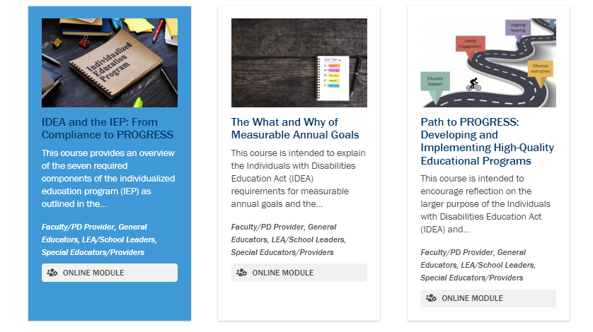
What Is Available From The PROGRESS Center To Assist With Preparing Educators?
https://promotingprogress.org/
Notes:
The PROGRESS Center has a wealth of freely available resources intended to support educators, local leaders, faculty and professional development providers and families to develop and implement high-quality educational programming for students with disabilities.
All of the resources can be found on the PROGRESS Center website at promotingprogress.org.
These resources include a series of IEP Tip Sheets aligned with the key components of the IEP
New tip sheets for parents to help them understand the components of the IEP and members of the IEP team
Instructional practice briefs aligned with evidence-based high-leverage practices
A review of state education agency guidance on special education
Stories from the classroom videos and discussion guides
Self-paced courses that include self-paced learning modules, related resources, and a certificate of completion (available after completing the self-paced learning module).
Modules focus on the IEP and IEP components, special education law, and a new series aligned with the instructional briefs. Additional courses are coming out regularly.

Slide 9
Share Your Thoughts!
How have you used PROGRESS resources (e.g., during professional learning, in courses you teach)?
How can you imagine using PROGRESS resources in your professional learning or courses?
Notes:
https://jamboard.google.com/d/1JpZcHkjvRqKWHkNFUeO-QPAemtUiKe2h7sC90Gw2M18/edit?usp=sharing
As you listen to our panel of presenters sharing about how they have used some of these PROGRESS resources within preservice and inservice preparation, share how you have or might consider using these resources.

Slide 10
Meet the Panelists!
Dr. Vicki Mingin
Sara Jorgensen
Steven Prater
Educational Consultant and University Instructor
PROGRESS Educator in Residence
Education Programs Professional
State Public Charter School Authority
State of Nevada
PROGRESS Educator in Residence
PROGRESS Center
Intensive Technical Assistance Lead
Notes:
We are excited to have a panel today including Vicki Mingin, Sara Jorgenson and Steven Prater. They are going to share about their experiences preparing inservice and preservice educators and how they have used the different PROGRESS resources within their efforts. Please share any questions you have for the presenters in the chat and don't remember to use the Jamboard to share your reflections and reactions.
Have panelists introduce themselves on the next slide.

Slide 11
Panel Questions
Priority questions:
What are the big needs that you are seeing with the educators and administrators you are working with? How have PROGRESS center resources helped you to address these needs?
Vicki, tell me about how you have used the PROGRESS Center resources within the structure of your courses? I know you and a team of Educators and Residences have been thinking about how to incorporate PROGRESS resources within courses, what are some of the things you have been talking about?
Sara and Steven, through the work you have done in Nevada, how have you structured the professional learning you have provided.
What recommendations do you have for other educators based on what you have learned from using the PROGRESS resources with preservice and inservice educators?
Other options based on time:
What has been the participants reactions to the resources? Have they indicated how they will use them in their work?
How do you plan to use PROGRESS Center resources in the future?
Notes:
HIDE SLIDE
https://jamboard.google.com/d/1JpZcHkjvRqKWHkNFUeO-QPAemtUiKe2h7sC90Gw2M18/edit?usp=sharing
Have panelists introduce themselves and why they are in the panel. Will probe as needed for the different resources (e.g., tip sheets, modules, stories from the classrooms). Will also meet with the panelists ahead of time to discuss so we know more about what resources they are using, how, etc.

Slide 12
Where Can I Find the Learning Modules You Mentioned?
Notes:
Navigating to the LMS to access learning modules and archived webinars
You heard the panelists talk about the learning modules, so we’re going to take a minute to show you how to access them.

Slide 13
Accessing Online Courses
Visit the Training tab on the PROGRESS Center Website
Select the course you are interested in viewing
Click the Go to Course Button

Slide 14
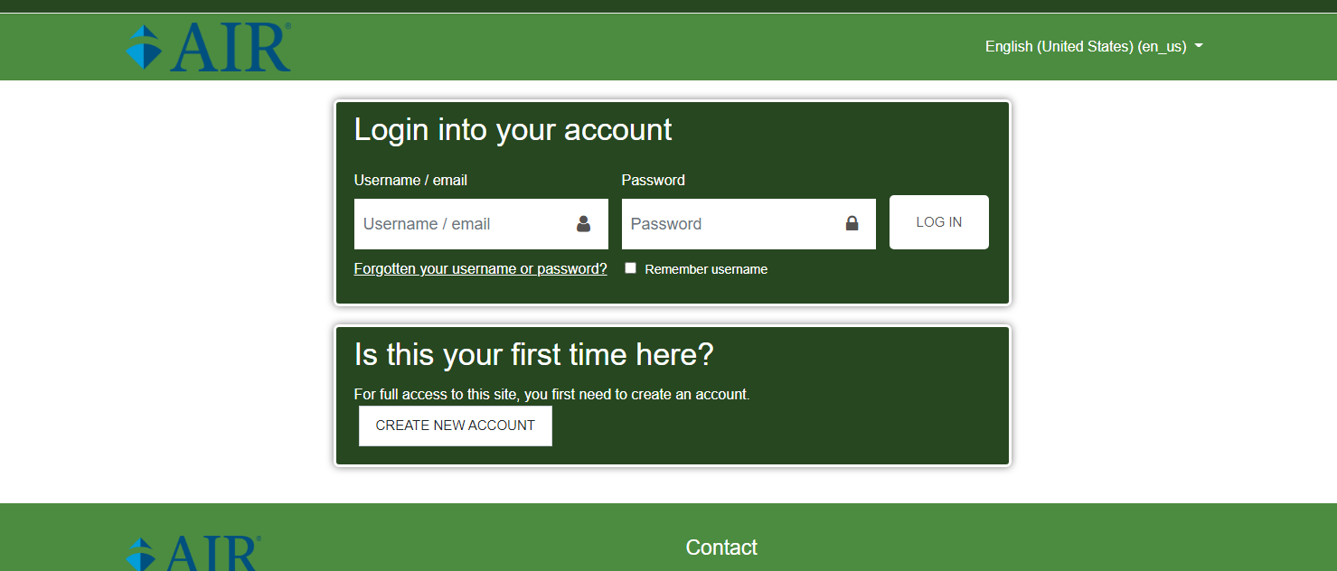
Learning Module Library Login
Notes:
https://courses-studentprogress.org/login/index.php

Slide 15
Learning Module Library Dashboard
Notes:
https://courses-studentprogress.org/login/index.php

Slide 16
Practice Based Professional Learning Activities
Coming Soon!
Notes:
Alex
We are excited to preview some new practice-based professional learning activities that will be available soon from PROGRESS! These activities were created from what we learned from working with our partner sites and conducting the focus groups that Stacy mentioned earlier. In particular, the importance of not assuming that people know this information- regardless of how long they have been in the field- and the need for multiple exposures over time.

Slide 17
Three Practice Based Professional Learning Activities
Strategies for Analyzing PROGRESS Center IEP Tip Sheets
Purpose: Understand IDEA requirements for IEP components
Getting to Know Your IEP
Purpose: Understand where the required components of an IEP appear in your local IEP document
Looking for Connections: Ensuring the Parts of the IEP Work Together
Purpose: Understand the extent to which the IEP is reasonably calculated to promote progress by focusing on how the parts of the IEP work together to address identified needs
Notes:
Each activity will include a facilitator guide and participant handouts. The facilitators guide that outlines the activity and provides tips for facilitating the activity and options for adjusting based on audience need and available time. The facilitators guide include suggested timing for each step of the activity and the materials needed for facilitating the activity
Let’s look at one activity in more depth

Slide 18
Strategies for Analyzing PROGRESS Center IEP Tip Sheets
Activity Overview
Purpose: Understand IDEA requirements for IEP components Suggested Time: 15-20 minutes Suggested Audience: General and Special Educators, Administrators, Special Education Staff, Preservice Educators Materials: Participant handout, IEP Tip Sheet, highlighter, sticky notes

Slide 19
Select the Tip Sheet To Focus On
Notes:
Select a Tip Sheet to focus on. This activity can be facilitated with any of the IEP Tip Sheets from the PROGRESS Center. It can be especially helpful for reviewing the Overview of Statement of Services and Aids.

Slide 20
Activity Structure
Step | Description of Step
Set the stage (2 minutes) | Set the activity purpose by reviewing why this activity is important and the primary activity objectives. Pass out materials. Orient participants to the structure of the IEP Tip Sheet.
Step 1: Independent reflection (2-3 minutes) | Ask participants to individually review the IDEA definition outlined on the top of the Tip Sheet, highlight or underline areas that stand out to them in the definition, and note takeaways and reflections.
Step 2: Small group or partner sharing 3–5 minutes) | Ask participants to: turn to a partner or form a small group, share what stood out to them while reviewing the IDEA definition on the tip sheet, and note any outstanding questions that they have.
Step 3: Whole group discussion and reflection (10-15 minutes) | Ask participants to share reflections, takeaways, and questions with the full group. Address participant questions. Reinforce main ideas from the Tip Sheet.

Slide 21
Optional Activity
Step | Description of step
Individual definition (4 minutes) | Ask participants to independently jot down in their own words what IDEA says about the IEP component.
Share definitions in pairs (3 minutes per partner) | In pairs, ask the first participant to share with their partner, and switch partners and repeat.

Slide 22
Where Can I Learn More?

Slide 23
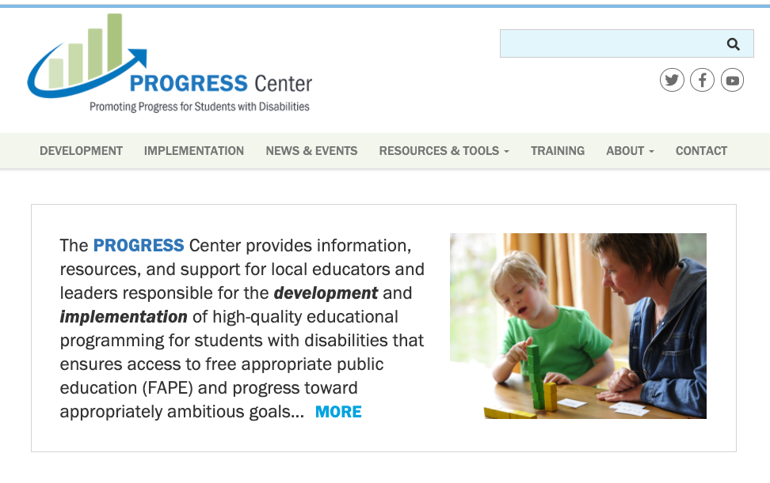
Find Additional Resources and Connections with PROGRESS Center
https://www.facebook.com/k12PROGRESS/
https://twitter.com/K12PROGRESS
https://promotingprogress.org/news/connect-progress-center
www.promotingPROGRESS.org
Notes:
We want to be sure that you have access to a wealth of resources from each of these Centers – [talk through the resources]

Slide 24
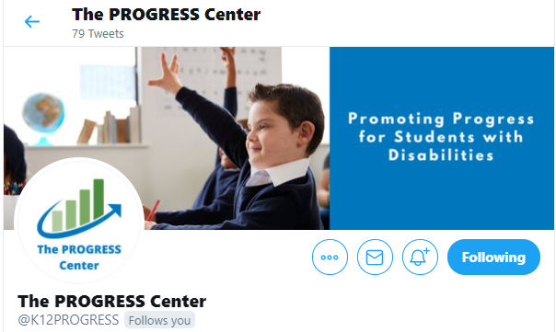
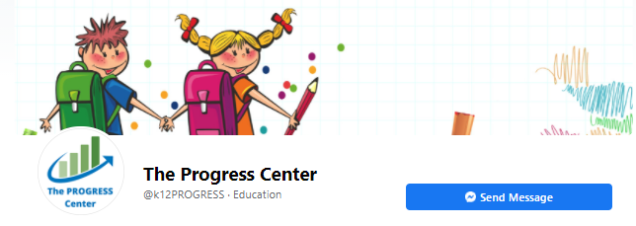
Staying Connected With the PROGRESS Center
Connect with us on Facebook and Twitter @k12progress
https://promotingprogress.org/news/connect-progress-center
Notes:
If you want to stay up to date, sign up for out newsletter on our home page or follow up on Twitter and Facebook.

Slide 25
Disclaimer
This material was produced under the U.S. Department of Education, Office of Special Education Programs, Award No. H326C190002. David Emenheiser serves as the project officer. The views expressed herein do not necessarily represent the positions or policies of the U.S. Department of Education. No official endorsement by the U.S. Department of Education of any product, commodity, service, or enterprise mentioned in this presentation is intended or should be inferred.

Slide 26
Reflection and Closing
Closing Questions or Comments?
Ticket Out the Door
Which resource are you looking forward to including in your professional learning opportunities?
IEP Tip sheets
Instructional Practice Briefs
Online learning modules
Universal TA activities
Other (let us know in the chat box)
Notes:
Program poll

Slide 27
PROGRESS Center Contact Information
progresscenter@air.org
1400 Crystal Drive, 10th Floor
Arlington, VA 22202-3289
202.403.5000
progresscenter@air.org
promotingprogress.org | www.air.org
https://www.facebook.com/k12PROGRESS/
https://twitter.com/K12PROGRESS
Notice of Trademark: “American Institutes for Research” and “AIR” are registered trademarks. All other brand, product, or company names are trademarks or registered trademarks of their respective owners.
This material was produced under the U.S. Department of Education, Office of Special Education Programs, Award No. H326C190002. David Emenheiser serves as the project officer. The views expressed herein do not necessarily represent the positions or policies of the U.S. Department of Education. No official endorsement by the U.S. Department of Education of any product, commodity, service, or enterprise mentioned in this presentation is intended or should be inferred.

