Slide 1
Ensuring SDI in the Secondary Setting
Dr. Tessie Bailey | Sara Evans
August 2023

Slide 2
Outcomes
In this session, presenters will
Explain what SDI looks like and doesn’t look like at the secondary level.
Model strategies to design and deliver SDI in secondary settings.
Share resources to support implementation.

Slide 3
Did you know?
Research shows that teachers and parents hold significantly lower educational expectations for adolescents labeled with disabilities than they do for similarly achieving and behaving adolescents not labeled with disability, and these lower expectations contribute to labeled adolescents’ lower educational expectations for themselves.
Shifrer, 2013

Slide 4
Our beliefs and expectations often determine the path we take or provide for our students.

Slide 5
The Importance of Holding High Expectations
Most students with disabilities, when given appropriate special education aids and services, can achieve similar academic and functional outcomes as their non-disabled peers.
Their success often boils down to opportunity and expectations.

Slide 6
Setting the Stage for Effective Service Delivery in Secondary Settings

Slide 7
Setting the Stage for Success
To effectively design goals and SDI to promote appropriately, ambitious growth, we must
Maintain high expectations
1
Articulate what we want the student to do
-Teacher clarity = ES .75; -Learning goals = ES .68; -Appropriate challenging goals = ES .59
2
Know the student and their circumstances
[PLAAFP Statement, IDEA Sec. 300.320 (a)(1); Endrew F., 2017]
3
Know what knowledge, skills, and strategies the student needs to meet ambitious goals (focus of SDI!)
4
Hattie, 2018

Slide 8
The Design of SDI Depends on the Other Components of the IEP
PLAAFP Statement
Annual Goals
Measuring Progress Toward Annual Goals
Date, Frequency, Duration, and Location of Services
Participation Outside Regular Education and in State and Districtwide Assessments
Statement of Special Education and Aids and Services
Includes SDI!

Slide 9
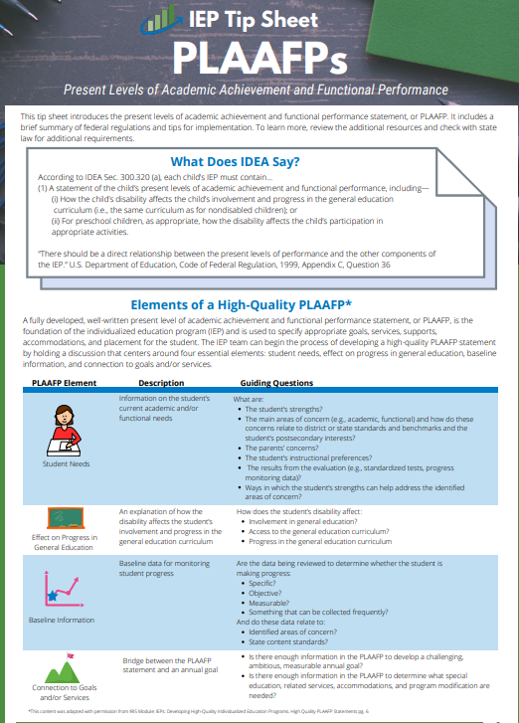
Where do we start? The PLAAFP Statement
(1) A statement of the child’s present levels of academic achievement and functional performance, including—
(i) How the child’s disability affects the child’s involvement and progress in the general education curriculum (i.e., the same curriculum as for nondisabled children)
IDEA Section 300.320(a)

Slide 10
What is meant by present levels of academic achievement?
“Academic achievement” generally refers to a child’s performance in academic areas, which could vary depending on a child’s circumstance or situation. These generally include required courses for graduation or high school readiness.
Academic Achievement
Writing
Science
History
Math
Reading
Source: 71 Fed. Reg. at 46662.

Slide 11
What is meant by present levels of functional skills?
“Functional performance” generally refers to activities that are not considered academic or related to a child’s academic achievement.
“Functional” often is used in the context of routine activities of everyday living.
Functional Performance
Eating
Behavior
Social Skills
Toileting
Dressing
Communication Skills
Mobility
Executive Functioning
Source: 71 Fed. Reg. at 46661

Slide 12
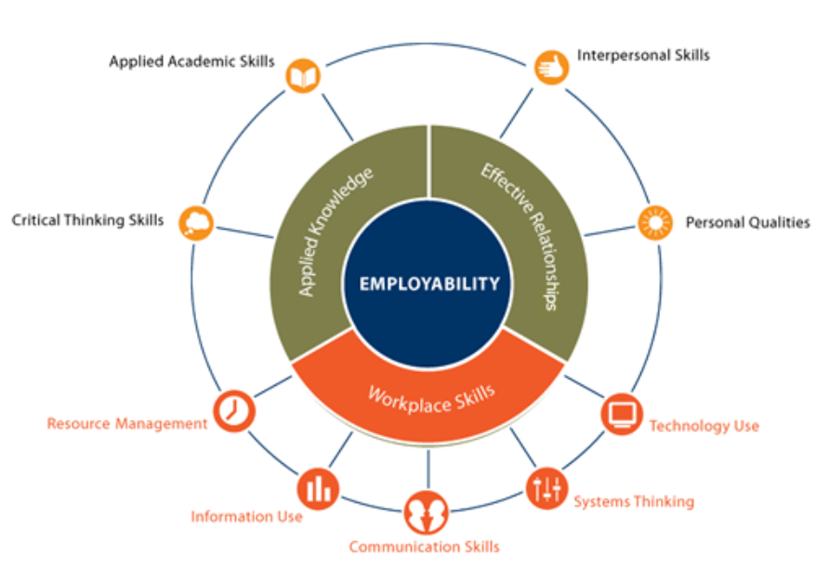
What functional skills are necessary for successful post school outcomes?
Employability Skills Framework
Perkins Collaborative Resource Network. (n.d.).

Slide 13
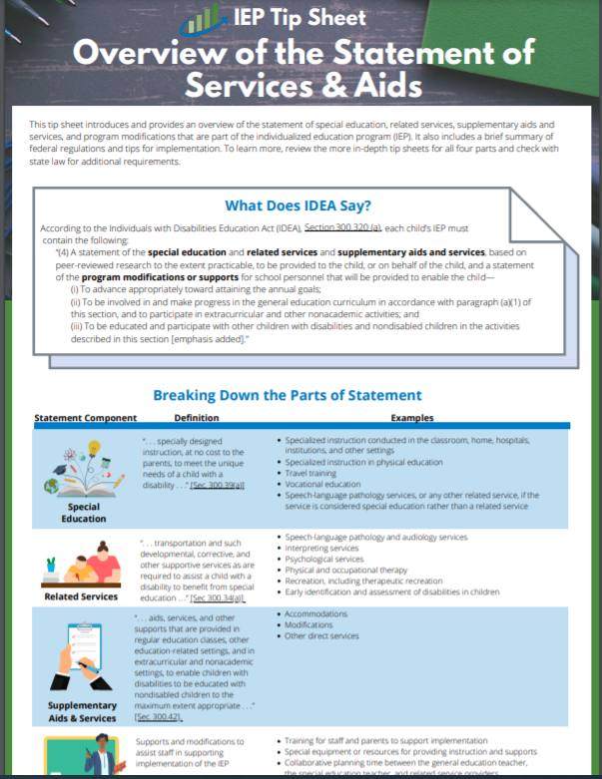
What does IDEA say about the statement of services and aids?
According to IDEA, Section 300.320 (a), each child’s IEP must contain the following:
“(4) A statement of the special education and related services and supplementary aids and services, based on peer-reviewed research to the extent practicable, to be provided to the child, or on behalf of the child, and a statement of the program modifications or supports for school personnel that will be provided to enable the child—… ″
IDEA, Sec. 300.320(a)(4), emphasis added

Slide 14
What does IDEA say about the purpose of the statement of services and aids?
“…to enable the child—
(i) To advance appropriately toward attaining the annual goals;
(ii) To be involved in and make progress in the general education curriculum in accordance with paragraph (a)(1) of this section, and to participate in extracurricular and other nonacademic activities; and
(iii) To be educated and participate with other children with disabilities and nondisabled children in the activities described in this section.” [emphasis added]
IDEA, Sec. 300.320(a)(4), emphasis added

Slide 15
Barriers to Providing SDI in Secondary Settings
Master school schedule
Competing priorities between credit accrual or delivery of specialized services.
Capacity to manage service delivery across large caseloads
Lack of clarity about roles for providing specialized instruction to students with disabilities.
Confusion about IDEA requirements for designing and providing SDI in secondary settings (accommodations vs SDI)

Slide 16
What are Supplementary Aids and Services?
“Supplementary aids and services means aids, services, and other supports that are provided in regular education classes, other education-related settings, and in extracurricular and nonacademic settings, to enable children with disabilities to be educated with nondisabled children to the maximum extent appropriate...”
IDEA Sec. 300.42; emphasis added.

Slide 17
Instructional Accommodations v. Modifications
Instructional Accommodations | Instructional Modifications
Changes how students access or demonstrate learning but does not change what they learn. | Changes what students learn and more commonly used with students who require more support or adjustments than accommodations can provide.
Examples include— Extended time to complete a task Reader for math assignment Calculator for problem-solving tasks | Examples include— Changing the expectations for learning Reducing the requirements of the task Reader for a reading comprehension activity Calculator for math calculation activities
Want to learn more? Check out the IRIS Center’s Accommodations: Instructional and Testing Supports for Students with Disabilities module, https://iris.peabody.vanderbilt.edu/module/acc/cresource/q3/p09/#content

Slide 18
What is Special Education or SDI?
“Specially designed instruction means adapting, as appropriate to the needs of an eligible child under this part, the content, methodology, or delivery of instruction—
(i) To address the unique needs of the child that result from the child’s disability; and
(ii) To ensure access of the child to the general curriculum, so that the child can meet the educational standards within the jurisdiction of the public agency that apply to all children.”
IDEA Sec. 300.39 (3), emphasis added

Slide 19
Why is SDI for mastery of strategy use important?
After repeated failures, students with LD display learned helplessness (which was displayed through lack of motivation or effort when faced with challenging tasks), feelings of hopelessness, low self esteem, and negative affectivity (e.g., irritability, shame, nervousness, guilt).
Mastery of skills to improve executive functioning processes can be taught through SDI, not just accommodated to increase performance.
Sideridis, 2003

Slide 20
Executive functioning skills are intentional and goal oriented
attention (e.g., persevering through multistep or difficult tasks);
inhibitory control (e.g., ignoring irrelevant or distracting information);
planning (e.g., identifying an appropriate sequence of steps to meet a goal);
self-monitoring (e.g., graphing progress on a chart, self-evaluate on-task behavior);
cognitive flexibility (e.g., shifting between tasks, procedures, or rules); and
working memory (e.g., organizing several pieces of incoming information).
PROGRESS Center, 2021

Slide 21
Areas of Focus to Provide SDI in Secondary Settings
Challenging goals (ES = .59)
Strategy monitoring (ES = .58)
Cognitive task analysis (ES = 1.29)
Strategy to integrate with prior knowledge (ES = .93)
Transfer strategies (ES = .86)
Mnemonics (ES = .76)
Help seeking (ES = .72)
Meta-cognitive strategies (ES = .60)
Rehearsal and Memorization (ES = .73)
Self-regulation strategies (ES = .52)
Note taking (ES = .50)
Study skills (ES = .46)
Teaching communication skills and strategies (ES = .43)
Hattie, J. (2018).

Slide 22
Implementation Strategies from the Field

Slide 23
Closing

Slide 24
Ensure on High-Quality Programming and Instruction
1
Consistent opportunities to work on GRADE-APPROPRIATE ASSIGNMENTS.
2
STRONG CORE INSTRUCTION, where students do most of the thinking in a lesson.
3
DEEP ENGAGEMENT in what they’re learning.
4
Teachers who hold HIGH EXPECTATIONS for students and believe they can meet grade-level standards (ES = 1.29).
(TNTP, 2018)

Slide 25
References
Hattie, J. (2018). Hattie Ranking: 252 Influences And Effect Sizes Related To Student Achievement. Retrieved from https://visible-learning.org/hattie-ranking-influences-effect-sizes-learning-achievement/
Perkins Collaborative Resource Network. (n.d.). Employability Skills Framework. https://s3.amazonaws.com/PCRN/docs/Employability_Skills_Framework_OnePager_20180212.pdf
PROGRESS Center. (2021). Cognitive and Metacognitive Strategies: What Do Teachers Need to Know? https://promotingprogress.org/sites/default/files/2021-08/Cog-MetaCog-Strategies-508.pdf
Shifrer, D. (2013). Stigma of a Label: Educational Expectations for High School Students Labeled with Learning Disabilities. Journal of Health and Social Behavior, 54(4), 462 – 480. https://doi.org/10.1177/002214651350334
Sideridis, G. D. (2003). On the origins of helpless behavior of students with learning disabilities: avoidance motivation? International Journal of Educational Research, 39 (4-5), 497 – 517.
TNTP. (2018). The Opportunity Myth: What Students Can Show Us About How School Is Letting Them Down—and How to Fix It. https://tntp.org/assets/documents/TNTP_The-Opportunity-Myth_Web.pdf

Slide 26
Disclaimer
This material was produced under the U.S. Department of Education, Office of Special Education Programs, Award No. H326C190002. David Emenheiser serves as the project officer. The views expressed herein do not necessarily represent the positions or policies of the U.S. Department of Education. No official endorsement by the U.S. Department of Education of any product, commodity, service, or enterprise mentioned in this presentation is intended or should be inferred.

Slide 27
PROGRESS Center
progresscenter@air.org
1400 Crystal Drive, 10th Floor
Arlington, VA 22202-3289
202.403.5000
progresscenter@air.org
promotingprogress.org | www.air.org
https://www.facebook.com/k12PROGRESS/
https://twitter.com/K12PROGRESS
Notice of Trademark: “American Institutes for Research” and “AIR” are registered trademarks. All other brand, product, or company names are trademarks or registered trademarks of their respective owners.
This material was produced under the U.S. Department of Education, Office of Special Education Programs, Award No. H326C190002. David Emenheiser serves as the project officer. The views expressed herein do not necessarily represent the positions or policies of the U.S. Department of Education. No official endorsement by the U.S. Department of Education of any product, commodity, service, or enterprise mentioned in this presentation is intended or should be inferred.
XXXXX_MO/22

