Slide 1
Using the Taxonomy of Intervention Intensity to Select, Design, and Intensify Intervention
August 4, 2023
Jason Harlacher, PhD
Senior Researcher

Slide 2
Jason Harlacher, PhD
Dr. Harlacher is a senior researcher at American Institutes for Research (AIR), where he provides technical assistance to state agencies and school districts on intensive intervention, classroom management, data-informed decision making, and implementation of MTSS. He currently serves as the director of the MTSS Center and co-director for the Wyoming MTSS Center.
He has more than 18 years of experience in education, having previously worked as a school psychologist, district-level coach, adjunct professor, state-level consultant, and researcher. He presents nationally on topics related to classroom management, data-based decision making, and MTSS. He is an award-winning author and holds several publications in peer-reviewed journals. He earned his PhD in school psychology from the University of Oregon in 2009.

Slide 3
Objectives
Learn the dimensions of the Taxonomy of Intervention Intensity
Connect use of the Taxonomy (a) to select/evaluate interventions and (b) to intensify existing interventions
Examine resources related to intensification

Slide 4
National Center on Intensive Intervention (NCII)
The mission of the NCII is to build knowledge and capacity of state and local leaders, faculty and professional development providers, educators, and other stakeholders to support implementation of intensive intervention for students with severe and persistent learning and/or social, emotional, or behavioral needs using data-based individualization (DBI).

Slide 5
NCII’s Approach to Intensive Intervention
A systematic method for using data to determine when and how to provide more intensive intervention.
An ongoing process—not a single intervention.
Intended for students with severe and persistent learning and behavioral needs.
Data-Based Individualization

Slide 6
Connecting DBI to a Multi-Tiered System of Supports (MTSS)
Characteristics | Tier 2 | Tier 3 - DBI
Instruction/ Intervention Approach | Follow standardized evidence-based programs as designed | Use standardized evidence-based program as a platform, but adapt instruction based on student data
Duration and Time Frame | Use duration and time frame defined by developer | Increase frequency and/or duration to meet student needs
Group Size | 3–7 students (as defined by developer) | Decrease group size to meet student needs (no more than 3)
Progress Monitoring | At least monthly | Weekly
Population Served | At risk (typically 15%–20% of student population) | Significant and persistent learning and/or behavior needs (typically 3%–5% of student population)

Slide 7
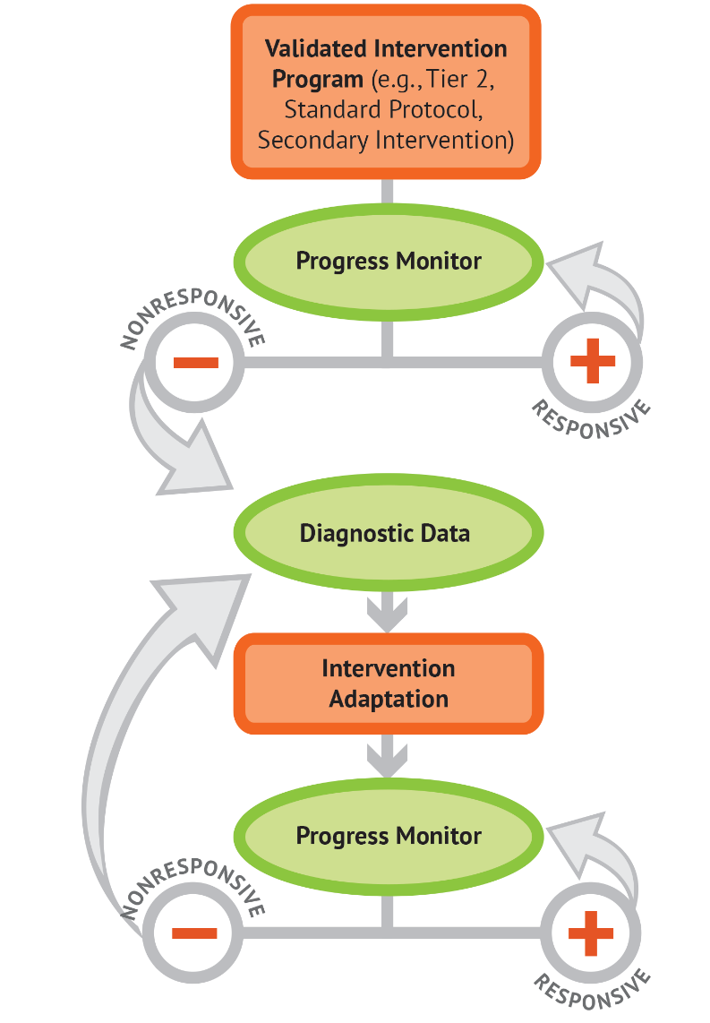
Build from Tier 2 Platform
Select an evidence-based intervention at Tier 2 and allow it to work (Step 1)
Gather diagnostic data (Step 3) to inform changes needed (Step 4)
The dimensions are your levers to adjust to individualize and intensify for students

Slide 8
Question
When choosing an intervention, what is one factor that you consider to make your choice?
Put your answer in the chat but wait to hit return.

Slide 9
Components to Consider When Selecting, Evaluating, and Adapting Interventions
Effect size
Evidence-based programs
Opportunities to respond
Group size
Alignment with grade level standards
Explicit instruction and modeling
Frequency and duration of intervention
Concrete learning opportunities
Breaking tasks into smaller steps
Connection to Tier 1 instruction
It would be helpful if there was a framework to guide our thinking when we are deciding what interventions to use and how to adapt them.

Slide 10
Taxonomy of Intervention Intensity
Strength | Is the intervention expected to lead to improved outcomes?
Dosage | Will the group size, duration, structure, and frequency provide sufficient opportunities to respond?
Alignment | Does the intervention mat the student’s identified needs?
Attention to Transfer | Does the intervention assist the student in generalizing the learned skills to general education or other tasks?
Comprehensiveness | Does the intervention include elements of explicit instruction?
Behavioral/Academic Support | Does the intervention integrate behavior and academic support throughout? (e.g., self-regulation, executive functioning, work completion, complements instruction versus supplants, etc.)
Individualization | Can the intervention be adjusted or individualized based on a data-based process?

Slide 11
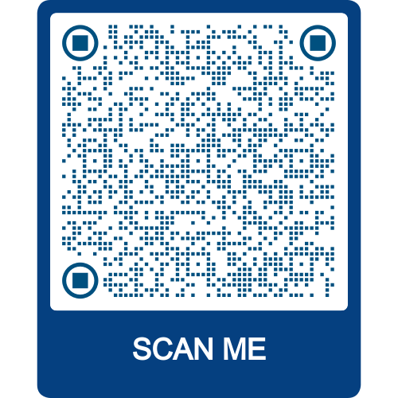
Taxonomy of Intervention Intensity Handout
Take 2 minutes and preview the handout.
Taxonomy

Slide 12
Dual Purpose: Taxonomy can help you…
Choose an intervention
Intensify an intervention

Slide 13
Defining the Taxonomy Dimensions

Slide 14
Dimension 1: Strength
Strength = How well does the intervention work for students with intensive intervention needs?
Stronger the evidence that the intervention works
Greater the strength of the intervention

Slide 15
Strength is More than Just “Does it work?”
Statistically significant finding means an effect was found (it “worked”)
Effect size indicates the magnitude of the effect (to what extent it “worked”)

Slide 16
Considerations: Strength
Has this intervention been evaluated empirically using scientifically sound, rigorous methodology?
Type/Source
Is the source reputable?
Population
Were the students included in the study similar to our students?
Desired Outcomes
Were the outcomes of interest relevant to our students?
Effect Size (for group design studies)
Does the evidence suggest that the intervention can produce a meaningful change?
Can it be trusted?

Slide 17
Understanding Effect Size
Student Outcome | Early Elementary K–3 |  | Upper Grades 4–9
 | Mean ES | No. of Effects | Mean ES | No. of Effects
Comprehension | .46 | 25 | .09 | 37
Reading Fluency | .34 | 11 | .12 | 8
Word Reading | .56 | 53 | .20 | 22
Spelling | .40 | 24 | .20 | 5
Note: ES = effect size
(Wanzek et al., 2013)

Slide 18
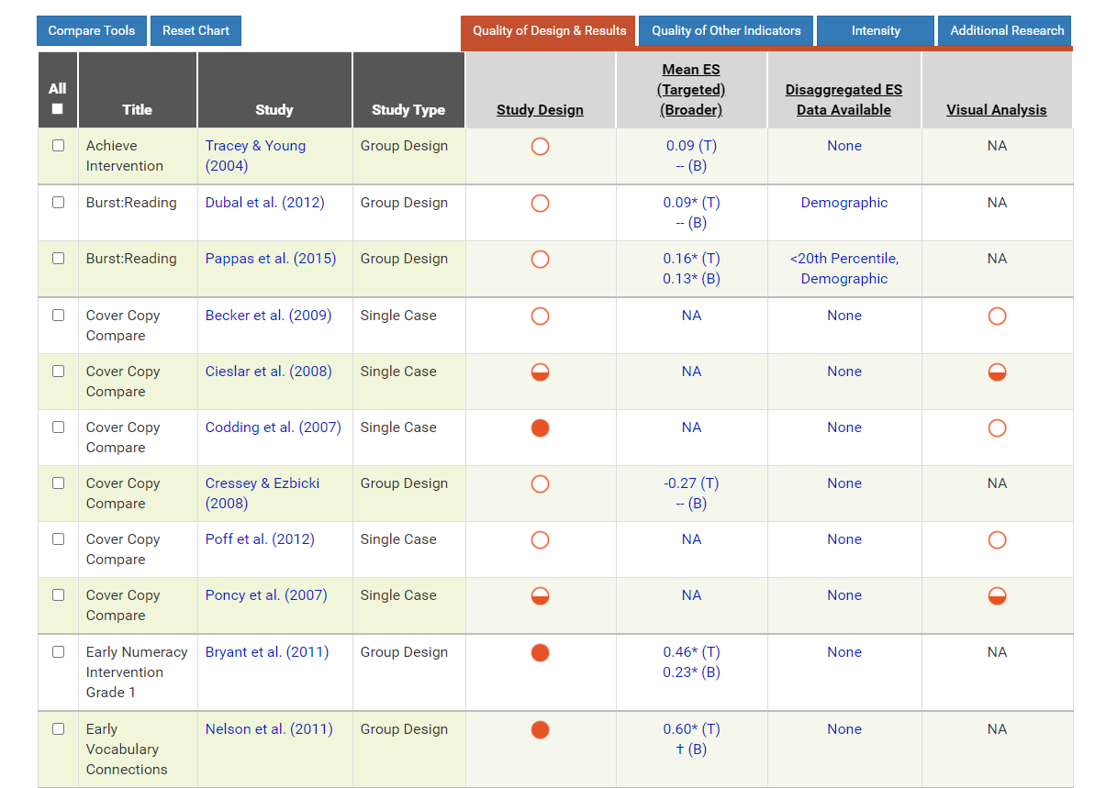
Resources: Strength
What Works Clearinghouse website
Academic Intervention Tools Chart
Behavior Intervention Tools Chart

Slide 19
Dimension 2: Dosage
Dosage = the number of opportunities a student has to
(a) respond to prompts or practice/demonstrate the target skill
(b) receive positive feedback or exchange tokens or points for backup reinforcers, and
(d) receive corrective feedback.
Prompt
Opportunity to Respond (OTR)
Feedback

Slide 20
Ways to Adjust Dosage
Intervention (30 mins)
Intervention
(45 mins)
Increase minutes per intervention session
Mon
(60 mins)
Wed (60 mins)
Tue
(60 mins)
Fri
(60 mins)
Increase frequency of sessions
Increase total sessions
Intervention (8 weeks)
Intervention (12 weeks)
Add additional time
Intervention (60 mins)
Teacher feedback
Teacher feedback
Teacher feedback
Teacher feedback
Additional Time (30 mins)
Teacher feedback
Teacher feedback

Slide 21
Other Ways to Adjust Dosage
5 practice problems
10 practice problems
Add more practice or problems
5 students
2 students
Reduce group size
What is the recommended dosage provided by the publisher or found in the research?
How far is the student’s achievement below grade level?
What is the complexity of the learning tasks (e.g., letter naming in kindergarten is less cognitively complex than comprehension of a third-grade science textbook)?
What is the student’s stamina and attention span?

Slide 22
Resource: Dosage
Strategies for Scheduling: How to Find Time to Intensify and Individualize Intervention

Slide 23
Dimension 3: Alignment
Alignment = how well the intervention aligns to the needs of the student(s)

Slide 24
Alignment
Academics
Addresses the student’s full set of academic skill needs.
Does not address skills the target student has already mastered.
Focuses on systematic instruction; no more than three foundational skills.
Incorporates a meaningful focus on skills necessary to access grade-appropriate curricular standards.
Behavior
Addresses schoolwide and classroom expectations
Addresses student’s skill needs
Does not address mastered skills
Matches rewards to student’s preferences and/or function of problem behavior

Slide 25
Considerations: Alignment
Does the intervention align with instruction throughout the day to ensure full coverage of needed skills?
Does the intervention align with behavioral or social-emotional expectations?

Slide 26
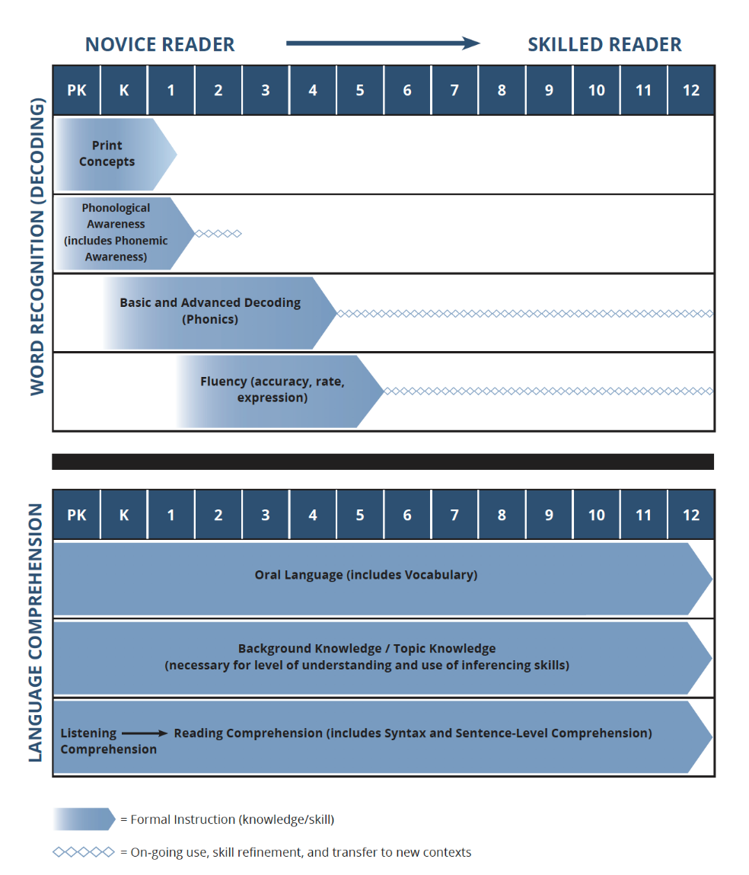
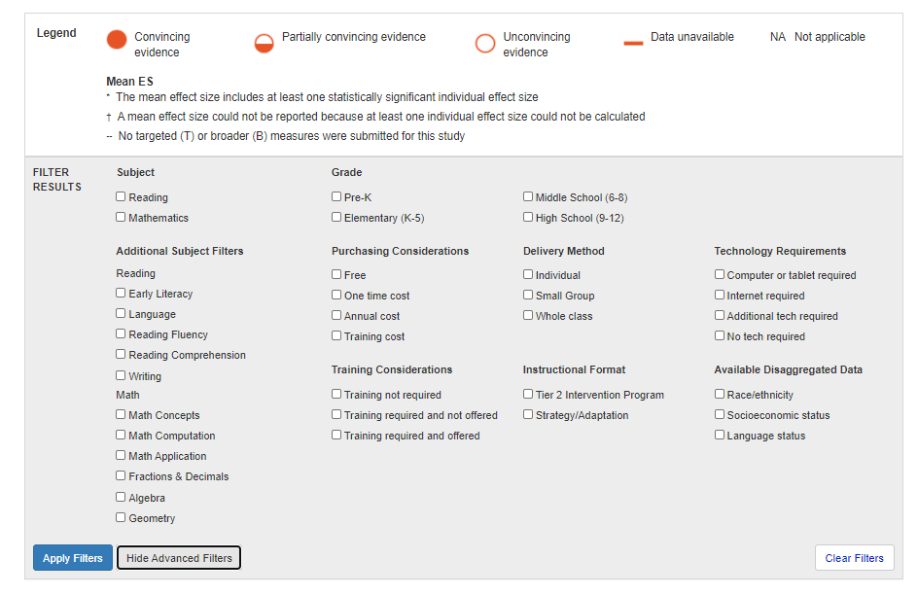
Resources: Alignment
Intensifying Literacy Instruction: Essential Practices

Slide 27
Dimension 4: Attention to Transfer
Attention to Transfer = to what extent is an intervention systematically designed to
help students transfer skills they learn to other formats and contexts,
help students realize the connection between mastered and related skills, and
demonstrate efficacy on standardized measures or measures of generalization?
Generalization
Be sure you plan for generalization of skills from instructional setting to others (can’t just hope it will happen.)

Slide 28
Considerations: Attention to Transfer
Less Intensive | More Intensive
Provides instruction only in the target skill without review Does not vary context Does not include self-regulation and metacognition practice or instruction | Provides a variety of opportunities to practice in different contexts Reinforces skills across context and situation Provides cumulative systematic review Offers opportunities for students to develop metacognition and self-regulation to apply strategies independently

Slide 29
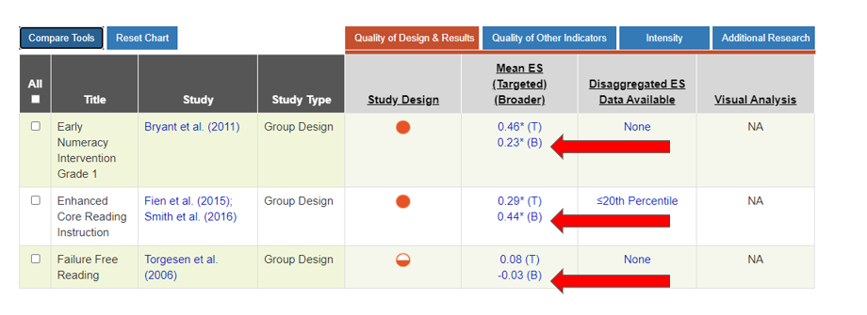
Resources: Attention to Transfer 1

Slide 30
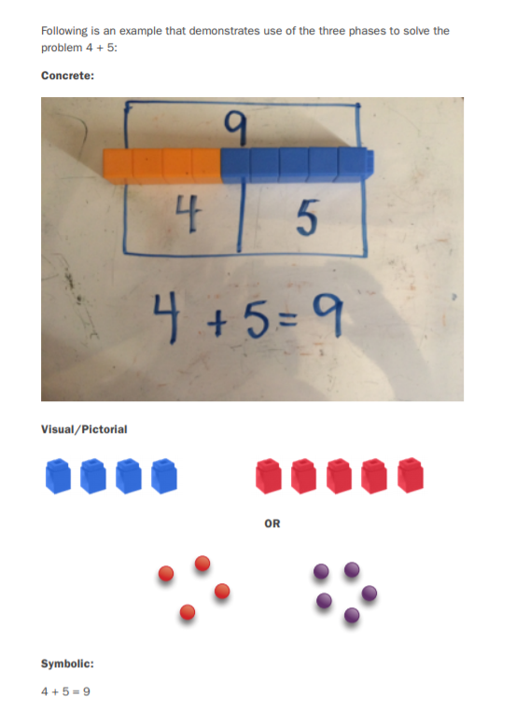
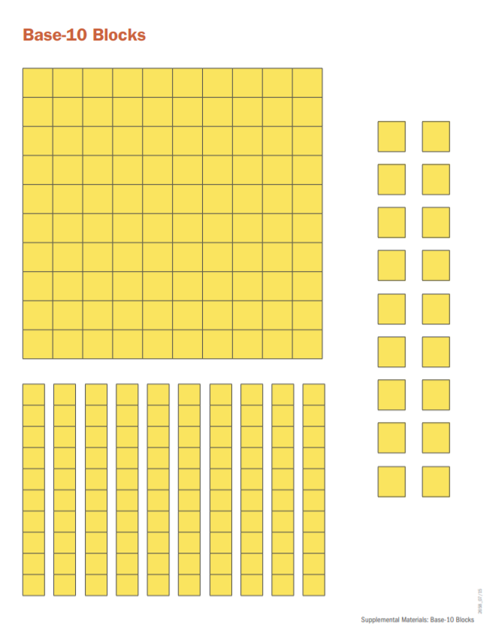
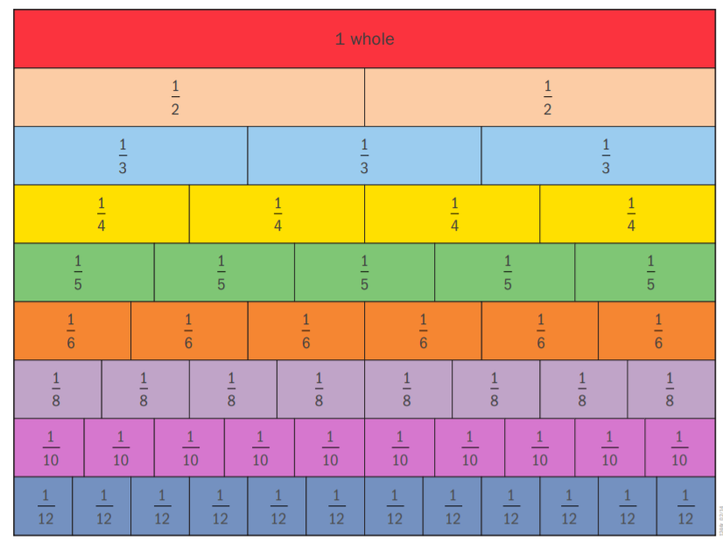
Resources: Attention to Transfer 2
Analyzing intervention to see if it helps students to transfer skills they learn to other formats and contexts.
Learn more about Concrete, Representational/Visual/Pictorial, and Abstract/Symbolic Models in the Principles for Designing Intervention in Mathematics

Slide 31
Dimension 5: Comprehensiveness
Comprehensiveness = extent to which explicit instruction principles are incorporated in the intervention.
Explicit Instruction
“A way of teaching where the teacher selects an important objective, models the skills being taught, and provides scaffolded practice to help a student achieve mastery” (Kearns, 2018).
Model (I do)
Lead (We do)
Test (You do)

Slide 32
More intensive instruction should be…
More explicit
More opportunities to respond
More immediate and clearer corrective feedback
More time to practice skills
Joseph, 2014; Burns et al., 2014; 2021
Prompt
Opportunity to Respond (OTR)
Feedback

Slide 33
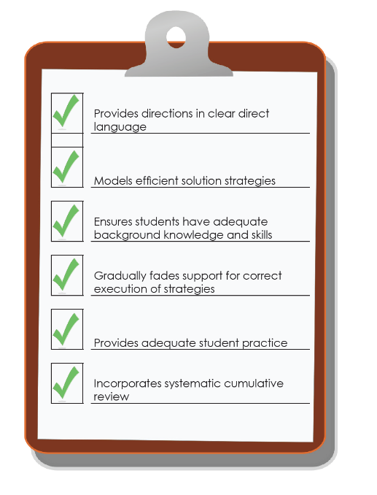
Academic Considerations: Comprehensiveness
Reflects the extent to the intervention incorporates explicit instruction.
Provides explanations in simple, direct language.
Models efficient strategies (e.g., decoding unknown words) instead of expecting students to discover strategies on their own.
Ensures that students have the necessary background knowledge and skills to succeed with these strategies.
Gradually fades support for students’ correct execution of these strategies.
Provides practice so that students use the strategies to generate many correct responses.
Incorporates systematic cumulative review.

Slide 34
Behavior Considerations: Comprehensiveness
The extent to which the intervention includes a plan for
teaching appropriate behavior;
adjusting antecedent conditions to prevent problem behavior;
reinforcing appropriate behavior;
minimizing reinforcement for problem behavior;
fading supports;
monitoring fidelity;
working in conjunction with related services; and
communicating with parents.

Slide 35
Resource: Comprehensiveness
Features of Explicit Instruction Course Content

Slide 36
Dimension 6: Academic and Behavior Supports
Skill deficit
Avoidance behavior
Removal from task

Slide 37
Considerations: Academic and Behavior Supports
Can the behavioral intervention be easily integrated within the context of academic instruction?
Does it complement rather than supplant the academic focus?
Does it include procedures for reinforcing responses related to academic achievement (e.g., engagement, work completion)?
Behavioral support refers to the extent to which interventions incorporate:
methods to promote self-regulation and executive function, and
behavioral principles to minimize non-productive behavior.
Skill deficit
Avoidance behavior
Removal from task

Slide 38
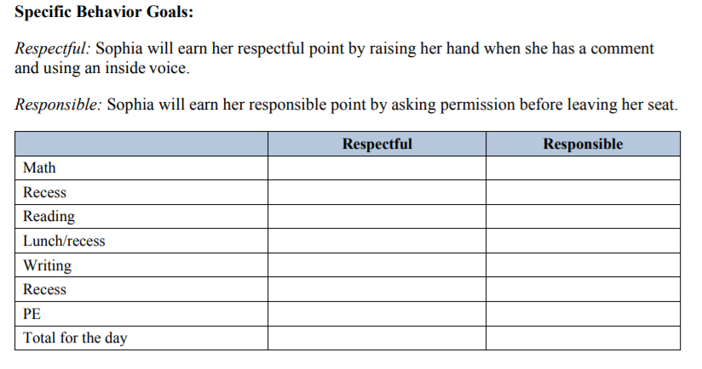
Examples & Resources: Behavior Support Strategies
Ensuring appropriate level of challenge
Developing behavior contracts
Reinforcement systems
Time management (e.g., using of a timer to develop stamina)
Goal setting
Self-monitoring
Incorporating “Think alouds”
Establishing clear rules/expectations
Behavior Strategies for Intensifying Intervention

Slide 39
Dimension 7: Individualization
Individualization = Data-based systematic adjustment of the intervention over time to address the student’s complex learning needs.
Are progress monitoring and diagnostic data available and used to adjust the intervention, based on student need or response?

Slide 40
How to Intensify or Adapt Interventions

Slide 41
How Do We Adapt Interventions?
Develop a hypothesis to help guide intervention adaptation.
Diagnostic data Hypothesis Intervention Adaptation
Examples:
Gina needs more practice opportunities.
Matthew needs more behavior supports to increase his engagement.
Sarah needs more explicit instruction in phonics.
informs
informs

Slide 42
Step 3: Diagnostic Data What data do I collect and how do I use it?
Information gathered details adaptations to fit the needs of the student and informs alterable variables to adjust (e.g., Instruction, Curriculum, and Environment or ICE).
Teams spend the least amount of time in problem analysis (i.e., developing a hypothesis)
Spend most time in problem identification
Focus too much on inalterable variable (Young & Gaughan, 2010; Rosenfield et al., 2018)

Slide 43
Use RIOT and ICEL for Step 3
Academic & Behavioral Curriculum
Learning (L) is an interaction among the instruction, curriculum, and environment (ICE)
Use multiple data points collected in multiple ways to assess the context to better understand what’s needed to support the learner (Review, Interview, Observe, Test)
Learner
Instruction
Environment
https://intensiveintervention.org/data-based-individualization/diagnostic-data

Slide 44
Educationally Relevant and Alterable Variables
Learner
With a peer:
Does your school collect this information when adapting interventions?
Instruction
Academic & Behavioral Curriculum
Environment
Explicit
Opportunities to respond
Corrective feedback
Engagement strategies
Culturally relevant
Scope and sequence
Level of difficulty
Match to learner need
High quality materials
Culturally relevant materials
Clearly taught expectations
Positive reinforcement
Positive interactions
Inclusive classrooms
Positive feedback

Slide 45
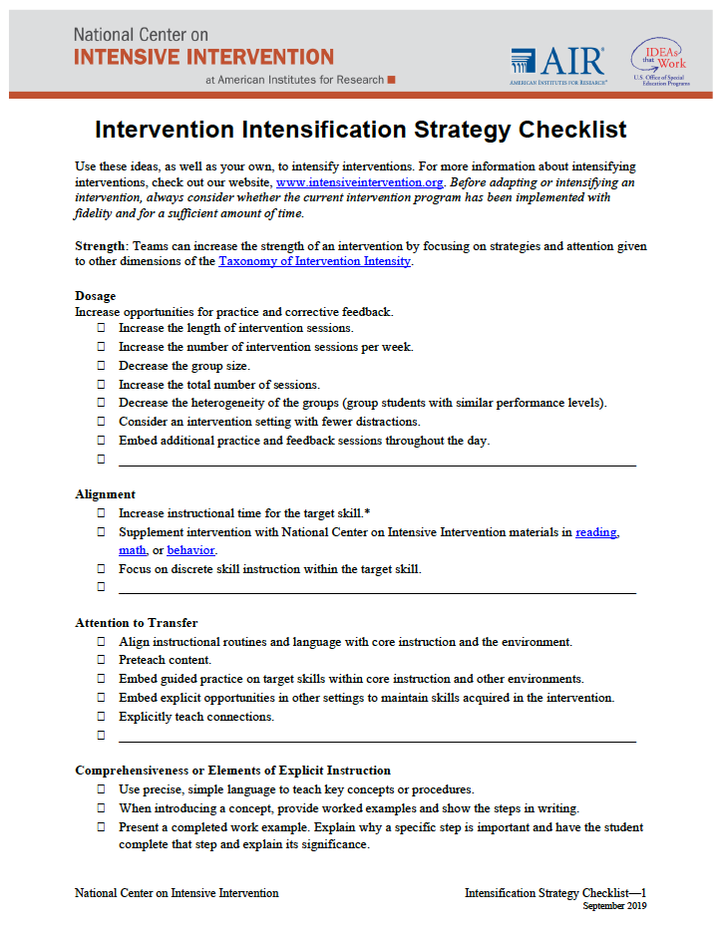
Key Considerations For Intensifying Interventions
Review the Intervention Intensification Strategy Checklist
Consider some of the ways you could intensity the interventions in your settings using these ideas.

Slide 46
Using the Taxonomy to Select, Evaluate, and Design a Validated Intervention Program

Slide 47
Where to Start?
Evaluate your current interventions at Tier 2 for suitability.
Is it the right fit for your context?
Notes:
Reference taxonomy sa one method

Slide 48
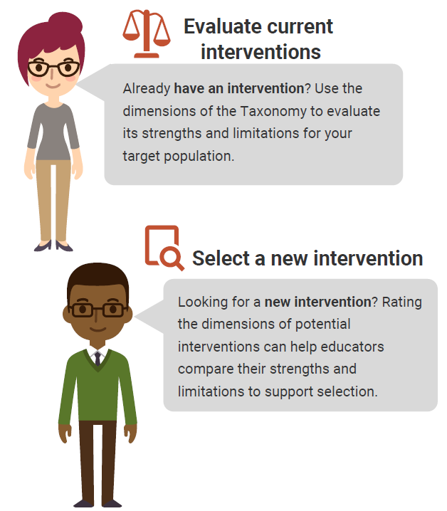
Using the Taxonomy to Find the Best Intervention
There are no perfect interventions.
BUT
Using the Taxonomy of Intervention Intensity can help you understand the strengths and weaknesses of your current intervention and support your selection of a new intervention.

Slide 49
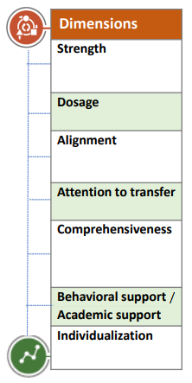
Rating an Intervention
The goal of rating an intervention is to provide a clear picture of the intervention:
There is no hard and fast rule for ratings.
Some dimensions will be easier to rate than others.
Ratings can help guide intensification.
0 | 1 | 2 | 3
Fails to Address Standard | Addresses Standard Minimally | Addresses Standard Moderately | Addresses Standard Well

Slide 50
Taxonomy of Intervention Intensity: Academic Rating Rubric
Academic Rating Rubric

Slide 51
Academic Intervention Taxonomy Briefs
Academic Intervention Taxonomy Briefs

Slide 52
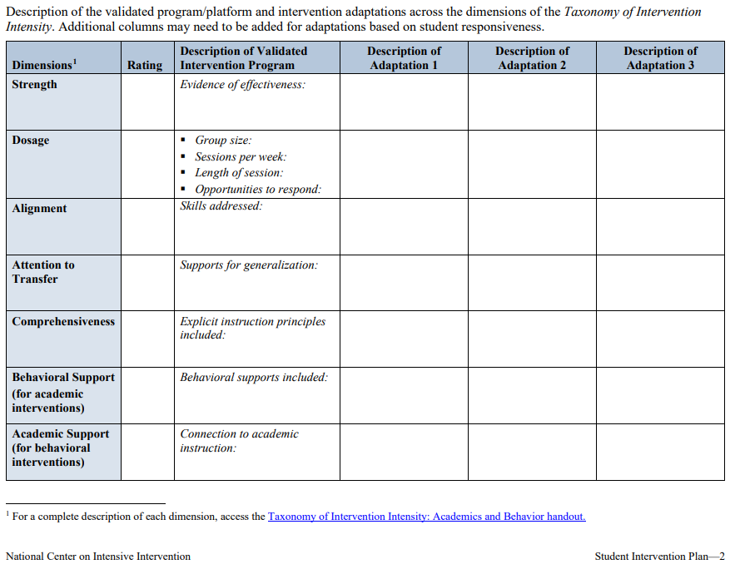
Documenting Rating and Interventions
Intervention Plan (For Small Groups or Individual Students)

Slide 53
What do I need to implement DBI well?

Slide 54
Tips for Successful Intensification
Select strategies that address the hypothesis

Slide 55
Tips for Successful Intensification 2
Select strategies that address the hypothesis
Start by increasing opportunities for practice and feedback

Slide 56
Tips for Successful Intensification 3
Select strategies that address the hypothesis
Start by increasing opportunities for practice and feedback
Intensify across the day instead of just during an intervention period

Slide 57
Tips for Successful Intensification 4
Select strategies that address the hypothesis
Start by increasing opportunities for practice and feedback
Intensify across the day instead of just during an intervention period
Make few but important changes

Slide 58
NCII

Slide 59
NCII Disclaimer
This presentation was produced under the U.S. Department of Education, Office of Special Education Programs, Award No. H326Q260001. Celia Rosenquist serves as the project officer. The views expressed herein do not necessarily represent the positions or policies of the U.S. Department of Education. No official endorsement by the U.S. Department of Education of any product, commodity, service, or enterprise mentioned in this resource is intended or should be inferred.

