Slide 1
Now That Your Backpack (Toolbox) is packed! Let’s Promote Progress!
August 4, 2022

Slide 2
Session Outcomes
Reflect on what you learned during the Prepping for PROGRESS! Adding New Tools to Your Backpack (Toolbox) for the Start of School
Identify available resources from the PROGRESS Center and partners to support the development and implementation of high-quality educational programming

Slide 3
Thank You

Slide 4
Event Review
Missed a session? All sessions except the networking opportunities were recorded and will be posted on the PROGRESS Center website.
Keynote focused on the Path to PROGRESS
Strands
Making Connections! Ensuring the Parts of the IEP Work Together to Promote Progress
Expanding Your Toolbox for Preparing Educators to Promote Progress!
Networking Opportunity
Networking Opportunity
Panel of stakeholders
Concurrent sessions
Belonging
Family Engagement
Fidelity
Special Education Law

Slide 5
IDEA FAPE Requirements
Procedural
In the development of an IEP, has the IEP team complied with the procedures set forth in IDEA? (Rowley)
Substantive
Is the IEP reasonably calculated to enable the child to make progress that is appropriate in light of the child’s circumstances? (Endrew F.)
Implementation
In implementing the IEP, were the instructional services and supports outlined in the IEP provided as agreed on during the IEP process?
FAPE Requirements

Slide 6
Program Development: Procedural
Participation Outside Regular Education and in State and Districtwide Assessments
Present Levels of Academic Achievement and Functional Performance (PLAAFPs)
Monitoring Plan
Statement of Special Education and Aids and Services
Date, Frequency, Duration and Location of Services
Measurable Goals

Slide 7
Program Development: Substantive
PLAAFPs:
Provide an assessment and data-driven baseline
Specially designed instruction (SDI):
Addresses unique needs and ensures access to and progress in the general curriculum
Monitoring Plan:
Informs us if services are leading to progress or if changes are needed
Measurable Goals: Connects to our PLAAFPs, SDI, and progress

Slide 8
Importance of Individualization

Slide 9
Implementing High-Quality Educational Programming
Ongoing Teaming
Progress
Family Engagement
Effective Instruction
Educator Support
Belonging

Slide 10
Development times implementation equals improved access and outcomes - FAPE
Development of high-quality educational programming
Implementation of high-quality educational programming
Improved access and outcomes - FAPE

Slide 11
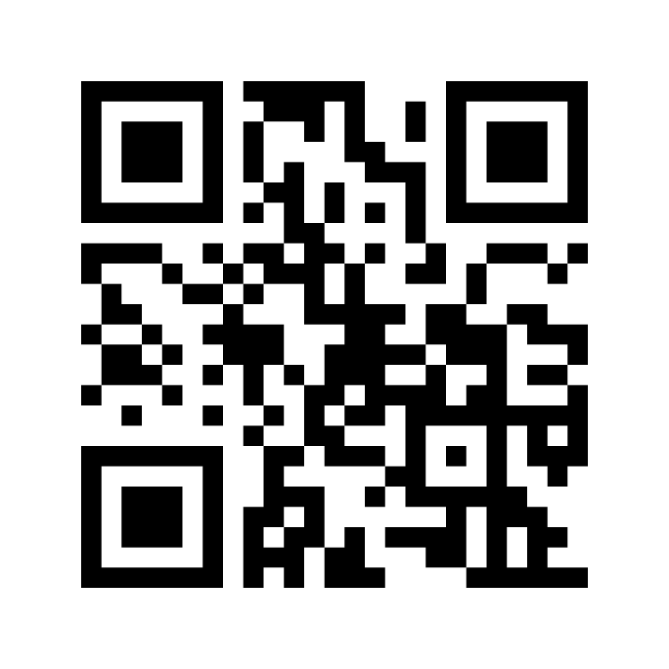
What does it take to promote progress for students with disabilities?
Reflect on what you heard over the past two days
Identify a word or two or three that you think describes what it takes to promote progress for students with disabilities
Share your thinking through menti by going to www.menti.com and use the code 4884 6336 or scan the QR code.

Slide 12
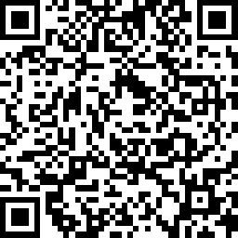
Event Reflection

Slide 13
Where can I find all the resources that were shared?
https://promotingprogress.org/

Slide 14
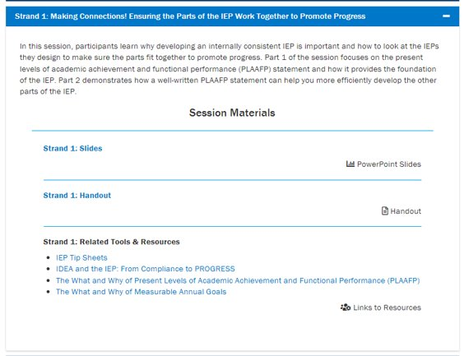
Event Materials
https://promotingprogress.org/news-events/prepping-progress-event-2022

Slide 15
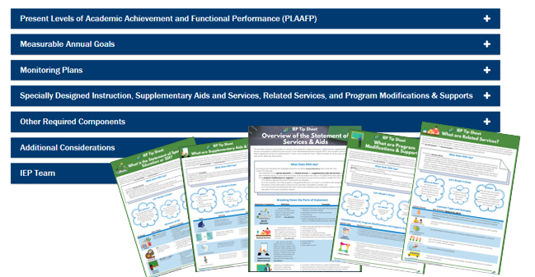
PROGRESS Resources to Support the Development of High-Quality Educational Programming

Slide 16
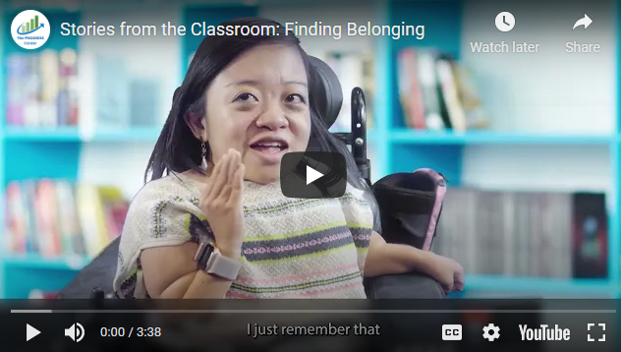
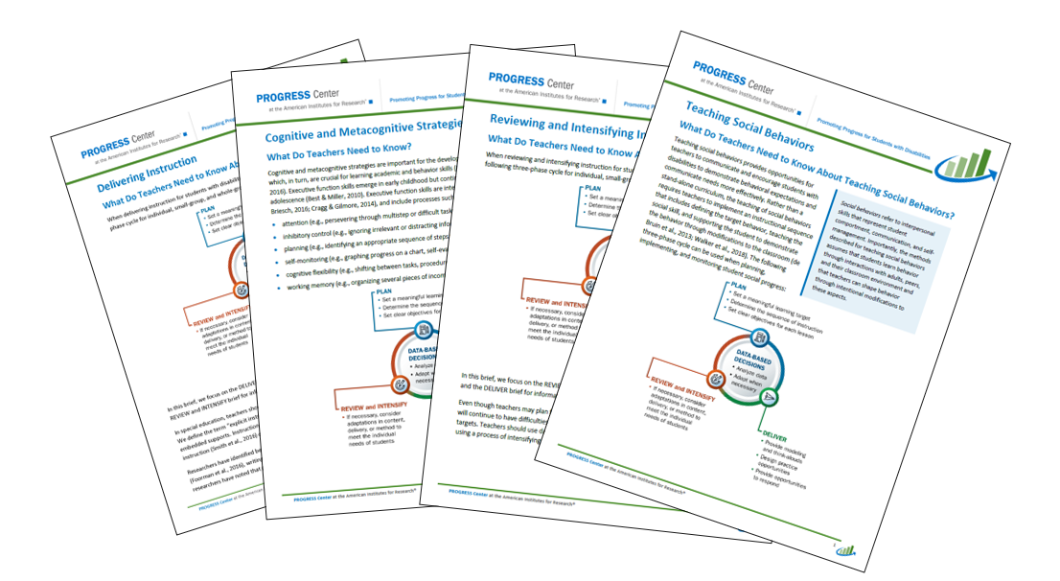
PROGRESS Resources to Support the Implementation of High-Quality Educational Programming

Slide 17
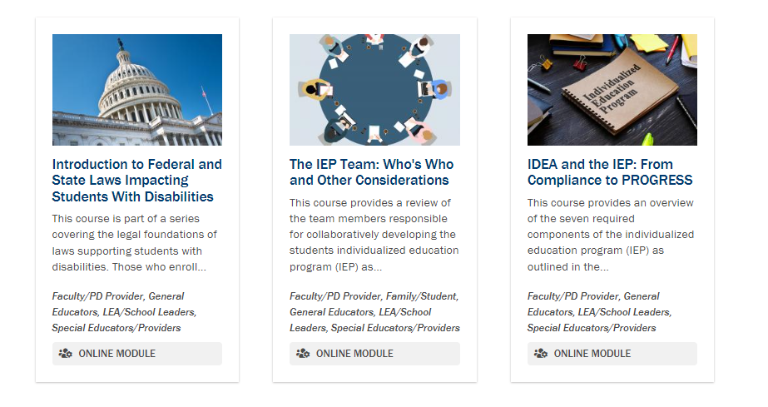
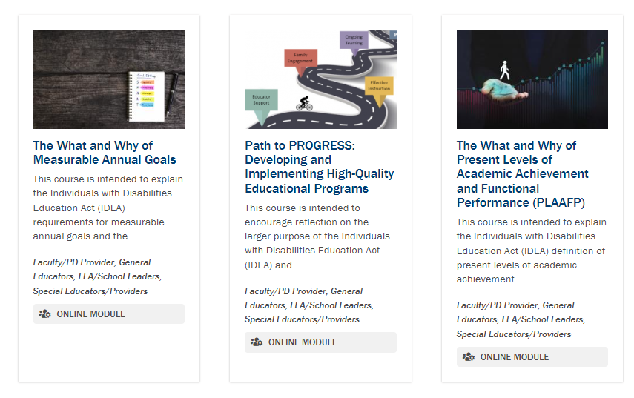
Self-Paced Training Modules

Slide 18
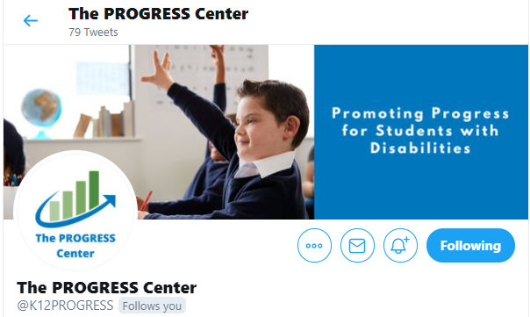
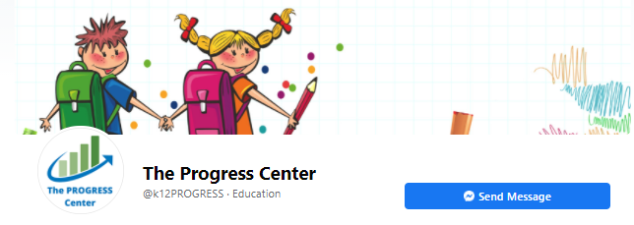
Staying Connected With the PROGRESS Center
Connect to us on Facebook and Twitter @k12progress
https://promotingprogress.org/news/connect-progress-center

Slide 19
Upcoming Event from the Department of Education
What: Smart Beginnings 2022/2023 a virtual three-day technical assistance event sharing information and strategies to launch a new academic engagement and learning year.
When: August 9-August 11
Who: Local education administrators, service providers, teachers, and parents.

Slide 20
Disclaimer
This material was produced under the U.S. Department of Education, Office of Special Education Programs, Award No. H326C190002. David Emenheiser serves as the project officer. The views expressed herein do not necessarily represent the positions or policies of the U.S. Department of Education. No official endorsement by the U.S. Department of Education of any product, commodity, service, or enterprise mentioned in this presentation is intended or should be inferred.

Slide 21
contact
1400 Crystal Drive, 10th Floor
Arlington, VA 22202-3289
202.403.5000
progresscenter@air.org
promotingprogress.org | www.air.org
https://www.facebook.com/k12PROGRESS/
https://twitter.com/K12PROGRESS
Notice of Trademark: “American Institutes for Research” and “AIR” are registered trademarks. All other brand, product, or company names are trademarks or registered trademarks of their respective owners.
This material was produced under the U.S. Department of Education, Office of Special Education Programs, Award No. H326C190002. David Emenheiser serves as the project officer. The views expressed herein do not necessarily represent the positions or policies of the U.S. Department of Education. No official endorsement by the U.S. Department of Education of any product, commodity, service, or enterprise mentioned in this presentation is intended or should be inferred.
XXXXX_MO/22

