Slide 1
Bringing it All Together: Keys to DBI Implementation
August 4, 2023
Jon Potter, PhD

Slide 2
Agenda
Lessons learned from implementing intensive intervention
Educator Panel

Slide 3
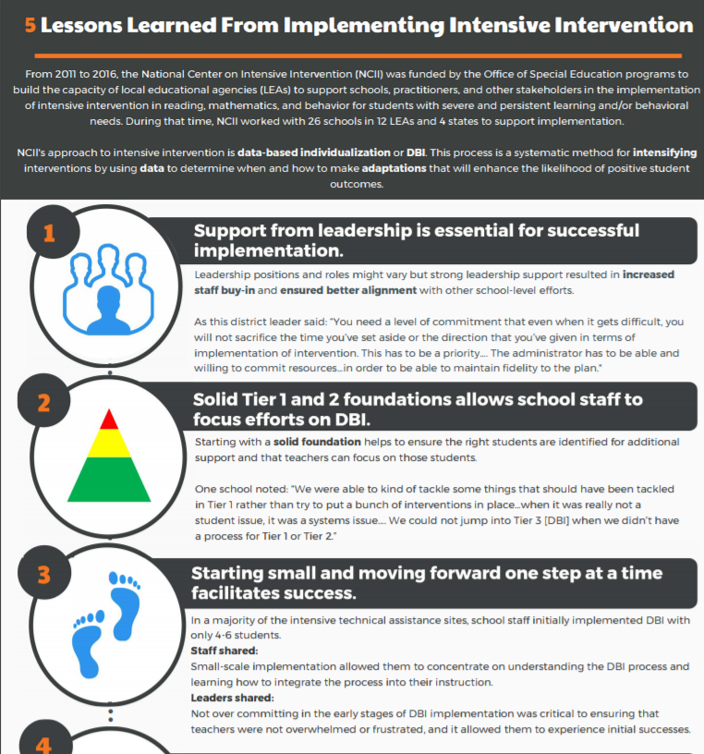
5 Lessons Learned From Implementing Intensive Intervention

Slide 4
1. Support from leadership is essential.
“You need a level of commitment that even when it gets difficult, you will not sacrifice the time you’ve set aside or the direction that you’ve given in terms of implementation of intervention. This has to be a priority. . . . The administrator has to be able and willing to commit resources . . . in order to be able to maintain fidelity to the plan.”
District Administrator

Slide 5
Leadership Resources
Four Keys to Support Intensive Intervention
Administrators & DBI

Slide 6
2. Ensure solid Tiers 1 and 2.
Starting with a solid foundation helps to ensure the right students are identified for additional support and that teachers can focus on those students.
Ensure appropriate infrastructures are in place:
Screening
Progress monitoring
Data-based decision making
High-quality instruction and intervention

Slide 7
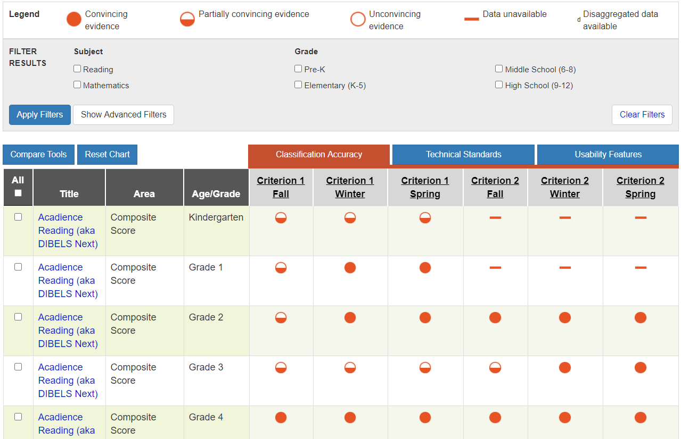
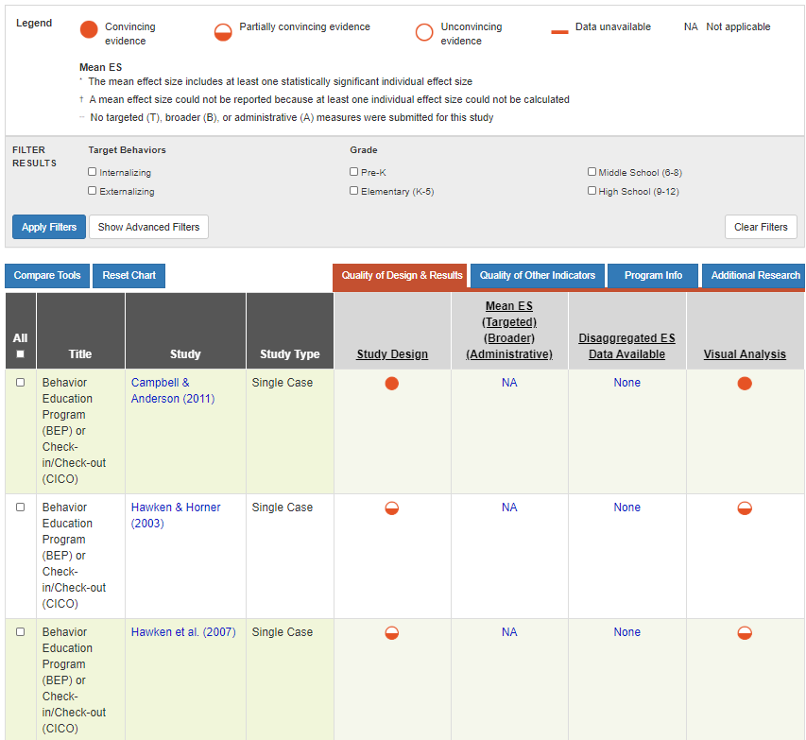
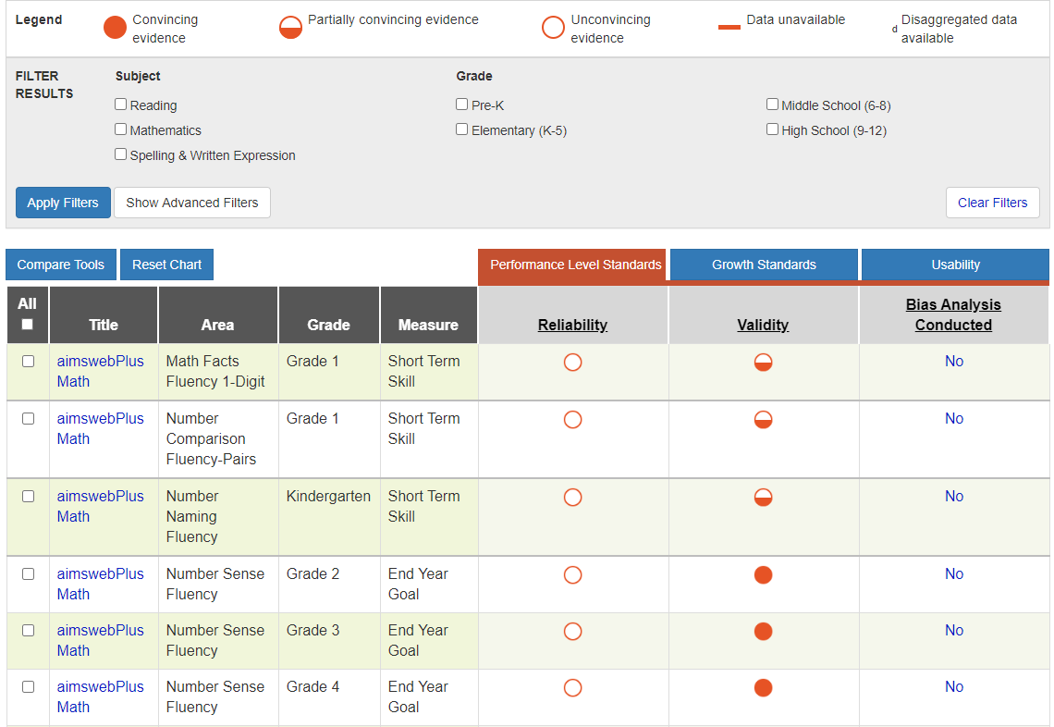
Tiers 1 and 2 Resources: Academic and Behavior Assessment and Intervention Tools Charts
Screening Tools Chart
Intervention Tools Chart
Progress Monitoring Tools Chart

Slide 8
3. Start small and focus on one step at a time.
Staff shared: Small-scale implementation allowed them to concentrate on understanding the DBI process and learning how to integrate the process into their instruction.
Leaders shared: Not overcommitting in the early stages of DBI implementation was critical to ensuring that teachers were not overwhelmed or frustrated and to allowing them to experience initial successes.

Slide 9
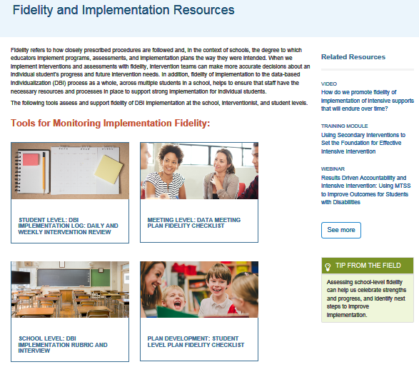
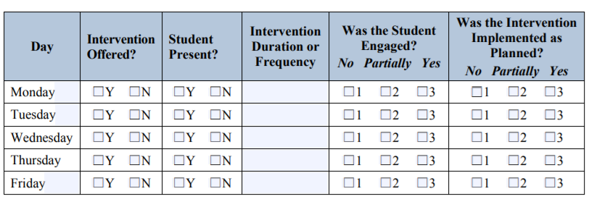
Resources: Monitoring Fidelity
Start by focusing on doing things consistently as designed before scaling up.
Fidelity Resources

Slide 10
4. Use formalized procedures and standard protocols.
Ensure processes are clearly documented (e.g., scripted meeting agendas and clear guidelines).
Provide ongoing professional development to ensure that the knowledge is not placed with a few key individuals and to ensure sustainability when staffing changes.

Slide 11
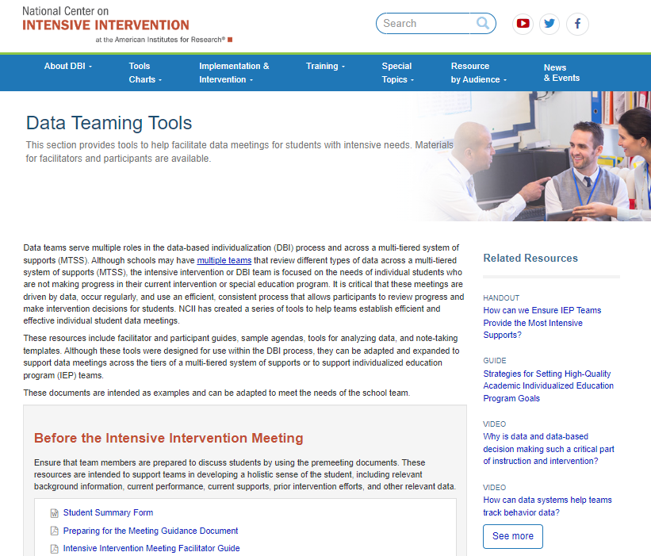
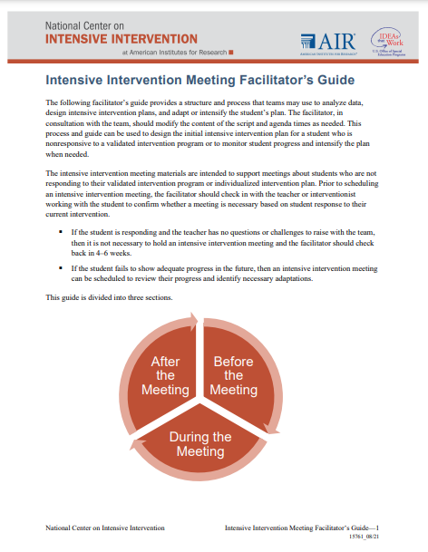
Facilitating Meetings to Review Data
Data Teaming Tools

Slide 12
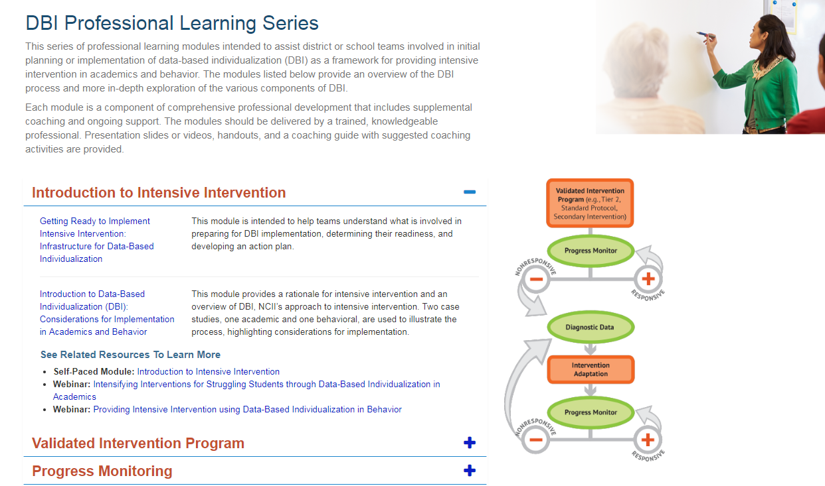
Professional Learning Resources
DBI Training Series
Online Learning Modules

Slide 13
5. Commit to the process.
It is important to commit to implementing the DBI process for an extended period of time and to know that the process will likely be bumpy along the way.
“Data-based decision making is not for wimps . . . You really got to go in knowing that it’s hard work. . . . Once you’ve made that commitment, you can’t just give up. . . . The only answer we’ve found so far is sometimes just going ahead and doing what we need to do and having the people look at the success.”
(Participant of NCII 2012-2016)

Slide 14
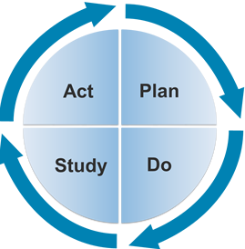
Create a culture of continuous improvement.
“The last piece of advice I would give to an administrator would be to never be satisfied with your school or district’s current level of performance. There is always room for improvement! An effective administrator continuously works with staff to reflect on the successful implementation of MTSS and how to make the system even more efficient and effective for students.”
~Paul Elery, Principal, Harvard Elementary School, Franklin Pierce School District

Slide 15
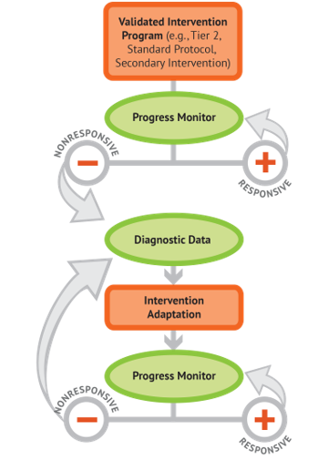
Educator Panel
Introductions
Julie Walker – Director of Elementary Curriculum and Instruction, Bend-LaPine, OR
Shelby Difonzo – Assistant Special Education Director, Fargo, ND
Leslie Anderson – Director of Pupil Personnel Services, East Providence, RI

Slide 16
Thank you!
Thank you to our panel members!
Thank you to all of you for joining us today!

Slide 17
Stay Up to Date with NCII
NCII’s website www.intensiveintervention.org has a wealth of resources to support this process!

Slide 18
NCII Contact Information

