Slide 1
Now That Your Supply Shelf Is Full, Let’s Promote Progress!
August 3, 2023

Slide 2
Thank You

Slide 3
Implementing High-Quality Educational Programming
Ongoing Teaming
Progress
Family Engagement
Effective Instruction
Educator Support
Belonging

Slide 4
How Can We Start the School Year Promoting Progress?
Bart Lyman
Nicolette Lesniak
Pamela White
School Psychologist and Professional Development Coordinator
Wyoming BOCES
Intensive Needs Teacher
Exceptional Student Services Instructional Support Specialist and Program Facilitator

Slide 5
Post Event Information
Missed a session? All sessions except the networking opportunities were recorded and will be posted on the PROGRESS Center website.
Need a certificate of attendance? A certificate will be sent to all participants who indicated in registration that they would like a certificate. The certificate will represent the total amount of time you participated in the event.

Slide 6
Where can I find all the resources that were shared?
https://promotingprogress.org/

Slide 7
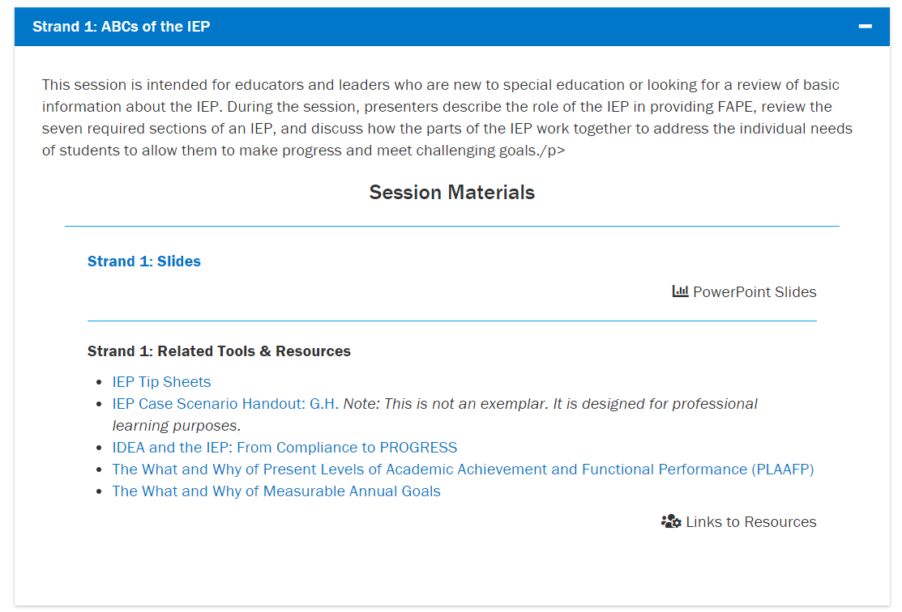
Event Materials
https://promotingprogress.org/news-events/prepping-progress-event-2023

Slide 8
PROGRESS Resources to Support the Development of High-Quality Educational Programming
https://promotingprogress.org/development

Slide 9
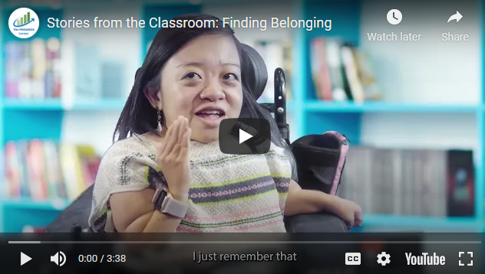
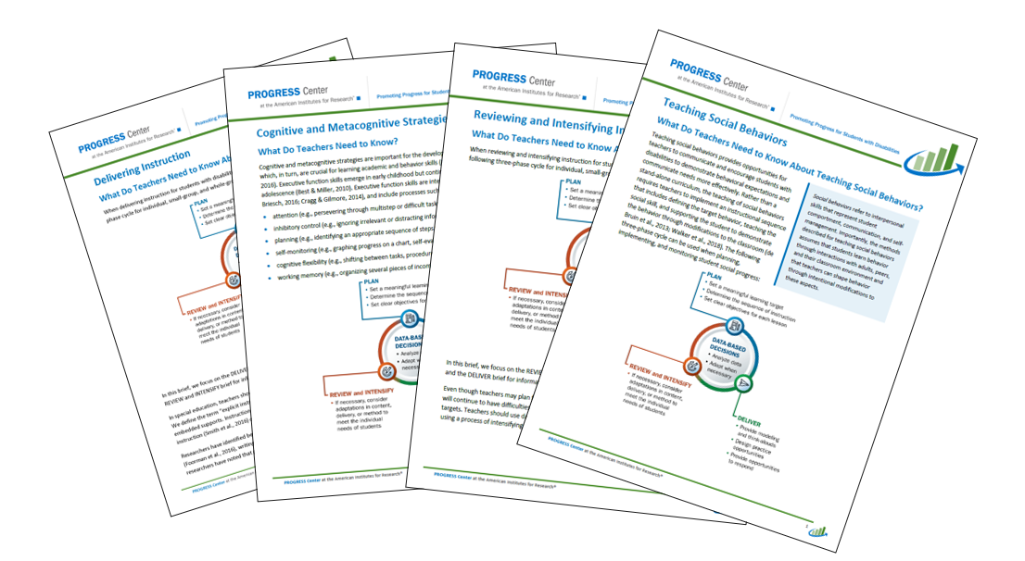
PROGRESS Resources to Support the Implementation of High-Quality Educational Programming
https://promotingprogress.org/implementation

Slide 10
Self-Paced Training Modules
https://promotingprogress.org/training

Slide 11
Staying Connected With the PROGRESS Center
Connect to us on Facebook and Twitter @k12progress
https://promotingprogress.org/news/connect-progress-center
Notes:
If you want to stay up to date, sign up for out newsletter on our home page or follow up on Twitter and Facebook.

Slide 12
Wait, There is More!
Day 3 Schedule: August 4, 2023
11:00 a.m.–12:00 p.m. ET (10:00 a.m. CT/9:00 a.m. MT/8:00 a.m. PT) | General Session
12:00–12:30 p.m. ET (11:00 a.m. CT/10:00 a.m. MT/9:00 a.m. PT) | Break
12:30–1:30 p.m. ET (11:30 a.m. CT/10:30 a.m. MT/9:30 a.m. PT) | Concurrent Sessions
1:30–1:45 p.m. ET (12:30 p.m. CT/11:30 a.m. MT/10:30 a.m. PT) | Break
1:45–2:45 p.m. ET (12:45 p.m. CT/11:45 a.m. MT/10:45 a.m. PT) | Concurrent Sessions (sessions repeated)
2:45–3:00 p.m. ET (1:45 p.m. CT/12:45 p.m. MT/11:45 a.m. PT) | Break
3:00–4:00 p.m. ET (2:00 p.m. CT/1:00 p.m. MT/12:00 p.m. PT) | Closing Session

Slide 13
All about Data-based Individualization
General Session: Introduction to Intensive Intervention
Concurrent Sessions:
Using the Taxonomy of Intervention Intensity to Select, Design, and Intensify Intervention
Using Academic Progress Monitoring for Individualized Instructional Planning
Using Behavior Progress Monitoring for Individualized Instructional Planning
General Session: Bringing It All Together: Keys to DBI Implementation

Slide 14
Disclaimer
This material was produced under the U.S. Department of Education, Office of Special Education Programs, Award No. H326C190002. David Emenheiser serves as the project officer. The views expressed herein do not necessarily represent the positions or policies of the U.S. Department of Education. No official endorsement by the U.S. Department of Education of any product, commodity, service, or enterprise mentioned in this presentation is intended or should be inferred.

Slide 15
contact
1400 Crystal Drive, 10th Floor
Arlington, VA 22202-3289
202.403.5000
progresscenter@air.org
promotingprogress.org | www.air.org
https://www.facebook.com/k12PROGRESS/
https://twitter.com/K12PROGRESS
Notice of Trademark: “American Institutes for Research” and “AIR” are registered trademarks. All other brand, product, or company names are trademarks or registered trademarks of their respective owners.
This material was produced under the U.S. Department of Education, Office of Special Education Programs, Award No. H326C190002. David Emenheiser serves as the project officer. The views expressed herein do not necessarily represent the positions or policies of the U.S. Department of Education. No official endorsement by the U.S. Department of Education of any product, commodity, service, or enterprise mentioned in this presentation is intended or should be inferred.
XXXXX_MO/22

