Slide 1
Prepping for PROGRESS
Raising Expectations, Access, and Outcomes for Students With Disabilities
August 2, 2023

Slide 2
Welcome

Slide 3
Where are you from?
Share in the Chat!

Slide 4
Welcome to the PROGRESS Center!
The PROGRESS Center provides information, resources, tools, and technical assistance services to support local educators in developing and implementing high-quality educational programs that enable children with disabilities to make progress and meet challenging goals.
HOW WILL WE HELP IMPROVE OUTCOMES FOR STUDENTS WITH DISABILITIES?
Share current research,
policies, guidance, success stories, and experiences from students, parents, educators, and
other stakeholders.
Partner with selected
local educators to develop and implement high-quality educational programs.​
Provide tools, resources, and
training materials for ALL educators, leaders, and families.
Visit us at www.promotingPROGRESS.org to learn more!
≈

Slide 5
How do we ensure that every student is on the path to PROGRESS?
Progress

Slide 6
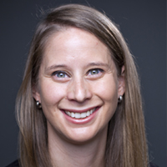
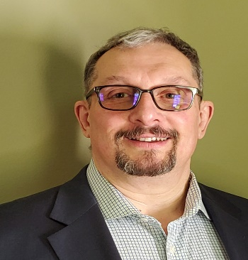
Introductions
Amy Peterson, Senior Researcher, PROGRESS Center Universal Technical Assistance Lead, American Institutes for Research
David Emenheiser, PhD, PROGRESS Center Project Officer, Office of Special Education Programs, U.S. Department of Education

Slide 7
Welcome from David Emenheiser
David Emenheiser, PhD, PROGRESS Center Project Officer, Office of Special Education Programs, U.S. Department of Education

Slide 8
Event Orientation
During the Event you will have the opportunity to:
hear from PROGRESS Center experts and stakeholder panels.
join a strand focused on the ABCs of the IEP or Myth Busting Common Confusions in Special Education network with others working with students with disabilities.
access concurrent sessions focused on preparing educators, SDI in the secondary grades, family engagement, and special education law.

Slide 9
Event Schedule: At A Glance
Day 1 (August 2): Welcome and Strand Sessions
Day 2 (August 3): Keynote and Concurrent Sessions
Day 3 (August 4): Keynote and Concurrent Sessions hosted by the National Center on Intensive Intervention

Slide 10
Today’s Schedule
Day 1 Schedule: August 2, 2023
11:00 a.m.–12:30 p.m. ET (10:00 a.m. CT/9:00 a.m. MT/8:00 a.m. PT) | Welcome & Panel
12:30–1:00 p.m. ET (11:30 a.m. CT/10:30 a.m. MT/9:30 a.m. PT) | Break
1:00–3:45 p.m. ET (12:00 p.m. CT/11:00 a.m. MT/10:00 a.m. PT) | Strand Sessions (break included)
3:45–4:00 p.m. ET (2:45 p.m. CT/1:45 p.m. MT/12:45 p.m. PT) | Break
4:00–4:30 p.m. ET (3:00 p.m. CT/2:00 p.m. MT/1:00 p.m. PT) | Topical Discussions

Slide 11
Day 1: Strand Options
Strand 1: The ABCs of the IEP
Strand 2: Are Accommodations SDI? Myth Busting This and Other Common Confusions in Special Education

Slide 12
Day 2: Concurrent Sessions
Creative Ways to Engage Families and Community Members: Lessons From Co-creating Resources
Prepping Preservice and In-Service Teachers for PROGRESS
Ensuring SDI in Secondary Settings
Providing a Free Appropriate Public Education (FAPE): Lessons From the Due Process Hearing Front
These same sessions will occur from 12:40-1:40 p.m. and 2:00-3:00 p.m., so you can choose to attend 2 of the 4 available sessions live. If you are interested in the other sessions, you can listen to their archived recordings after the event!

Slide 13
Viewing Your Schedule

Slide 14
Joining Sessions

Slide 15
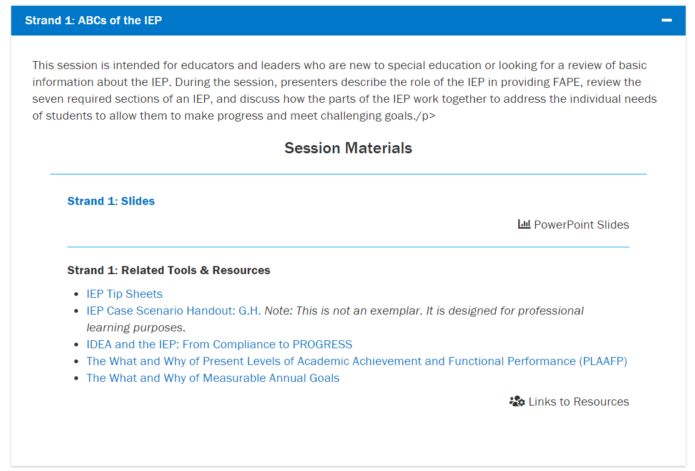
Where can I find event materials and recordings after the event?

Slide 16
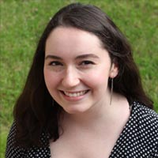
Technical Support
Do you have a question about the technology?
Do you need support in accessing a session?
Do you have questions about accessing materials?
Reach out to Mia Mamone at mmamone@air.org with any challenges! She will do her best to address any needs throughout the event.

Slide 17
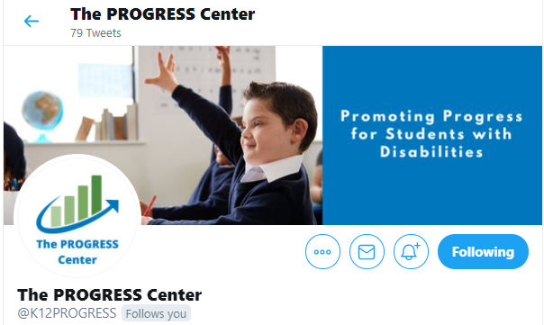
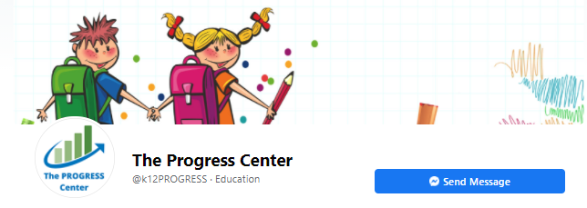
Connect with the PROGRESS Center
Connect with us on Facebook and Twitter @k12progress
Share your learning by using the hashtag #promotingprogress2023

Slide 18
Fostering Belonging to Promote Student Progress

Slide 19
Finding Belonging

Slide 20
What Does it Mean to Belong?
Think about a time when you really felt like you fit in.
Share in the chat some words that described how you felt.

Slide 21
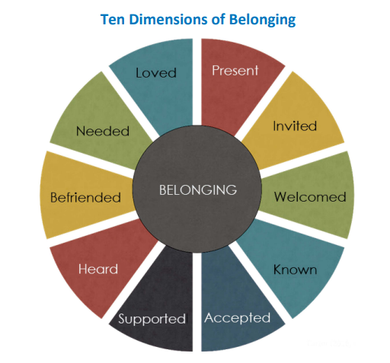
To be…
Carter (2021); Carter & Biggs (2021)

Slide 22
What is Belonging?

Slide 23
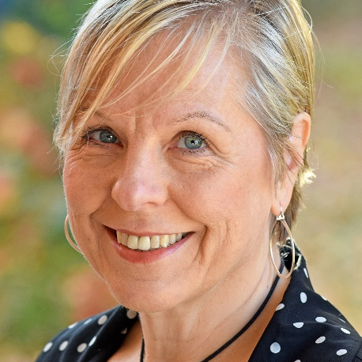
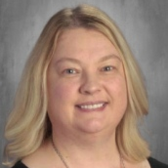
Meet the Presenters
Donna Sacco
Xuan Truong
Dawn DeLorenzo
Jennifer Franks
Senior Technical Assistance Consultant
AIR
Career Counselor Central Piedmont Community College
Special Education Teacher & Teacher Leader
Union Township Middle School
Parent

Slide 24
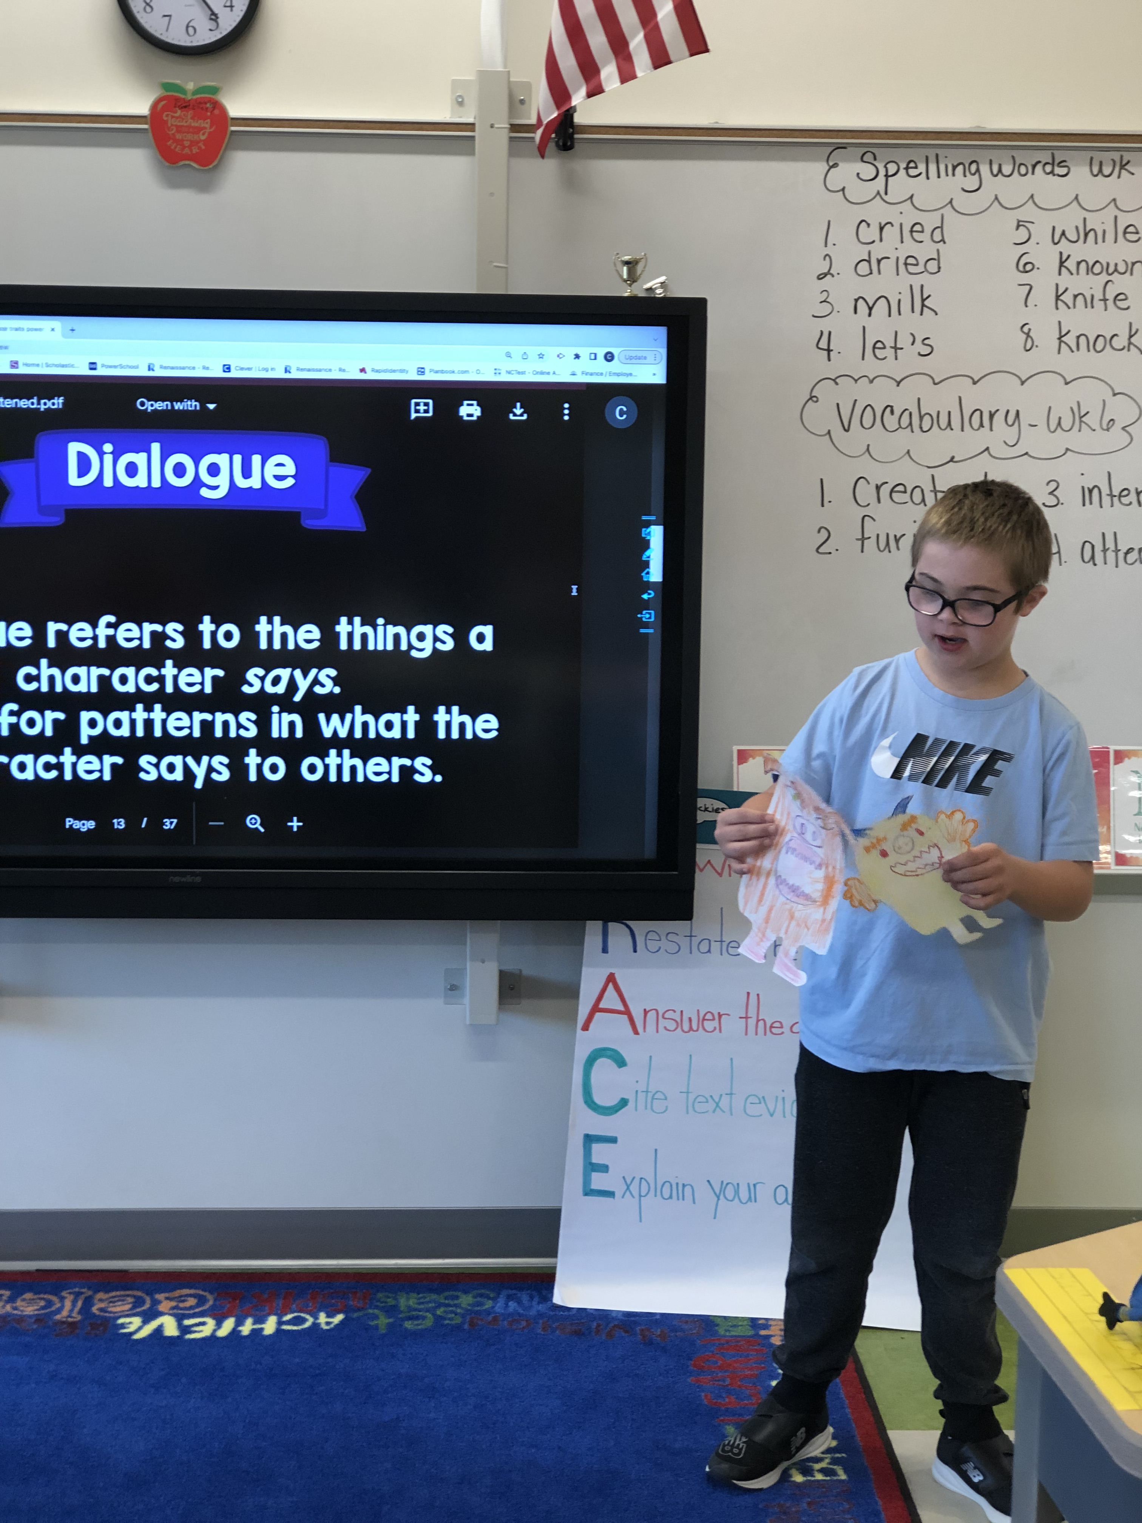
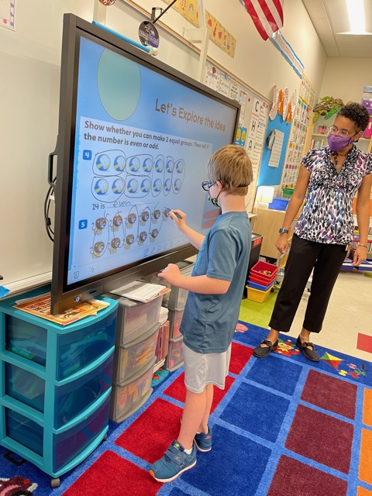
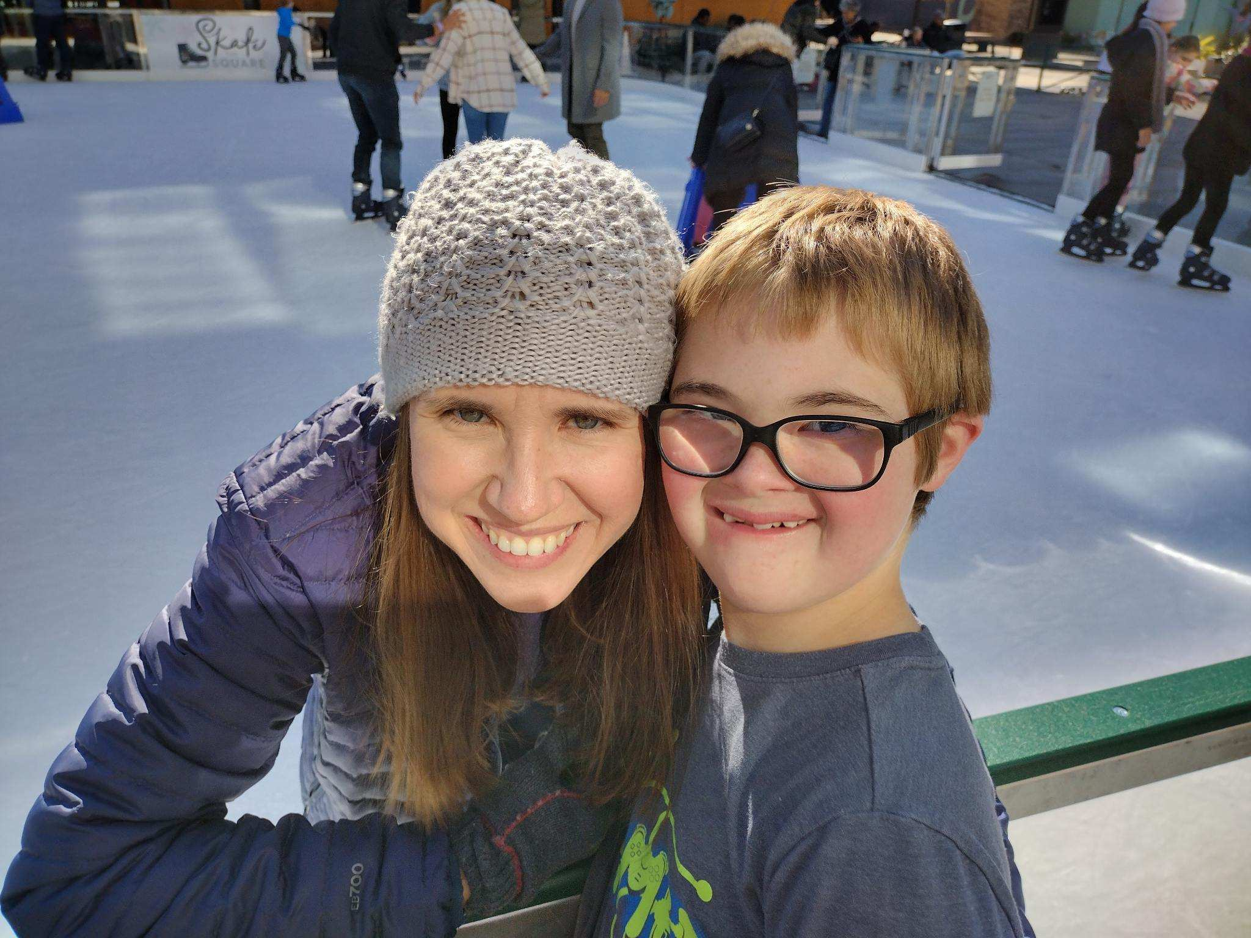
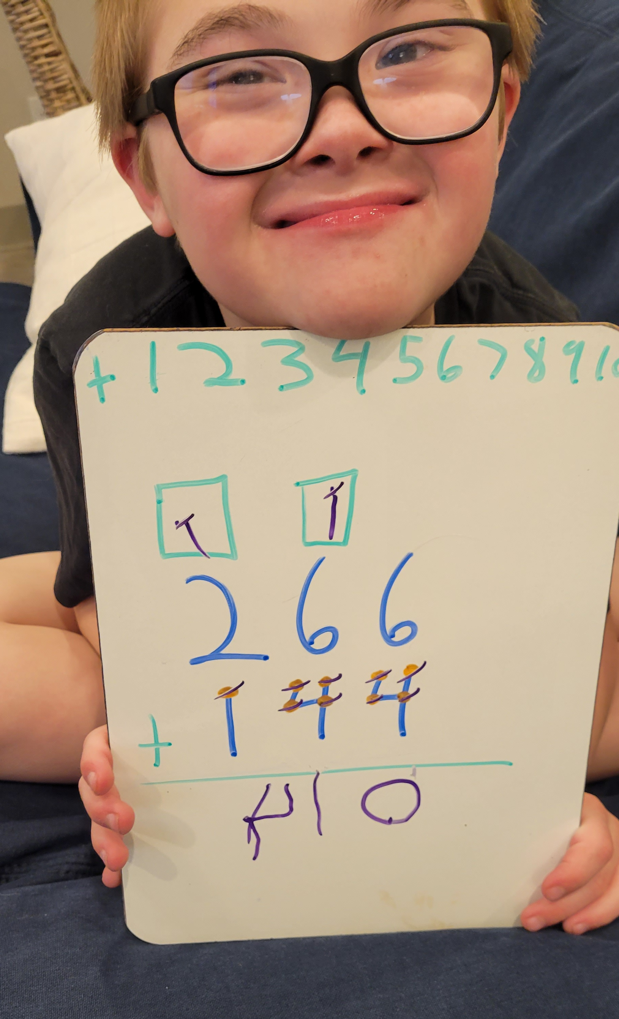
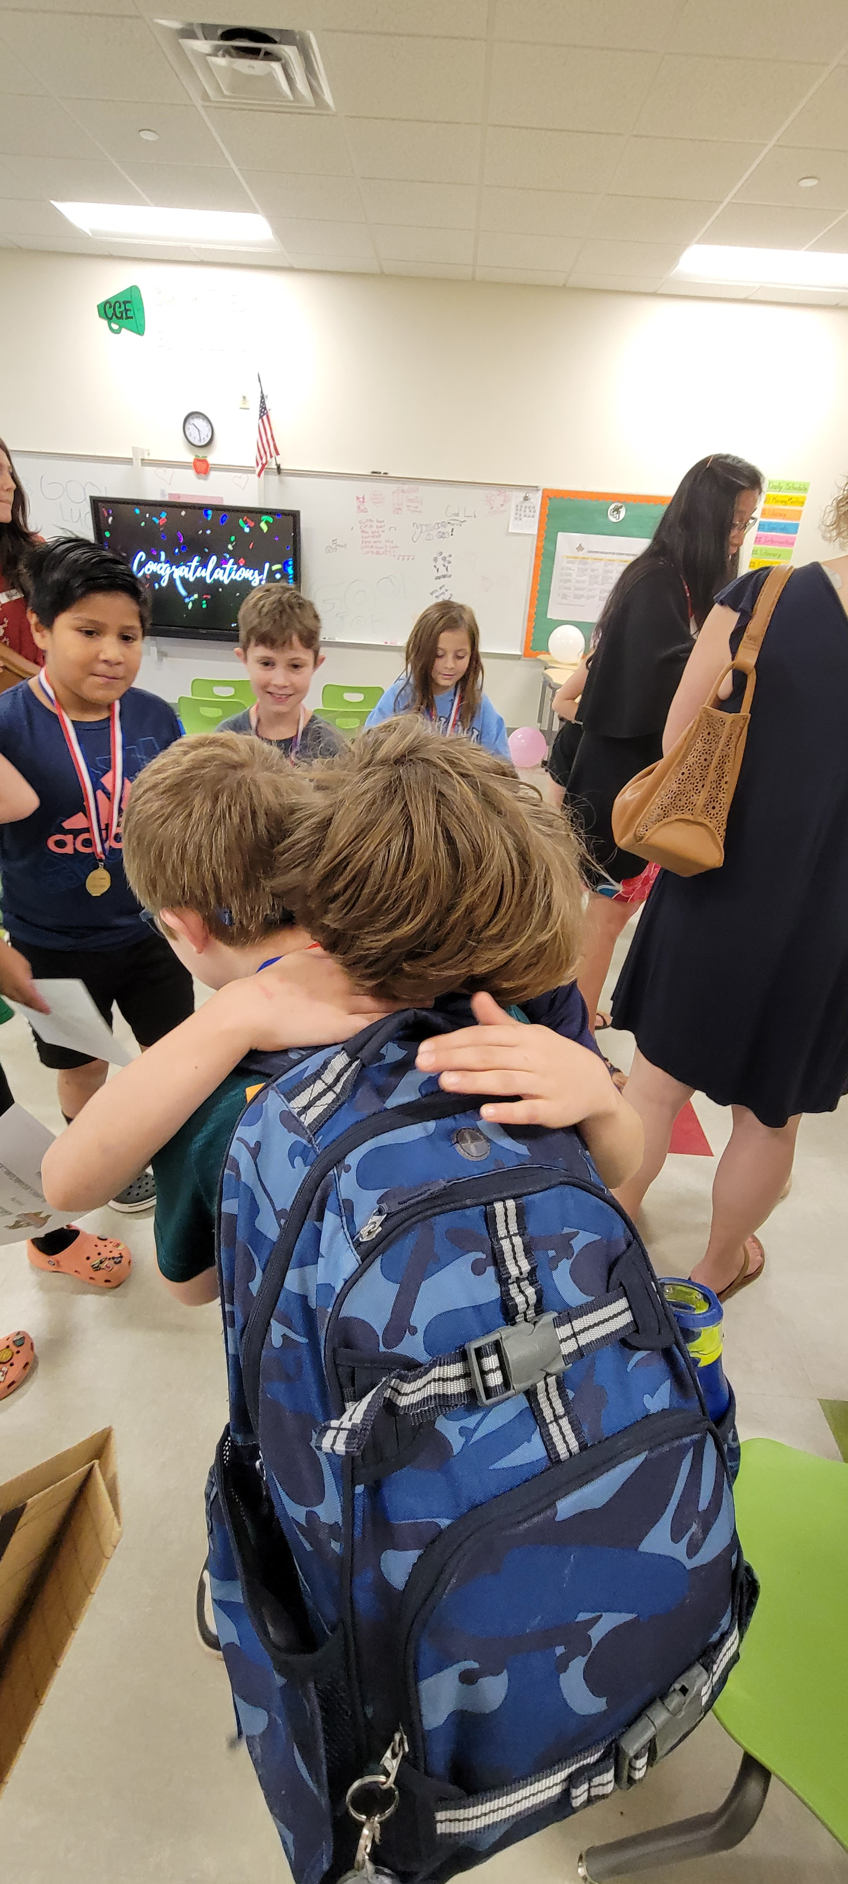
Jennifer & Jackson Franks

Slide 25
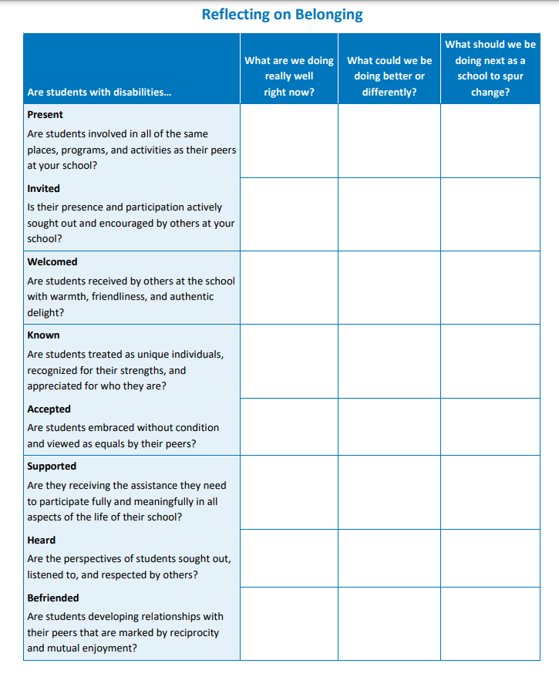
Where Can I Learn More About Belonging?

Slide 26
Don’t Forget!
Day 1 Schedule: August 2, 2023
11:00 a.m.–12:30 p.m. ET (10:00 a.m. CT/9:00 a.m. MT/8:00 a.m. PT) | This Session
12:30–1:00 p.m. ET (11:30 a.m. CT/10:30 a.m. MT/9:30 a.m. PT) | Break
1:00–3:45 p.m. ET (12:00 p.m. CT/11:00 a.m. MT/10:00 a.m. PT) | Strand Sessions (break included)
3:45–4:00 p.m. ET (2:45 p.m. CT/1:45 p.m. MT/12:45 p.m. PT) | Break
4:00–4:30 p.m. ET (3:00 p.m. CT/2:00 p.m. MT/1:00 p.m. PT) | Topical Discussions

Slide 27
Staying Connected With the PROGRESS Center
Connect with us on Facebook and Twitter @k12progress
https://promotingprogress.org/news/connect-progress-center

Slide 28
Reminder! Where can I find event materials and recordings after the event?

Slide 29
References
Carter, E. W. (2021). Dimensions of belonging for individuals with intellectual and developmental disabilities. In A. W. Harrist & S. M. Wilson (Series Eds.), J. L. Jones & K. L. Gallus (Vol. Eds.), Belonging and resilience in individuals with intellectual and developmental disabilities: Community and family engagement (pp. 13-34). Springer.
Carter, E. W., & Biggs, E. E. (2021). Creating communities of belonging for students with significant cognitive disabilities. University of Minnesota, TIES Center. https://publications.ici.umn.edu/ties/peerengagement/belonging/introduction

Slide 30
Disclaimer
This material was produced under the U.S. Department of Education, Office of Special Education Programs, Award No. H326C190002. David Emenheiser serves as the project officer. The views expressed herein do not necessarily represent the positions or policies of the U.S. Department of Education. No official endorsement by the U.S. Department of Education of any product, commodity, service, or enterprise mentioned in this presentation is intended or should be inferred.

Slide 31
PROGRESS Center
progresscenter@air.org
1400 Crystal Drive, 10th Floor
Arlington, VA 22202-3289
202.403.5000
progresscenter@air.org
promotingprogress.org | www.air.org
https://www.facebook.com/k12PROGRESS/
https://twitter.com/K12PROGRESS
Notice of Trademark: “American Institutes for Research” and “AIR” are registered trademarks. All other brand, product, or company names are trademarks or registered trademarks of their respective owners.
This material was produced under the U.S. Department of Education, Office of Special Education Programs, Award No. H326C190002. David Emenheiser serves as the project officer. The views expressed herein do not necessarily represent the positions or policies of the U.S. Department of Education. No official endorsement by the U.S. Department of Education of any product, commodity, service, or enterprise mentioned in this presentation is intended or should be inferred.

