Slide 1
Collaboration Compass
Engaging Parents on a Path to PROGRESS
Nicole Bucka | Stacy Hirt | Alex Marken
August 2022
18714_0714

Slide 2
Meet the Presenters
Stacy Hirt
Alex Marken
Nicole Bucka
AIR
Researcher
AIR
Researcher
Rhode Island Parent &
MTSS Implementation Specialist

Slide 3
Session Outcomes
Increase knowledge and awareness of challenges that families experience in navigating the individualized education program (IEP) process.
Share tools that schools and districts can use to increase family/caregiver knowledge and confidence in how they can support the development and implementation of high-quality educational programs for their child with a disability.
Spotlight how Rhode Island is working with local educators to improve family engagement.

Slide 4
Introduce Yourself!
Poll: What is your current role that led you to this session?
Breakout session: Promoting collaboration
Briefly introduce yourself
Share a strategy that has worked for you to help enhance parent and school collaboration.

Slide 5
Parent Perspectives and Experiences

Slide 6
Parent Perspectives and Experiences

Slide 7
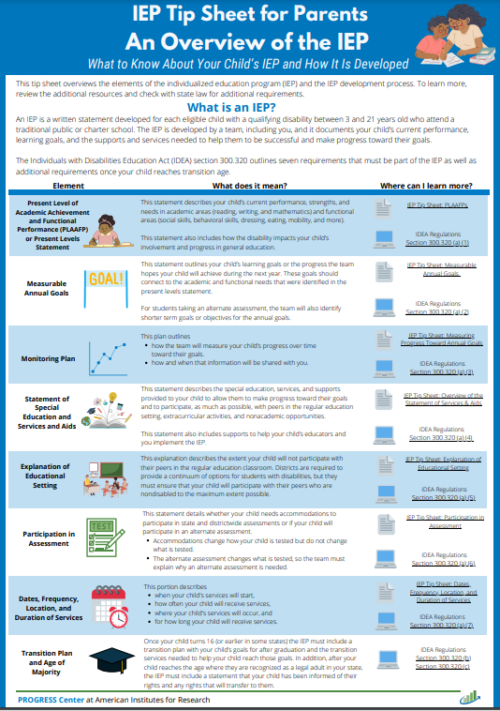
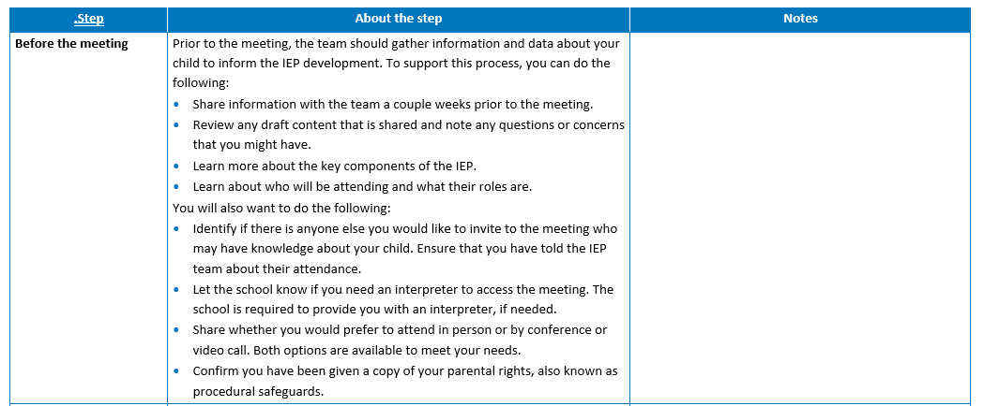
Tools

Slide 8
Promote Meaningful Engagement

Slide 9
Promote Meaningful Engagement: Parent Perspectives
Parents and caregivers (37%) did not feel meaningfully involved in the development of their child’s IEP, describing opportunities to ask questions and offer suggestions as the IEP team discussed goals, supports, and student needs (n = 32).

Slide 10
Promote Meaningful Engagement: Parent Quote
“I received test scores twice per year as per the testing requirements, each quarter for the IEP report card, and then monthly with attached data charts to support info in the written narrative.”

Slide 11
Promote Meaningful Engagement: Tips for PROGRESS
Communicate and collaborate often! The IEP meeting should not be the only time that the team collaborates with parents.
Ask for parent input! A couple of weeks prior to an IEP meeting, the team should reach out to ask the parent for information about their child that can be used to support the IEP development.
Ensure parents are ready to participate. Prior to the IEP meeting, designate at least one teacher to reach out to the parent and provide an overview of the meeting structure. They can meet and review the proposed agenda and roles and address any questions the parents might have.

Slide 12
IEP Tip Sheet for Parents: The IEP Team

Slide 13
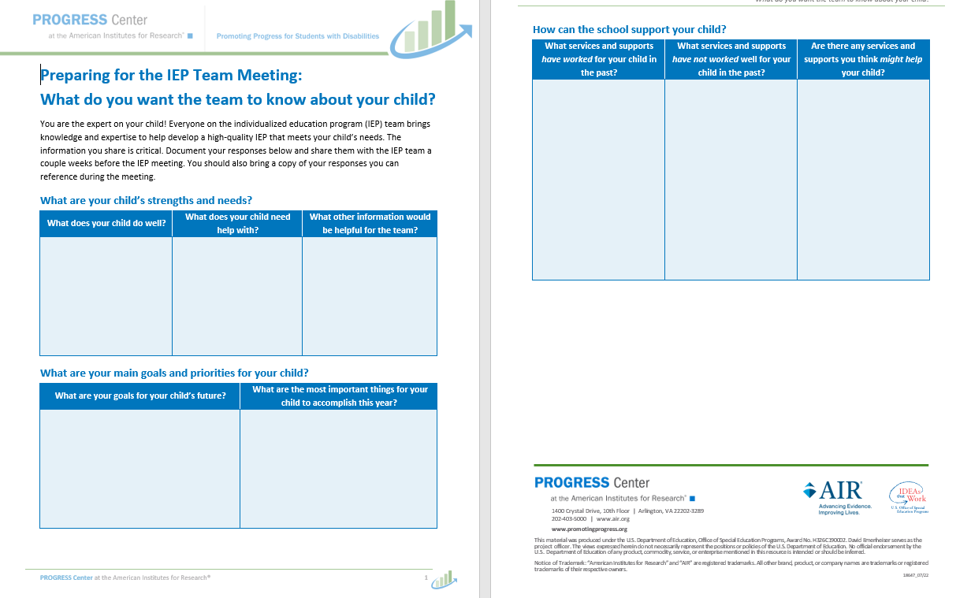
IEP Team resources

Slide 14
Stories From the Classroom

Slide 15
Engage Families in Determining Individualization of Supports

Slide 16
Engage Families in Determining Individualization of Supports: Parent Perspectives
Less than half (43%) of the parents and caregivers found the academic, behavioral, and social-emotional supports their child received facilitated school success (n = 30).

Slide 17
Engage Families in Determining Individualization of Supports: Parent Quotes
“I would agree that the school does not understand his disability and does not have appropriate methodologies to meet his needs.”
“Special education isn’t meant to be a lifelong sentence. It is support services to build and improve skill deficits. Students should exit special education; special education is too focused on being compliant for procedures versus providing FAPE [free appropriate public education].”

Slide 18
Engage Families in Determining Individualization of Supports: Tips for PROGRESS
Ask parents/caregivers what services and supports have worked for their child in the past.
Ask parents/caregivers what did not work.
Ask parents/caregivers for suggested services that the team might try.
Help families understand how services are individualized and designed based on their child’s unique needs.
Source: Placeholder for sources and permissions (if needed).

Slide 19
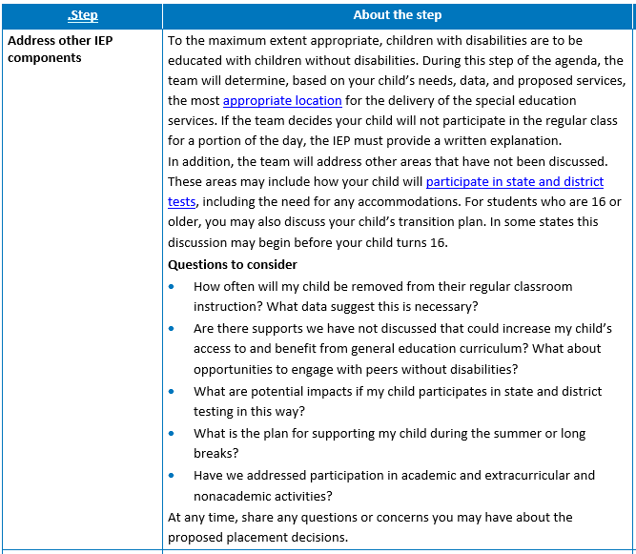
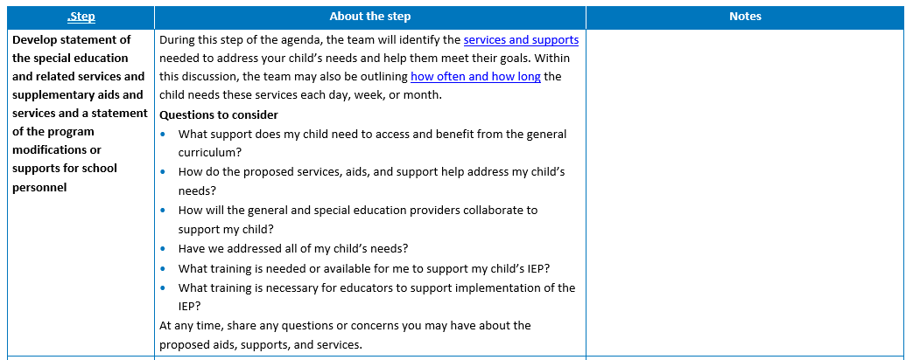
IEP Team Resources Continued

Slide 20
Overview of the Statement of Services and Aids

Slide 21
Provide Regular and Meaningful Access to Progress Data

Slide 22
Provide Regular and Meaningful Access to Progress Data: Parent Perspective
Less than 34% of the respondents shared they regularly received data about their child’s progress toward IEP goals (n = 32).

Slide 23
Provide Regular and Meaningful Access to Progress Data: Parent Quote
“Progress monitoring was lacking, and it was often anecdotal or observational.”

Slide 24
Provide Regular and Meaningful Access to Progress Data: Tips for PROGRESS
Establish a standardized schedule for updating parents that outlines the format and frequency data sharing.
Ensure that parents understand how the data are being shared and what the data mean.
Source: Placeholder for sources and permissions (if needed).

Slide 25
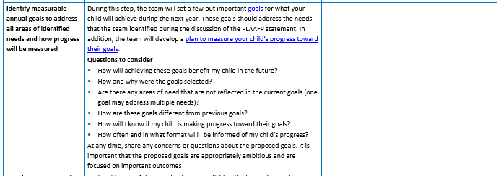
IEP Team Meeting Guide resource

Slide 26
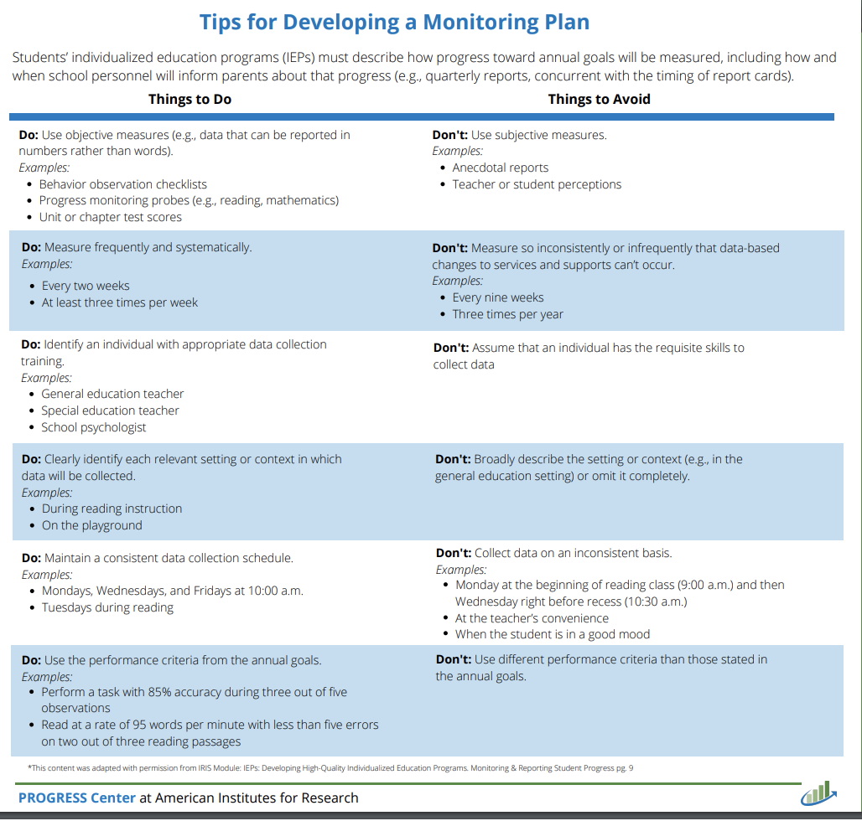
Monitoring Plan Resources

Slide 27
Rhode Island
Spotlight

Slide 28
BRIDGE-RI
Rhode Island’s Educator Professional Learning Platform

Slide 29
BRIDGE-RI

Slide 30
PACER videos

Slide 31
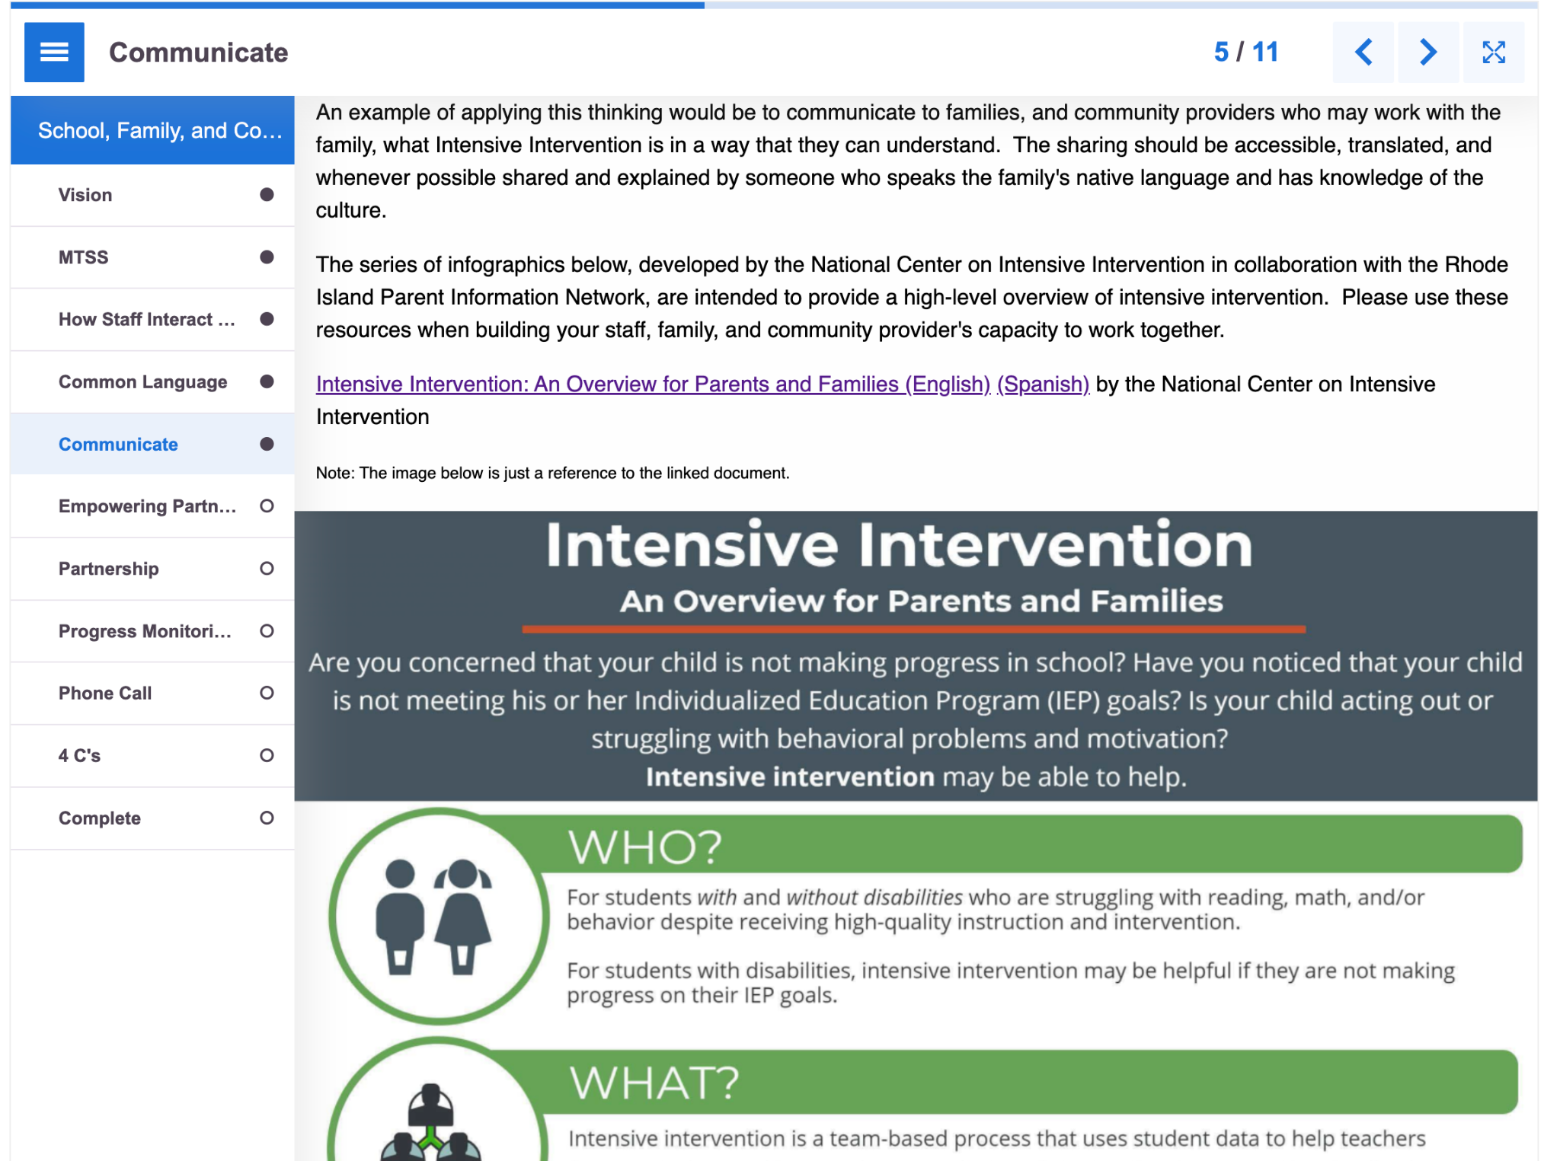
Intensive Intervention resource

Slide 32
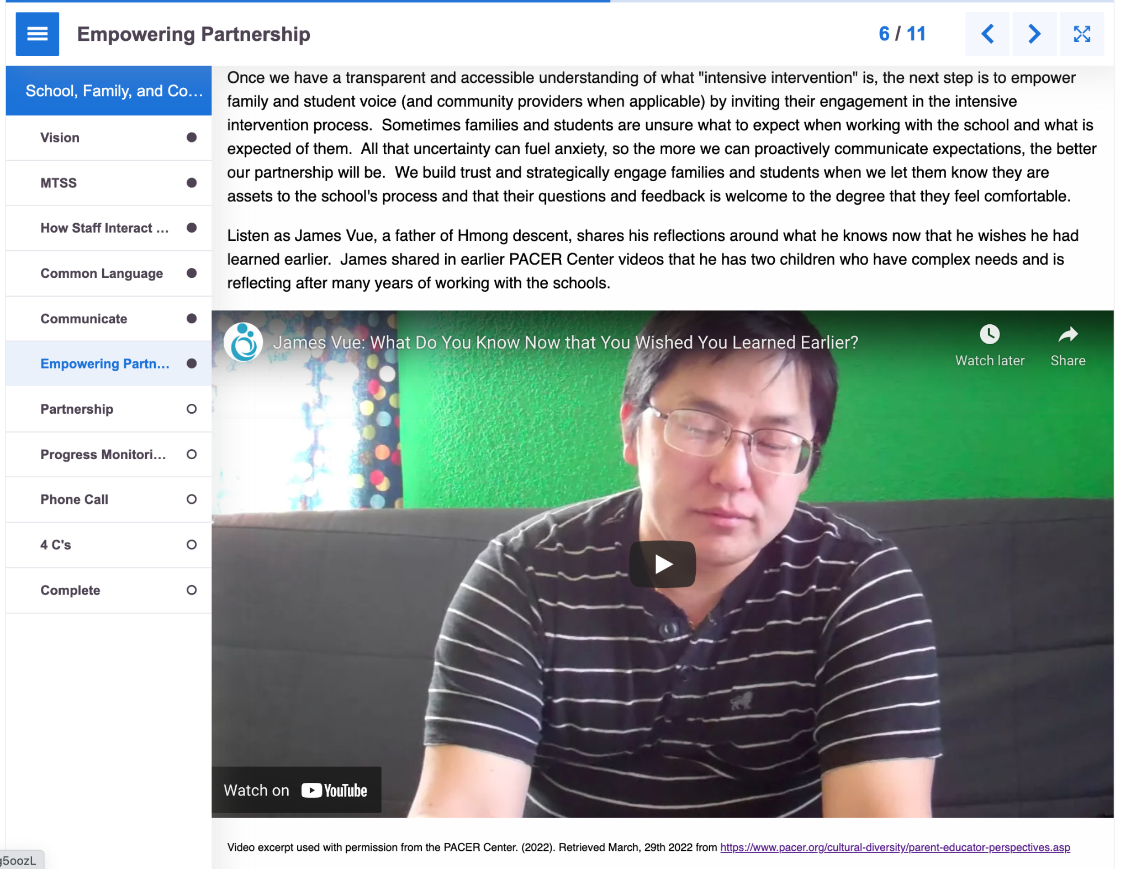
PACER videos continued

Slide 33
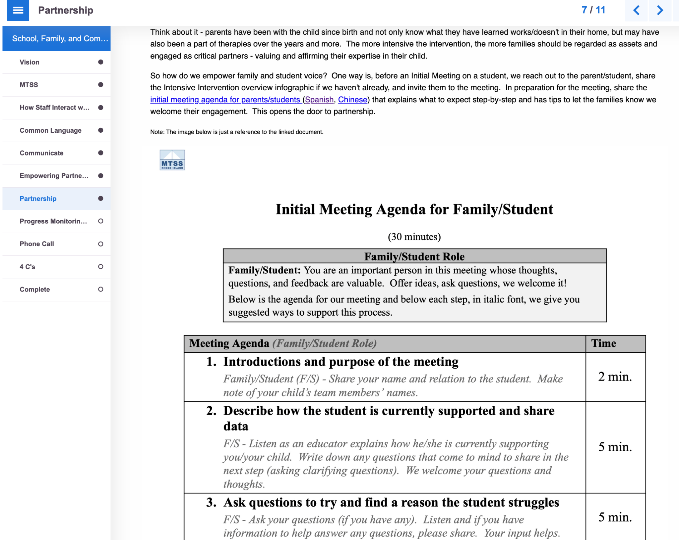
Family/Student Initial Meeting resource

Slide 34
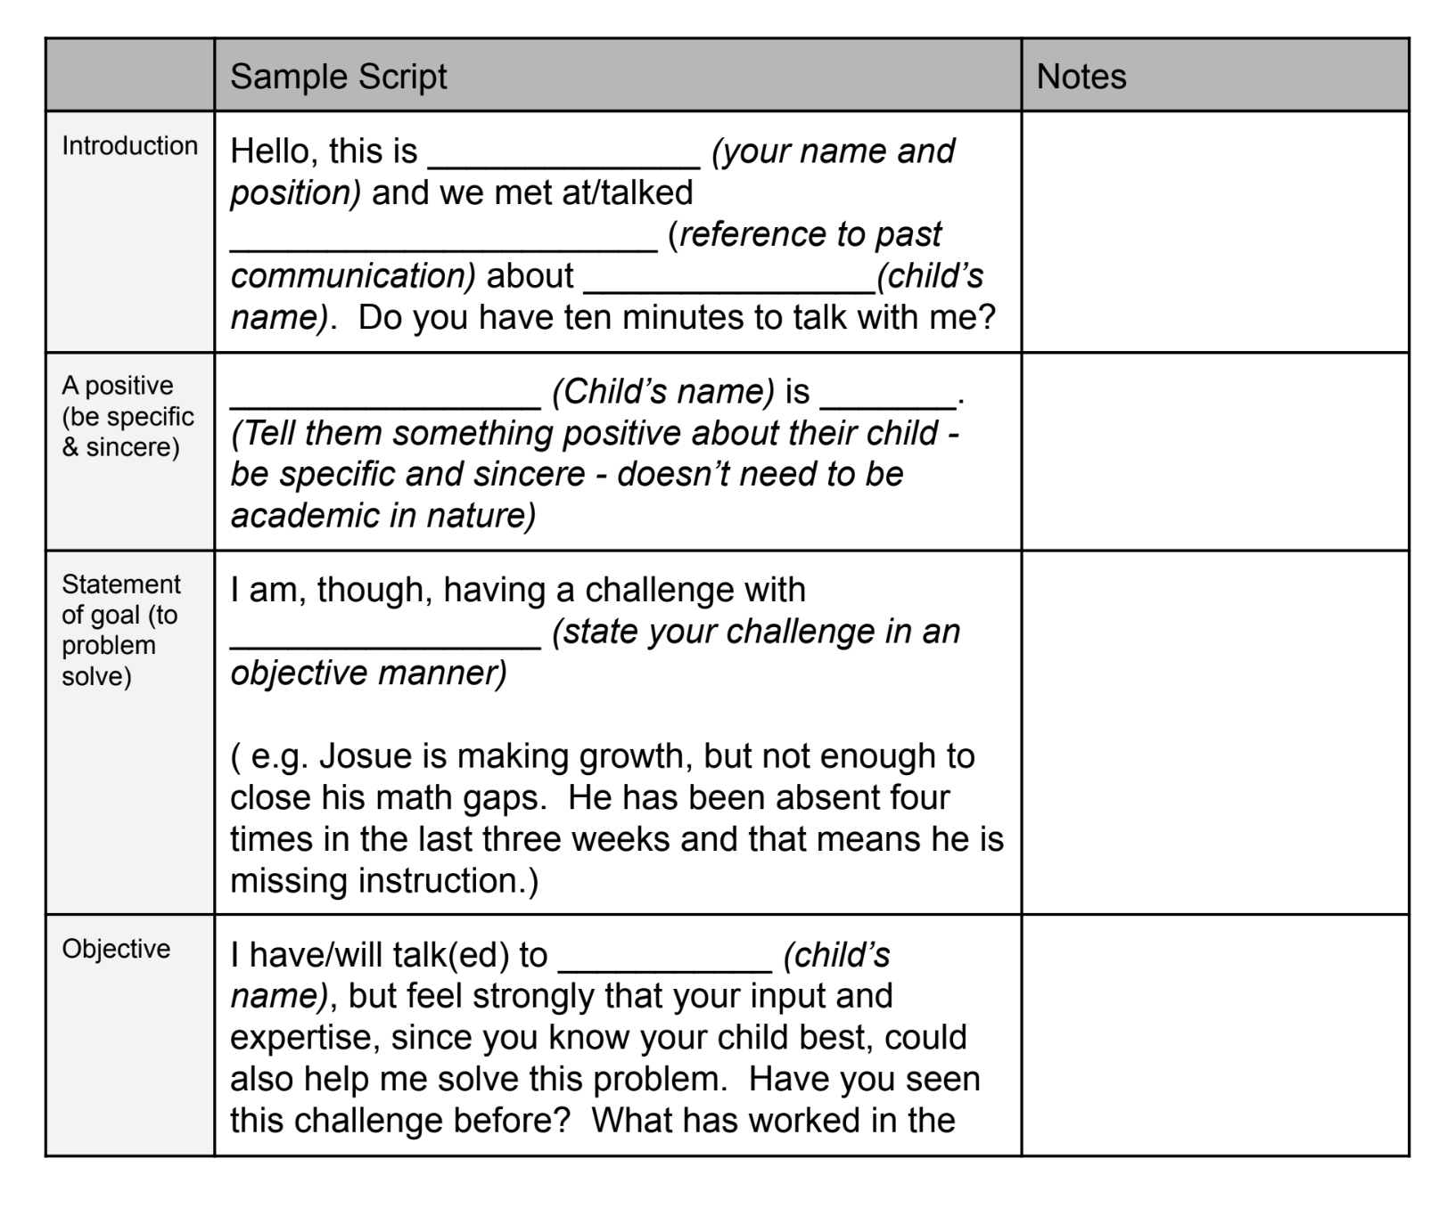
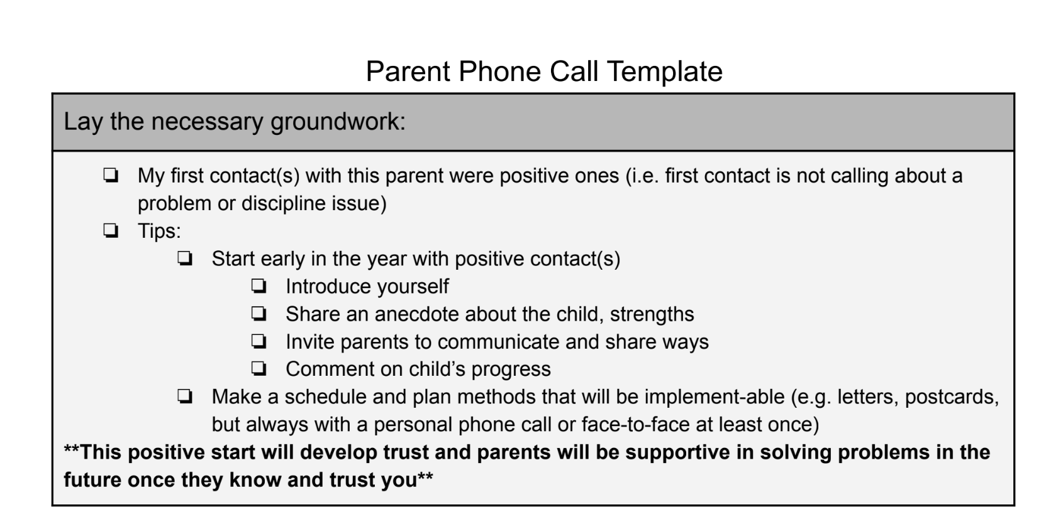
Parent phone call template

Slide 35
Questions

Slide 36
Additional Resources

Slide 37
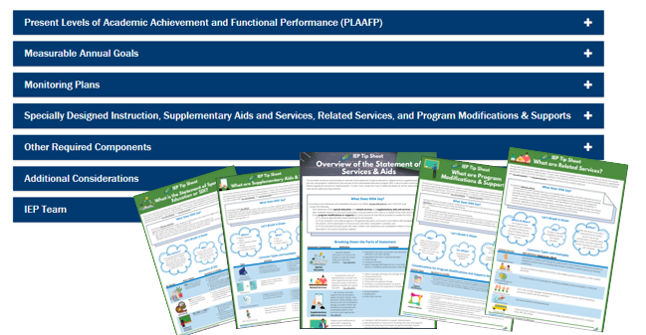
PROGRESS Center Resources to Support the Development of High-Quality Educational Programming

Slide 38
Find Your Parent Center
Center for Parent Information and Resources: www.parentcenterhub.org

Slide 39
Staying Connected With the PROGRESS Center
Connect with us on Facebook and Twitter @k12progress.
https://promotingprogress.org/news/connect-progress-center

Slide 40
Disclaimer
This material was produced under the U.S. Department of Education, Office of Special Education Programs, Award No. H326C190002. David Emenheiser serves as the project officer. The views expressed herein do not necessarily represent the positions or policies of the U.S. Department of Education. No official endorsement by the U.S. Department of Education of any product, commodity, service, or enterprise mentioned in this presentation is intended or should be inferred.

Slide 41
Contact
1400 Crystal Drive, 10th Floor
Arlington, VA 22202-3289
202.403.5000
progresscenter@air.org
promotingprogress.org | www.air.org
https://www.facebook.com/k12PROGRESS/
https://twitter.com/K12PROGRESS
Notice of Trademark: “American Institutes for Research” and “AIR” are registered trademarks. All other brand, product, or company names are trademarks or registered trademarks of their respective owners.
This material was produced under the U.S. Department of Education, Office of Special Education Programs, Award No. H326C190002. David Emenheiser serves as the project officer. The views expressed herein do not necessarily represent the positions or policies of the U.S. Department of Education. No official endorsement by the U.S. Department of Education of any product, commodity, service, or enterprise mentioned in this presentation is intended or should be inferred.
18714_07/22

