Slide 1
Did We Do What We Said We Would?
Why Developing a High-Quality IEP Isn’t Enough!
Steven Prater, Amy Peterson, and Aleksis Kincaid
August 2022
18713_07/22

Slide 2
Meet the Presenters
Steven Prater
Aleksis Kincaid
Amy Peterson
PROGRESS Center
Intensive Technical Assistance Co-Lead
PROGRESS Center
Knowledge Development Researcher
PROGRESS Center
Universal Technical Assistance Lead

Slide 3
Session Outcomes
Participants will be able to do the following:
Explain the importance of fidelity of implementation in providing free appropriate public education (FAPE).
Describe the five elements of fidelity.
Identify resources to aid in developing and implementing high-quality educational programming and monitoring fidelity.

Slide 4
Identifying Our Purpose
Why do we do what we do? Drop it in the chat!
What drew you to supporting students with disabilities?
What do you want for your students?

Slide 5
Why Do We Do What We Do? Linking Purpose to Law
The primary requirement of the Individuals with Disabilities Education Act (IDEA) and the crucial obligation for special education administrators and teachers is to provide a special education that confers FAPE.

Slide 6
IDEA FAPE Requirements
Procedural
In the development of an individualized education program (IEP), has the IEP team complied with the procedures set forth in IDEA? (Rowley)
Substantive
Is the IEP reasonably calculated to enable the child to make progress that is appropriate in light of the child’s circumstances? (Endrew F.)
Implementation
In implementing the IEP, were the instructional services and supports outlined in the IEP provided as agreed on during the IEP process?
FAPE Requirements

Slide 7
Implementation
In failure to implement cases, parents have asserted that a school district has denied FAPE, based on the claim that the school district failed to partially or fully implement their child’s IEP.
“An IEP, like a contract . . . embodies a binding commitment and provides notice to both parties as to what services will be provided to a student” (M.C. v. Antelope Union School District, 2017, p. 1197).

Slide 8
FAPE and Implementation: Breaking Down Findings From Case Law
Fidelity of Implementation
Capacity to Implement

Slide 9
Development times implementation equals improved access and outcomes
Development of high-quality educational programming
Implementation of high-quality educational programming
Improved access and outcomes: FAPE

Slide 10
Chatterfall
What is one word you think of when you think of fidelity?
Type your answer in the chat but don’t press enter until we say Go.

Slide 11
Why Is Fidelity Important?

Slide 12
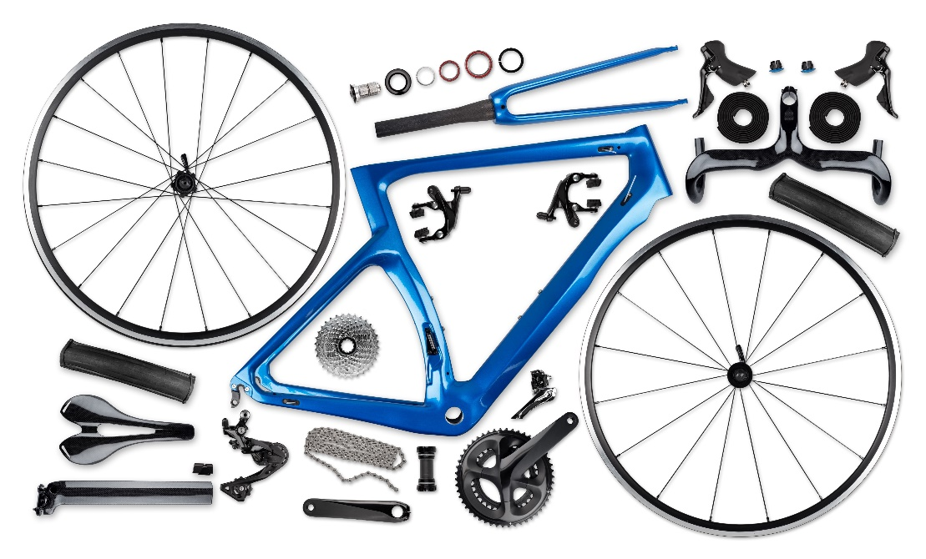
Fidelity Considerations Within Special Education
In the development of an IEP, has the IEP team complied with the procedures set forth in IDEA?
In our instructional programming, have we implemented the instruction as designed?

Slide 13
Five Elements of Fidelity
Adherence
Exposure
Quality of Delivery
Program Specificity
Student Engagement

Slide 14
Breakout Discussion
Review the Considerations for Effective Implementation: 5 Elements of Fidelity from the National Center on Intensive Intervention.
Discuss the following questions in small groups:
How have you accounted for these elements of fidelity within the context of implementing IEPs/interventions in special education?
Which of the five elements pose the most challenge and why?
Share takeaways with the larger group.

Slide 15
Resources to Support Development and Implementation With Fidelity

Slide 16
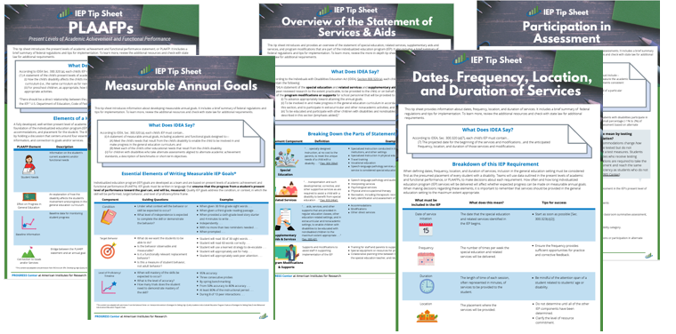
IEP Tip Sheets

Slide 17
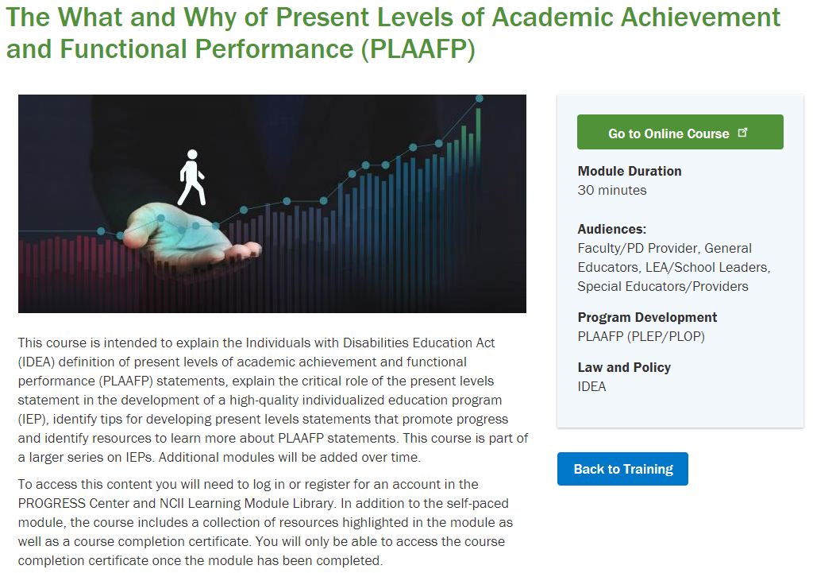
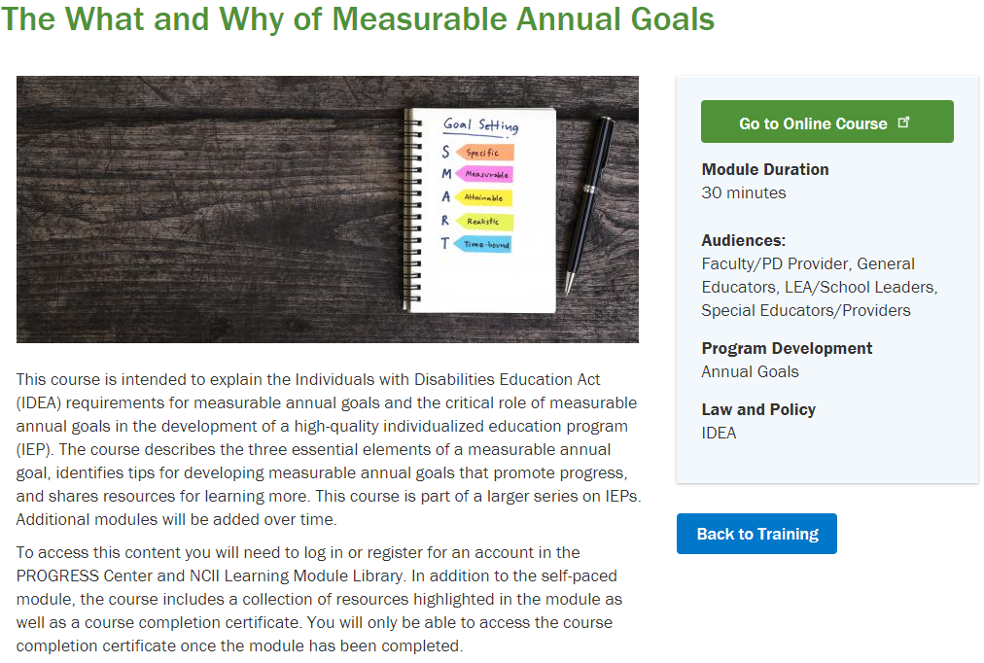
Online Modules

Slide 18
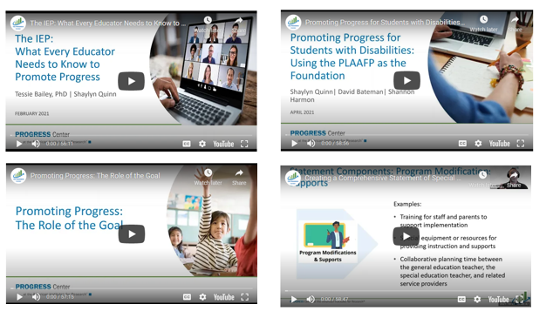
Webinars

Slide 19
Resources to Support Development and Implementation With Fidelity 2

Slide 20
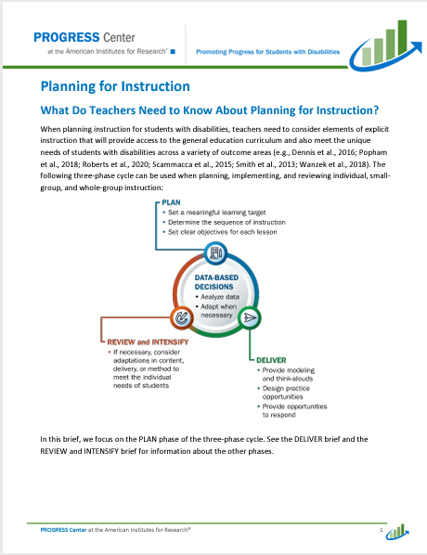
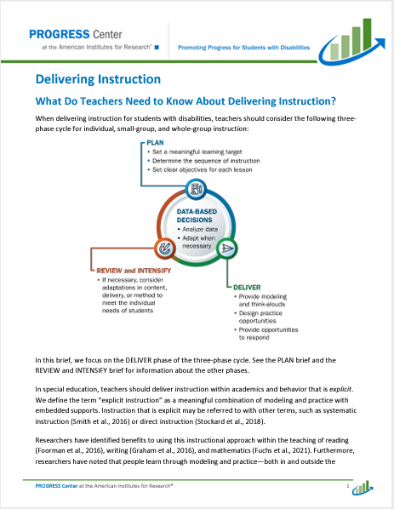
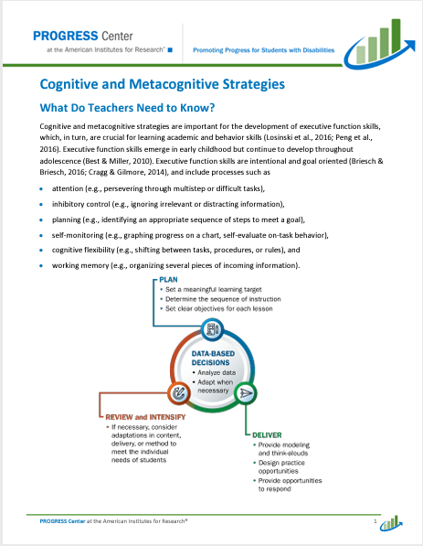
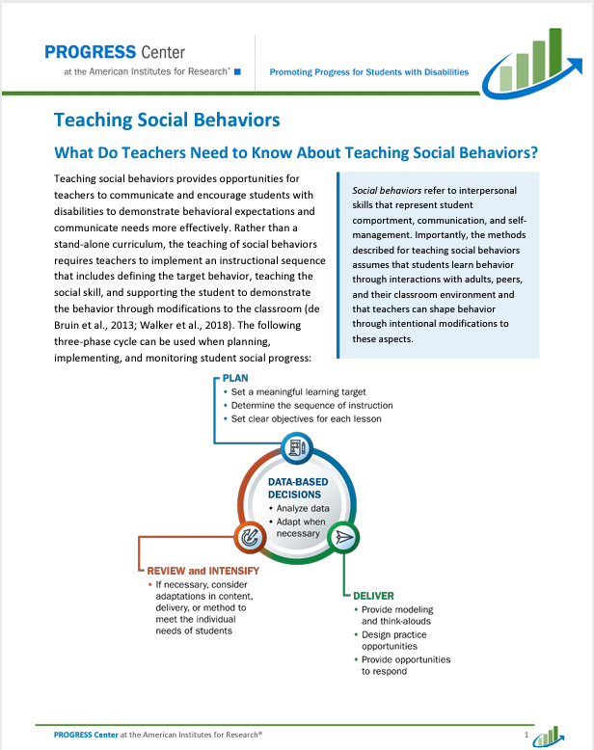
Instructional Practice Briefs
The briefs highlight six evidence-based, high-leverage practices.
An extensive and systematic meta-analysis identified these practices.
A three-phase cycle was used for planning, delivering, reviewing, and intensifying individual, small-group, and whole-group instruction.

Slide 21
Belonging
Students learn best and are the most successful when they are welcomed and feel a sense of belonging at school. Belonging is experienced when students are present, invited, welcomed, known, accepted, involved, supported, heard, befriended, and needed.

Slide 22
How Do We Know If We Have Implemented With Fidelity?

Slide 23
Monitoring Fidelity—Examples
Element | Data source examples
Adherence | Self-report, observation checklist, and teaching logs/lessons
Duration/exposure | Self-report, observation, and attendance records
Quality of delivery | Observation, reflection, and self-report on techniques used
Program specificity | Intervention component checklist
Student engagement | Student progress, student survey, and observation
Sources: Dane & Schneider (1998); Mellard & Johnson (2008); O’Donnell (2008).

Slide 24
Tools to Monitor Fidelity: Keep It Simple!

Slide 25
How Do We Use Fidelity Data Within Decision Making?
Ensures that instruction has been implemented as intended.
Allows us to link student outcomes to instruction.
Helps in determining intervention effectiveness and instructional decision making.
Helps in understanding systemic barriers that may be impacting implementation fidelity.
Source: Pierangelo & Giuliani (2008).

Slide 26
Fidelity data can help us consider development and implementation across multiple levels.​
Educator
Student
System

Slide 27
Reminder! Development times implementation equals improved access and outcomes
Development of high-quality educational programming
Implementation of high-quality educational programming
Improved access and outcomes: FAPE

Slide 28
References
Barwick, M. (2014). Fidelity and implementation [video]. https://youtu.be/n0fQxh74OOk ​
Dane, A. V., & Schneider, B. H. (1998). Program integrity in primary and early secondary prevention: Are implementation effects out of control? Clinical Psychology Review, 18, 23–24.​ https://doi.org/10.1016/s0272-7358(97)00043-3
Mellard, D. F., & Johnson, E. (2008). RTI: A practitioner’s guide to implementing response to intervention. Corwin Press.​
O’Donnell, C. L. (2008). Defining, conceptualizing, and measuring fidelity of implementation and Its relationship to outcomes in K–12 curriculum intervention research. Review of Educational Research, 78(1), 33–84.​ https://doi.org/10.3102/0034654307313793
Pierangelo, R., & Giuliani, G. (2008). Teaching students with learning disabilities: A step-by-step guide for educators. Corwin Press.

Slide 29
Contact
1400 Crystal Drive, 10th Floor
Arlington, VA 22202-3289
202.403.5000
progresscenter@air.org
promotingprogress.org | www.air.org
https://www.facebook.com/k12PROGRESS/
https://twitter.com/K12PROGRESS
18713_07/22

Slide 30
Disclaimer
This material was produced under the U.S. Department of Education, Office of Special Education Programs, Award No. H326C190002. David Emenheiser serves as the project officer. The views expressed herein do not necessarily represent the positions or policies of the U.S. Department of Education. No official endorsement by the U.S. Department of Education of any product, commodity, service, or enterprise mentioned in this presentation is intended or should be inferred.

