Slide 1
Expanding Your Toolbox for Preparing Educators to Promote Progress!
Donna Sacco, Riley O’Donnell, Steven Prater, Clare Merlin-Knoblich, and Alex Marken
August 2022
18779_07/22

Slide 2
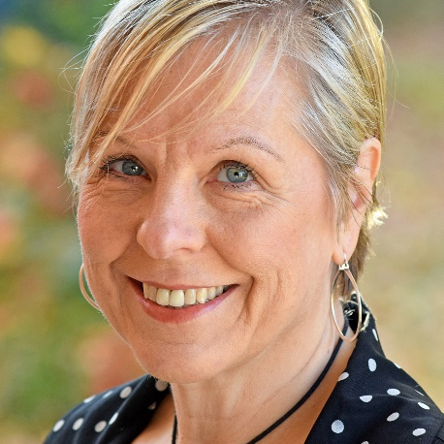
Meet the Team
Donna Sacco
Riley O’Donnell
Steven Prater
Alex Marken
Presenter PROGRESS Center
Senior Technical Assistance Consultant
Presenter
PROGRESS Center
Research Assistant
Presenter
PROGRESS Center
Senior Technical Assistance Consultant
Technical Support for Session
PROGRESS Center
Researcher

Slide 3
Introduce Yourself!
In the chat, please give your name, role, and where you are from.
Name
Role
Where you are from

Slide 4
Agenda
Welcome
Challenge One: Connection Between Development and Implementation
Challenge Two: Connections Across Seven Components of the IEP
Break [20 minutes]
Challenge Three: Asynchronous v. Synchronous Learning
Challenge Four: Facilitating Conversations About Development and Implementation of High-Quality IEPs
Closing

Slide 5
Collective Teacher Efficacy
It is the collective belief of educators in their ability to positively affect students, including students with disabilities.
It is built on evidence of impact.
Collective belief that you can make a difference.
Evidence you are making a difference.
ES = 1.57*
×
=
*ES = effect size. Based on work of Eells (2011) and Hattie (2017).

Slide 6
Where Do We Start? Collective Efficacy Starts With the Right Questions!
What do we want for our students, teachers, and families?
What is the current reality and who are the players?
What do our students, teachers, and families need to be successful?
How can we maximize our resources to support students, teachers, and families?

Slide 7
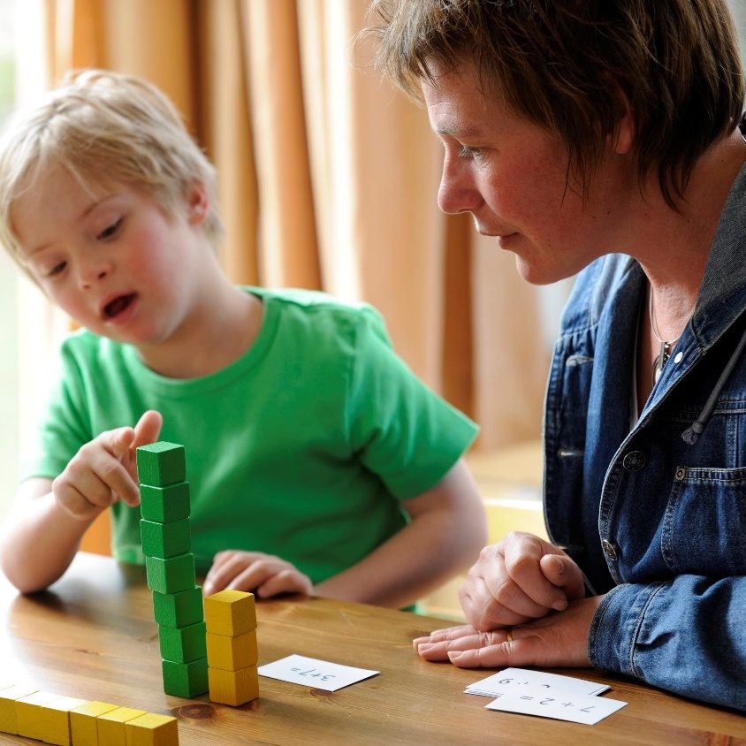
Development times implementation equals FAPE
Development of high-quality educational programming
Implementation of high-quality educational programming
Improved access and outcomes: free appropriate public education (FAPE)

Slide 8
Challenge One!
How do we structure in-service and preservice preparation to help educators see the connection between the development and implementation of high-quality programming provided to students with disabilities?

Slide 9
IDEA FAPE Requirements
Procedural
In the development of an individualized education program (IEP), has the IEP team complied with the procedures set forth in the Individuals with Disabilities Education Act (IDEA)? (Rowley)
Substantive
Is the IEP reasonably calculated to enable the child to make progress that is appropriate in light of the child’s circumstances? (Endrew F.)
Implementation
In implementing the IEP, were the instructional services and supports outlined in the IEP provided as agreed on during the IEP process?
FAPE Requirements

Slide 10
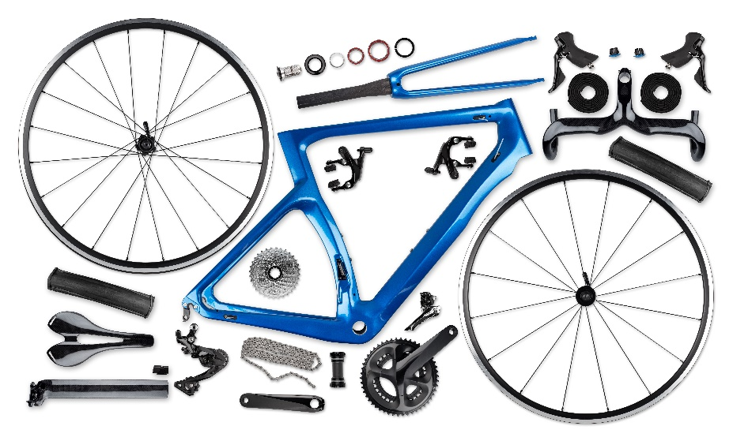
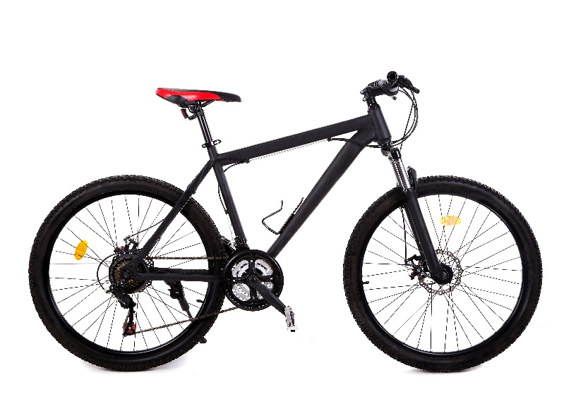
Using an Analogy to Make the FAPE Components Come Alive

Slide 11
PROGRESS Center Home Page
www.promotingPROGRESS.org

Slide 12
Development Tab

Slide 13
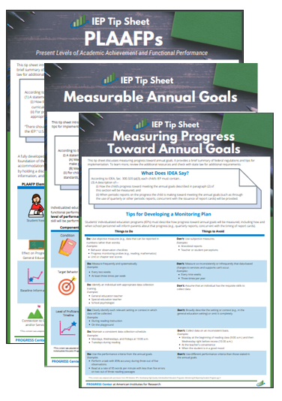
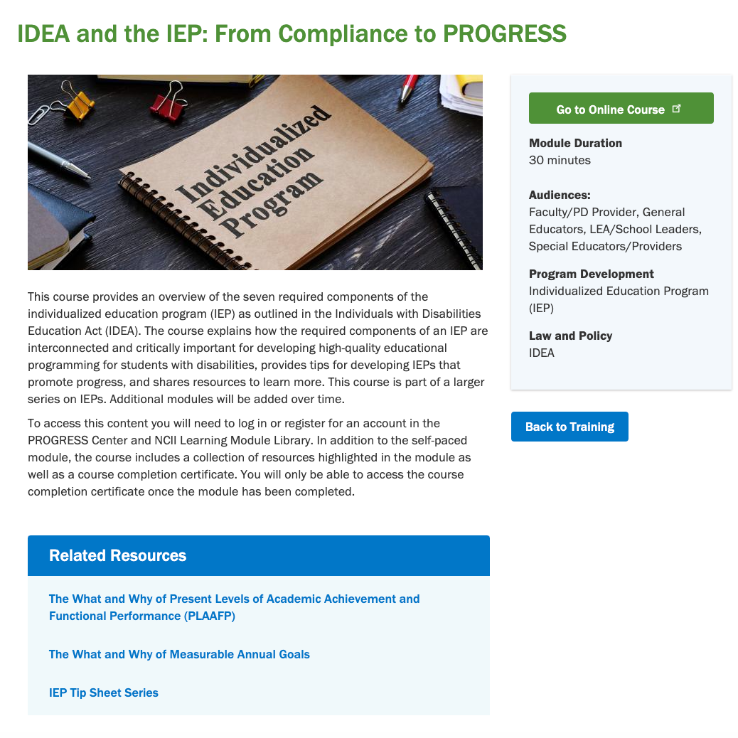
Example of Development Resources
IEP Tip Sheets
Self-Paced Training Modules
Archived Webinars

Slide 14
Implementation Tab

Slide 15
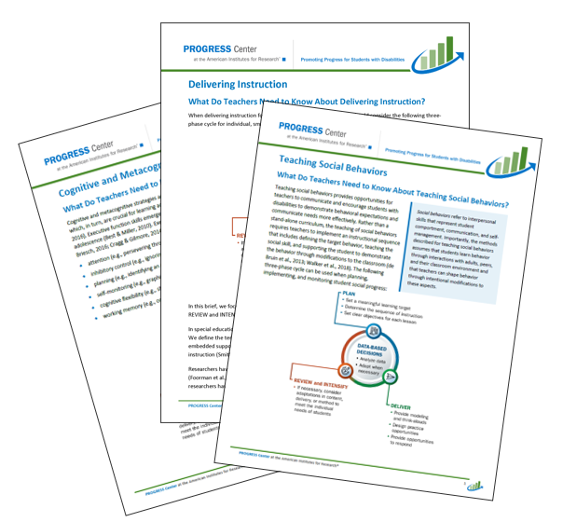
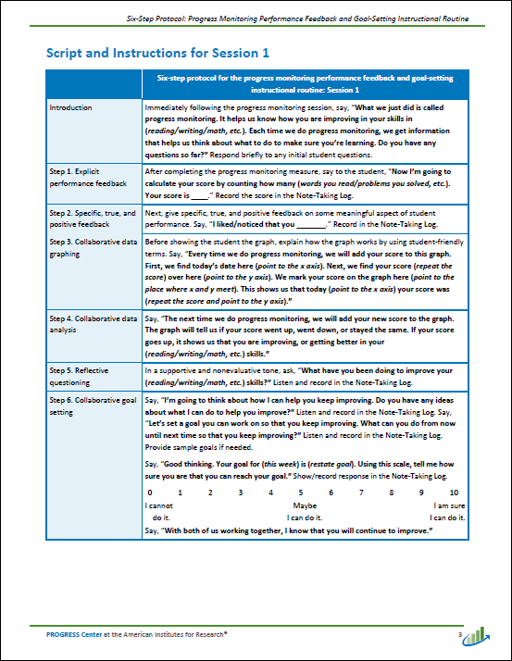
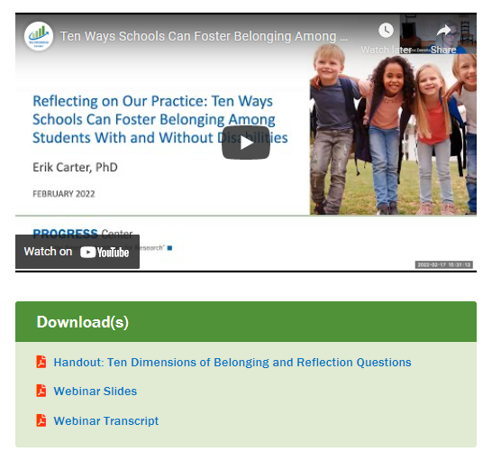
Example of Implementation Resources
Instructional Practice Briefs
Six-Step Protocol: Progress Monitoring Performance Feedback and Goal-Setting Instructional Routine
Archived Webinars Focused on Belonging

Slide 16
Where Can I Find the Stories From the Classroom Video Series?

Slide 17
PROGRESS Training Resources

Slide 18
Challenge Two!
How do we design our preservice and in-service preparation to help educators see the connections across the components of the IEP rather than the parts as stand-alone pieces?

Slide 19
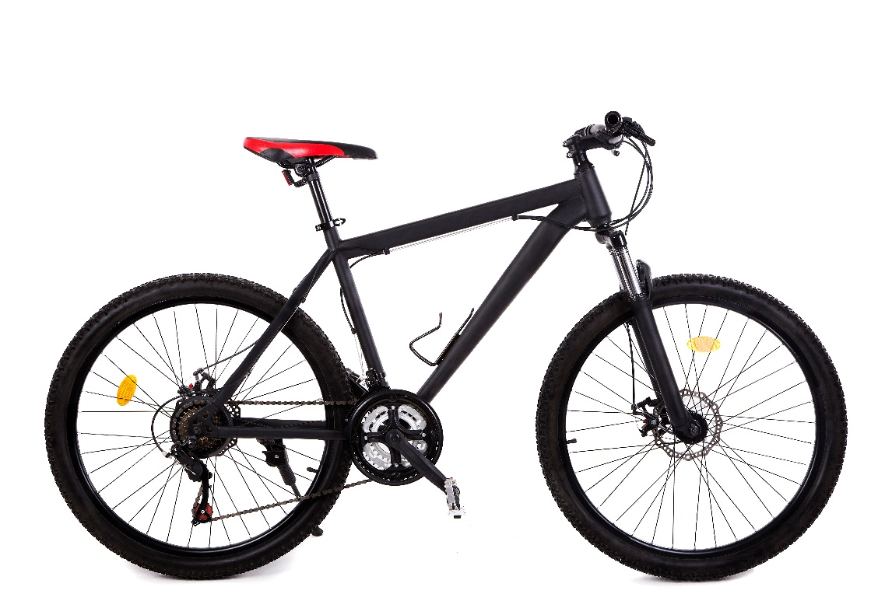
Challenge! (Challenge 2 Cont.)
How do we design our preservice and in-service preparation to help educators see the connections across the components of the IEP rather than the parts as stand-alone pieces?

Slide 20
IEP Tip Sheets: How Can We Use Them in Professional Learning?

Slide 21
Breakout Discussion

Slide 22
Connecting the PLAAFP Statement to Goals and the Statement of Special Education and Aids & Services
PLAAFP
Annual Goals
Measuring Progress Toward Annual Goals
Date, Frequency, Duration, and Location of Services
Participation Outside Regular Education and in State and Districtwide Assessments
Statement of Special Education and Aids & Services
Note. PLAAFP = present levels of academic achievement and functional performance.

Slide 23
What Is the Big Deal About the PLAAFP Statement?
If designed well, it prevents us from experiencing the dreaded and harmful
Assumacide is when we make decisions about programming or identify practices or supports based on our assumptions, rather than evidence.
“Assumacide”

Slide 24
Successful development and implementation of special education depends on the quality of the PLAAFP statement!

Slide 25
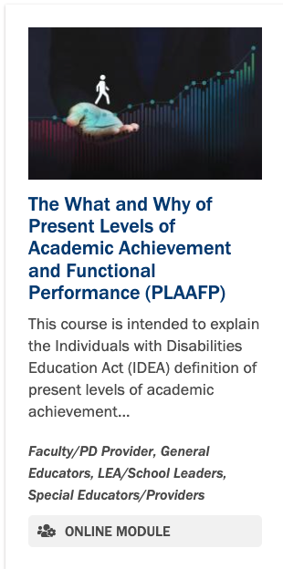
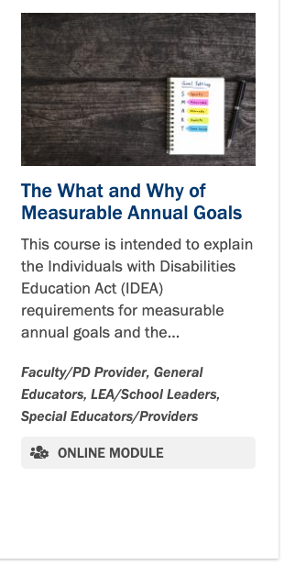
Developing a Scope and Sequence to Illustrate the Connections

Slide 26
Example From Our Work
Request from the Commonwealth of the Northern Mariana Islands to train their school staff on PLAAFP statements and IEP goal setting
Participants: Special Educators
Timeline: Three 2-hour trainings in a 6-week period.

Slide 27
Structure of the Three-Part Learning Series
Overview of Promoting PROGRESS
MODULE: IDEA and the IEP: From Compliance to PROGRESS (30 minutes)
PRACTICE SESSION 1: Path to PROGRESS and Role of the PLAAFPs
PLAAFP Statements
MODULE: The What and Why of Present Levels of Academic Achievement and Functional Performance (PLAAFP) (30 Minutes)
HANDOUT: IEP TIP SHEET: PLAAFPs
PRACTICE SESSION 2: The What and Why of Present Levels of Academic Achievement and Functional Performance (PLAAFP)
Measurable Annual Goals
MODULE: The What and Why of Measurable Annual Goals (30 minutes)
HANDOUT: IEP TIP SHEET: Measurable Annual Goals
PRACTICE SESSION 3: Using the PLAAFPs to Develop Annual IEP Goals

Slide 28
Practical Application Sessions
During practice sessions,
reviewed important information,
incorporated knowledge checks,
provided examples and nonexamples, and
practiced and had discussion with the participants’ own IEP examples.

Slide 29
Sample PLAAFP Structure With Key Ingredients
Data [includes source] indicate Student [ performs in this way—objective data] _______________ which affects _________________ [must include impact on involvement and progress in the general education curriculum]. As a result, he needs _____________________ [justifies proposed services and supports].

Slide 30
Nature of Mathematics Need: Example
On recent standardized math benchmark tests conducted in January 2022, G.H. scored at the 9th percentile, which is well below average. On three standardized measures of mixed-math fact fluency administered on 2/7 and 2/8, G.H. accurately recalled, on average, 18 facts compared with grade-level expectations of 75 facts in 2 minutes [objective data describing the nature of the math need]. Specifically, G.H. recalled about three multiplication mixed facts (0–9), 15 addition facts (0–9), and 0 division and subtraction facts (0–9) in the 2 minutes. This affects his ability to complete sixth-grade math assignments at the same rate as his peers and efficiently use mental math calculation skills to complete word problems [impact]. To complete grade-level math assignments, G.H. currently benefits from shortened assignments, peer support, and the use of a calculator. Increasing his math fact proficiency would increase his ability to independently access and benefit from grade-level math instruction. Review of current intervention implementation data suggests that G.H. benefits from daily direct one-on-one instruction distributed across the school day [rationale for proposed service].

Slide 31
Sample Breakout Session: Application
ACTIVITY: With your team or in partners, identify and highlight the service, supplementary aid or service, related service, or program modification related to each need (use the same color highlighter associated with the highlighted need).
REFLECT: To what extent did every need have a clearly aligned service, aid, or program modification?
What do you need?
Copy of the IEP with highlighted needs (deidentified and not an original)
Four or five different colored highlighters

Slide 32
Sample Breakout Session 2: Application
ACTIVITY: With your team or in partners, use the tip sheet to evaluate the extent to which the goal statements include the essential elements (condition, behavior, proficiency criteria).
REFLECT:
What were areas of strength?
What areas can we refine?
What do you need?
Copy of an IEP (deidentified and not an original)
IEP Tip Sheet: Annual Goal Statement

Slide 33
Lessons Learned
Know your audience and customize the pace and content covered to their level of readiness.
Have participants complete module before the practice session.
Ask participants to provide a certificate of completion to encourage accountability for completing the prework.
Provide opportunities for groups to work as a team and invite general educators to learn as well!
Encourage participants to replicate the activities with additional IEPs as homework after the session.

Slide 34
Reflection Activity
Using the reaction button:
Thumbs up if you think you can use any of these ideas in your work.
In the chat:
How might you include these ideas in your scope and sequence?

Slide 35
Challenge Three!
How do we maximize time by leveraging asynchronous and synchronous learning opportunities?

Slide 36
Claire Merlin-Knoblich
University of North Carolina, Charlotte
Associate Professor
claremerlin@uncc.edu

Slide 37
This presentation is ironic. It is not flipped!

Slide 38
Flipped Learning
A teaching approach in which students view prerecorded video lectures outside of class and then engage in activities applying course content during class.

Slide 39
Traditional Class or Professional Development
For Students
For Instructors
In a nonflipped classroom: lecture occurs in class and homework occurs out of class.
In a nonflipped classroom: instructors plan a lecture and may plan in-class activities in which students apply content they learned in the lecture.

Slide 40
Class or Professional Development Using Flipped Learning
For Students
For Instructors
In a flipped classroom: lecture is delivered out of class (via video lecture) and homework (or application of content) occurs in class.
In a flipped classroom: instructors create concise video lectures summarizing and synthesizing course content and plan meaningful, collaborative, in-class activities in which students apply content they learned in video lectures.

Slide 41
Benefits of Flipped Learning
Solves the lecture/practice dilemma (Gladding & Ivers, 2012)
Encourages synthesis of material, critical thinking in students, and higher order thinking (Sams & Bergmann, 2013)
Helps emphasize the application of key ideas to practitioner context (Berge, 2015)

Slide 42
Benefits of Flipped Learning 2
Is student centered instead of teacher focused (Grant, 2013)
Allows students to access content when needed (Bergmann & Sams, 2012)
Allows for differentiation and supporting diverse student needs (Berge, 2015; Sams & Bergmann, 2013)

Slide 43
How to Flip a Class
Video Lecture: Prework
Preclass Question
In-class Activities

Slide 44
How to Flip a Class Step 1
Video Lecture: Prework
Preclass Question
In-class Activities

Slide 45
How to Flip a Class Step 2
Video Lecture: Prework
Preclass Question
In-class Activities

Slide 46
How to Flip a Class Step 3
Video Lecture: Prework
Preclass Question
In-class Activities

Slide 47
Tips for Happy Flipping
Start small
Collaborate
Embrace the prep as an investment
Seek participant feedback

Slide 48
Using PROGRESS Resources Within a Flipped Model

Slide 49
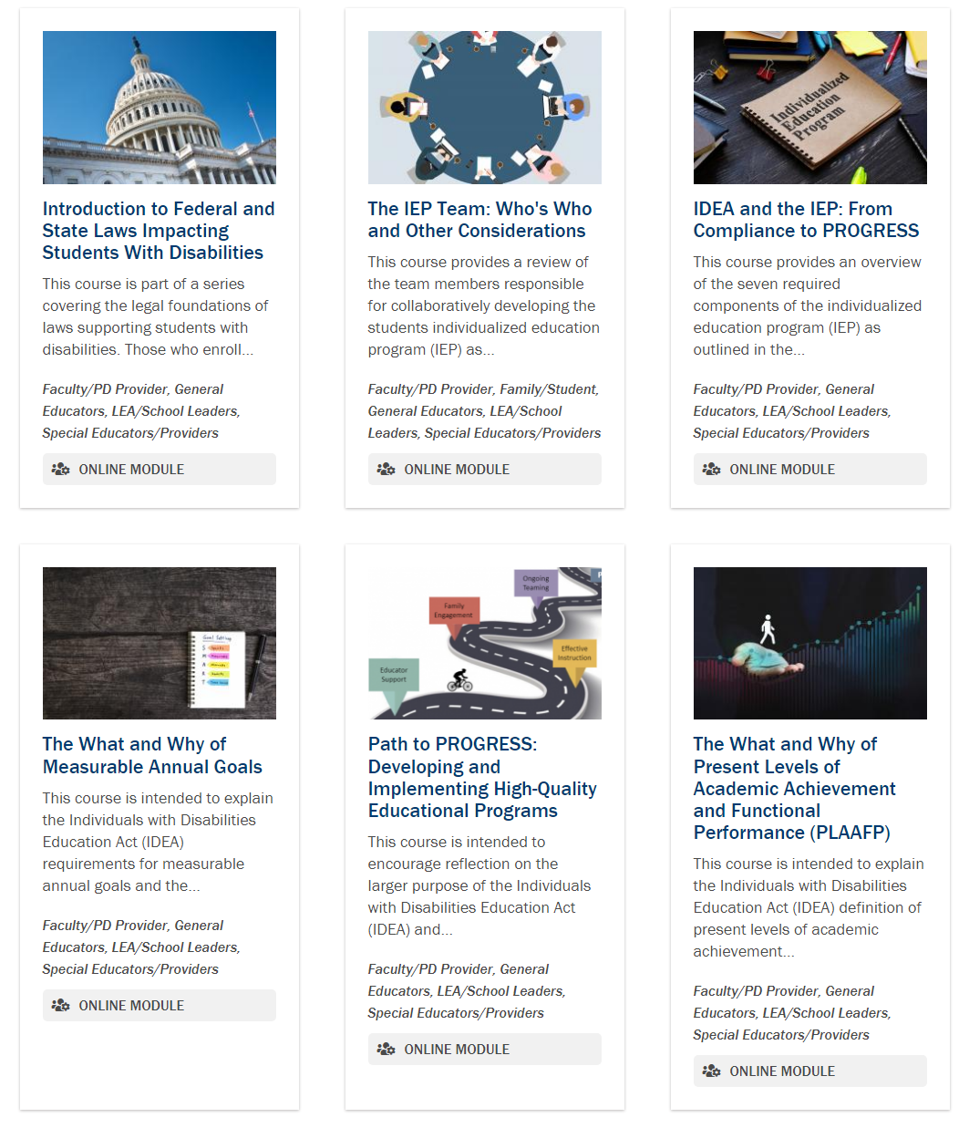
Self-Paced Learning Modules
Introduction to Federal and State Laws Impacting Students With Disabilities
The IEP Team: Who’s Who and Other Considerations
IDEA and the IEP: From Compliance to PROGRESS
The What and Why of Measurable Annual Goals
Path to PROGRESS: Developing and Implementing High-Quality Educational Programs
The What and Why of Present Levels of Academic Achievement and Functional Performance (PLAAFP)
Introduction to Intensive Intervention
And more on the way!

Slide 50
Self-Paced Learning Modules Landing Page

Slide 51
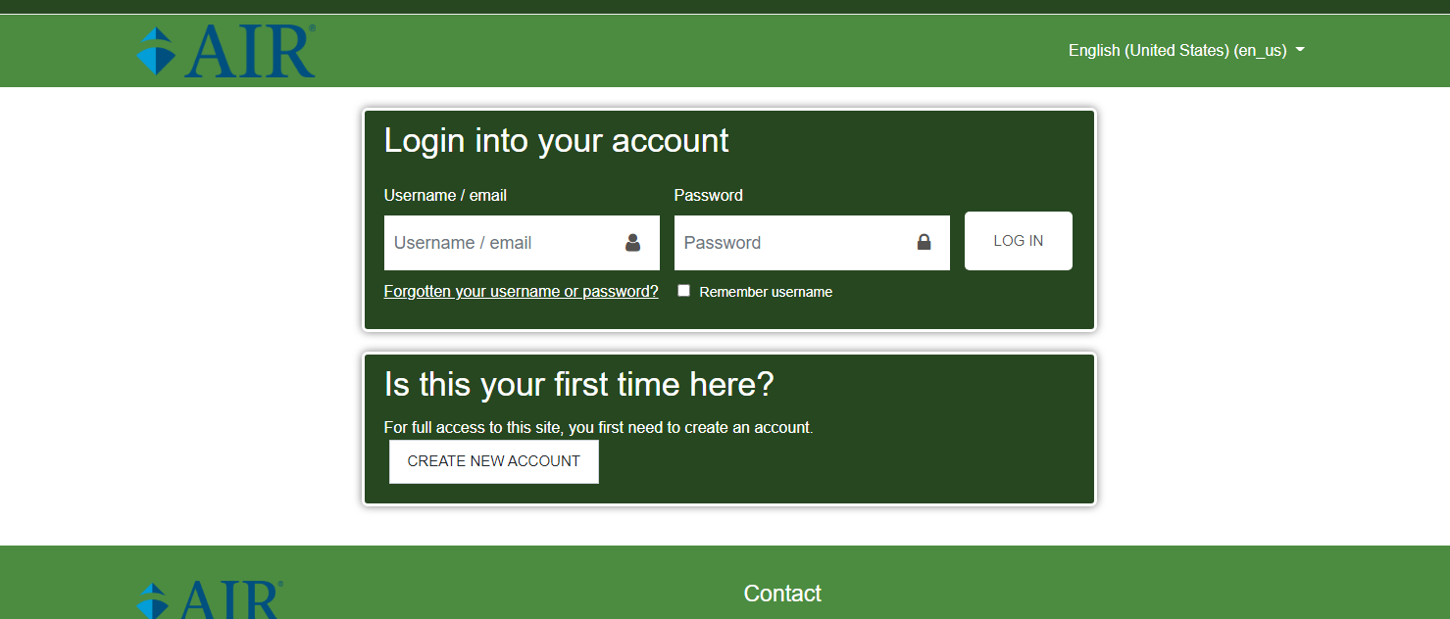
Registering for Self-Paced Learning Modules

Slide 52
Archived Webinars Can Work Too!

Slide 53
Reflection
Using the reaction button:
Thumbs up if you think you can use our resources to try a flipped classroom model for your instruction.
In the chat:
How might you use a flipped classroom model with our resources?

Slide 54
Challenge Four!
How do we facilitate discussions about critical topics related to developing and implementation high-quality educational programming for students with disabilities?

Slide 55
Where Can I Find the Stories From the Classroom Video Series? Reminder

Slide 56
Stories From the Classroom

Slide 57
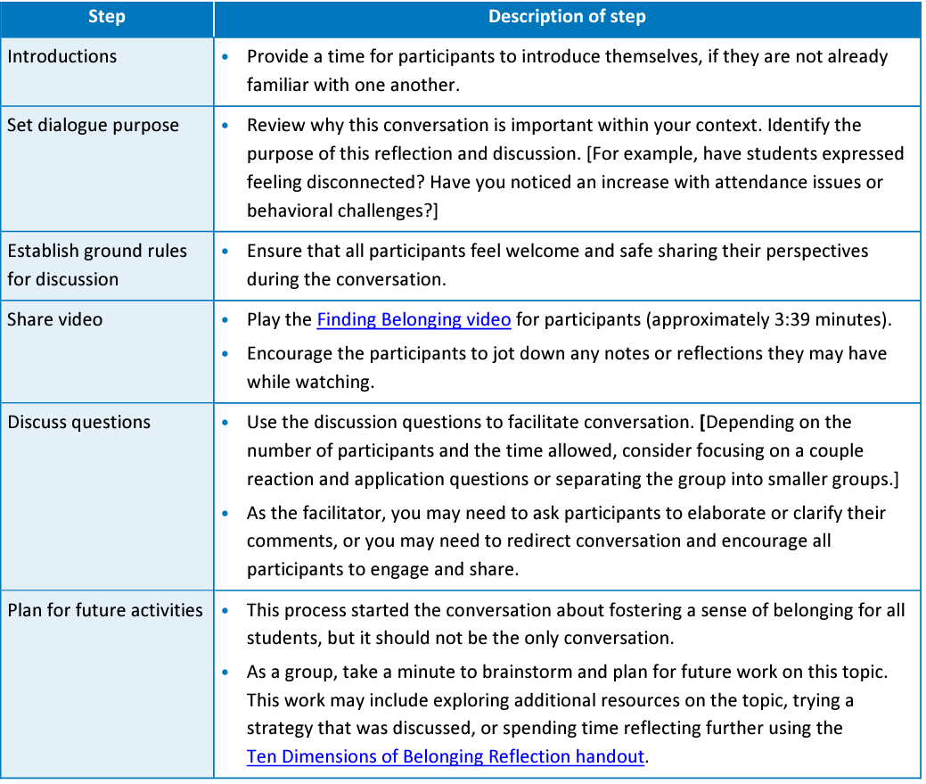
Stories From the Classroom Discussion Guides
Structured process to facilitate discussions
Intended to be short conversations or reflections but can be expanded based on available time.
Includes reaction and application questions.

Slide 58
Stories From the Classroom
Words Matter

Slide 59
Breakout Discussion 2
Come back with two questions you might ask to facilitate a robust discussion.

Slide 60
Putting It all Together for Professional Learning

Slide 61
Where to Start?

Slide 62
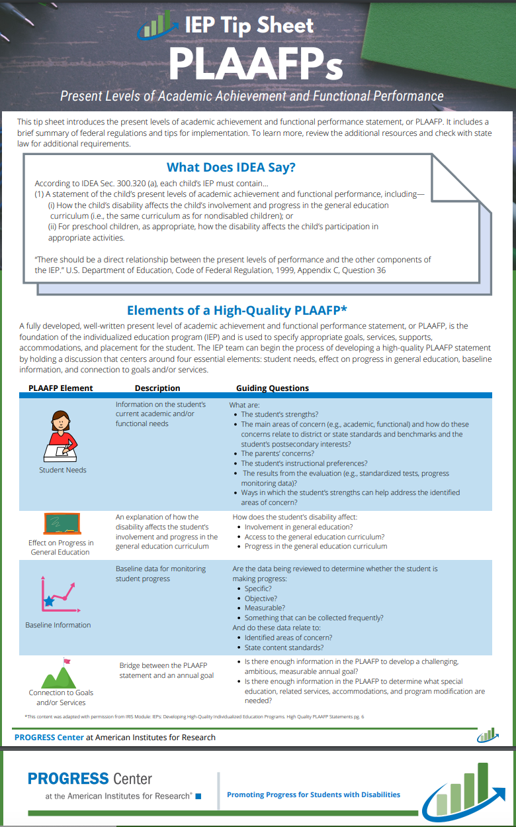
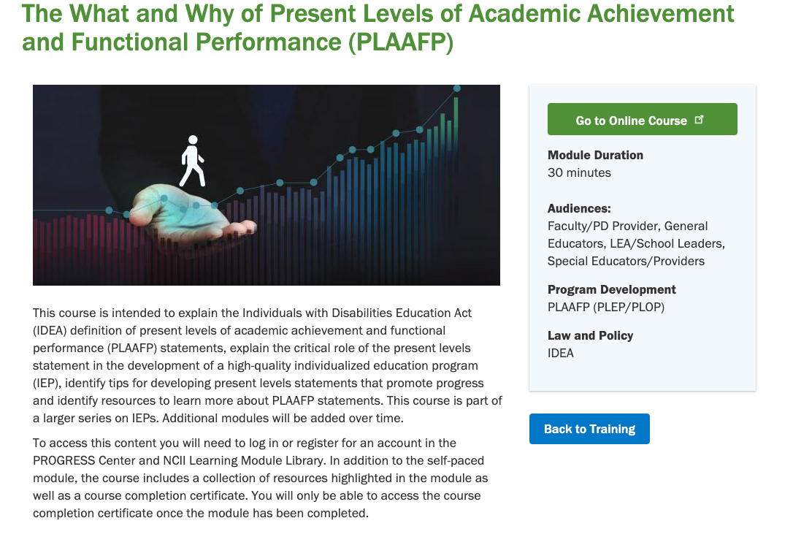
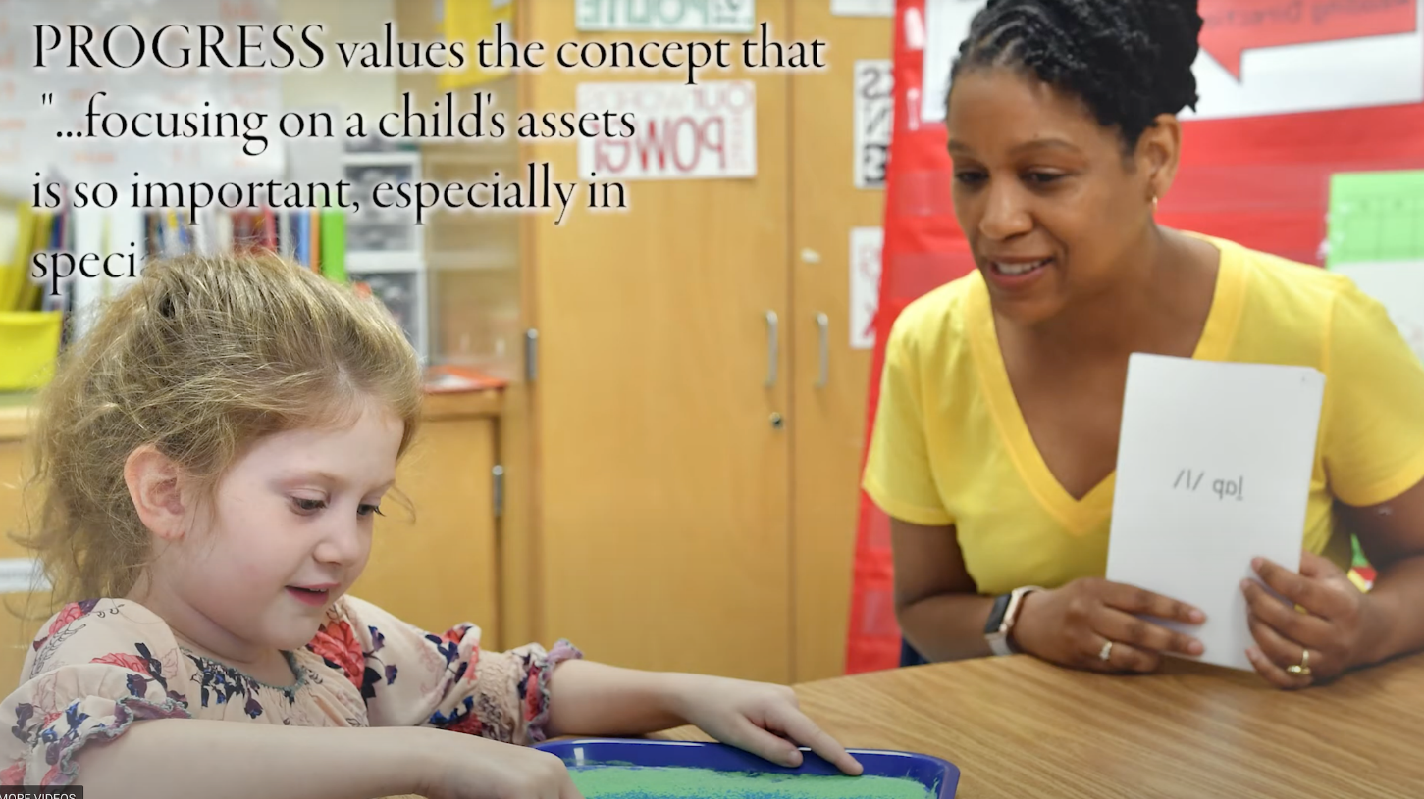
Pairing PROGRESS Resources: A
The What and Why of Present Levels of Academic Achievement and Functional Performance (PLAAFP)
IEP TIP Sheet: PLAAFPs
Stories From the Classroom: Focusing on Strengths within Assessment and Classroom Instruction

Slide 63
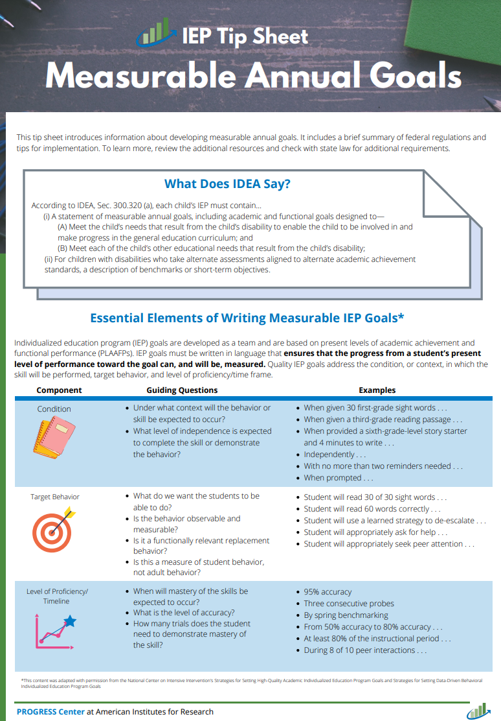
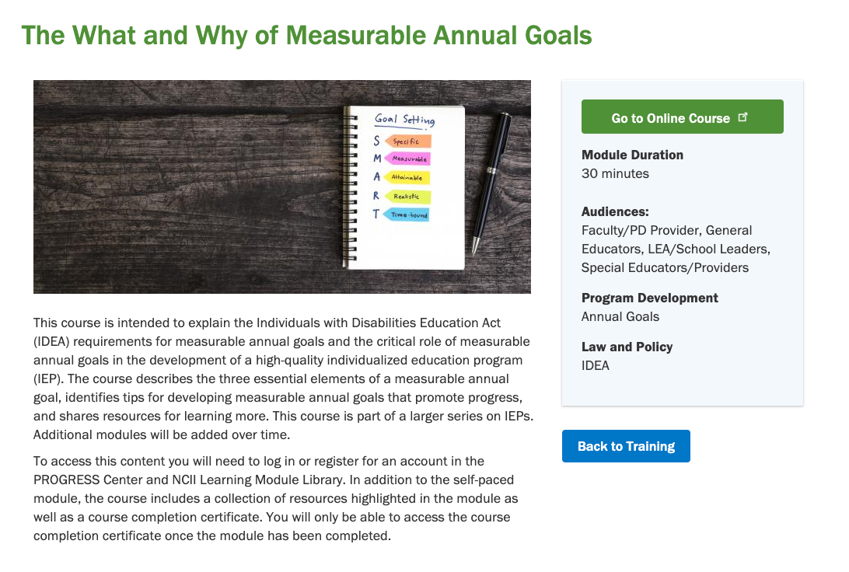
Pairing PROGRESS Resources: B
The What and Why of Measurable Annual Goals
IEP TIP Sheet: Measurable Annual Goals
Stories From the Classroom: Appreciating High Expectations

Slide 64
Questions

Slide 65
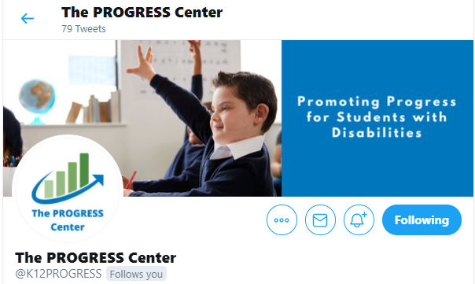
Staying Connected With the PROGRESS Center
Connect to us on Facebook and Twitter @k12progress
https://promotingprogress.org/news/connect-progress-center

Slide 66
Disclaimer
This material was produced under the U.S. Department of Education, Office of Special Education Programs, Award No. H326C190002. David Emenheiser serves as the project officer. The views expressed herein do not necessarily represent the positions or policies of the U.S. Department of Education. No official endorsement by the U.S. Department of Education of any product, commodity, service, or enterprise mentioned in this presentation is intended or should be inferred.

Slide 67
Reminder: Event Schedule for Tomorrow
Time (ET) | Session
10:15–10:45 a.m. | Optional Networking Discussion
10:45–11:00 a.m. | BREAK
11:00 a.m. –12:00 p.m. | General Session: Panel Discussion
12:00–12:40 p.m. | BREAK
12:40–1:40 p.m. | Concurrent Sessions
1:40–2:00 p.m. | BREAK
2:00–3:00 p.m. | Concurrent Sessions
3:00–3:20 p.m. | BREAK
3:20–4:00 pm | Closing Session
Reminder! You must register for each session independently. Haven’t registered for a session you would like to attend? Don’t worry, there is still time.

Slide 68
References
Berge, A. N. Z. L. (2015). Flipped learning in the workplace. Journal of Workplace Learning, 27, 162-172. doi:10.1108/JWL-06-2014-0044
Bergmann, J., & Sams, A. (2012). Flip your classroom: Reach every student in every class every day. Washington, DC: International Society for Technology in Education.
Ells, R. (2011). Meta-analysis of the relationship between collective efficacy and student achievement.
Unpublished doctoral dissertation. Loyola University of Chicago. https://ecommons.luc.edu/cgi/viewcontent.cgi?article=1132&context=luc_diss
Endrew F., v. Douglas County School District RE-1, 580 U.S. ___ (2017). https://www.supremecourt.gov/opinions/16pdf/15-827_0pm1.pdf
Gladding, S. T., & Ivers, N. N. (2012). Group work: Standards, techniques, practice, and resources. In D. M. Perera-Diltz and K. C. MacCluskie (Eds.) The Counselor educator’s survival guide: Designing and teaching outstanding courses in community mental health counseling and school counseling (pp. 171-186). New York: Routledge.

Slide 69
References 2
Grant, C. (2013). First inversion: A rationale for implementing the “flipped approach” in tertiary music courses. Australian Journal of Music Education, 1, 3-12.
Hattie, J. (2018). Hattie Ranking: 252 Influences And Effect Sizes Related To Student Achievement. https://visible-learning.org/hattie-ranking-influences-effect-sizes-learning-achievement/
Board of Education of the Hendrick Hudson Central School District v. Rowley, 458 U.S. 176 (1982)
Sams, A. & Bergmann, J. (2013). Flip your students’ learning. Educational Leadership, 70, 16-20.

Slide 70
contact
1400 Crystal Drive, 10th Floor
Arlington, VA 22202-3289
202.403.5000
progresscenter@air.org
promotingprogress.org | www.air.org
https://www.facebook.com/k12PROGRESS/
https://twitter.com/K12PROGRESS
Notice of Trademark: “American Institutes for Research” and “AIR” are registered trademarks. All other brand, product, or company names are trademarks or registered trademarks of their respective owners.
This material was produced under the U.S. Department of Education, Office of Special Education Programs, Award No. H326C190002. David Emenheiser serves as the project officer. The views expressed herein do not necessarily represent the positions or policies of the U.S. Department of Education. No official endorsement by the U.S. Department of Education of any product, commodity, service, or enterprise mentioned in this presentation is intended or should be inferred.
18779_07/22

