Slide 1
Using Academic Progress Monitoring for Individualized Instructional Planning
August 4, 2023
Jon Potter, PhD

Slide 2
Agenda
Progress monitoring overview
Approaches and tools for academic progress monitoring
Goal setting
Making instructional decisions for individual students
Available NCII resources

Slide 3
Progress Monitoring Overview

Slide 4
What is Progress Monitoring?
Progress monitoring is repeated measurement of student performance over the course of intervention to index/quantify responsiveness to intervention and to thus determine, on an ongoing basis, when adjustments to the program are needed to improve responsiveness.
National Center on Intensive Intervention, 2017

Slide 5
Monitoring Progress vs. Progress Monitoring
Monitoring progress is not the same as progress monitoring.
Monitoring Progress
Often informal or unstandardized
Can occur during daily instruction
Provides data for immediate, real-time instructional decisions
Uses formative assessments, questioning, providing feedback, and similar strategies
Used for all students
Progress Monitoring
Valid and reliable measures, with standardized delivery
Frequency depends on intensity of instruction and recommendations of the developer (e.g., weekly or monthly)
Requires ongoing and graphed data (i.e., 6–9 data points for valid interpretation
Used for entitlement decisions and students receiving targeted and intensive interventions

Slide 6
Why Is Progress Monitoring Important?
Identify students who are not making adequate progress
Compare the efficacy of different forms of instruction
Determine when an instructional change is needed
Data allow us to
Estimate the rates of improvement (ROI) across time
Support communication with parents and students
Support the development of present levels of performance, IEP goals, and monitoring plan for students with disabilities

Slide 7
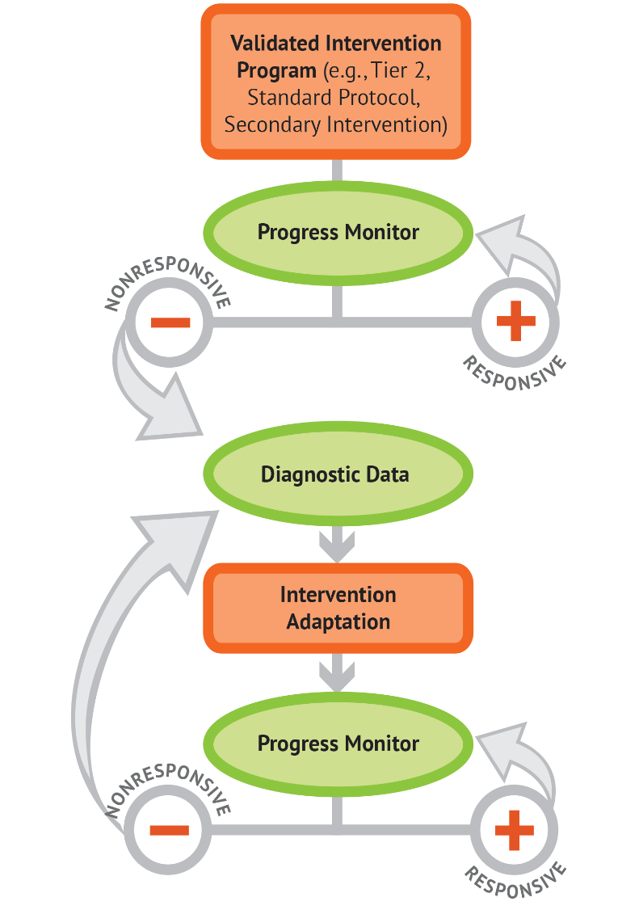
Progress Monitoring and DBI

Slide 8
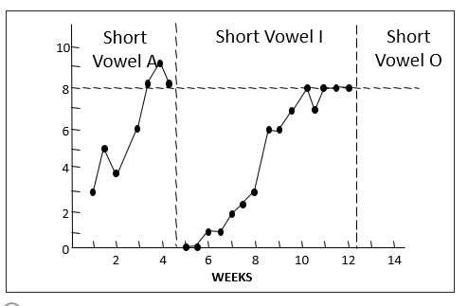
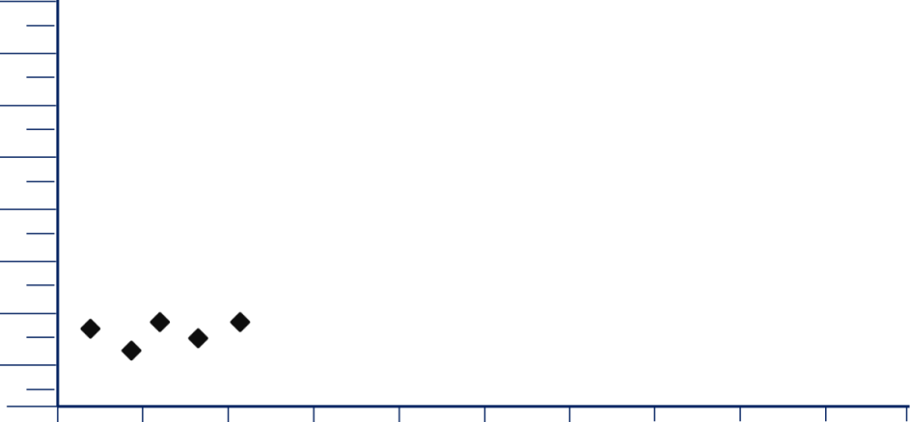
Getting Started with Progress Monitoring: Select the Target and Measure
Determine target behavior
Identify a measure
Single Skill Measure
General Outcome Measure

Slide 9
Identify a Measure: Key Characteristics
Have sufficient number of alternate forms of equal and controlled difficulty.
Specify minimum acceptable growth.
Provide benchmarks for minimum acceptable end-of-year performance.
Have reliability and validity information for the performance-level score and for growth for students with intensive needs.

Slide 10
In the Chat:
In which academic areas do you currently have progress monitoring measures that you use?
In which academic areas do you need to progress monitoring measures?

Slide 11
Goal Setting

Slide 12
Steps for Goal Setting
Establish Baseline Performance
Choose a Goal-Setting Strategy
Write a Measurable Goal

Slide 13
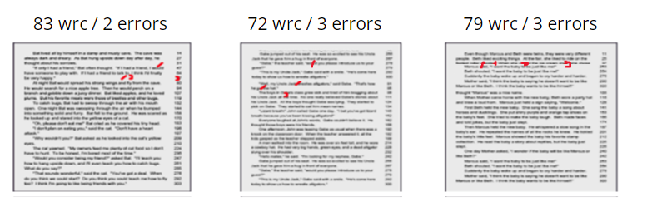
Establish a Baseline
Option 1. Use the student’s score from universal screening.
Set the baseline using the same tool for progress monitoring
Option 2: Administer three progress monitoring probes in one testing session and select the median score.

Slide 14
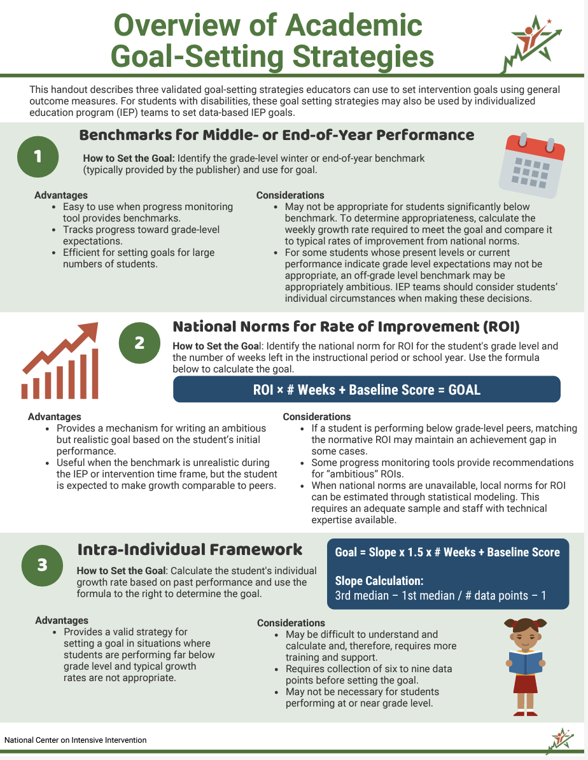
Choose a Goal-Setting Strategy
Benchmarks
National norms for weekly ROI
Intra-individual framework

Slide 15
Goal-Setting Strategy Option 1: Benchmarks
Benchmark: specifies the level of performance expected on a specific measure at a specific point in time, usually the end of the student’s present grade level.
Steps for setting a goal using benchmarks:
Identify the appropriate grade level benchmark for the timeframe.
Graph the benchmark and draw a line between the baseline and goal.

Slide 16
Option 1: Benchmarks for Middle- or End-of-Year Performance
Spring Benchmark:
90 WRC

Slide 17
Considerations for Using Benchmarks

Slide 18
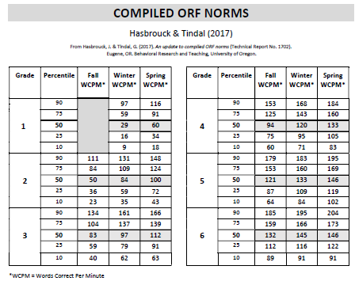
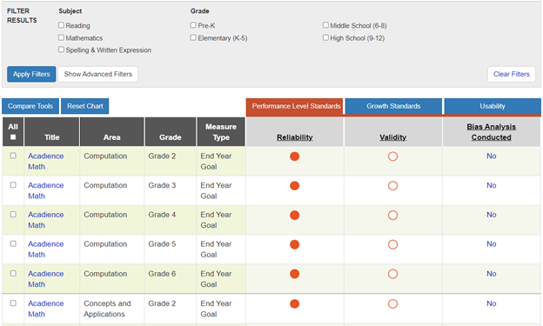
Where do you find benchmarks?
Published Research
Publisher Data Systems
NCII Resource: https://intensiveintervention.org/resource/update-compiled-orf-norms
NCII Resource: https://charts.intensiveintervention.org/chart/progress-monitoring

Slide 19
Option 2: National Norms for Rate of Improvement
Rates of Improvement (ROI): average growth students are expected to make per week on a specific measure, according to local or national norms.
There is a standard formula for calculating goal using rate of improvement (ROI):
ROI x # Weeks + Baseline Score = GOAL
ROI =
2 Digits/Week
10 Weeks
Baseline = 30 Digits
GOAL = 50 Digits
+
=
X

Slide 20
Option 2: National Norms for Rate of Improvement 2

Slide 21
Considerations for Using Rates of Improvement

Slide 22
Where do you find rates of improvement?

Slide 23
Option 3: Intra-Individual Framework
Intra-Individual Framework: uses the student’s previous growth rate to calculate the individualized goal.
Slope
Target Growth Rate
# of Weeks
Baseline Score
Goal
X
X
+
=
Represents the student’s rate of improvement (SROI)
Need 6-9 data points
Represents growth needed to close the gap
For example, if student needs to make 50% more progress, target growth rate would be 1.5

Slide 24
Setting a Goal Using an Intra-Individual Framework
Baseline
19
GOAL
34 WRC
Slope
1.0
X
Target Growth Rate
1.5
X
# of Weeks
10
+
=
Baseline = 19 WRC

Slide 25
Considerations for Using Intra-Individual Framework

Slide 26
Write a Measurable Goal
Quality IEP goals address the condition, or context in which the skill will be performed, target behavior, and level of proficiency/time frame.
Sample template for IEP structure:
When given [grade level and tool], the student will [observable behavior and goal] [level of proficiency and time frame].

Slide 27
In the Chat: 2
Which option(s) are you currently using to set student goals?

Slide 28
Making Instructional Decisions for Individual Students

Slide 29
Analyzing Graphed Data
After setting a goal, collecting progress monitoring data, and graphing progress monitoring data, ask the following questions to determine if a change is needed.
Is the student’s performance improving?
Is the student’s performance improving sufficiently to meet their goal?

Slide 30
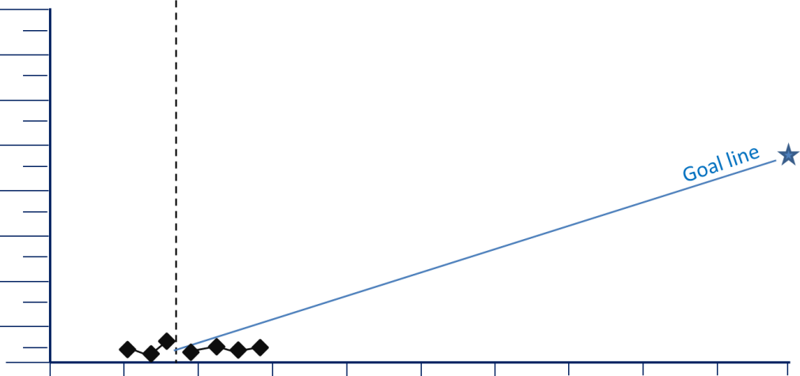
Graphs: Very low scores
The situation: Your student’s scores are very low, close to the bottom of the graph.
Consider: Are there issues with your progress monitoring measure or process?

Slide 31
Graphs: Highly variable scores
Consider:
Are there issues with your progress monitoring measure or process?
Is the assessment consistently administered?
Does the student’s motivation or engagement vary from day to day?
The situation: Your student’s scores are highly variable with a lot of ”bounce” from day to day.

Slide 32
Graphs: Flat trend line
The situation: The trend line of your student’s scores is flat or going down
Consider: Has the plan been implemented as intended?

Slide 33
Graphs: Goal line steeper than the trend line
Consider
Was the appropriate method used to set the goal?
Intensifying the intervention rather than trying something new.
The situation: The trend line is increasing, but it is less steep than the the goal line

Slide 34
Graphs: Trend line steeper than goal line
The situation: The trend line is steeper than the goal line.
Consider: Was the original goal appropriately ambitious given the student’s circumstances?

Slide 35
Graphs: Scores flat after change
The situation: After an instructional change, progress monitoring data do not indicate an increased access to instruction
Consider: Why might the original intervention have worked better for the student?

Slide 36
Graphs: Scores improving after change
The situation: After an instructional change, the trend line is steeper than before the change was made
Consider: Continue the intervention and monitor the student’s progress through the end of the year.

Slide 37
Decision Rules for Analyzing Progress Monitoring Data
4 Point Rule
Trend Line Analysis

Slide 38
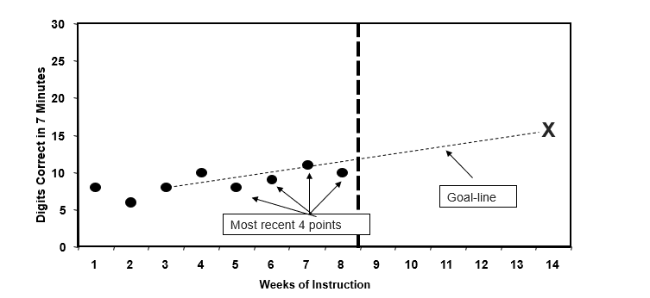
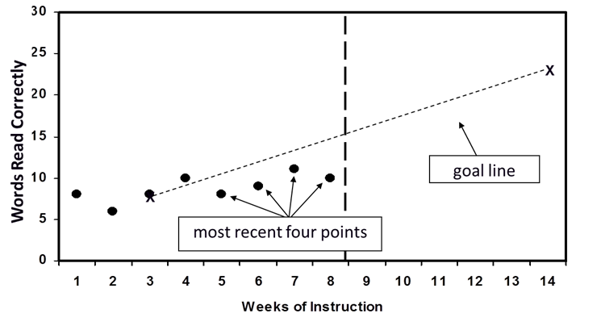
The Four Point Rule
If three weeks of instruction have occurred AND at least six data points have been collected, examine the four most recent data points.
POSITIVE
POOR
QUESTIONABLE
If all four are above the goal line, increase the goal
If all four are below goal line, consider adapting the intervention
If the four data points are both above and below the goal line, keep collecting data and continue to monitor progress.

Slide 39
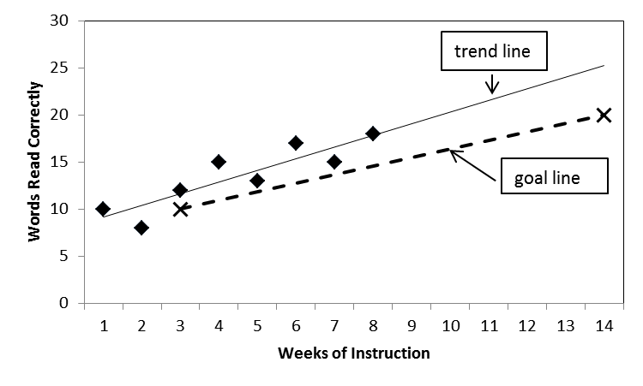
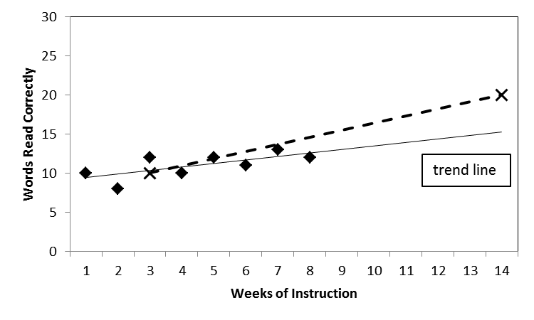
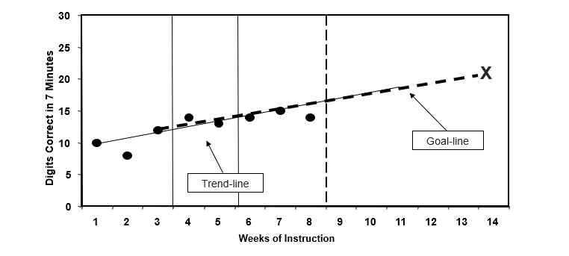
Trend Line Analysis
If four weeks of instruction have occurred AND at least eight data points have been collected, figure the trend of current performance and compare to goal line.
POSITIVE
POOR
QUESTIONABLE
If the student’s trend line is steeper than the goal line, increase the goal (if goal is below benchmark).
If the student’s trend line is flatter than the goal line, consider adapting the intervention and assess fidelity.
If the student’s trend line and goal line are the same, keep collecting data and continue to monitor progress.

Slide 40
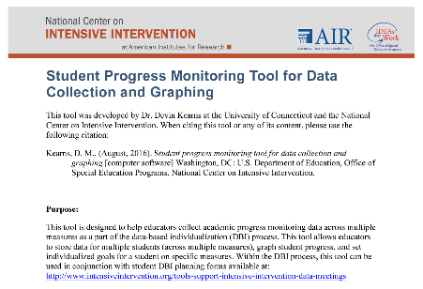
Want to Learn More?
NCII Academic Progress Monitoring Tools Chart. These charts display expert ratings on the technical rigor of assessments.
TOOL: Student Progress Monitoring Tool for Data Collection and Graphing. This tool is designed to help educators collect academic progress monitoring data across multiple measures as a part of the data-based individualization (DBI) process.
GUIDE: Strategies for Setting High-Quality Academic Individualized Education Program Goals. In this guide, we explain how educators can establish IEP goals that are measurable, ambitious, and appropriate in light of the student's circumstances.

Slide 41
Additional NCII Training Modules

Slide 42
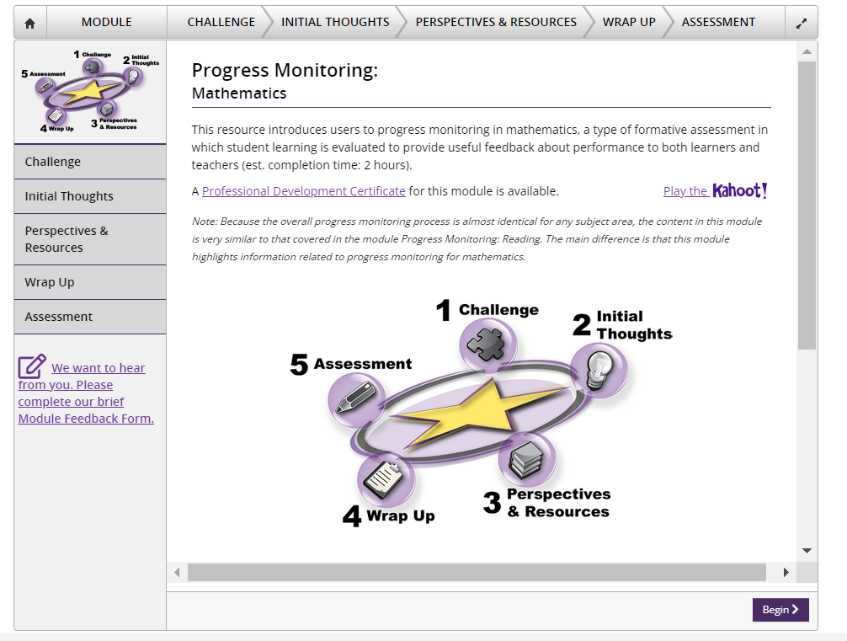
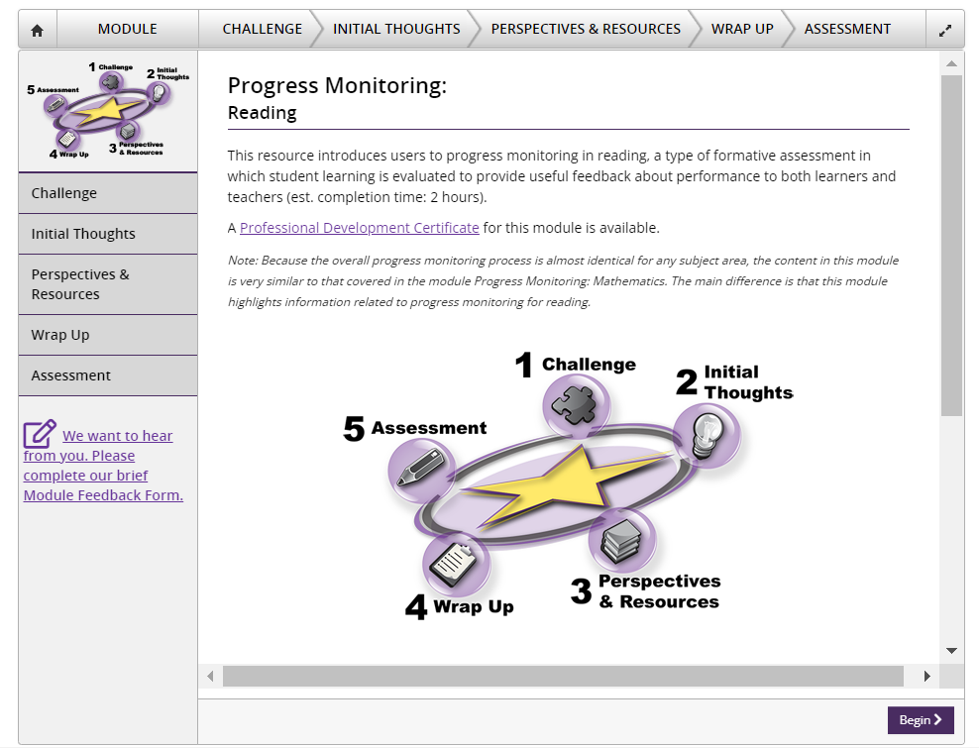
Partner Training Modules

Slide 43
NCII Disclaimer
This presentation was produced under the U.S. Department of Education, Office of Special Education Programs, Award No. H326Q260001. Celia Rosenquist serves as the project officer. The views expressed herein do not necessarily represent the positions or policies of the U.S. Department of Education. No official endorsement by the U.S. Department of Education of any product, commodity, service, or enterprise mentioned in this resource is intended or should be inferred.

Slide 44
NCII Contact Information

