Slide 1
Prepping for PROGRESS
Raising Expectations, Access, and Outcomes for Students With Disabilities
August 3, 2023

Slide 2
Welcome

Slide 3
Day 1 Recap
Welcome and Panel Presentation
Strand Sessions
ABCs of the IEP
Are Accommodations SDI? Myth Busting This and Other Common Confusions in Special Education
Networking Time

Slide 4
Share a takeaway or two from yesterday in the chat!
What are you most excited about from what you learned yesterday?
What questions do you still have?

Slide 5
Welcome to the PROGRESS Center!
The PROGRESS Center provides information, resources, tools, and technical assistance services to support local educators in developing and implementing high-quality educational programs that enable children with disabilities to make progress and meet challenging goals.
HOW WILL WE HELP IMPROVE OUTCOMES FOR STUDENTS WITH DISABILITIES?
Share current research,
policies, guidance, success stories, and experiences from students, parents, educators, and
other stakeholders.
Partner with selected
local educators to develop and implement high-quality educational programs.​
Provide tools, resources, and
training materials for ALL educators, leaders, and families.
Visit us at www.promotingPROGRESS.org to learn more!
≈

Slide 6
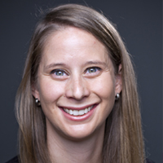
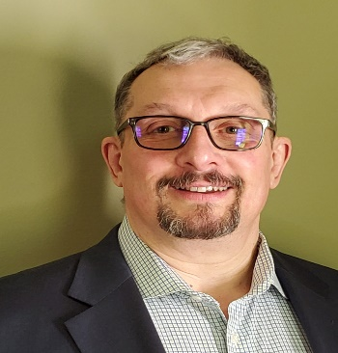
Introductions
Amy Peterson, Senior Researcher, PROGRESS Center Universal Technical Assistance Lead, American Institutes for Research
David Emenheiser, PhD, PROGRESS Center Project Officer, Office of Special Education Programs, U.S. Department of Education
Tessie Bailey, PhD, PROGRESS Center Director, American Institutes for Research

Slide 7
Welcome from David Emenheiser
David Emenheiser, PhD, PROGRESS Center Project Officer, Office of Special Education Programs, U.S. Department of Education

Slide 8
Event Schedule Overview: Day 2!
Day 2 Schedule: August 3, 2023
10:15–10:45 a.m. ET (9:15 a.m. CT/8:15 a.m. MT/7:15 a.m. PT) | Topical Discussion
10:45–11:00 a.m. ET (9:45 a.m. CT/8:45 a.m. MT/7:45 a.m. PT) | Break
11:00 a.m.–12:15 p.m. ET (10:00 a.m. CT/9:00 a.m. MT/8:00 a.m. PT) | General Session (we are here!)
12:15–12:45 p.m. ET (11:15 a.m. CT/10:15 a.m. MT/9:15 a.m. PT) | Break
12:45–1:45 p.m. ET (11:45 a.m. CT/10:45 a.m. MT/9:45 a.m. PT) | Concurrent Sessions
1:45–2:00 p.m. ET (12:45 p.m. CT/11:45 a.m. MT/10:45 a.m. PT) | Break
2:00–3:00 p.m. ET (1:00 p.m. CT/12:00 p.m. MT/11:00 a.m. PT) | Concurrent Sessions
3:00–3:15 p.m. ET (2:00 p.m. CT/1:00 p.m. MT/12:00 p.m. PT) | Break
3:15–4:00 p.m. ET (2:15 p.m. CT/1:15 p.m. MT/12:15 p.m. PT) | Closing Session

Slide 9
Day 2: Concurrent Sessions
Creative Ways to Engage Families and Community Members: Lessons From Co-creating Resources
Prepping Preservice and In-Service Teachers for PROGRESS
Ensuring SDI in Secondary Settings
Providing a Free Appropriate Public Education (FAPE): Lessons From the Due Process Hearing Front
These same sessions will occur from 12:40-1:40 p.m. and 2:00-3:00 p.m., so you can choose to attend 2 of the 4 available sessions live. If you are interested in the other sessions, you can listen to their archived recordings after the event!

Slide 10
Viewing Your Schedule

Slide 11
Joining Sessions

Slide 12
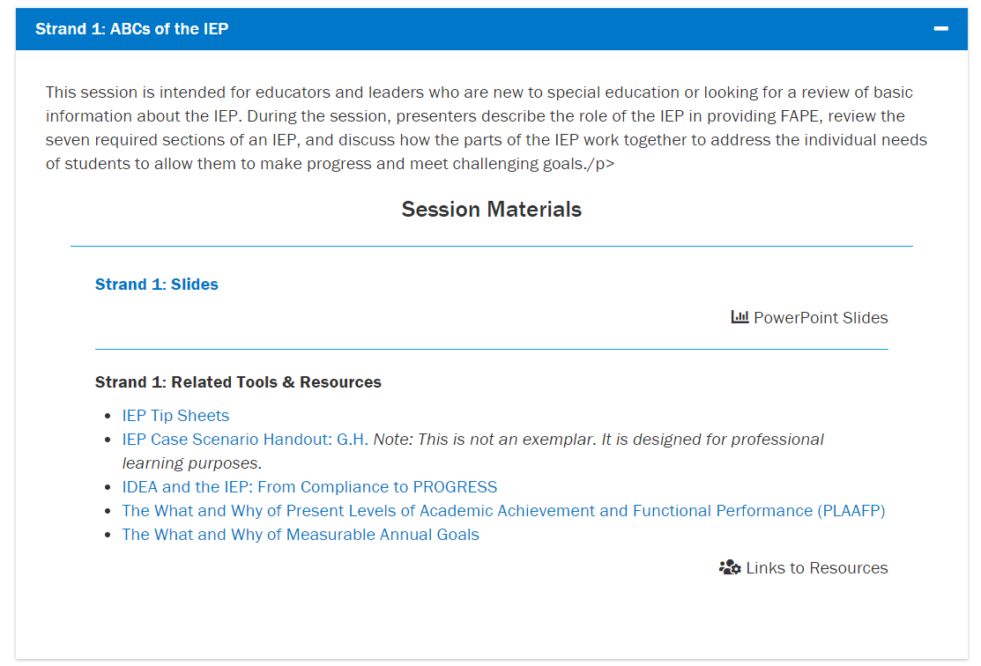
Where can I find event materials and recordings after the event?

Slide 13
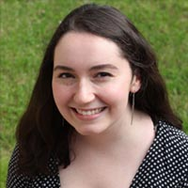
Technical Support
Do you have a question about the technology?
Do you need support in accessing a session?
Do you have questions about accessing materials?
Reach out to Mia Mamone at mmamone@air.org with any challenges! She will do her best to address any needs throughout the event.

Slide 14
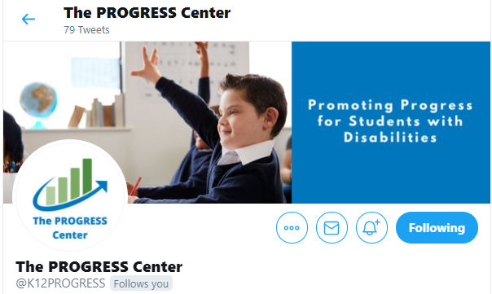
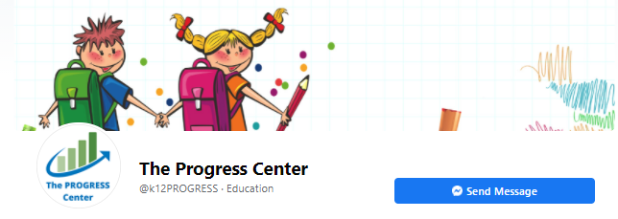
Connect With the PROGRESS Center
Connect with us on Facebook and Twitter @k12progress
Share your learning about the event at #promotingprogress2022

Slide 15
Leveraging an MTSS to Develop and Implement the IEP
Tessie Bailey, PhD

Slide 16
Buffman et al. Quote
There is no way a single teacher
has all the time,
all the knowledge,
and all the skills
to meet all the needs
of every child in his or her class(es).
Buffman, Mattos, & Webber 2009
program
every school or district.
Notes:
Slide has animations

Slide 17
Students with Disabilities in a Tiered Support System
68%
Spend 80% or more in the general education classroom
95%
Spend some portion of their day in the general education classroom
https://content.govdelivery.com/accounts/USED/bulletins/311f842

Slide 18
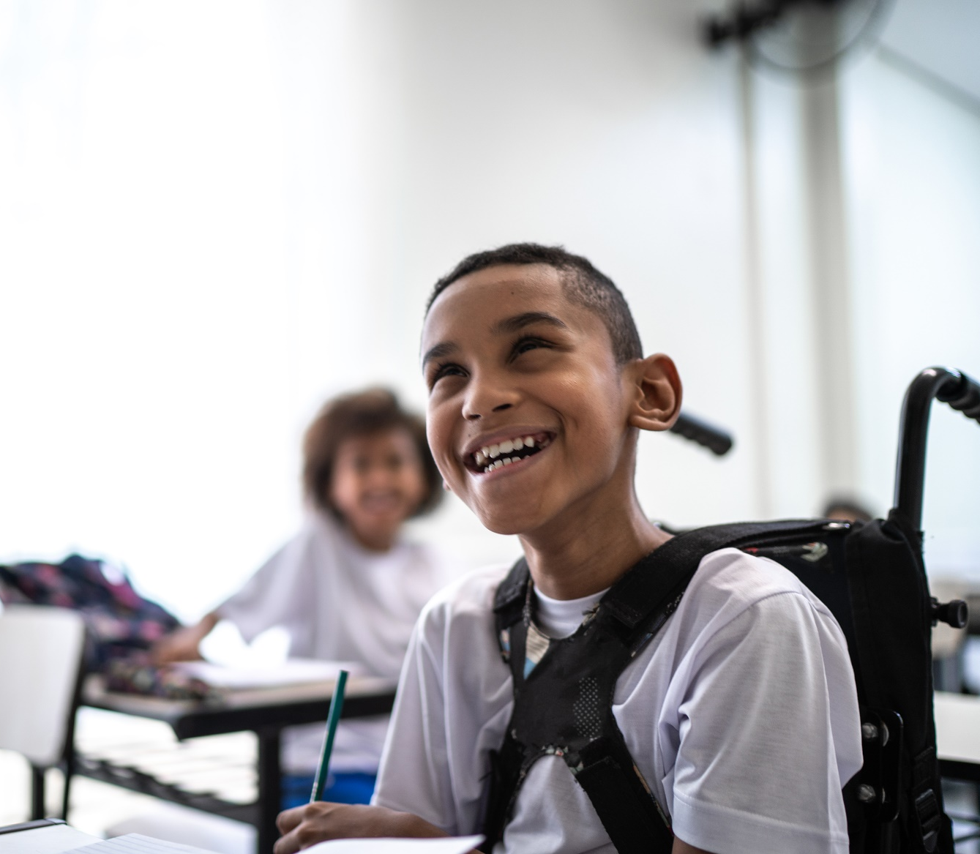
Students with Disabilities in General Education
All students are general education students first.
Some students require special education aids and services to access and benefit from general curriculum similarly to their peers.

Slide 19
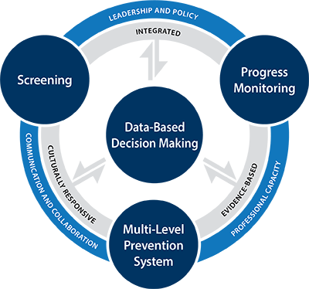
Multi-tier system of support in Every Student Succeeds Act (ESSA, 2015)
Identified as an approach for improving outcomes for students with disabilities and English Language Learners [Sec 2103 (b)(3)(F)].
ESSA requires use of evidence-based interventions.

Slide 20
Let’s Clear the Air! Common Misconceptions
The primary purpose of MTSS is to identify students with disabilities.
FALSE! While RTI within MTSS can support the child find activities, the primary purpose of an MTSS is “to maximize student achievement and support students’ social, emotional, and behavior needs” (https://mtss4success.org/)
Special education is Tier 3 or beyond.
FALSE! Special education is not a tier (or a place) and can be delivered in any setting, including extracurricular activities, based on the unique needs of the child.

Slide 21
Let’s Clear the Air! More Common Misconceptions
Students with IEPs cannot participate in Tier 2 interventions.
FALSE! Schools have discretion in how they implement the special education services outlined in the IEP. If the available intervention addresses the student’s unique needs, it may be used to implement the IEP service.
Tier 3 intensive intervention is the same as specially designed instruction (SDI) under IDEA.
SORT OF! Tier 3 intensive intervention uses a validated process for individualizing and intensifying instruction that can also be used to design SDI. However, it is only considered “SDI under IDEA” if the student needs the specialized instruction to address impacts of a disability.

Slide 22
Share in the chat.
Other than a disability, why might a student need more specialized, individualized instruction through MTSS?

Slide 23
MTSS provides a continuum of supports…even for students with disabilities.
Tier 3: Intensive intervention likely needed by 3-5% of students to fully benefit
SWDs, GT, ELLs
Receive services at all levels, depending on need
Tier 2: 15% of students may need supplemental, targeted supports to fully benefit.
Tier 1: 80% of students benefit without additional supports

Slide 24
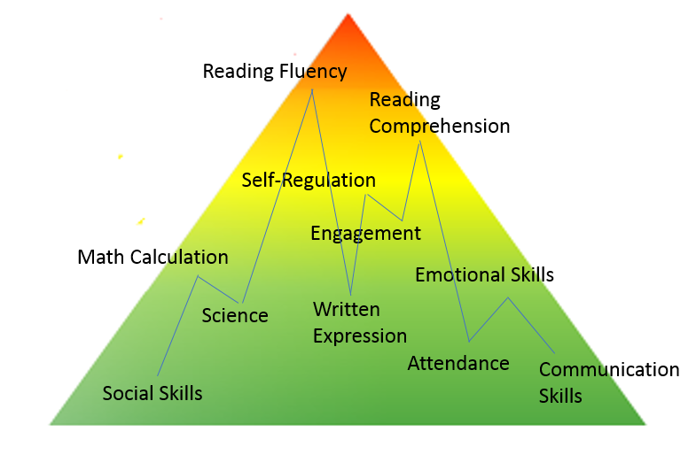
MTSS addresses the needs of the whole child by aligning systems and supports.
There is no such thing as a ‘Tier 2’ or a ‘SPED’ student!

Slide 25
How can MTSS Support IDEA Child Find and Eligibility Determination Obligations?
Assist in child find obligations (i.e., identify, locate, and evaluate) through MTSS screening/risk verification process [20 U.S.C. § 1412(a)(3)(A)].
Ensure provision of Tiers 2-3 interventions to rule out lack of instruction [34 C.F.R. § 300.309(a)].
Provide data to demonstrate “need” for special education [20 U.S.C. § 1401(3)(A)].
Provide formal progress monitoring data that can be provided to parents [34 C.F.R. § 300.309(b)].
Compare student performance to peers and gather data to understand any unique circumstances.

Slide 26
But what about identified students?
To appropriately support identified students with disabilities, we need effective implementation of school-wide MTSS.

Slide 27
We Must Ensure Appropriate Progress
“To meet its substantive obligation under the IDEA, a school must offer an IEP reasonably calculated to enable a child to make progress appropriate in light of the child’s circumstances.” [emphasis added]
—Endrew F. v. Douglas County School District RE-1 (2017)

Slide 28
Strategies for Leveraging MTSS for IEP Development

Slide 29
Strategy 1. Leverage MTSS Data for Present Level Statement
Screening, progress monitoring, and Tier 1 classroom data provide objective, measurable data for how “the child’s disability affects the child’s involvement and progress in the general education curriculum” in the present level statement.
[Sec. 300.320(a)(1)(i)]

Slide 30
Strategy 2: Support Validated IEP Goal Setting
Screening and progress monitoring data and established benchmarks can assist teams in setting realistic, ambitious IEP goals “to enable the child to be involved in and make progress in the general education curriculum” [Sec. 300.320(a)(2)(A)]
Guides available from the National Center on Intensive Intervention at: https://intensiveintervention.org/implementation-intervention/goal-setting

Slide 31
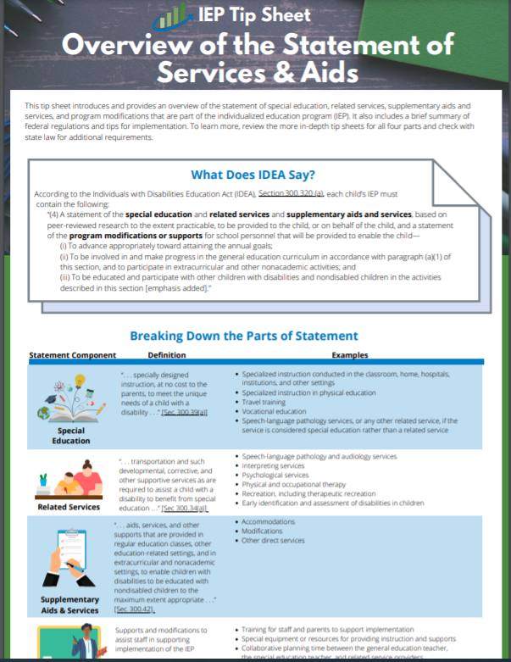
Strategy 3. Use evidence from PM and instructional delivery to develop IEP statement of aids and services.
According to IDEA, Section 300.320 (a), each child’s IEP must contain the following:
“(4) A statement of the special education and related services and supplementary aids and services, based on peer-reviewed research to the extent practicable, to be provided to the child, or on behalf of the child, and a statement of the program modifications or supports for school personnel that will be provided… ″
IDEA, Sec. 300.320(a)(4); emphasis added

Slide 32
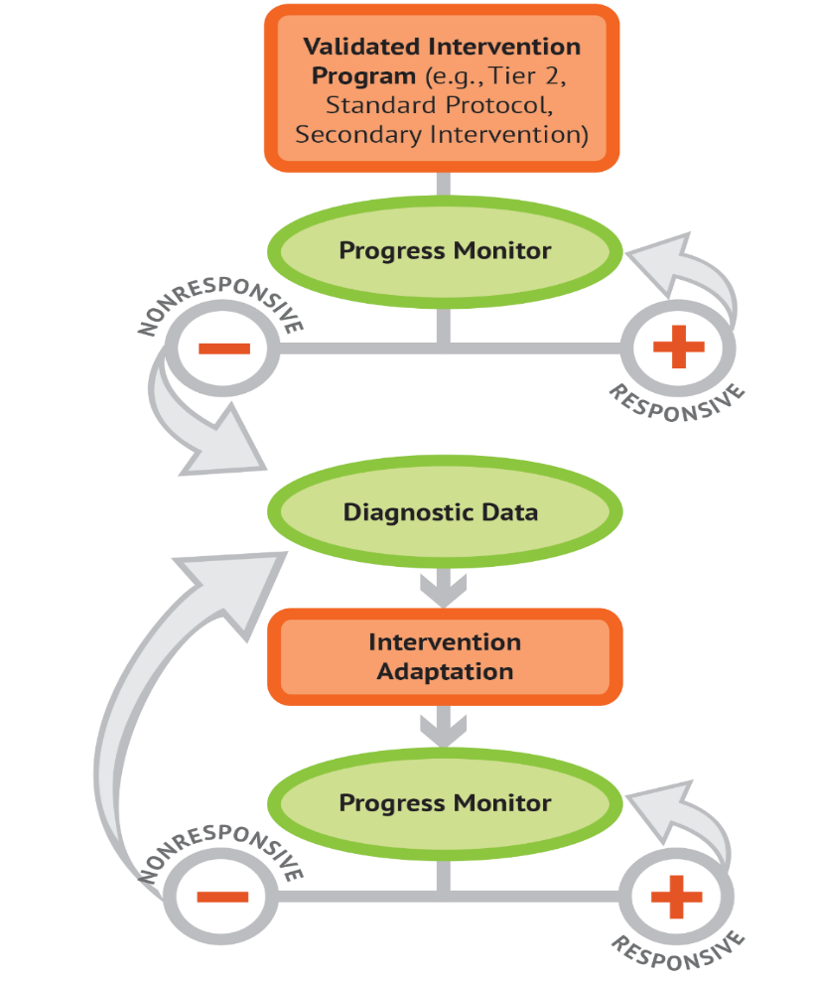
MTSS and Specially Designed Instruction
Requires an evidence-based, iterative process that uses individual progress monitoring data to make decisions about instructional adaptations.
Well-designed MTSS, includes the infrastructure for this process.

Slide 33
Five Steps for Tier 3 and SDI
Validated intervention program, delivered with fidelity
Progress monitoring
Diagnostic data used to develop a hypothesis
Adaptation to validated intervention
Continued progress monitoring, with adaptations occurring whenever needed to ensure adequate progress

Slide 34
Strategy 4. Use progress monitoring to inform the documented intensity of supports
MTSS data can provide evidence for more accurate estimates of level of service needed to promote progress towards goals [Sec. 300.320(a)(7)].
Growth with 60 mins of SDI
Growth with 30 mins of SDI

Slide 35
Leveraging MTSS Components to Implement the IEP

Slide 36
How could MTSS support implementation of the IEP?
Screening and PM support implementation of IEP goal monitoring plan [Sec. 300.320(a)(3)(i)]
Teaming infrastructure facilitates support for school personnel to implement the IEP.
Tier 1 provides required access to the general curriculum through delivery of IEP supplementary aids and services.
Intervention schedule offers time for delivery of SDI and related services.

Slide 37
Special Education Leverages MTSS Levels of Prevention
Characteristics | Tier 2 – Small Group | Tier 3 – Intensive Intervention
Instruction/ Intervention Approach | Follow standardized evidence-based programs as designed | Use standardized evidence-based program as a platform, but adapt instruction based on student data
Duration and timeframe | Use duration and timeframe defined by developer | Increase frequency and/or duration to meet student needs
Group size | 3–7 students (as defined by developer) | Decrease group size to meet student needs (no more than 3
Progress Monitoring | At least monthly | Weekly
Population served | At-risk (typically 15–20% of student population) | Significant and persistent learning and/or behavior needs (typically 3–5% of student population)
Adapted with permission from the National Center on Intensive Intervention

Slide 38
MTSS provides infrastructure for the delivery of the IEP’s statement of services and aids.
“(4) A statement of the special education and related services and supplementary aids and services, based on peer-reviewed research to the extent practicable, to be provided to the child, or on behalf of the child, and a statement of the program modifications or supports for school personnel that will be provided… ″
IDEA, Sec. 300.320(a)(4); emphasis added

Slide 39
High-leverage practices (HLPs) with MTSS
While HLPs are not SDI, their use is essential for the design and delivery of IEP’s, SDI, and related services and ensuring access to the general curriculum.

Slide 40
Six high-Leverage, Evidence-Based Practices in MTSS-1
Planning for Instruction
Cognitive and Metacognitive Strategies
Delivering Instruction
Teaching Social Behaviors
Reviewing and Intensifying Instruction
Instructional Technology

Slide 41
MTSS and the IEP: Common Questions and Answers

Slide 42
What if we are in the initial phases of MTSS implementation?
Regardless of phase of MTSS implementation, schools are still legally obligated to provide a free appropriate public education (FAPE) in the least restrictive environment (LRE) through the IEP for eligible students.

Slide 43
What interventions can we use for SDI?
SDI is not a program and cannot be purchased. However, some students’ SDI may be delivered using existing standardized, purchased programs within MTSS depending on their individual needs.

Slide 44
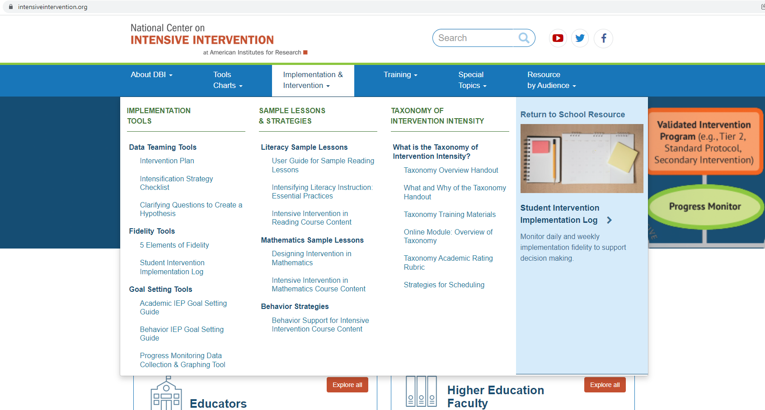
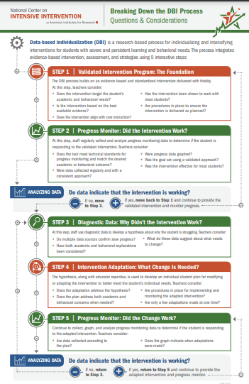
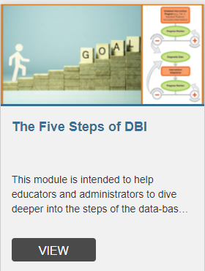
What supports are available to support special education teachers in their role within MTSS?
Connect on Twitter
@MTSSCenter & @TheNCII
https://intensiveintervention.org/

Slide 45
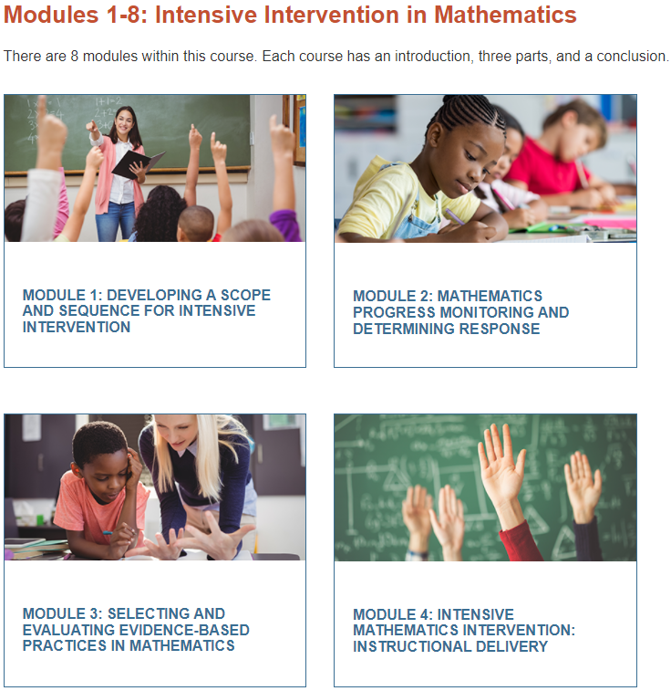
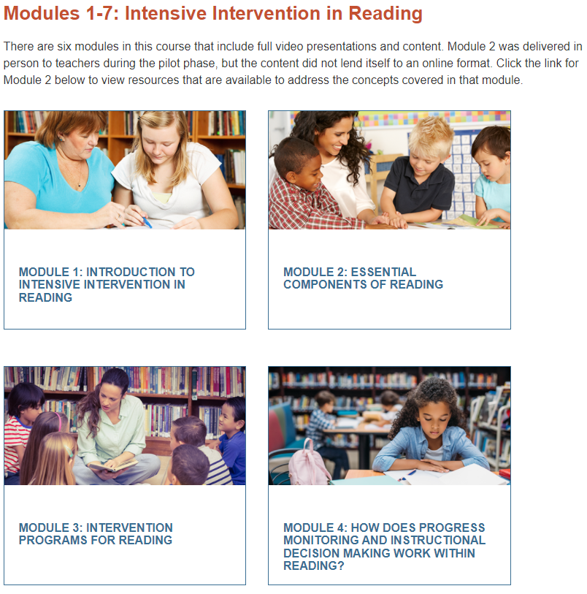
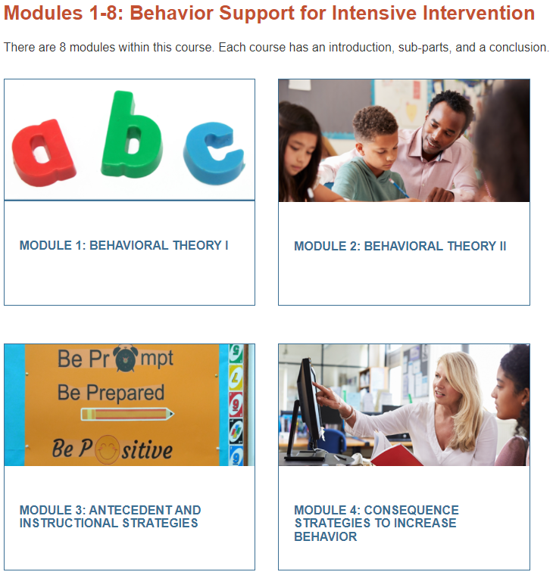
Content Deep Dives for Designing and Providing Specially Designed Instruction
Math
Math
Literacy
https://intensiveintervention.org/training/course-content

Slide 46
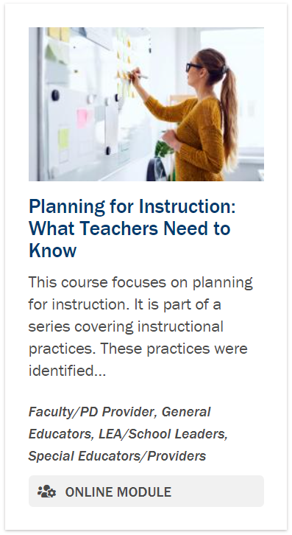
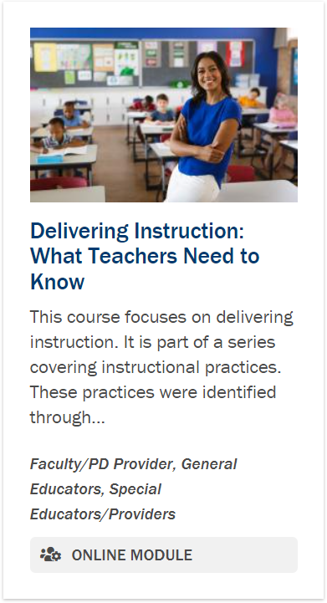
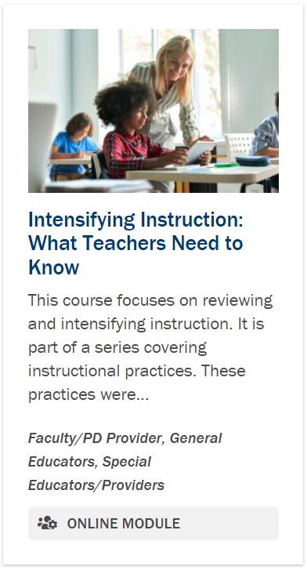
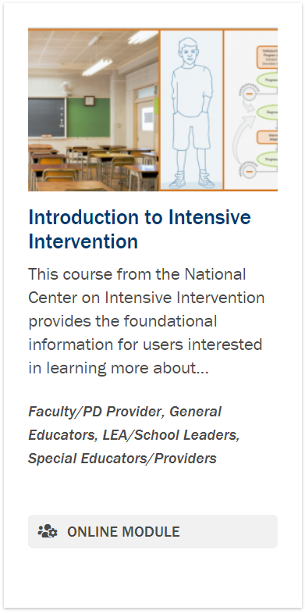
Resources to Support HLPs Across the Tiers
https://promotingprogress.org/training

Slide 47
Remind me again, how can MTSS benefit special education implementation?
Effective special education delivery leverages the data, instruction, infrastructure, and collective effect of MTSS.

Slide 48
Reminder! Connect With the PROGRESS Center
Connect with us on Facebook and Twitter @k12progress
Share your learning about the event at #promotingprogress2023

Slide 49
Don’t Forget
Day 2 Schedule: August 3, 2023
10:15–10:45 a.m. ET (9:15 a.m. CT/8:15 a.m. MT/7:15 a.m. PT) | Topical Discussion
10:45–11:00 a.m. ET (9:45 a.m. CT/8:45 a.m. MT/7:45 a.m. PT) | Break
11:00 a.m.–12:15 p.m. ET (10:00 a.m. CT/9:00 a.m. MT/8:00 a.m. PT) | General Session (we are here!)
12:15–12:45 p.m. ET (11:15 a.m. CT/10:15 a.m. MT/9:15 a.m. PT) | Break
12:45–1:45 p.m. ET (11:45 a.m. CT/10:45 a.m. MT/9:45 a.m. PT) | Concurrent Sessions
1:45–2:00 p.m. ET (12:45 p.m. CT/11:45 a.m. MT/10:45 a.m. PT) | Break
2:00–3:00 p.m. ET (1:00 p.m. CT/12:00 p.m. MT/11:00 a.m. PT) | Concurrent Sessions
3:00–3:15 p.m. ET (2:00 p.m. CT/1:00 p.m. MT/12:00 p.m. PT) | Break
3:15–4:00 p.m. ET (2:15 p.m. CT/1:15 p.m. MT/12:15 p.m. PT) | Closing Session

Slide 50
Reminder! Where can I find event materials and recordings after the event?

Slide 51
Disclaimer
This material was produced under the U.S. Department of Education, Office of Special Education Programs, Award No. H326C190002. David Emenheiser serves as the project officer. The views expressed herein do not necessarily represent the positions or policies of the U.S. Department of Education. No official endorsement by the U.S. Department of Education of any product, commodity, service, or enterprise mentioned in this presentation is intended or should be inferred.

Slide 52
PROGRESS Center
progresscenter@air.org
1400 Crystal Drive, 10th Floor
Arlington, VA 22202-3289
202.403.5000
progresscenter@air.org
promotingprogress.org | www.air.org
https://www.facebook.com/k12PROGRESS/
https://twitter.com/K12PROGRESS
Notice of Trademark: “American Institutes for Research” and “AIR” are registered trademarks. All other brand, product, or company names are trademarks or registered trademarks of their respective owners.
This material was produced under the U.S. Department of Education, Office of Special Education Programs, Award No. H326C190002. David Emenheiser serves as the project officer. The views expressed herein do not necessarily represent the positions or policies of the U.S. Department of Education. No official endorsement by the U.S. Department of Education of any product, commodity, service, or enterprise mentioned in this presentation is intended or should be inferred.

