Slide 1
Introduction to Intensive Intervention
August 4, 2023
Jon Potter, PhD

Slide 2
About the National Center on Intensive Intervention
The mission of the NCII is to build knowledge and capacity of state and local leaders, faculty and professional development providers, educators, and other stakeholders to support implementation of intensive intervention for students with severe and persistent learning and/or social, emotional, or behavioral needs using data-based individualization (DBI).

Slide 3
How Can NCII Support Students with Disabilities?
Students with disabilities should have access to all levels of instruction and intervention they require, including intensive intervention. DBI can specifically enhance the quality of special education by providing a systematic data-based process for:
Designing and providing specially designed instruction based on student need,
Outlining needs, strengths, and baseline performance within the present levels of academic achievement and functional performance
Writing ambitious but realistic individualized education program (IEP) goals,
Evaluating progress toward IEP goals,
Intensifying specialized instruction for students who are not making adequate progress, and
Planning for the whole child.

Slide 4
How Can NCII Support Equity?
The DBI process provides an opportunity to ensure equitable access and outcomes regardless of race, gender, ethnicity, economic status, language status, and disability status, but educators must intentionally examine and consider the impact of unconscious bias within implementation as it relates to assessment and instructional programs, data interpretation, and instructional practices and educational systems must examine the impact of their policies and practices.

Slide 5
How Does NCII Consider Integration?
The success of DBI hinges on educators intentionally considering students’ academic, social, emotional, and behavioral needs through an integrated approach and in designing an intensive intervention plan based on the unique needs and strengths of students.

Slide 6
Event Schedule Overview: Day 3!
Day 3 Schedule: August 4, 2023
11:00 a.m.–12:00 p.m. ET (10:00 a.m. CT/9:00 a.m. MT/8:00 a.m. PT) | General Session
12:00–12:30 p.m. ET (11:00 a.m. CT/10:00 a.m. MT/9:00 a.m. PT) | Break
12:30–1:30 p.m. ET (11:30 a.m. CT/10:30 a.m. MT/9:30 a.m. PT) | Concurrent Sessions
1:30–1:45 p.m. ET (12:30 p.m. CT/11:30 a.m. MT/10:30 a.m. PT) | Break
1:45–2:45 p.m. ET (12:45 p.m. CT/11:45 a.m. MT/10:45 a.m. PT) | Concurrent Sessions
2:45–3:00 p.m. ET (1:45 p.m. CT/12:45 p.m. MT/11:45 a.m. PT) | Break
3:00–4:00 p.m. ET (2:00 p.m. CT/1:00 p.m. MT/12:00 p.m. PT) | Closing Session

Slide 7
Day 3: Concurrent Sessions
Using the Taxonomy of Intervention Intensity to Select, Design, and Intensify Intervention
Using Academic Progress Monitoring for Individualized Instructional Planning
Using Behavior Progress Monitoring for Individualized Instructional Planning
These same sessions will occur from 12:30-1:30 p.m. and 1:45-2:45p.m., so you can choose to attend 2 of the 3 available sessions live. If you are interested in the other session, you can listen to their archived recordings after the event!

Slide 8
Viewing Your Schedule

Slide 9
Joining Sessions

Slide 10
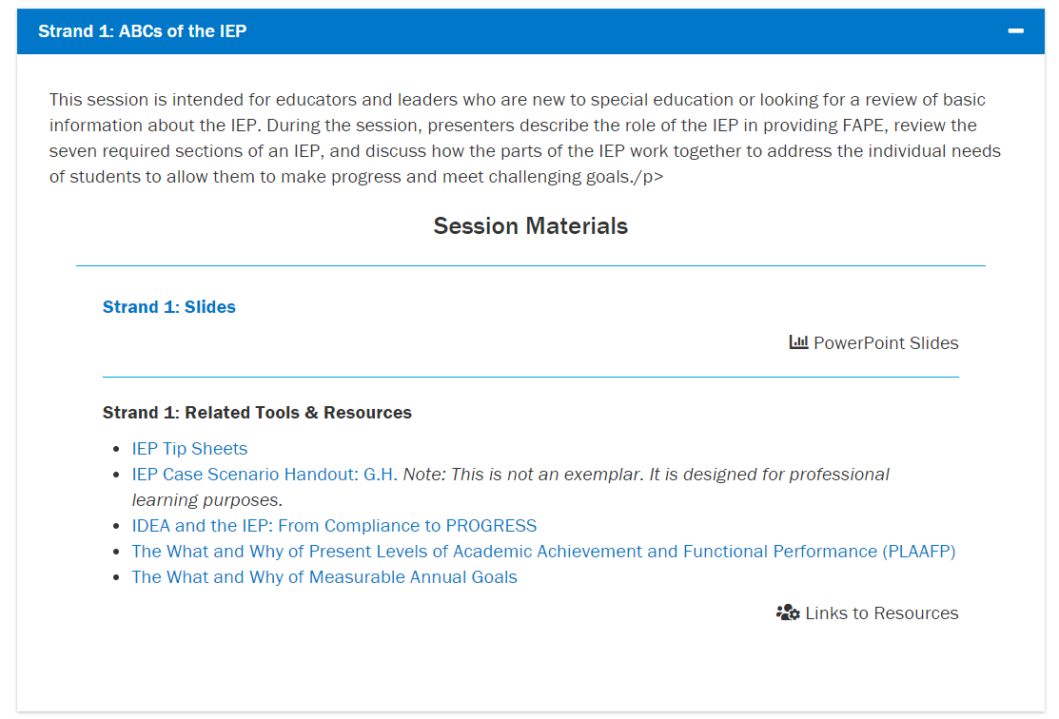
Where can I find event materials and recordings after the event?

Slide 11
Introduction to Intensive Intervention 2

Slide 12
Learner Outcomes
At the end of this session, participants will be able to do the following:
Explain the rationale for intensive intervention.
Describe the steps in the data-based individualization (DBI) process and how they can be used to provide SDI to students with disabilities.
Access and use National Center on Intensive Intervention (NCII) resources to support implementation of DBI.

Slide 13
What is intensive intervention?
Intensive intervention addresses severe and persistent learning and behavioral difficulties.
Characterized by increased intensity and individualization
Driven by data

Slide 14
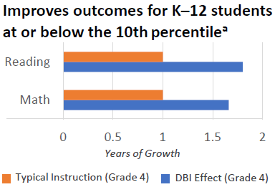
Benefits of Providing Intensive Intervention
“In one year, 78% of students receiving intervention reached ambitious growth goals set using national norms. Thirty percent of students were exited from any kind of intervention.” —Bristol Warren Regional School District, Rhode Island
(Jung, McMaster, Kunkel, Shin, & Stecker, 2018; Scammacca, Fall, & Roberts, 2015)

Slide 15
Introduction to DBI

Slide 16
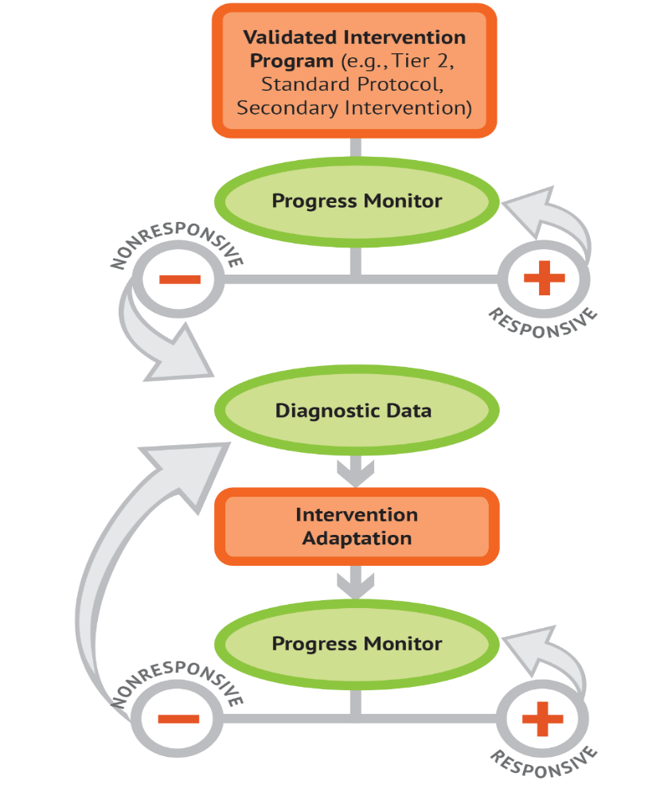
What is data-based individualization (DBI)?
DBI Process
Data-based individualization (DBI) is a research-based process for individualizing and intensifying interventions for students with severe and persistent learning and behavioral needs.
The process integrates evidence-based intervention, assessment, and strategies.

Slide 17
Where does intensive intervention fit within a multitiered system of supports (MTSS)?
Characteristics | Tier 1 | Tier 2 | Tier 3
Instruction/ Intervention Approach | Comprehensive research-based curriculum | Standardized, targeted small-group instruction | Individualized, based on student data
Group Size | Classwide (with some small-group instruction) | 3–7 students (as defined by developer) | No more than 3 students
Progress Monitoring | 1x per term | At least 1x per month | Weekly
Population Served | All students | Students at risk (typically 15% to 20% of student population) | Significant and persistent learning and/or behavioral needs

Slide 18
DBI Process
Validated intervention program, delivered with fidelity
Progress monitoring
Diagnostic data used to develop a hypothesis
Adaptation to validated intervention
Continued progress monitoring, with adaptations occurring whenever needed to ensure adequate progress

Slide 19
DBI Step 1: Lay the foundation for DBI.
STEP 1: Start with a standardized, validated intervention program.

Slide 20
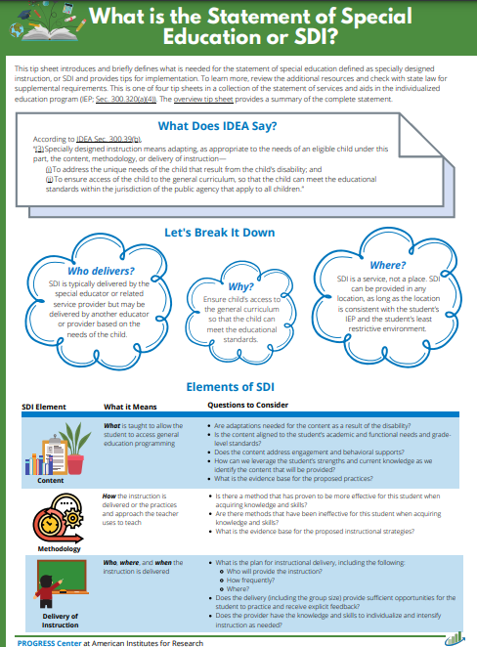
Specially Designed Instruction (SDI)
(3) Specially designed instruction means adapting, as appropriate to the needs of an eligible child under this part, the content, methodology, or delivery of instruction—
(i) To address the unique needs of the child that result from the child’s disability; and
(ii) To ensure access of the child to the general curriculum, so that the child can meet the educational standards within the jurisdiction of the public agency that apply to all children.
Sec. 300.39 Special education, emphasis added
PROGRESS Center
IEP Tip Sheet

Slide 21
Not sure where to start? Select known evidenced-based practices for teaching students with disabilities.
Elements of SDI | What are example evidence-based examples across disability categories?
Content What is taught | Social behaviors, communication, or language skills Five big ideas of reading (knowledge and strategies) Cognitive and metacognitive strategies Math language, math calculation, word problems, fractions, and number sense Functional life skills, vocational skills, or adapted physical education Handwriting, spelling, sentence construction, typing, and word processing
Methodology How the instruction is delivered or the practices and approach the teacher uses to teach | Systematic, explicit instruction delivered in small groups or 1:1; co-teaching Timed activities to build fluency Concrete and semi-concrete representations and number lines Scaffolding, repeated reading, and peer-assisted learning strategies Use of instructional technology or computer-based teaching
Delivery of instruction Who delivers and where and when is it delivered | Where: Special classroom, general education classroom, community-based classroom Who: Content or behavioral specialist, special education teacher, or related service provider When: Providing 10–30 additional practice opportunities distributed across the day; 30–45 minutes daily

Slide 22
DBI Step 2: Did the intervention work?
STEP 2: Develop a progress monitoring plan that includes an ambitious goal.

Slide 23
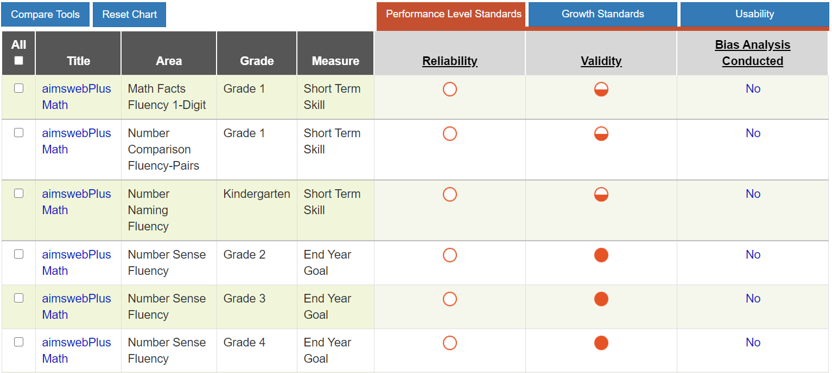
Tools to Support Collecting Valid Reliable Data for Progress Monitoring
Academic Progress Monitoring Tools Chart
Behavior Progress Monitoring Tools Chart
Strategies for Setting High-Quality Academic Individualized Education Program Goals
Strategies for Setting Data-Driven Behavioral Individualized Education Program Guide

Slide 24
Analyzing Data to Guide Decision Making
Do data indicate that the SDI is working?
Initiation of current IEP
Many students with disabilities will respond to the initial delivery of high-quality SDI aligned to the needs resulting from the disability.

Slide 25
Analyzing Data to Guide Decision Making 2
Do data indicate that the SDI is working?
Initiation of current IEP
Initiation of current IEP
For some students with disabilities, our initial design of SDI will not be adequate.

Slide 26
DBI Step 3: Why didn’t the intervention work?
STEP 3: Use informal diagnostic data to develop a hypothesis about WHY the student is not responding.

Slide 27
What should be considered when developing a hypothesis?
Learner
Instruction
Curriculum
Environment
Methodology
How it’s delivered
Content
What is taught
Delivery
Who delivers and
when and where
Elements of SDI

Slide 28
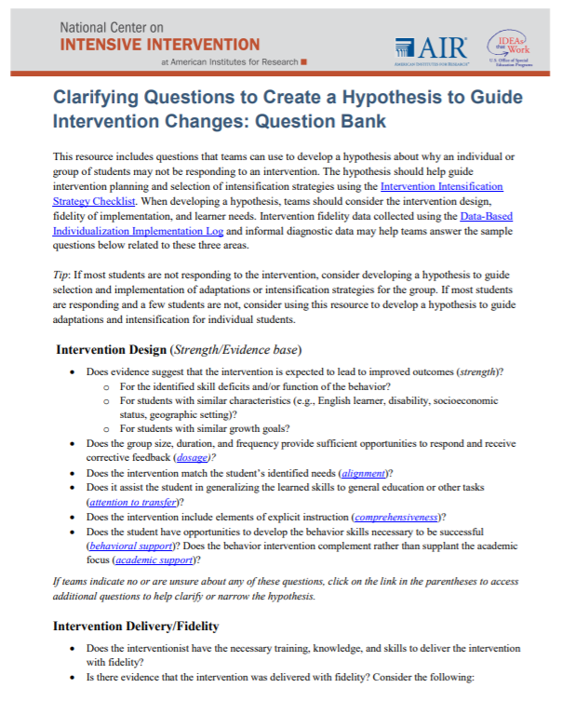
Tools for Analyzing Informal Diagnostic Data
Clarifying Questions to Create a Hypothesis

Slide 29
Tools for Analyzing Informal Diagnostic Data 2
Taxonomy of Intervention Intensity

Slide 30
DBI Step 4: What change is needed?
STEP 4: Intensify and individualize the intervention to address the hypothesis.

Slide 31
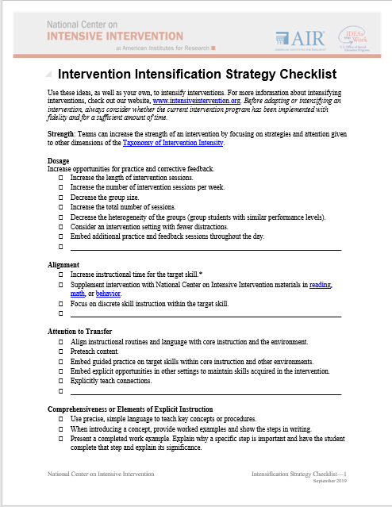
Tools for Adapting and Intensifying Interventions
Consider:
Strength
Dosage
Alignment
Attention to transfer
Comprehensiveness
Behavioral and Academic Support
Individualization
Intervention Intensification Strategy Checklist

Slide 32
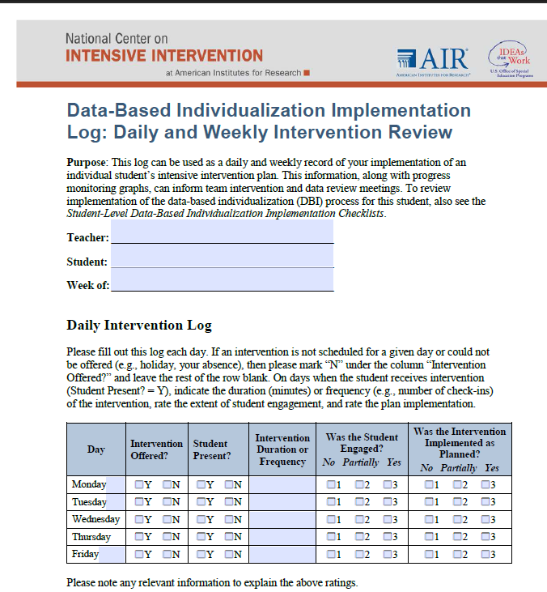
Implementation Monitoring: Was the adapted intervention delivered with fidelity?
Fidelity is still important!
Focus on fidelity to the adapted student plan.
Fidelity Tools

Slide 33
DBI Step 5: Did the change work?
STEP 5: Monitor the student’s response to the adaptation (at least 4–6 data points).

Slide 34
Academics: Is the student responding to the adapted intervention?
Intervention
Adaption 1 Phase Line

Slide 35
DBI is an ongoing process based on the student’s responsiveness to SDI

Slide 36
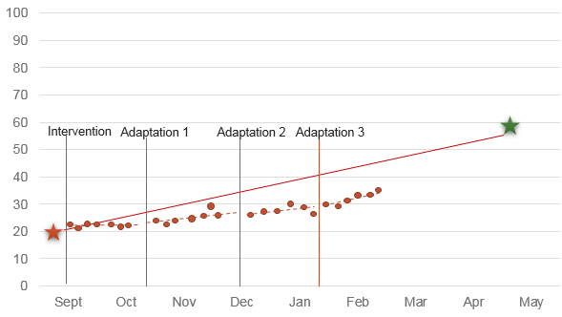
The Ongoing Process of SDI
Adaptation 3
Adaptation 2
Initiation of current IEP
Adaptation 1

Slide 37
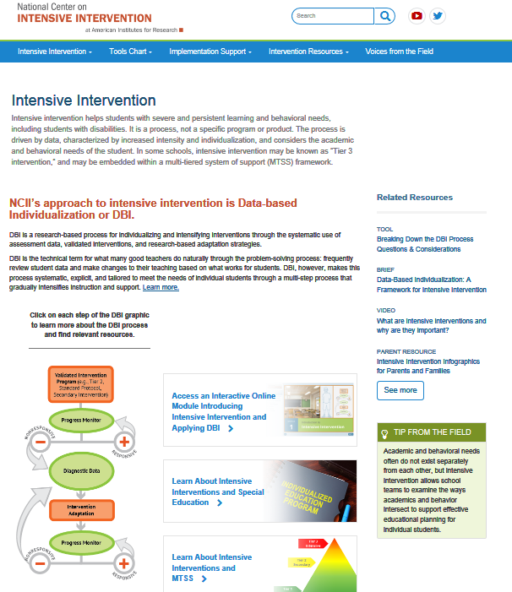
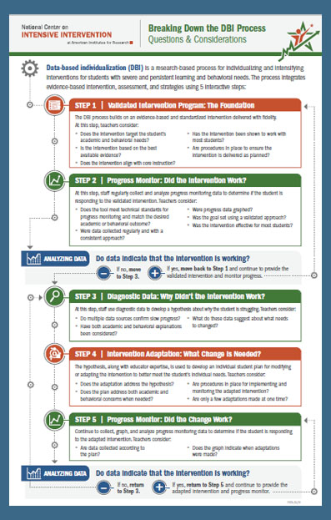
Introduction to DBI and Intensive Intervention
Self-paced module
Web toolkit
One-page overview

Slide 38
NCII Disclaimer
This presentation was produced under the U.S. Department of Education, Office of Special Education Programs, Award No. H326Q260001. Celia Rosenquist serves as the project officer. The views expressed herein do not necessarily represent the positions or policies of the U.S. Department of Education. No official endorsement by the U.S. Department of Education of any product, commodity, service, or enterprise mentioned in this resource is intended or should be inferred.

Slide 39
NCII Contact Information

