Slide 1
Are Accommodations SDI? Myth Busting This And Other Common Confusions In Special Education
Sara Evans | Dr. Tessie Bailey | Alex Marken
August 2023

Slide 2
Session Objectives
Define the four parts of the statement of aids and services.
Explain how the statement of aids and services works with other components of the IEP.
Access resources to support additional learning related to the statement of aids and services.

Slide 3
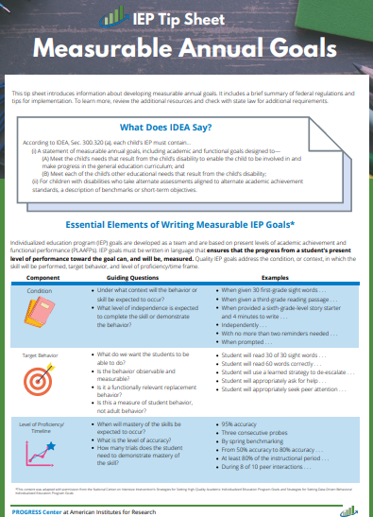
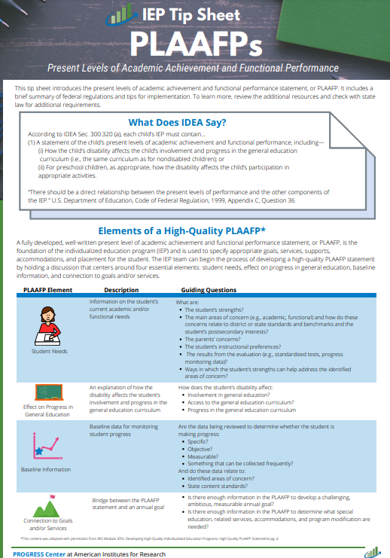
Resources
IEP Tip Sheet: Overview of the Statement of Services & Aids
IEP Tip Sheet: What are Program Modifications & Supports?
IEP Tip Sheet: What are Supplementary Aids & Services?
IEP Tip Sheet: What are Related Services?
IEP Tip Sheet: What is the Statement of Special Education or SDI?

Slide 4
Why promote ambitious growth?
Endrew F. v. Douglas County School District RE-1 (2017)
“To meet its substantive obligation under the IDEA, a school must offer an IEP reasonably calculated to enable a child to make progress appropriate in light of the child’s circumstances.” (emphasis added)

Slide 5
Setting the Stage for Ambitious Growth
To effectively design goals and SDI to promote appropriately, ambitious growth, we must
Maintain high expectations
1
Articulate what we want the student to do
-Teacher clarity = ES .75; -Learning goals = ES .68; -Appropriate challenging goals = ES .59
2
Know the student and their circumstances
[PLAAFP Statement, IDEA Sec. 300.320 (a)(1); Endrew F., 2017]
3
Know what knowledge, skills, and strategies the student needs to meet ambitious goals (focus of SDI!)
4
Source: Effect Sizes from: Hattie, J. (2018). Hattie Ranking: 252 Influences And Effect Sizes Related To Student Achievement https://visible-learning.org/hattie-ranking-influences-effect-sizes-learning-achievement/

Slide 6
For PROGRESS, we need internally consistent IEPs that promote ambitious growth
PLAAFP
Annual Goals
Measuring Progress Toward Annual Goals
Date, Frequency, Duration, and Location of Services
Participation Outside Regular Education and in State and Districtwide Assessments
Statement of Special Education and Aids and Services

Slide 7
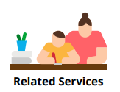
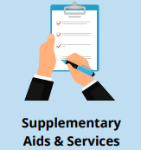
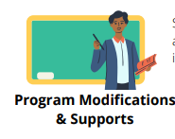
Did you know our proposed services include four parts?

Slide 8
What is on your mind? What questions do you have?

Slide 9
Statement of Aids and Services: Breaking Down the Four Essential Parts

Slide 10
For PROGRESS, we need internally consistent IEPs that promote ambitious growth 2
PLAAFP
Annual Goals
Measuring Progress Toward Annual Goals
Date, Frequency, Duration, and Location of Services
Participation Outside Regular Education and in State and Districtwide Assessments
Statement of Special Education and Aids and Services

Slide 11
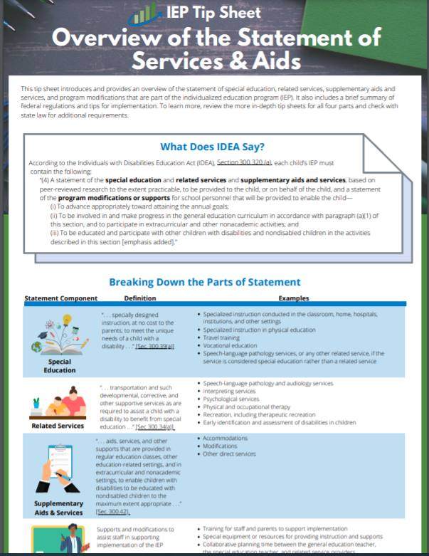
What does IDEA say about the statement of services and aids?
Individually, highlight the key features of the statement of aids and services (4 min).
As you read put in the chat box one of the following:
A question
New learning
A confusion

Slide 12
What does IDEA say about the statement of services and aids? IDEA 1
According to IDEA, Section 300.320 (a), each child’s IEP must contain the following:
“(4) A statement of the special education and related services and supplementary aids and services, based on peer-reviewed research to the extent practicable, to be provided to the child, or on behalf of the child, and a statement of the program modifications or supports for school personnel that will be provided to enable the child—… ″
IDEA, Sec. 300.320(a)(4), emphasis added

Slide 13
What does IDEA say about the statement of services and aids? IDEA 2
“(i) To advance appropriately toward attaining the annual goals;
(ii) To be involved in and make progress in the general education curriculum in accordance with paragraph (a)(1) of this section, and to participate in extracurricular and other nonacademic activities; and
(iii) To be educated and participate with other children with disabilities and nondisabled children in the activities described in this section.”
IDEA, Sec. 300.320(a)(4), emphasis added

Slide 14
Same Need, Same Goal, Different Aids and Services
6th grade student with a learning disability that impacts the student’s ability to decode and fluently read connected text.
Type of Service | Sample Proposed Services
SDI | Daily 30-minute direct instruction in phonics and reading fluency taught by the special education teacher
Related Service | Speech services to address disfluency/stutter impacting fluent reading of connected text
Supplementary | Access to audio books or peer reader
Program modifications/ supports for staff | Special education teacher participation in Orton Gillingham training program

Slide 15
Same Need, Same Goal, Different Services
9th grade student with an other health impairment that impacts the student’s ability to attend and to manage sensory input.
Type of Service | Sample Proposed Services
SDI | Daily, 15-min explicit instruction on cognitive and metacognitive strategies to increase stamina and ability to independently regulate behaviors.
Related Service | Occupational therapy (OT) to provide sensory integration therapy 30- minutes weekly.
Supplementary | Use of noise canceling headphones, wobble cushion for seat, shortened assignments
Program modifications/ supports for staff | Collaborative planning time for OT, general education teacher, and special education teacher to plan appropriate sensory activities in special and general education environments.

Slide 16
Let’s break down the statement of services and aids.

Slide 17
Part 1 Special Education = SDI
Individually, highlight the key features or things you want to remember about SDI (2 min).
In the chat, answer one of the following questions
How do we document what SDI will be provided?
Who generally provides SDI in our school? Who could provide SDI?
What questions do we have about SDI?

Slide 18
Special Education = SDI
(3) Specially designed instruction means adapting, as appropriate to the needs of an eligible child under this part, the content, methodology, or delivery of instruction—
(i) To address the unique needs of the child that result from the child’s disability; and
(ii) To ensure access of the child to the general curriculum, so that the child can meet the educational standards within the jurisdiction of the public agency that apply to all children.
IDEA, Sec. 300.39, emphasis added

Slide 19
Specifically Adapting the Instructional…
Elements of SDI | What it Means
Content | What is taught to allow the student to access general education programming
Methodology | How the instruction is delivered or the practices and approach the teacher uses to teach
Delivery of Instruction | Who, where, and when the instruction is delivered

Slide 20
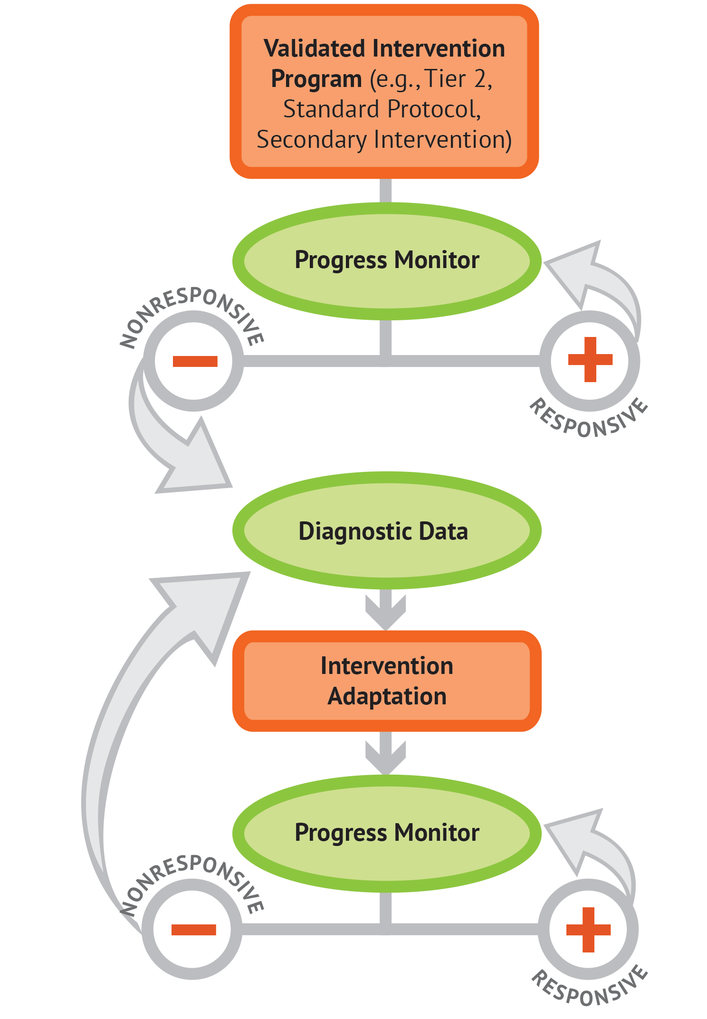
SDI requires an iterative process based on individual student data
Data-based individualization or DBI
Research based process for individualizing and intensifying instruction and intervention through the systematic use of assessment data, validated interventions and research-based strategies
Process not a program or product
Considers academic and functional needs of the student
Content adapted with permission from the National Center on Intensive Intervention

Slide 21
Validated process for designing SDI
Collaboration opportunities to identify need and next steps
IEP or learning outcome goal
Intervention
Adaptation 1
Adaptation 2

Slide 22
IDEA Sec. 300.306: Eligibility Requirements
A group of qualified professionals and the parent of the child determines whether the child meets the criteria for at least 1 of 13 disability categories.
needs special education and related services because of the disability (not due to lack of academic instruction or limited English proficiency).
AND
The need for SDI must result from the impact of the disability.

Slide 23
Part 2 Related Services
Individually, highlight the key features or things you want to remember about related services (2 min).
In the chat, answer one of the following questions:
How do we determine which students need what related services?
What is the primary purpose of related services?
Who generally provides related services? Who could provide these services?

Slide 24
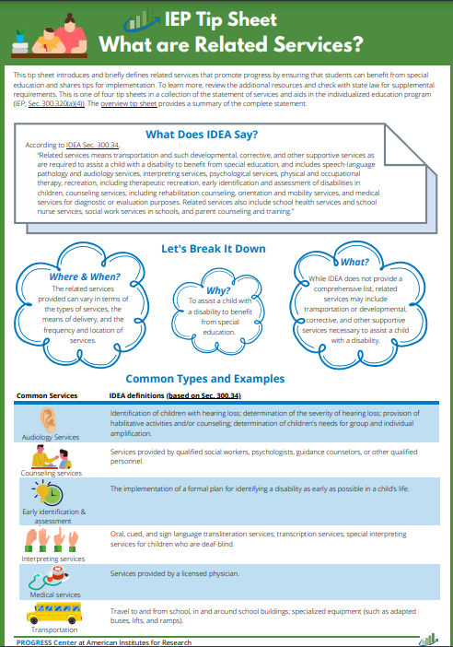
Related Services
“Related services means transportation and such developmental, corrective, and other supportive services as are required to assist a child with a disability to benefit from special education, and includes speech-language pathology and audiology services, interpreting services, psychological services, physical and occupational therapy, recreation, including therapeutic recreation, early identification and assessment of disabilities in children, counseling services, including rehabilitation counseling, orientation and mobility services, and medical services for diagnostic or evaluation purposes.
Related services also include school health services and school nurse services, social work services in schools, and parent counseling and training.”
IDEA Sec. 300.34, emphasis added

Slide 25
Did you know?
In some cases, special education includes “speech-language pathology services, or any other related service, if the service is considered special education rather than a related service under State standards” and meets the definition of SDI.
For example, a student with a physical impairment who needs physical or occupational therapy SDI to benefit from physical education curriculum.

Slide 26
Part 3 Supplementary Aids and Services
Individually, highlight the key features or things you want to remember about supplementary aids and services (2 min).
In the chat, answer one of the following questions:
How do we determine which students need what supplementary aids and services?
What is the primary purpose of these aids and services?
Whose role is to provide these services?

Slide 27
Supplementary Aids and Services
“Supplementary aids and services means aids, services, and other supports that are provided in regular education classes, other education-related settings, and in extracurricular and nonacademic settings, to enable children with disabilities to be educated with nondisabled children to the maximum extent appropriate...”
IDEA Sec. 300.42, emphasis added

Slide 28
Instructional Accommodations v. Modifications
Instructional Accommodations | Instructional Modifications
Changes how students access or demonstrate learning but does not change what they learn. | Changes what students learn and more commonly used with students who require more support or adjustments than accommodations can provide.
Examples include— Extended time to complete a task Reader for math assignment Calculator for problem-solving tasks | Examples include— Changing the expectations for learning Reducing the requirements of the task Reader for a reading comprehension activity Calculator for math calculation activities
Content adapted with permission from IRIS Center https://iris.peabody.vanderbilt.edu/module/acc/

Slide 29
Did you know? 504
Students who only need accommodations to access and benefit from the general curriculum are not eligible as a child with a disability under IDEA. However, these children may be eligible under Section 504.

Slide 30
Part 4 Program Modifications and Supports
Individually, highlight the key features of or things you want to remember about program modifications or supports (3 min).
In the chat, answer one of the following questions:
How do we determine which students need what program modifications or supports?
What is the primary purpose of these supports? Which personnel may need these services?
Who is responsible for providing these services?

Slide 31
Program Modifications and Supports
(4) . . . a statement of the program modifications or supports for school personnel that will be provided to enable the child—
(i) To advance appropriately toward attaining the annual goals;
(ii) To be involved in and make progress in the general education curriculum in accordance with paragraph (a) (1) of this section, and to participate in extracurricular and other nonacademic activities; and
(iii) To be educated and participate with other children with disabilities and nondisabled children in the activities described in this section.”
IDEA Sec. 300.320 (a),

Slide 32
Closing and Resources

Slide 33
Statement of Aids and Services
Statement of special education and aids and services
Related services
Supplementary aids and services
Program modifications and supports
Special education

Slide 34
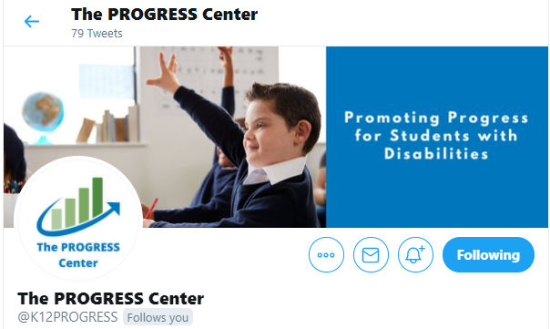
Staying Connected With the PROGRESS Center
Connect with us on Facebook and Twitter @k12progress
https://promotingprogress.org/news/connect-progress-center

Slide 35
Disclaimer
This material was produced under the U.S. Department of Education, Office of Special Education Programs, Award No. H326C190002. David Emenheiser serves as the project officer. The views expressed herein do not necessarily represent the positions or policies of the U.S. Department of Education. No official endorsement by the U.S. Department of Education of any product, commodity, service, or enterprise mentioned in this presentation is intended or should be inferred.

