Slide 1
Creative Ways to Engage Families and Community Members:
Lessons from Co-Creating Resources With Families to Demystify Special Education
Donna Sacco | Kathleen Donovan|
Gina Argotti | Monica Lozano Caldera
August 2023
XXXXX_MO/22

Slide 2
Meet the Presenters
Donna Sacco
Kathleen Donovan
Gina Argotti
Monica Lozano
Caldera
Senior Technical Assistance Consultant
AIR
Parent Resource Coordinator
Arlington, VA Public Schools
Parent Leader
Arlington, VA Public Schools
Diversity, Equity, and Inclusion Coordinator
Arlington, VA Public Schools
Notes:
The image placeholders are 2” by 2” square. Please use high resolution photos (300 ppi) that have been cropped to a minimum size of 2” square (150x150 pixels). Photos should be head and shoulder only with a plain background. To insert an image in a blank picture placeholder, click the picture icon to open the Insert Picture dialog, navigate to the folder that contains the desired image and double-click the image. Delete an existing image, rather than changing it. If square images aren’t used, it may be necessary to reset the slide layout by clicking on the Reset option in the Slides group of the Home menu.
Delete unused presenter placeholders and re-center the remaining placeholders if necessary.

Slide 3
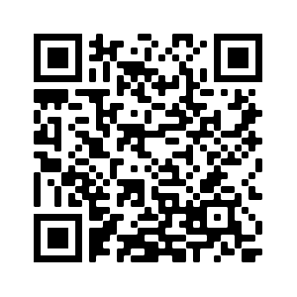
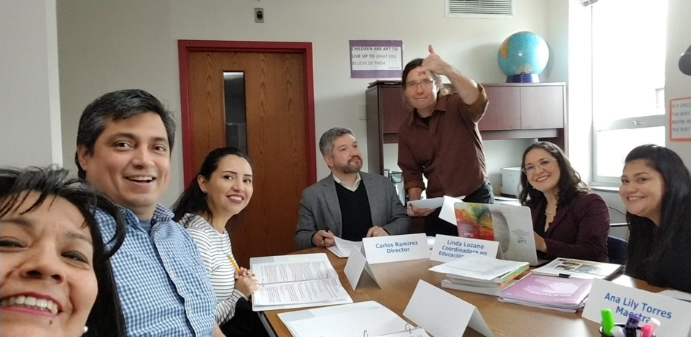
La Sopa de la Abuela/Grandma’s Soup: The telenovela as a tool to help families
navigate special education
Prepping for PROGRESS August 2-4, 2023
Tell us what brings you to our session!
Notes:
Kathleen: 20-30 seconds
Welcome! We are thrilled to be here with the PROGRESS Center community today. Many thanks to Donna Sacco for their kind invitation and for coordinating our session today.
Our team from Arlington Public Schools - or APS as we often refer to ourselves - is excited to share a project we’re incredibly proud of: La Sopa de la Abuela!

Slide 4
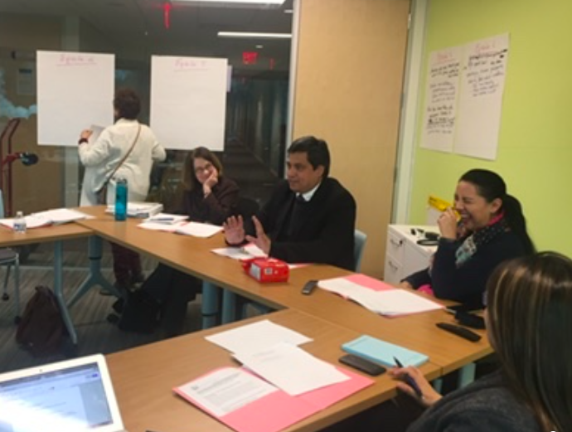
Learning Objectives
In this session, you will—
Learn why and how we created a telenovela
Discover how the telenovela format can support families (and staff) navigating the special education process
Obtain new ideas, tools, and resources to prepare families to navigate special education and advocate for their children.
Reflect on the power of collaborative approaches for supporting families.
Notes:
Kathleen: 25 seconds
Our goals for today are to share why and how our telenovela came to be; the research it was based on; the approach we used to co-create the session; how the information we were trying to share was transformed into a video; how this tool can support families (and staff) in navigating the special education process; and the power of collaborative approaches for supporting families.
Transition to introductions….

Slide 5
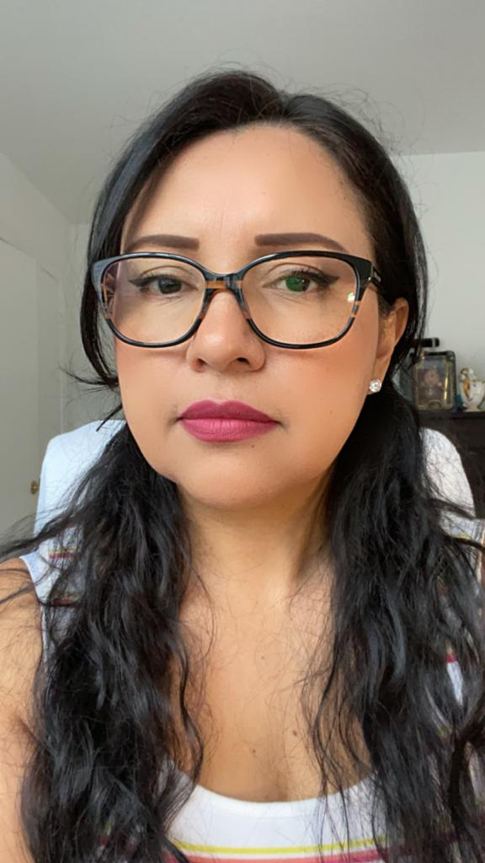
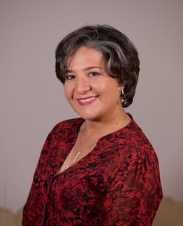
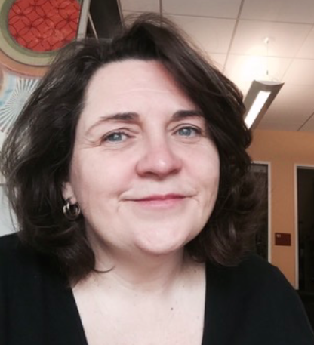
Our Team
Gina Argotti APS Parent Leader
Monica Lozano Caldera Diversity, Equity & Inclusion Coordinator
Kathleen Donovan Special Education Parent Resource Center Coordinator
Notes:
KATHLEEN: 2.5 minutes (30 seconds each for intros)
Speaking of collaboration, one of the things we’re most proud of about La Sopa de la Abuela is the collaborative design and production team that we represent today.
We’ve listed our names alphabetically, and fortunately our first team member represents the most important part of our design team - our parent community!
Gina, would you take a moment to introduce yourself?
(Once Gina finishes, she can introduce Monica).
Monica introduces herself, then tosses to Kathleen.
Kathleen introduces.
Thank you, Monica. My name is Kathleen Donovan, and I’m incredibly proud to be a member of the initial design that created La Sopa de la Abuela. I have spent my entire career as a special educator working in the disability community, and have been with APS for over 30 years. For the last 22 years, I have served in my current role as a Special Education Coordinator at our Parent Resource Center.

Slide 6
Welcome and Introductions
Conociéndonos /Getting to Know Each Other
In the chat, please share:
Your name
Your role and district/organization
What brings you to this session
Notes:
Monica: 1-2 minutes OUR dear friend, and former colleague, Dr. Rosa Briceno, was one of our design team members who was masterful in using effective engagement strategies during sessions. Rosa also opened our sessions with “Conociendonos”... which means “getting to know each other”. Even though we’re virtual, now that you know a little bit about us, let’s find out who else is here in our virtual space. Please share your name, your role, where you’re from, and what brings you to this session in the chat.

Slide 7
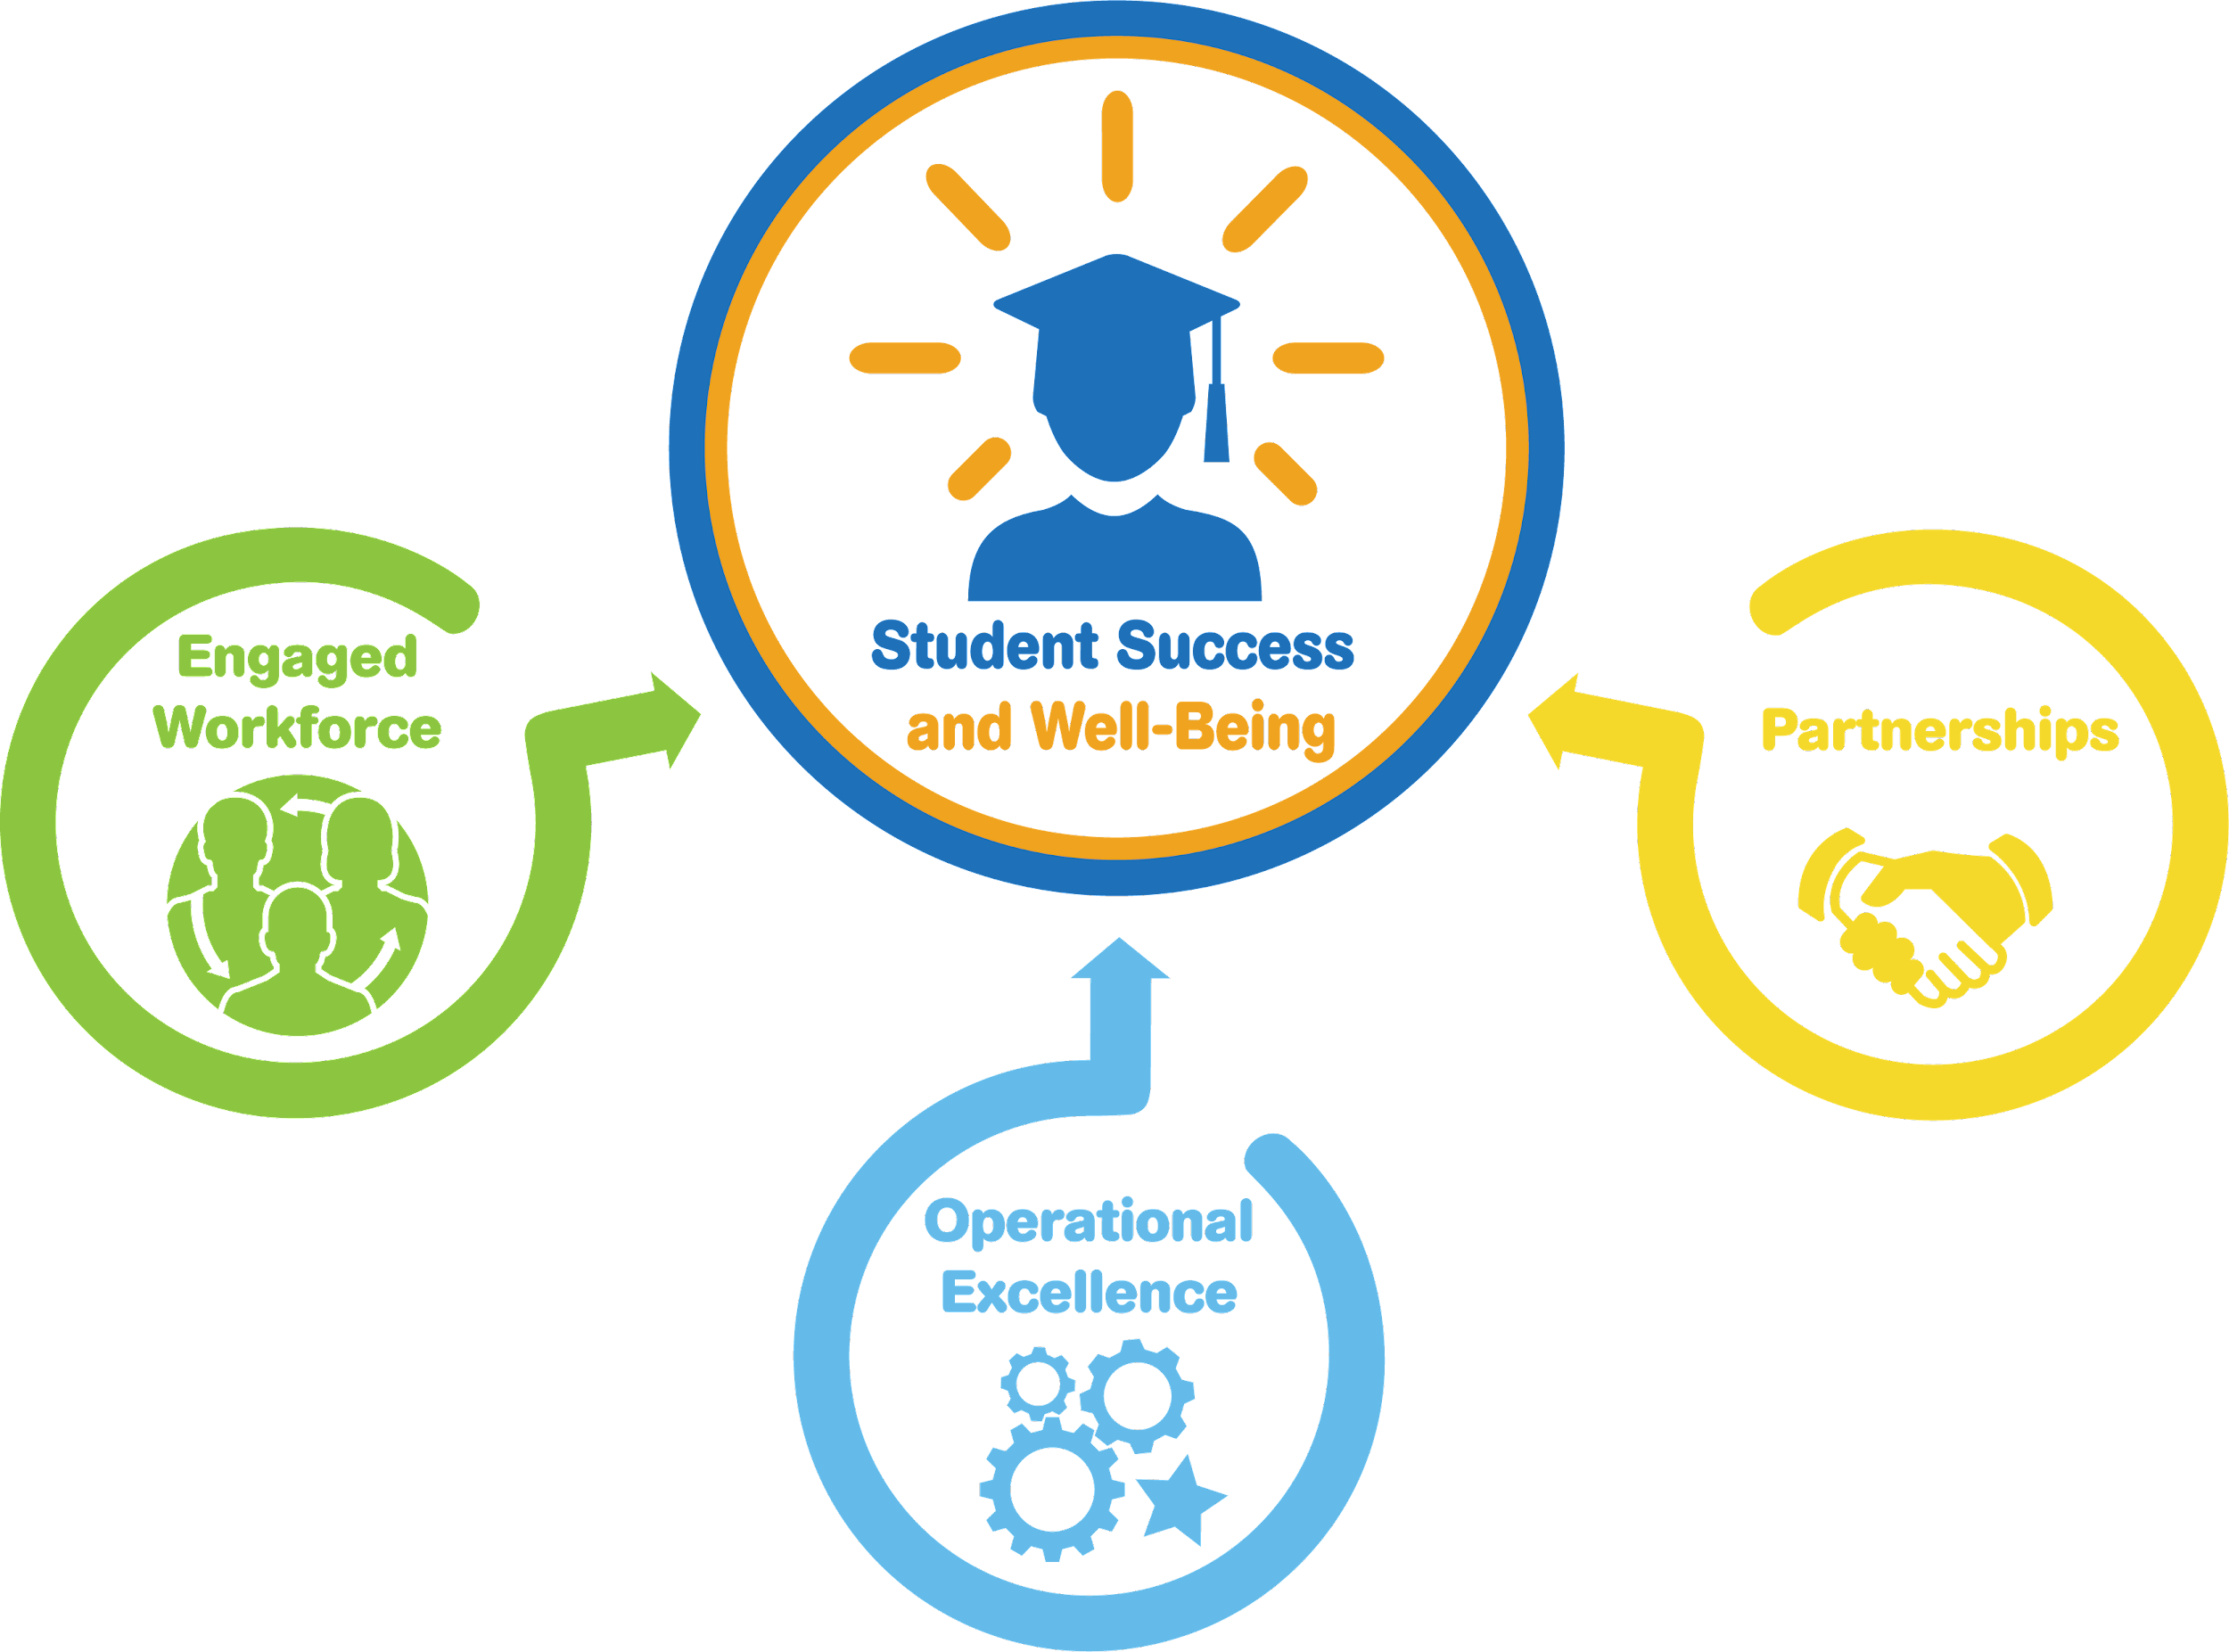
Arlington Public Schools, VA
2018-24 Strategic Plan Goals
Our School District
26 Elementary Schools
6 Middle Schools
4 High Schools
6 additional secondary programs
1 K-12 Virtual Learning Program
Develop strong and mutually supportive partnerships
Notes:
Kathleen: 30 seconds
To provide context, Arlington Public Schools is a diverse and dynamic community located just across the Potomac River from Washington, D.C.
APS is the 13th largest of Virginia’s 132 school divisions.
In our 26 square miles, we have: (Read school numbers above)
On the next slide, you can learn more about our diverse student body.

Slide 8
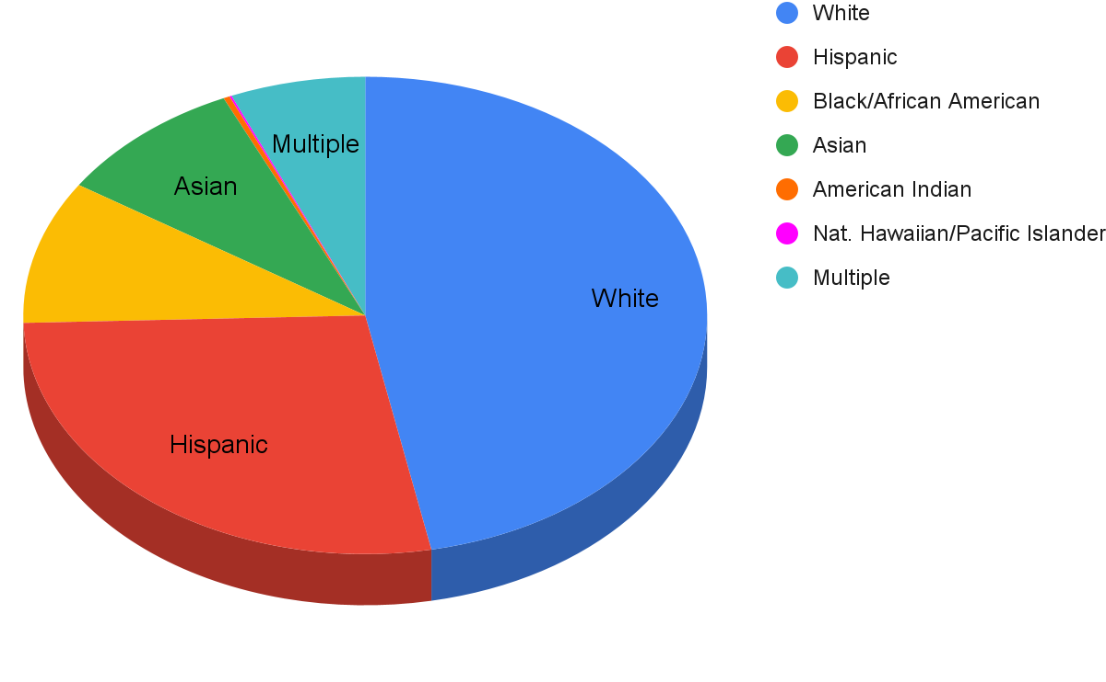
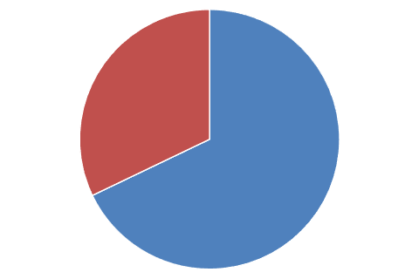
Our Students
APS’ richly diverse 27,045 students from Pre-K to 12th Grade
hail from 142 nations and speak 115 languages
Race/Ethnicity
Black/African American
Economically Disadvantaged
32%
Notes:
Kathleen: 20 seconds
APS’ students hail from 142 nations and speak 115 different languages.
You can see from the pie chart on the screen that our community is richly diverse.
White 46.9 %
Hispanic 27.6 %
Black/African American 9.7 %
Asian 9.0 %
Amer. Indian/Alaskan Nat. 0.3 %
Nat. Hawaiian/Pac. Islander 0.1 %
Multiple 6.4 %
Approximately 32% of our students qualify for free/reduced lunch.

Slide 9
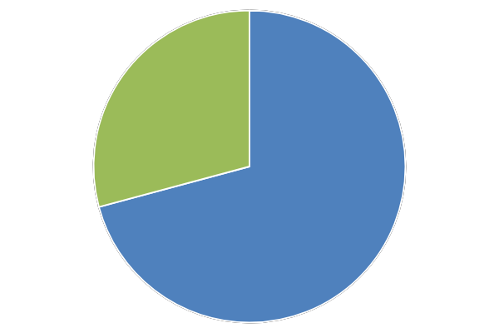
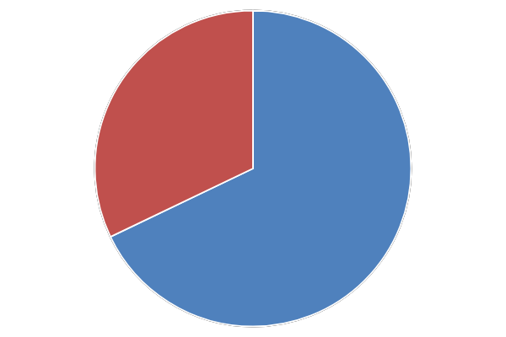
Approximate numbers of students who speak a language other than English at home
In APS
Receiving special education services in APS
29%
32%
Notes:
Kathleen: 15 seconds
Approximately 29% of our students speak a language other than English at home.
Approximately 32% of our students with disabilities speak a language other than English at home.

Slide 10
FACE in APS
Notes:
Kathleen: 1 minute
In 2014, APS adopted a Family and Community Engagement (FACE) policy that aligns with the dual capacity framework organizational (integrated, systemic, sustained) and process conditions (relational, collaborative, linked to learning) as well as the National PTA standards.
Our district’s demographics and our FACE policy laid the foundation for how La Sopa de la Abuela came to be.

Slide 11
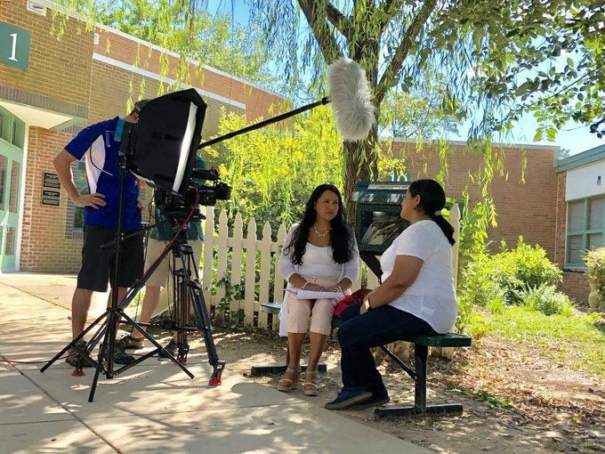
Why the Telenovela
Responds to a strongly felt need in our school community.
Provides additional supports for families of EL learners with special needs.
Notes:
Kathleen & Gina : 4 minutes
Kathleen - 1 minute
Here in APS, we believe it is powerful to start with WHY - to focus on and identify WHY we do the work we do.
Our WHY for this project was simple but compelling. Parents and staff both care deeply about outcomes for students.
We know as you do that family engagement positively impacts those outcomes, and the regulations that govern special education require family engagement. However, we also know that special education processes are often very emotional and complex - especially when trying to navigate them in a foregin language. Conversations among colleagues and with families clarified a significant and unmet need in our community.
Gina, from a parent’s perspective, can you tell us a little bit more about how it felt to be navigate the special education process at the beginning of your family’s journey?
GINA - 2-3 minutes - Describe the need for resources and information from a parent perspective.
Gina: Briefly TELL your STORY - what type of supports did I need, the challenges of learning about special education & navigating the process in a second language
Kathleen (30 seconds): Thanks so much, Gina. So, our WHY was to ensure that families were connected to the information and resources they needed to navigate special education; to address the emotions that come along with it; to make informed decisions and provide informed consent; and to develop strong and positive partnerships with school staff because we know that this knowledge and advocacy will make a difference for families, staff, and most importantly, for our students.

Slide 12
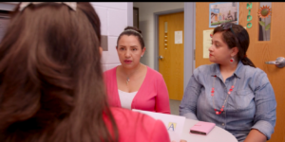
The Telenovela as an educational tool
Popular Education/Popular Theater methods
Problem Posing approach
Use “codes” to help focus group attention on a problem
Use questions to generate discussion about a real-life situation
Adult Education Principles
Notes:
MONICA: 3minutes
Once we identified our unmet need related to special education and WHY it was so important to address it, we turned to our next question …. HOW to respond to this need.
As we considered various options, our team was drawn to both the principles of adult education, and the work in popular education that was pioneered by Paulo Freire, a Brazilian educator and philosopher who became a leading figure in critical pedagogy around the world. Freire developed a problem-posing approach that continues to inspire educators today. It recognizes the crucial role of dialogue in adult learning and the necessity to base any teaching on the learners’ own lives and experiences.
The telenovela format serves as a sort of “cultural code” where people can see themselves reflected, and can focus their attention on resolving a real life problem they face.

Slide 13
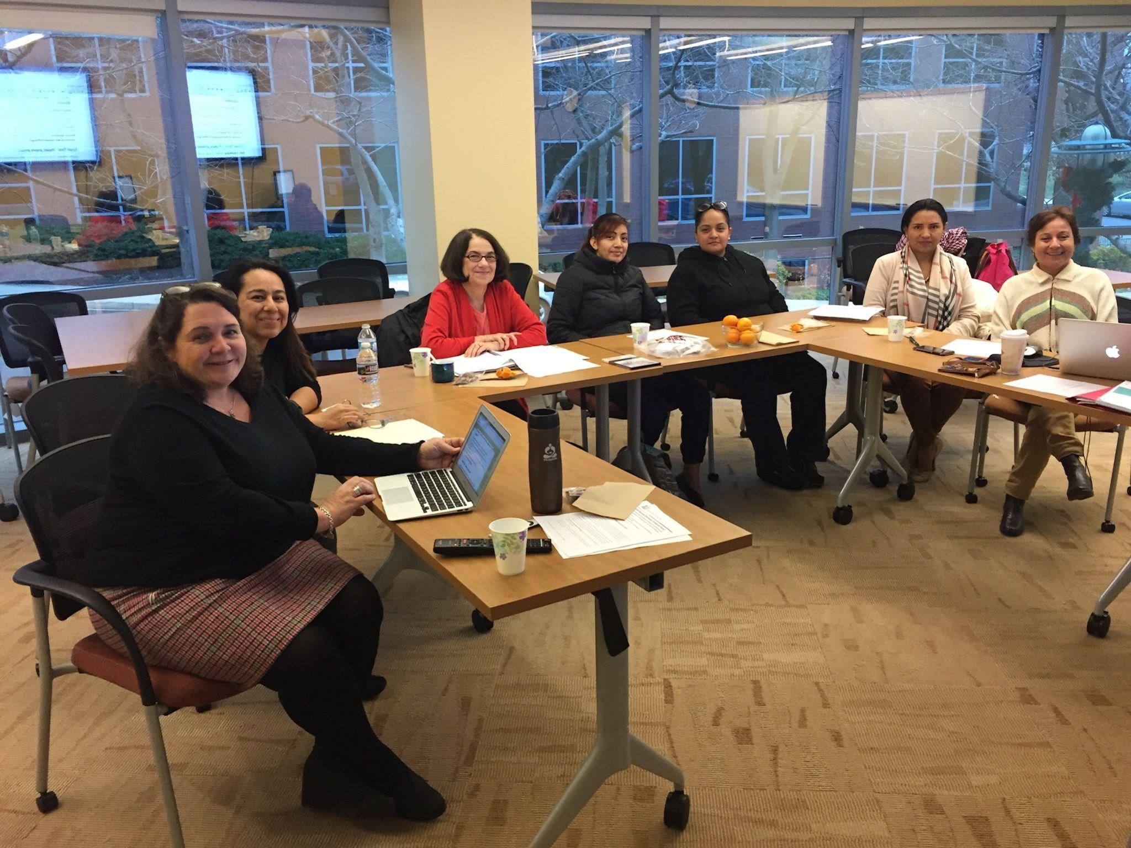
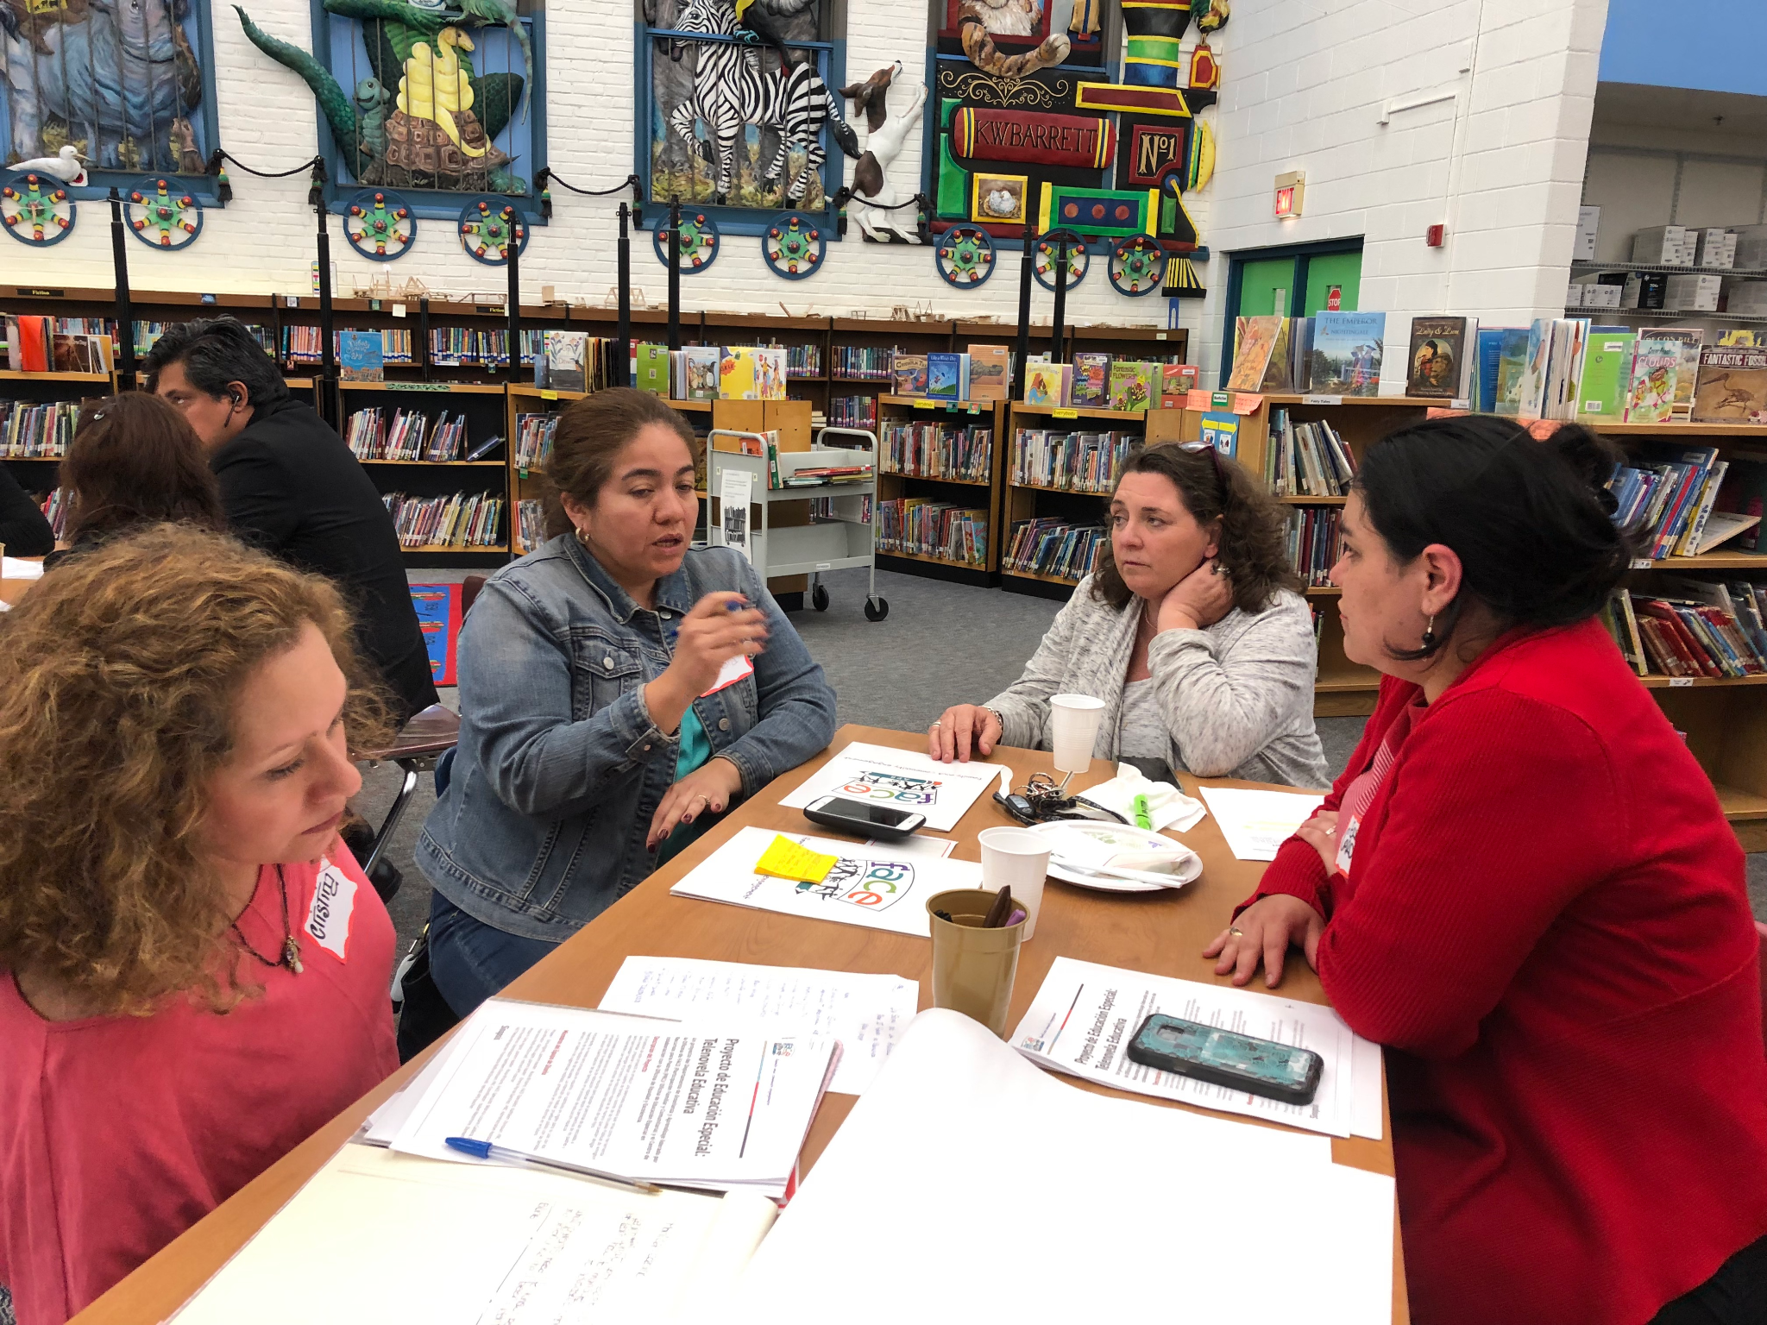
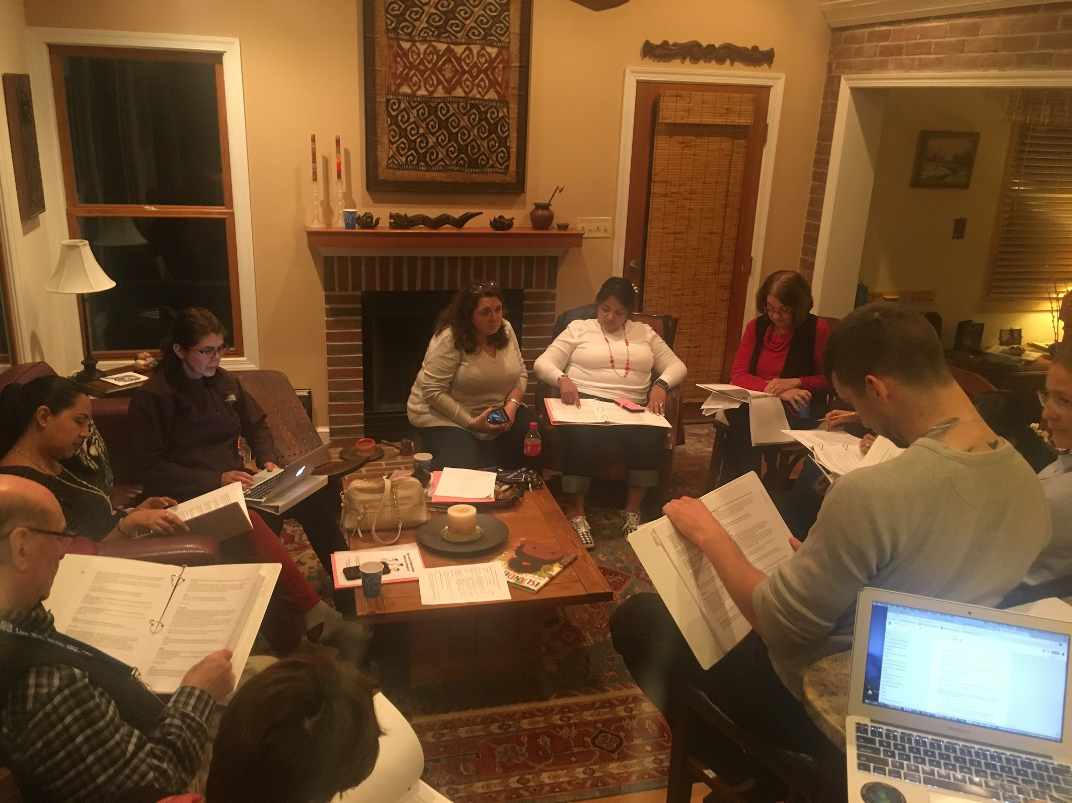
Co-Creation
Doing with parents,
not for parents
Working in partnership:
Design Team
Scriptwriting
Focus groups
Notes:
MONICA: 1-2 minutes
In considering our FACE policy and the dual capacity framework, we realized immediately that this project required a collaborative approach, and that we needed not just to create a resource FOR parents, but to create a resource WITH parents. So, our design team began co-creating a script. Our then FACE Specialist, Dr. Briceno, brought knowledge of family engagement. Kathleen brought knowledge of the special education process and the roles of families as members of educational teams. Gina and the other parents on the design team brought their stories, and lived experiences.
Together, the collaborative design team with representatives from special education, FACE and English Learners, combined with parent leaders, identified the messages that were important to include in the telenovela. They worked for almost a year writing the script, and conducting focus groups in the community. Fortunately we had an amazing Arlington Educational Television (AETV) team who then made the magic happen! Bryan will tell you more about how the script was transformed once we turned it over to AETV.

Slide 14
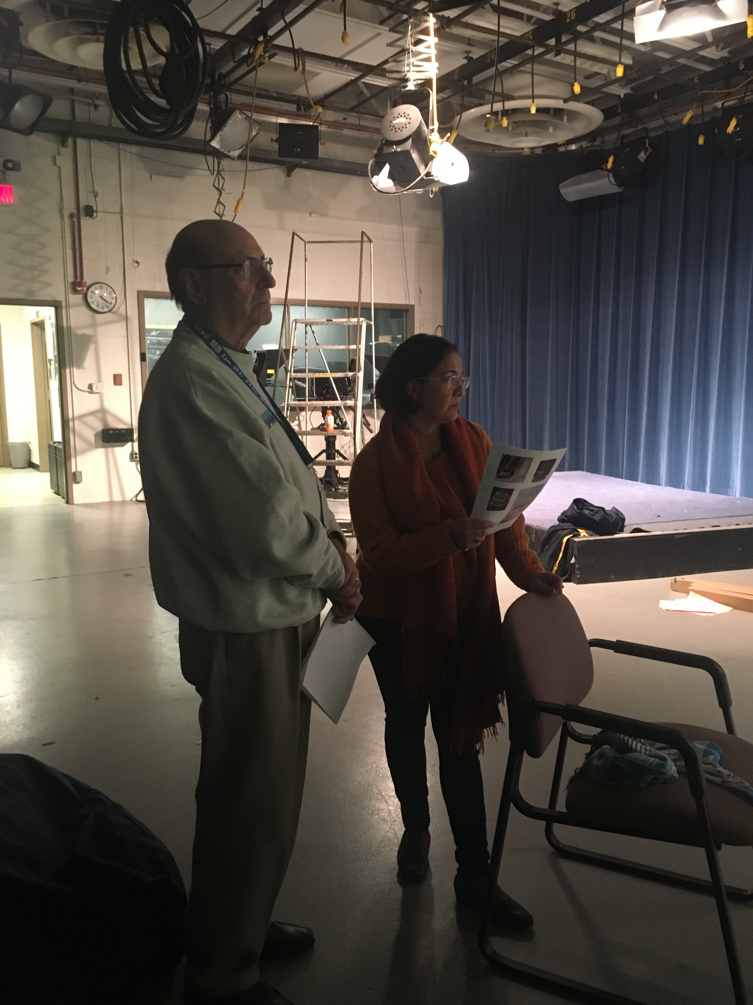
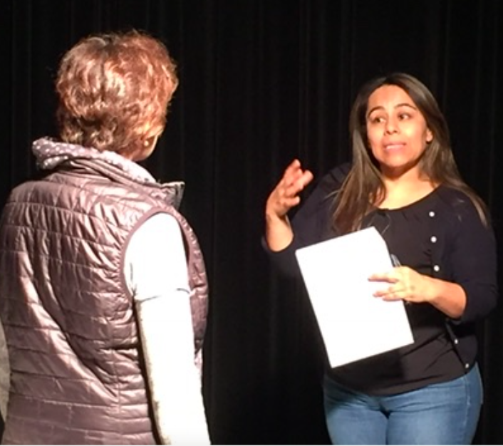
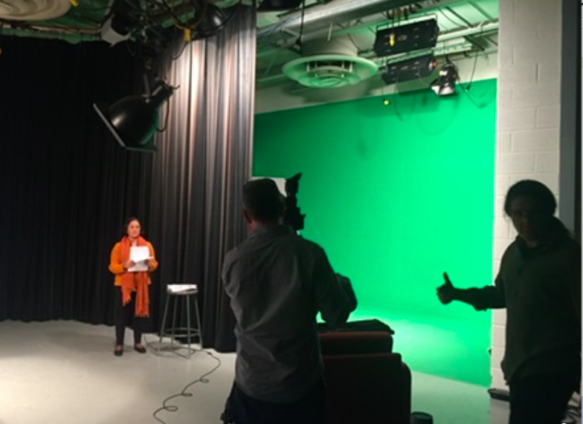
Video Pre-Production
Notes:
Kathleen - 30 SECONDS
Pre-Production:
1) After the design team created the script,we worked with our amazing colleagues in Arlington Education Television (AETV)
2) Who took our written words and turned them into moving images
3) They worked with us to help us “Show not tell” our story
4) Casting for roles story
-Juan & Patricia blew us away
-They commented no older roles in script
-We decided to write them in
-That community engagement & collaboration invaluable
-Dynamic interactions led to best parts and title of Telenovela
-Trans-generational story important for cultural significance of target audience
-Cast included, Administrative staff, teachers, support staff, Parents, Principal

Slide 15
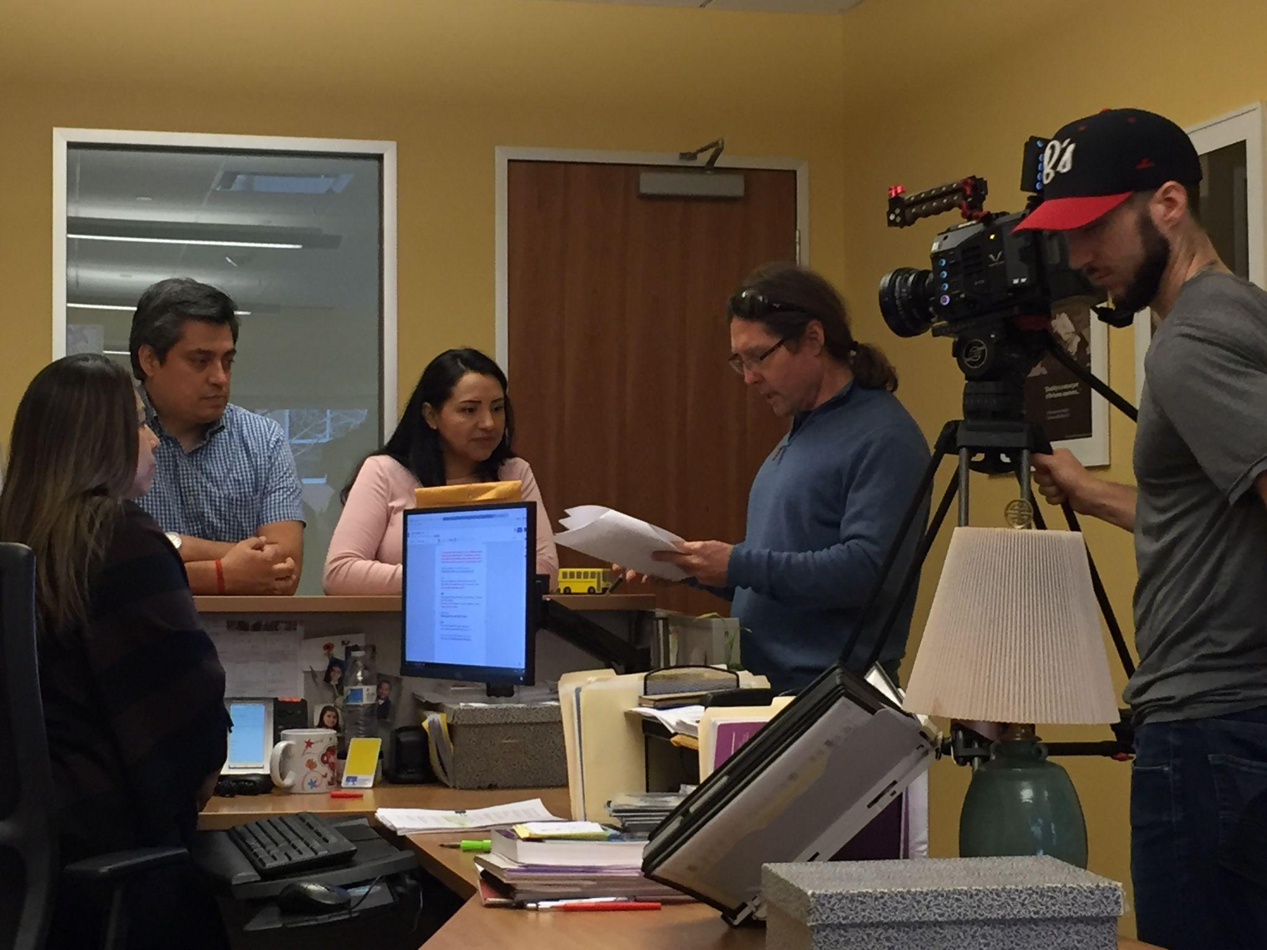
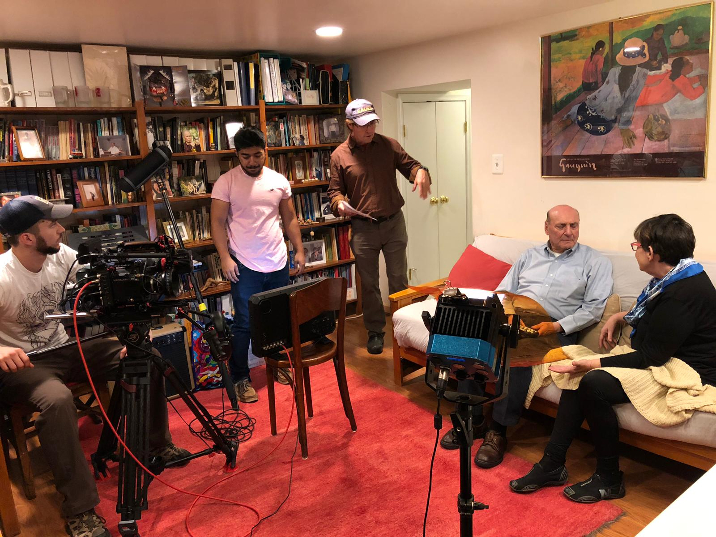
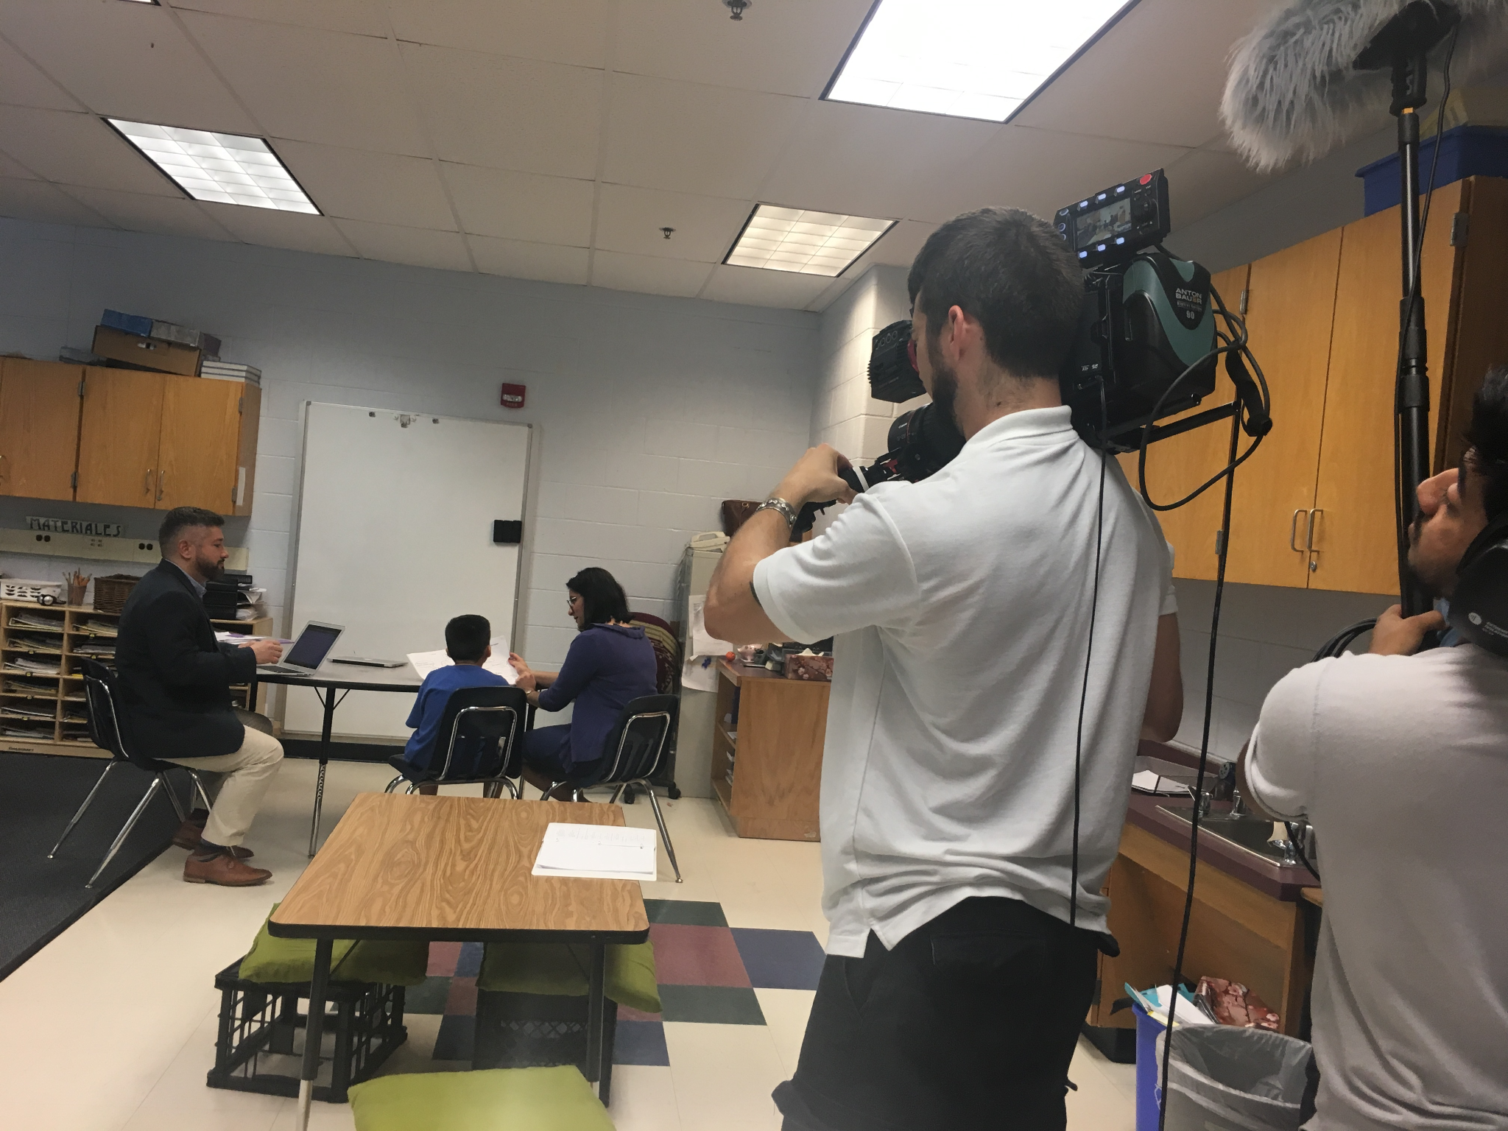
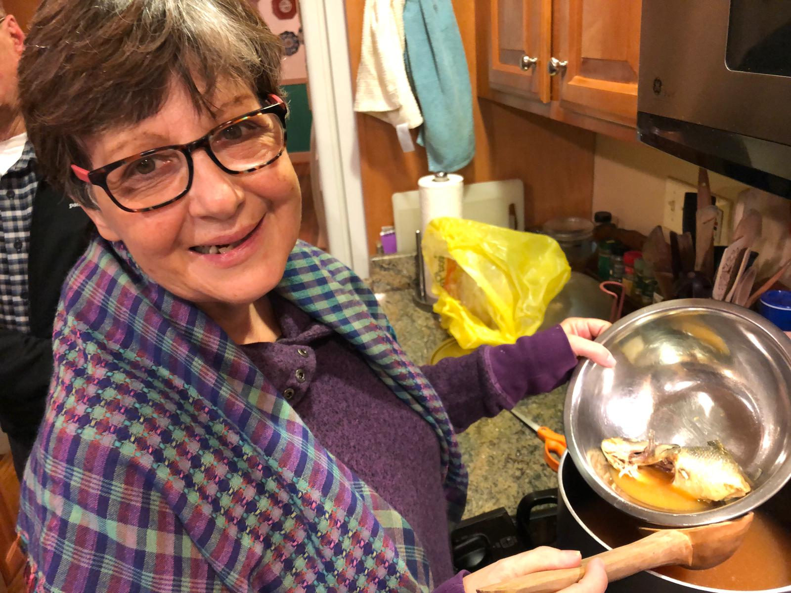
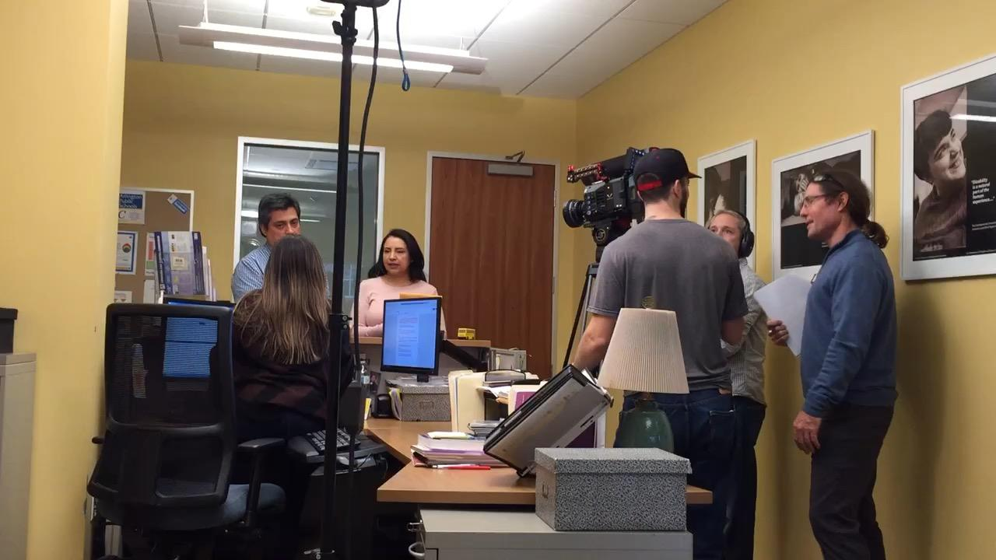
Video Production
Notes:
Kathleen - 30 SECONDS
Working with a
1) 4 Person Crew (Director, Cinematographer, Audio Engineer, Grip),
Our collaboration continued as we filmed; often tweaking to add authenticity to our script.
We filmed on site in a few of our schools, at the Parent Resource Center in our central administrative office, and in our colleague Rosa’s home! :)
3) Having fun leads to the best / most authentic moments
4) Watching old Telenovelas helped during filming to capture the drama / style

Slide 16
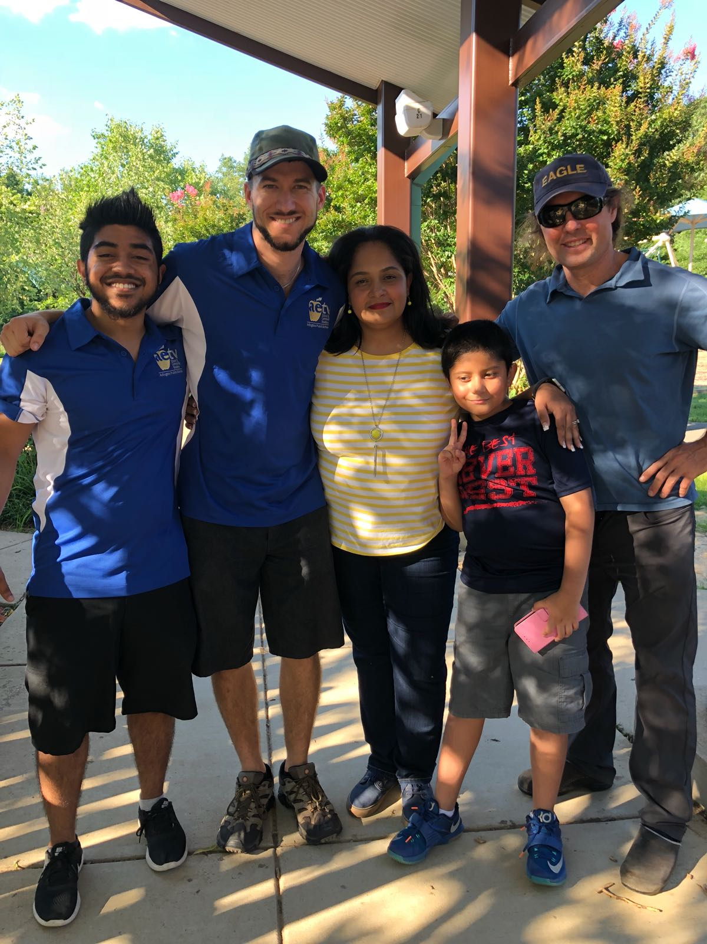
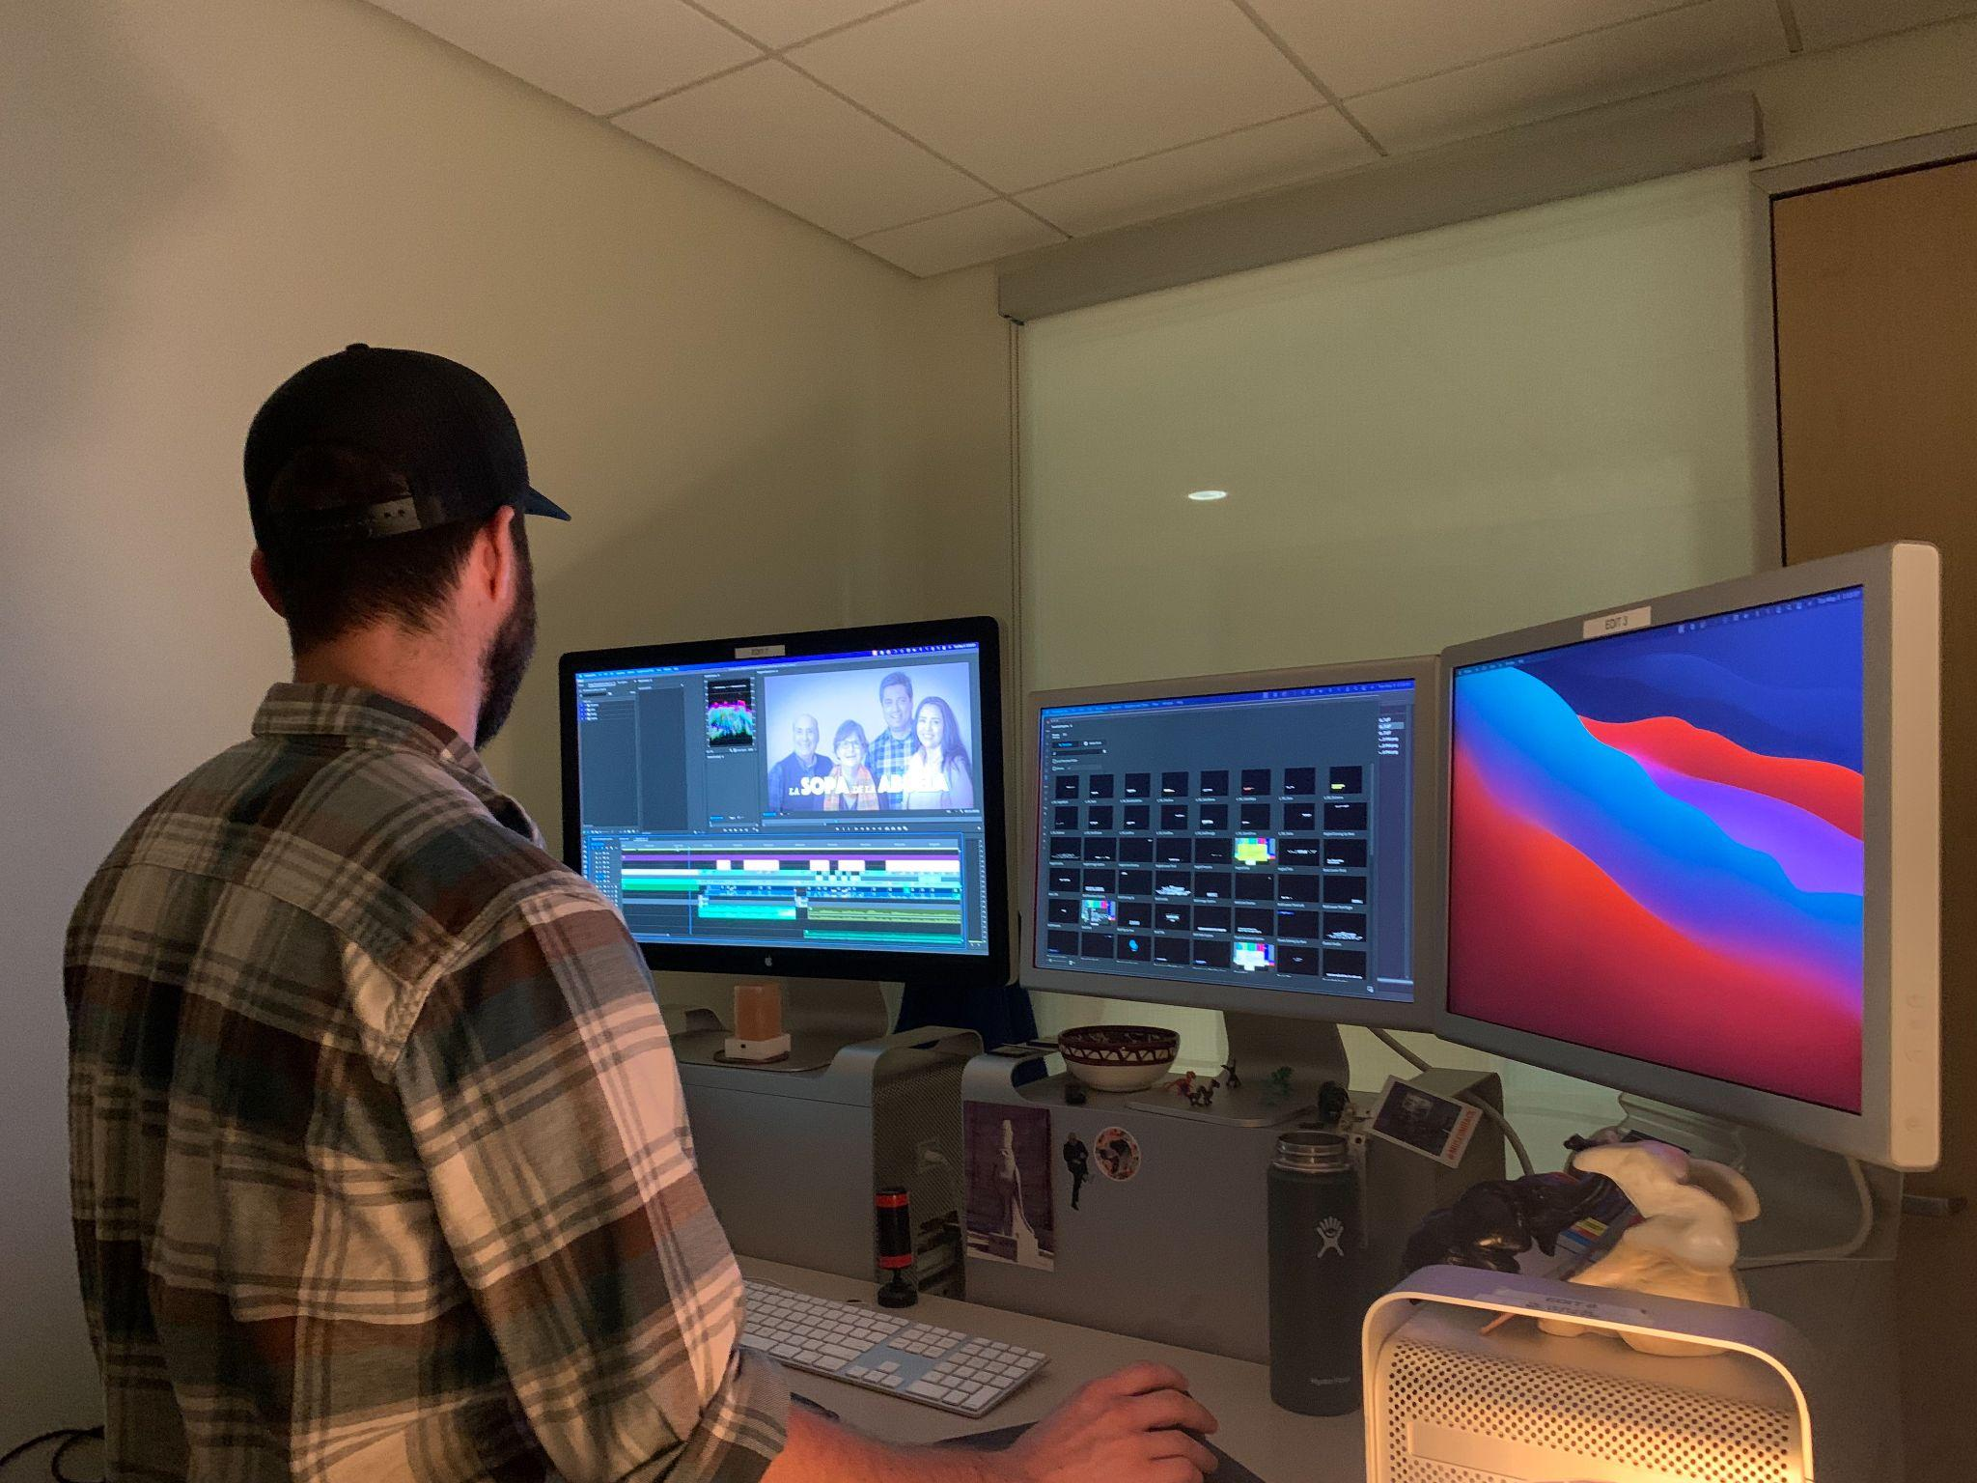
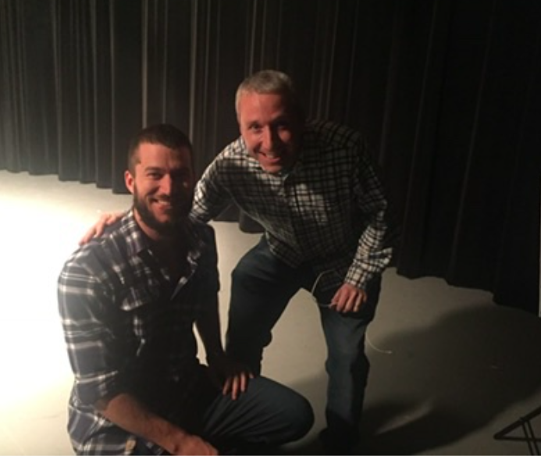
Video Post-Production
Notes:
Kathleen Post-Production: - 30 SECONDS
2) COVID shut us down for 2 years :(
4) Community collaboration continued ex: Student at Career Center created the narration for football announcer
Worked on subtitling to ensure accessibility for non-Spanish speakers
5) Three Main Takeaways:
-Team effort
-Community collaboration
-Power of adaptability

Slide 17
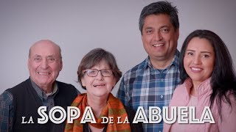
Episode 1: What’s Going On With My Child?
La Sopa de la Abuela consists of five episodes (each about 10 minutes long) and follows a family’s journey through the special education cycle.
Notes:
Episode 1 Screening:
1) Brief introduction to La Sopa de la Abuela (1 sentence)
2) Grab your tamales and empanadas!

Slide 18
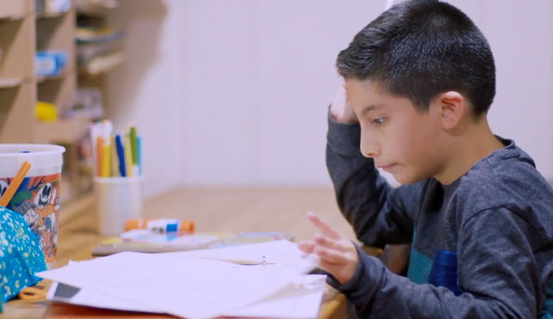
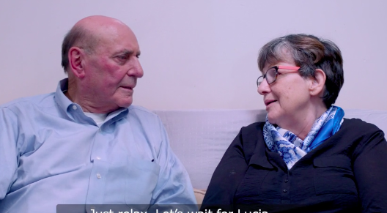
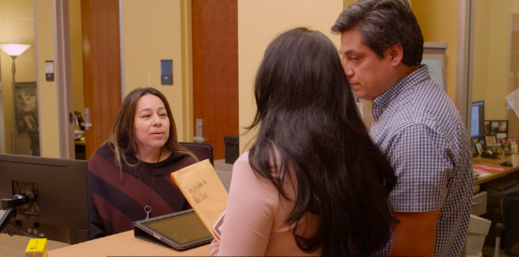
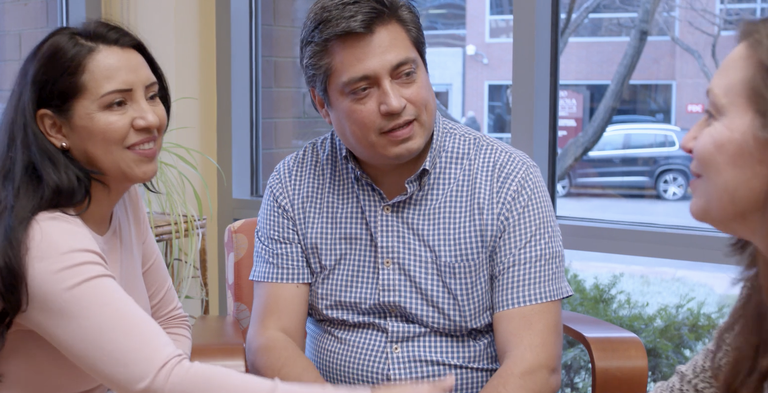
Episode 2: What Do We Need to Know?
Notes:
Gina
In Episode 2, my character, Lucia and her husband visit the Parent Resource Center and begin accessing information and support to help navigate this process.

Slide 19
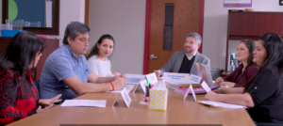
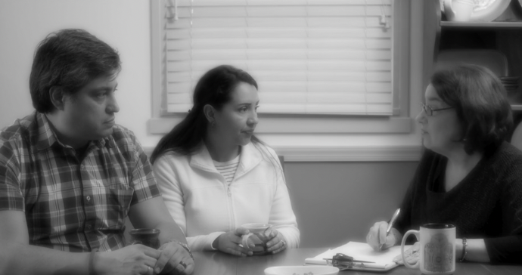
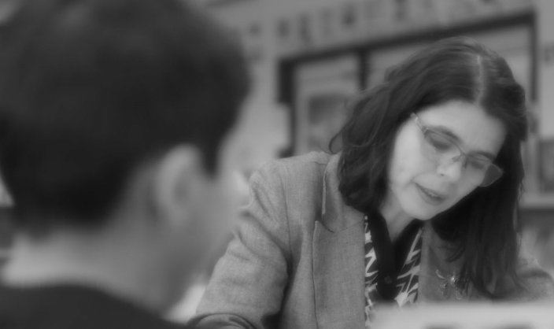
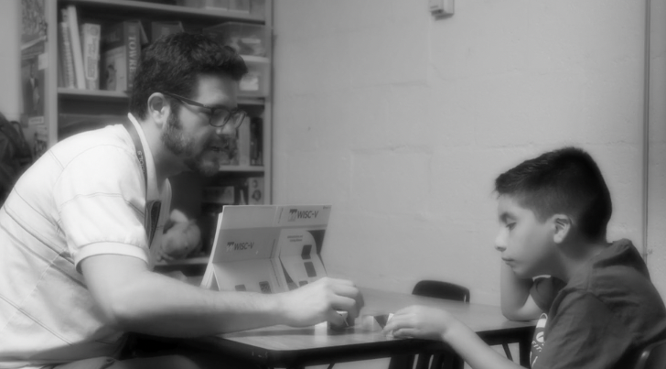
Episode 3: Why are there so many tests?
Notes:
Gina - 30 seconds Many families are often surprised at how many assessments are sometimes conducted, and this episode was designed to familiarize families with the nature of various assessments that might be conducted during the process.

Slide 20
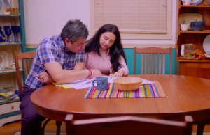
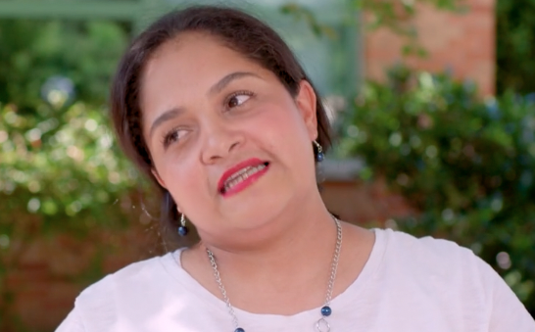
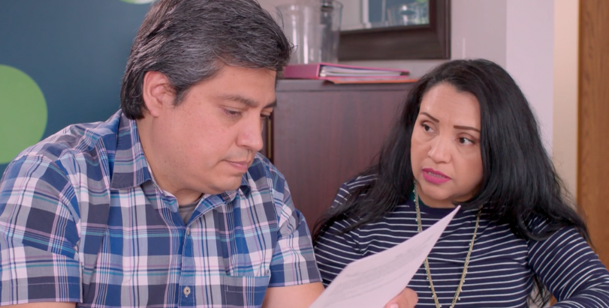
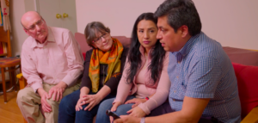
Episode 4: How do we cope with this news?
Notes:
Gina - 30 seconds
In Episode 4, Lucia reconnects with her friend Karina, who recounts the challenges she faced during her own eligibility meeting years before in another school district. She encourages Lucia to be sure to obtain and review copies of the test reports prior to the meeting. Six weeks later, Lucia and Jose work together to review the reports in advance of the meeting at home. A few days later, we see Lucia and Jose attending the meeting. They are prepared and feel comfortable asking questions.

Slide 21
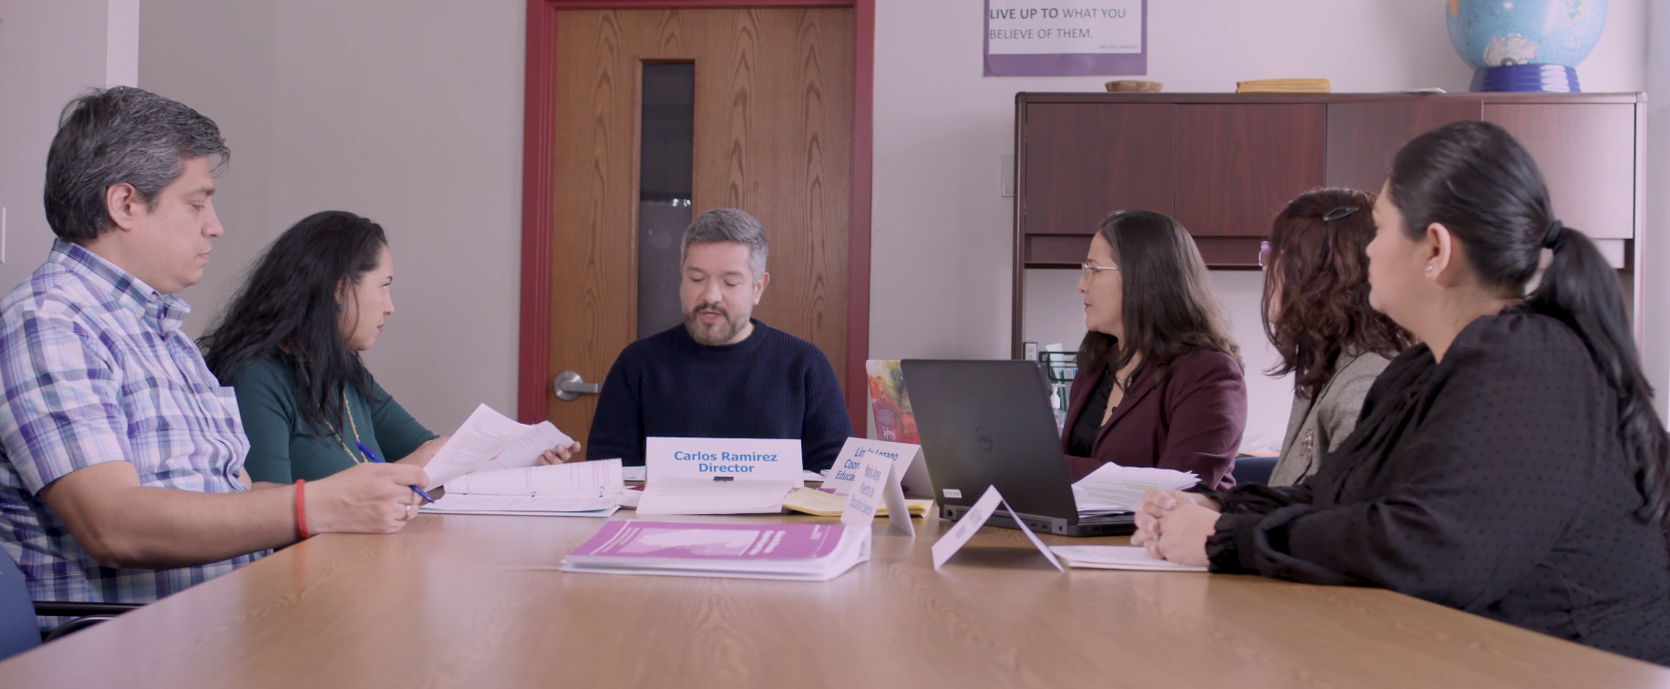
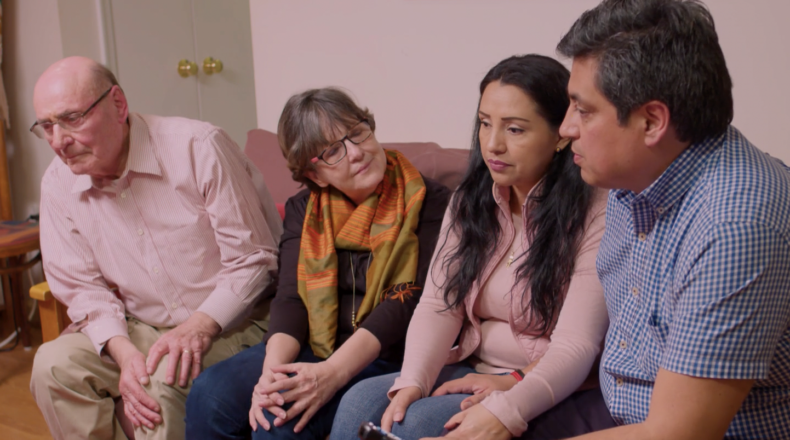
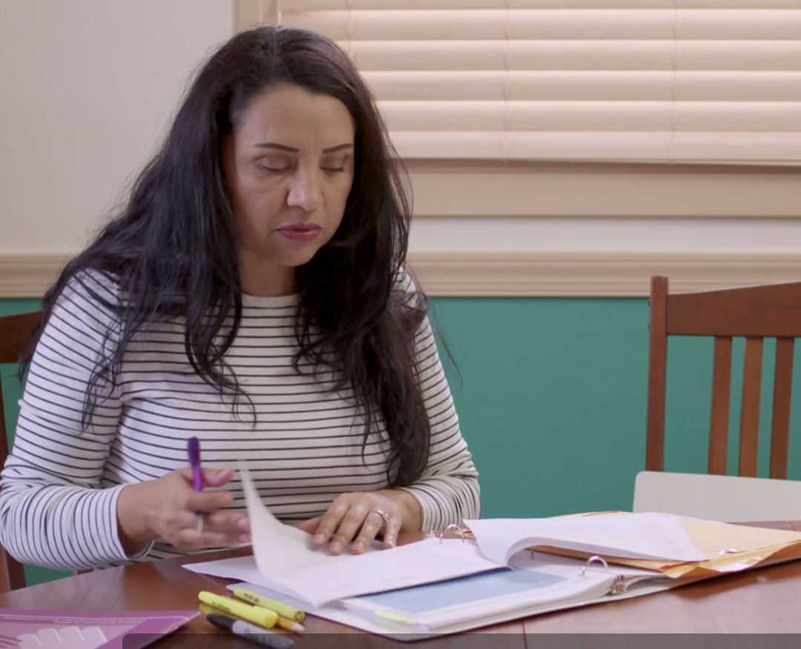
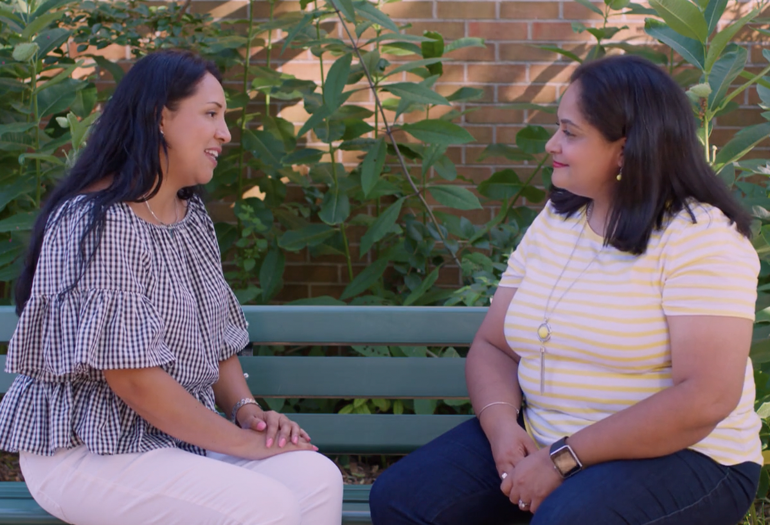
Episode 5: What If We Disagree?
Notes:
Gina- 30 seconds
Finally, in Episode 5, Pedro has been found eligible, and Lucia and Jose prepare for his IEP meeting. During the meeting, when Jose asks about what happens if parents disagree, the principal explains that the team will continue talking and exploring options to reach consensus.

Slide 22
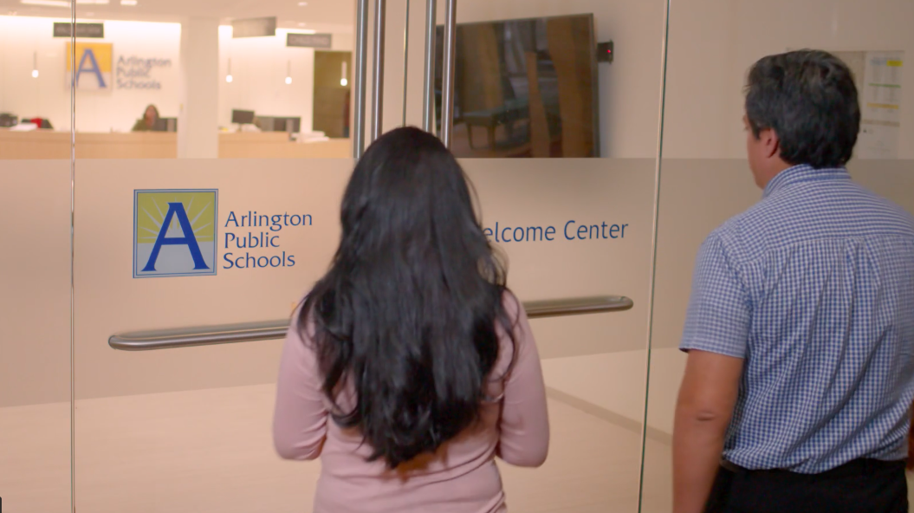
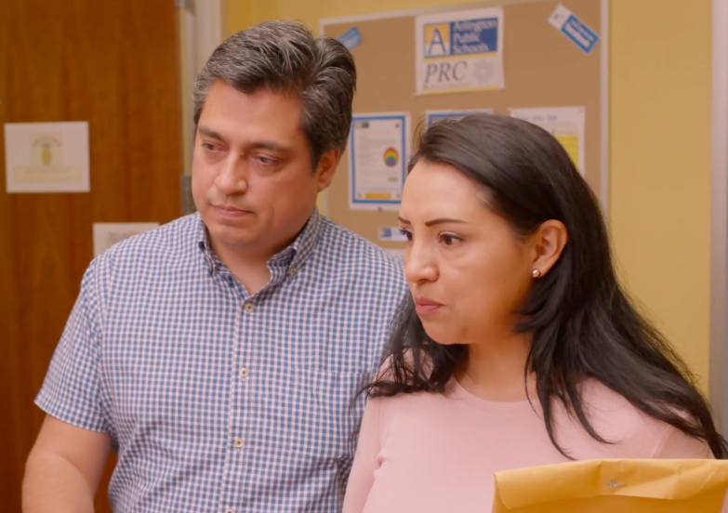
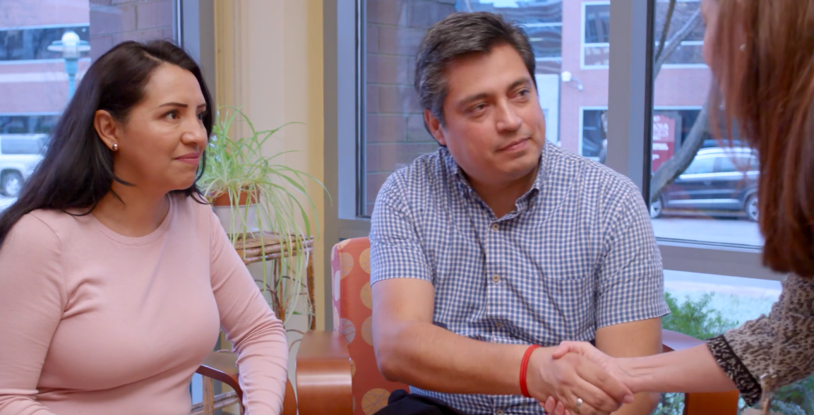
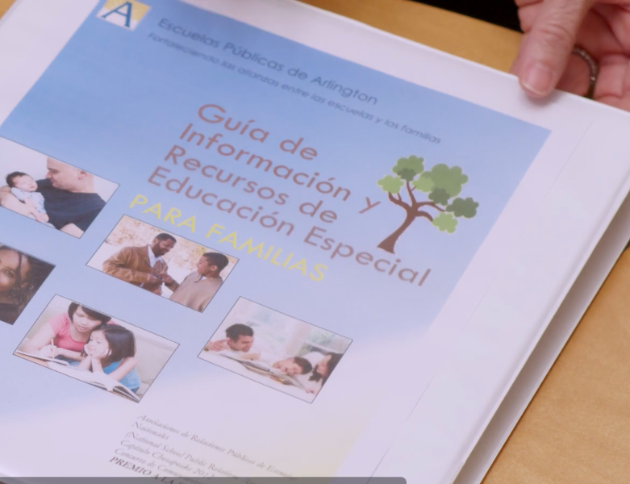
Reflections
Notes:
Gina: 3 minutes
Describe from parent perspective & personal experiences how the telenovela series as a resource might help, and as a parent leader, what your hopes are for families.
Becoming an advocate is a journey….

Slide 23
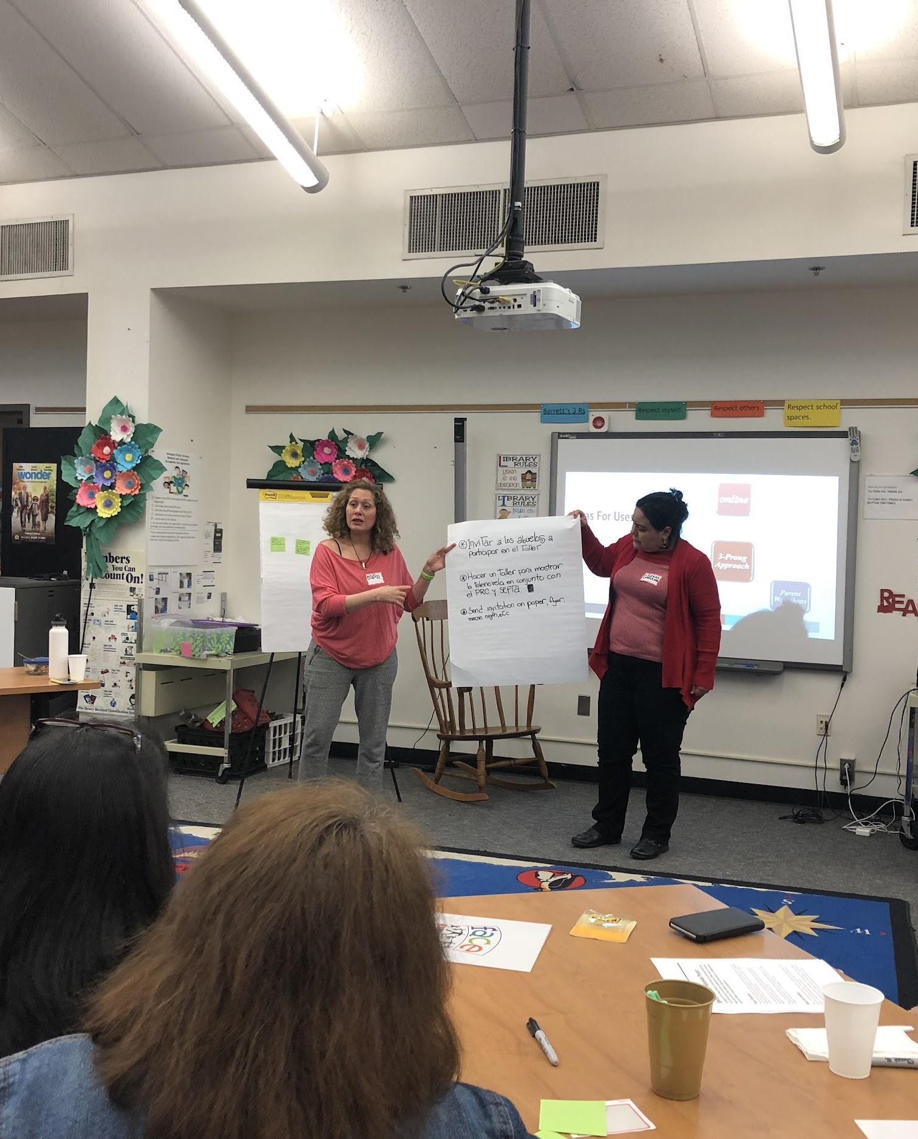
Ideas for Using the Novela
Independent web-based learning
Face to face sessions with families
Staff professional learning sessions
Notes:
MONICA: 2 minutes
Make the connection with equity
Talk about closing the opportunity gap for parents - ESL and SpEd ---achievement gap
Stereotypes
INTRODUCE GUIDE
I am happy to share how we are moving forward with this work to provide opportunities for deeper learning. In working with parents, we now have two options:
First - Independent web-based learning. All 5 episodes are posted online so anyone can access them and use the episodes to learn, access resources in real-time when needed, and teach and talk about the special education process.
Second - Our hope in the future is to offer five week, in-person learning sessions to accompany the five episodes. As COVID conditions in our area interfered this winter, in January we piloted a virtual five week series. We developed facilitator guides for each session, and tried to create a safe virtual space for families to reflect, interact with others, and participate in activities and exercises that walk us through this process.
Finally, as we consider the dual capacity framework, we have also facilitated opportunities for staff members to watch the series. Our hope is that the insights shared will inform best family engagement practices, deepen understanding, and strengthen partnerships.

Slide 24
Sample Parent Session Experience
The roles of Student Support Team Members
Matching activity
Notes:
Monica - 1 minute - describe matching activity - how we give the photos/title and then the description; parents pair up to discuss; NEXT SLIDE

Slide 25
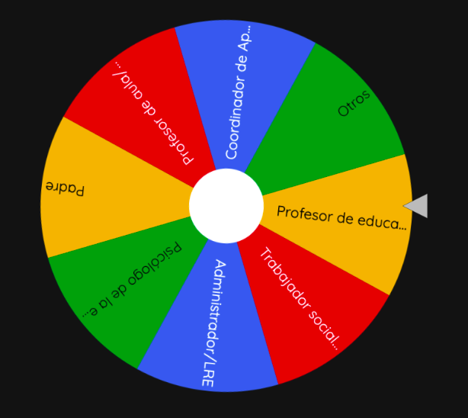
Sample Parent Session Experience
Roles of Student Support Team Members
Notes:
Monica - 1 minute
Then we use a fun game (what’s the Spanish word?) for them to report out to the larger group!

Slide 26
Sample Parent Session Activity
Take a minute to reflect in silence or jot down your answers to the following:
Why do Lucia and her husband seem alarmed when they heard the words special education?
What perceptions and beliefs about special education might you encounter in your family/community?
Notes:
Monica - 30 SECONDS
On the next slides, we’ve included a few more exercises from our Telenovela Learning Session facilitator guides. One of our hopes is to have open conversations about stigma and unspoken fears that may be present.

Slide 27
Sample Parent Session Activity
Share your reflections with your group as you feel comfortable.
STIGMA :
When someone is viewed in a negative way due to a characteristic or personal trait that is thought to be a disadvantage
How do your reflections connect with this word?
Notes:
Monica: 1 minute
Our goal is to have a parent and a staff member co-facilitate these sessions...

Slide 28
Pilot Parent Learning Sessions
Notes:
Kathleen - .25
Due to the pandemic, we wound up piloting our first parent series virtually, and then last year we held a full day Saturday seminar.

Slide 29
Initial Feedback
Understanding all steps in the special education process
Knowing their consent was required for all special education decisions
Learning about the roles of special education team members
Unfamiliarity with the special education process and not sure how to best advocate for their child
Parents reporting:
Notes:
Kathleen: In reviewing the pre and post course data, there was:
a decrease in parents who reported that they were not familiar with the process and were still not sure how to best advocate for their child (33% to 15%)
an increase in parents who reported that they’d had the opportunity to learn about the roles of special education team members (54% to 85%)
an increase in parents who reported that they understood all of steps in the special education process (23% to 58%)
an increase in the number of parents who reported being aware that their consent was required for all special education decisions regarding testing, placement, special education services, and the location of services provided (53% to 85%).

Slide 30
Key Messages in Novela Series
Validate and recognize feelings and strong emotions
Acknowledge fears of labels and stigma
Affirm and foster the strengths of students
Be aware there are a range of disabilities
Learn the steps in the special education cycle
Prepare for meetings
Know parental rights and the power of consent
Be empowered to disagree
You are not alone/resources
PARENTS are EQUAL MEMBERS OF and ASSETS to educational teams
Notes:
Kathleen: 45 seconds
Circling back to our WHY….
When we conceived of this project, we wanted to ensure that families are connected to the information and resources they need to navigate special education;
to address the emotions that come along with it;
to make informed decisions and provide informed consent; and to develop strong and positive partnerships with school staff because we know that this knowledge and advocacy will make a difference for families, staff, and most importantly, for our students.
We hope this series will be a wonderful resource not just for our community, but for each of your communities. As you use this tool, we encourage you to watch with intentionality for the key messages interwoven throughout the series which include.
Validate and recognize feelings and strong emotions
Acknowledge fears of labels and stigma
Affirm and foster the strengths of students
Be aware there are a range of disabilities
Learn the steps in the special education cycle
Prepare for meetings
Know parental rights and the power of consent
Be empowered to disagree
You are not alone/resources
PARENTS are EQUAL MEMBERS OF and ASSETS to educational teams
So, I know there’s a lot to consider, but let’s turn to the next slide for some reflection.

Slide 31
Reflections and Takeaways
Think about the supports that families of English Learners with special needs in your district must navigate in special education.
What can you apply from what you learned today to strengthen your family engagement practice in this area?
Notes:
Kathleen: 20 seconds
We know that reflection gives our brains time to pause and create meaning, which leads to learning. We’d invite you at some point to take time to reflect on the needs of the families in your school districts, and consider whether some of our experiences and the resources we’ve shared might strengthen your practices.

Slide 32
Telenovela Resources
Telenovela Home Page
www.apsva.us/prc
Notes:
Kathleen: 30 seconds
Thanks to all of you again for joining us. The QR code on the screen will take you to the Telenovela homepage, which you can also access at www.apsva.us/prc - Just click on the Telenovela link of the page to find the episodes, as well as a link to resources we’ve begun to build for our parent series.

Slide 33
Contact
Kathleen Donovan Special Education Coordinator Parent Resource Center (PRC)
Office of Teaching and Learning Arlington Public Schools
703-228-7239 kathleen.donovan@apsva.us
www.apsva.us/prc
Request session materials:
bit.ly/telenovelamaterials
Notes:
Kathleen - 10 seconds
- Should you need additional information, please feel free to reach out to me at the APS PRC.

Slide 34
Closing
Discussion:
Questions?
Thoughts?
Comments?
Notes:
Questions?
In closing, thank you so much for joining us today to celebrate and share this resource that will support families and staff in collaborating to support outcomes for students - especially those with disabilities. Our team is glad to respond to questions and comments.

Slide 35
Stories from the Classroom Video Series
Notes:
Donna: Let me help you find the Stories from the Classroom. Go to the home page and click on the resources tab. Here you will see the stories from the classroom. Currently we have 12 stories. X of those stories have discussion guides that accompany them. These are guides that help you lead a conversation in a meeting, a professional development, or a classroom using one of the videos to launch the discussion. I am constantly adding to these so keep following us on Twitter to see when the next one will be released.

Slide 36
Stories from the Classroom: Using a Telenovela to Explain the Special Education Process
Features a conversation between Kathleen Donovan, Parent Resource Center Coordinator for Arlington Public Schools (APS) and Gina Argotti a parent in APS
The goal of this resources was to:
Illustrate a creative way that a district has worked to reach families,
Illustrate the power of engaging families in the process of developing the messaging/materials,

Slide 37
Disclaimer
This material was produced under the U.S. Department of Education, Office of Special Education Programs, Award No. H326C190002. David Emenheiser serves as the project officer. The views expressed herein do not necessarily represent the positions or policies of the U.S. Department of Education. No official endorsement by the U.S. Department of Education of any product, commodity, service, or enterprise mentioned in this presentation is intended or should be inferred.

Slide 38
PROGRESS Center
progresscenter@air.org
1400 Crystal Drive, 10th Floor
Arlington, VA 22202-3289
202.403.5000
progresscenter@air.org
promotingprogress.org | www.air.org
https://www.facebook.com/k12PROGRESS/
https://twitter.com/K12PROGRESS
Notice of Trademark: “American Institutes for Research” and “AIR” are registered trademarks. All other brand, product, or company names are trademarks or registered trademarks of their respective owners.
This material was produced under the U.S. Department of Education, Office of Special Education Programs, Award No. H326C190002. David Emenheiser serves as the project officer. The views expressed herein do not necessarily represent the positions or policies of the U.S. Department of Education. No official endorsement by the U.S. Department of Education of any product, commodity, service, or enterprise mentioned in this presentation is intended or should be inferred.
XXXXX_MO/22

