Slide 1

Using Behavior Progress Monitoring for Individualized Instructional Planning
August 4, 2023
Caitlyn Majeika, PhD

Slide 2

Agenda
Setting the stage
Overview of progress monitoring
Steps for behavior progress monitoring
Making instructional decisions using progress monitoring data
Additional resources

Slide 3
Setting the Stage

Slide 4

Case Study: Eduardo
Eduardo is a 6th grade student in Mr. Kim’s math class. Mr. Kim has been struggling with Eduardo during class for the past month. Eduardo is constantly off task and requires a lot of redirection to tasks—especially during independent work time on his laptop. Mr. Kim is also concerned that Eduardo’s time off task is impacting his progress in math. Recently, Mr. Kim met with his fellow 6th grade teachers for a data team meeting. During this meeting, Eduardo’s screening data show he is at risk in math and in academic behavior.

Slide 5

The Proposed Plan
Next week, Eduardo will begin math intervention with the interventionist, Ms. Jones, during Tiger Time twice per week. In addition, Eduardo will start check-in check-out to help support his behavior. Mr. Kim and the math interventionist work together to create a progress monitoring plan for Eduardo that they will use to monitor his academic behaviors to determine if the intervention is working.

Slide 6
Overview of Progress Monitoring

Slide 7
What Is Progress Monitoring?
Progress monitoring (PM) is repeated measurement of student performance over the course of intervention to index/quantify responsiveness to intervention.
PM allows teachers to determine, on an ongoing basis, when adjustments to the program are needed to improve responsiveness.
National Center on Intensive Intervention, 2017

Slide 8
Monitoring Progress vs. Progress Monitoring
Monitoring progress is not the same as progress monitoring.
Monitoring Progress
Often informal or unstandardized
Can occur during daily instruction
Provides data for immediate, real-time instructional decisions
Uses formative assessments, questioning, providing feedback, and similar strategies
Used for all students
Progress Monitoring
Valid and reliable measures, with standardized delivery
Frequency depends on intensity of instruction and recommendations of the developer (e.g., weekly or monthly)
Requires ongoing and graphed data (i.e., 6–9 data points for valid interpretation
Used for entitlement decisions and students receiving targeted and intensive interventions

Slide 9
Why Is Progress Monitoring Important?
Identify students who are not making adequate progress
Compare the efficacy of different forms of instruction
Determine when an instructional change is needed
Data allow us to
Estimate the rates of improvement (ROI) across time
Support communication with parents and students
Support the development of present levels of performance, IEP goals, and monitoring plan for students with disabilities

Slide 10
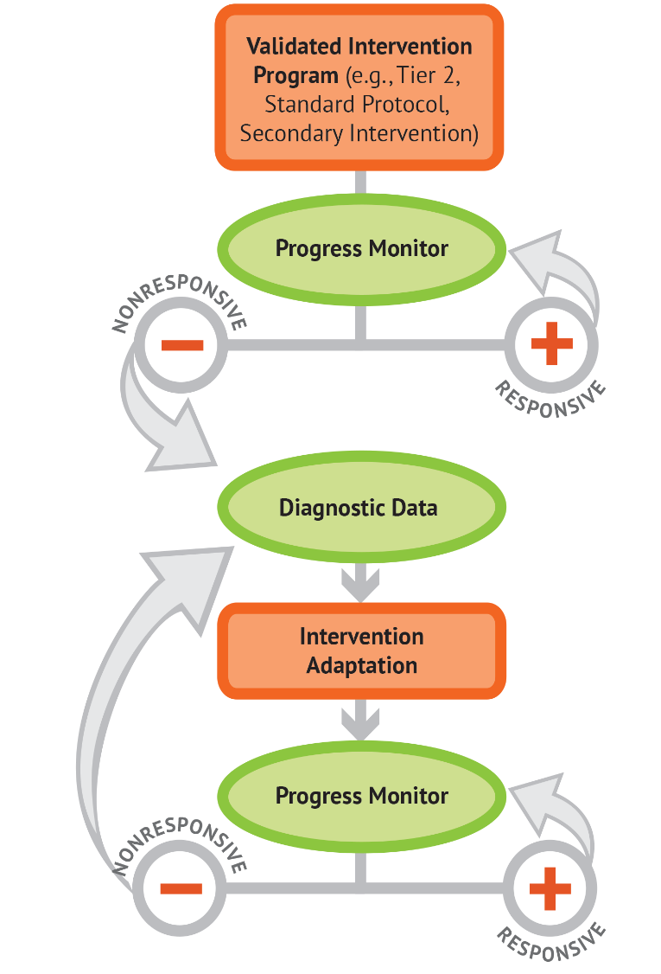
Progress Monitoring and DBI

Slide 11
Steps for Behavior Progress Monitoring

Slide 12
Behavior Progress Monitoring Steps
Select and define target behavior
Select and align a tool
Create a progress monitoring plan
Set goals and decision rules
Collect, graph, and analyze data

Slide 13
Step 1: Select and Define Target Behavior
Select Target Behavior
  List behaviors identified as problematic by teachers and from screening data.
  Once you select the behavior of focus, identify the replacement behavior.
    This is the behavior you want the student to engage in instead of the problem behavior.
    This a behavior you want to improve.
    Example: A replacement behavior for shouting out is raising your hand.

Slide 14
Step 1: Select and Define Target Behavior 2
Define Target Behavior
  Use clear, concise language.
  Construct the definition so the target behavior can be observed and measured by others.
  Define examples and non-examples of what the behavior does and does not include.

Slide 15
Examples of Target Behavior Definitions
Definition | Quality | Rationale
Tara is disruptive. | Poor | Not measurable/observable. Leaves room for subjectivity and inconsistency.
Tara makes inappropriate comments during class. | Better | Adds more context but lacks sufficient detail of what the behavior looks like.
Tara curses at her teacher and peers, talks excessively about unrelated tasks/work, or insults peers during class. | Best | Specifies what the inappropriate comments are that are disrupting class.

Slide 16
Case Study: Target Behavior
Problem behavior: Off-task behavior
Target behavior (replacement behavior): On-task behavior
Definition: On-task behavior is appropriately participating in classwork and completing assignments as expected.
  Examples: Using materials appropriately; completing work as expected; participating in the lesson; participating in small group work; interacting with the correct website when on laptop; raising hand to ask for help when needed.
  Non-examples: Using materials inappropriately; head on desk during lesson or independent work; talking to a peer during a lesson or independent work; remaining at desk instead of working in small group; navigating away from assigned websites; shouting out for help.

Slide 17

In the Chat:
What are common student behaviors you progress monitor for?

Slide 18

Step 2: Select and Align a Tool
First, select a tool that:
  Captures target behavior in meaningful way (e.g., observation, Direct Behavior Rating [DBR]).
  Can feasibly be incorporated into teaching routine.
  Has an appropriate scale for measurement (e.g., 1-10 rating, frequency count, percentage of time).
Next, align the tool with the target behavior.

Slide 19
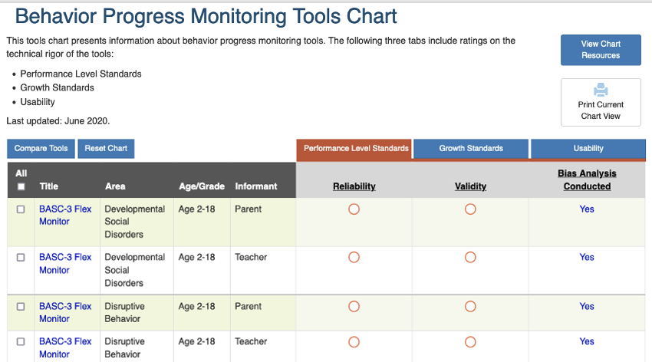
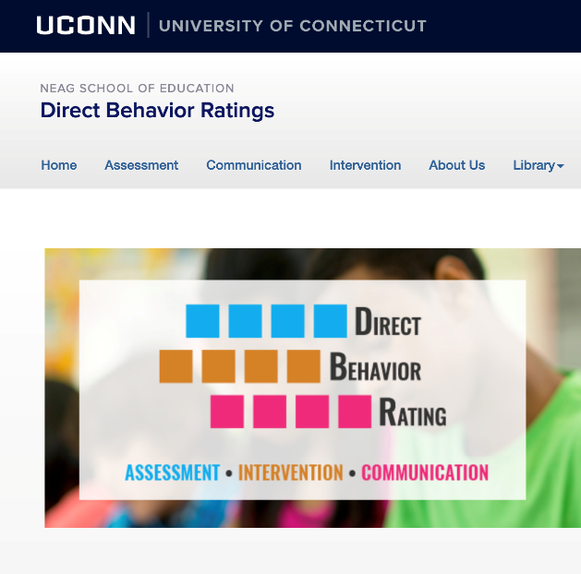
Where Can I Find Progress Monitoring Tools?
NCII Resource: https://charts.intensiveintervention.org/bprogressmonitoring
University of Connecticut Resource: https://dbr.education.uconn.edu/

Slide 20
Common Tools for Progress Monitoring
 | Systematic Direct Observation (SDO) | Direct Behavior Rating (DBR)
Definition | Observing a student and systematically observing behavior. | A brief rating of a target behavior following a specified observation period.
Example | Tallying the number of times a student raises their hand to respond during a whole group lesson. | Marking off the percentage of time a student was engaged during a lesson.
Advantages | Aligned to the behavior being observed. Applicable to a wide range of observable behaviors. Measures various dimensions of behavior. | Instrumentalize traditional rating systems so that ratings become outcome data that somebody can utilize. Feasibly collect data multiple times enabling teachers to have many data points. Valid, reliable, and feasible.
Challenges | Time intensive. Requires a trained observer. Can be difficult to implement if observer must perform other duties at same time. | May not provide granular level of data needed to see changes in student behavior over time.

Slide 21
In the Chat: 2
Have you ever used systematic direct observation or DBR for progress monitoring?
If not, which tools have you used for progress monitoring?

Slide 22
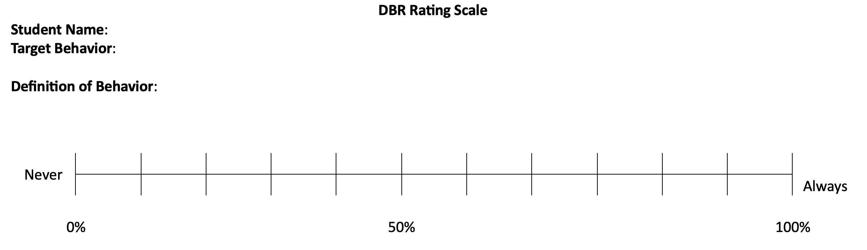
Let’s Explore DBR Further
Adapted from DBR here: https://dbr.education.uconn.edu/

Slide 23
Align DBR to Target Behavior
Align DBR to match target behavior and definition for individual students.
Adapted from DBR here: https://dbr.education.uconn.edu/

Slide 24
Case Study: Tool Selection
  Tool Selected = DBR
    DBR allows Mr. Kim to easily collect data on Eduardo’s behavior while teaching.
    Eduardo’s check-in check-out system also targets on-task behavior, showing high alignment between PM and intervention.
    DBR has rating scale that can measure percentage of time on task during math class.

Slide 25
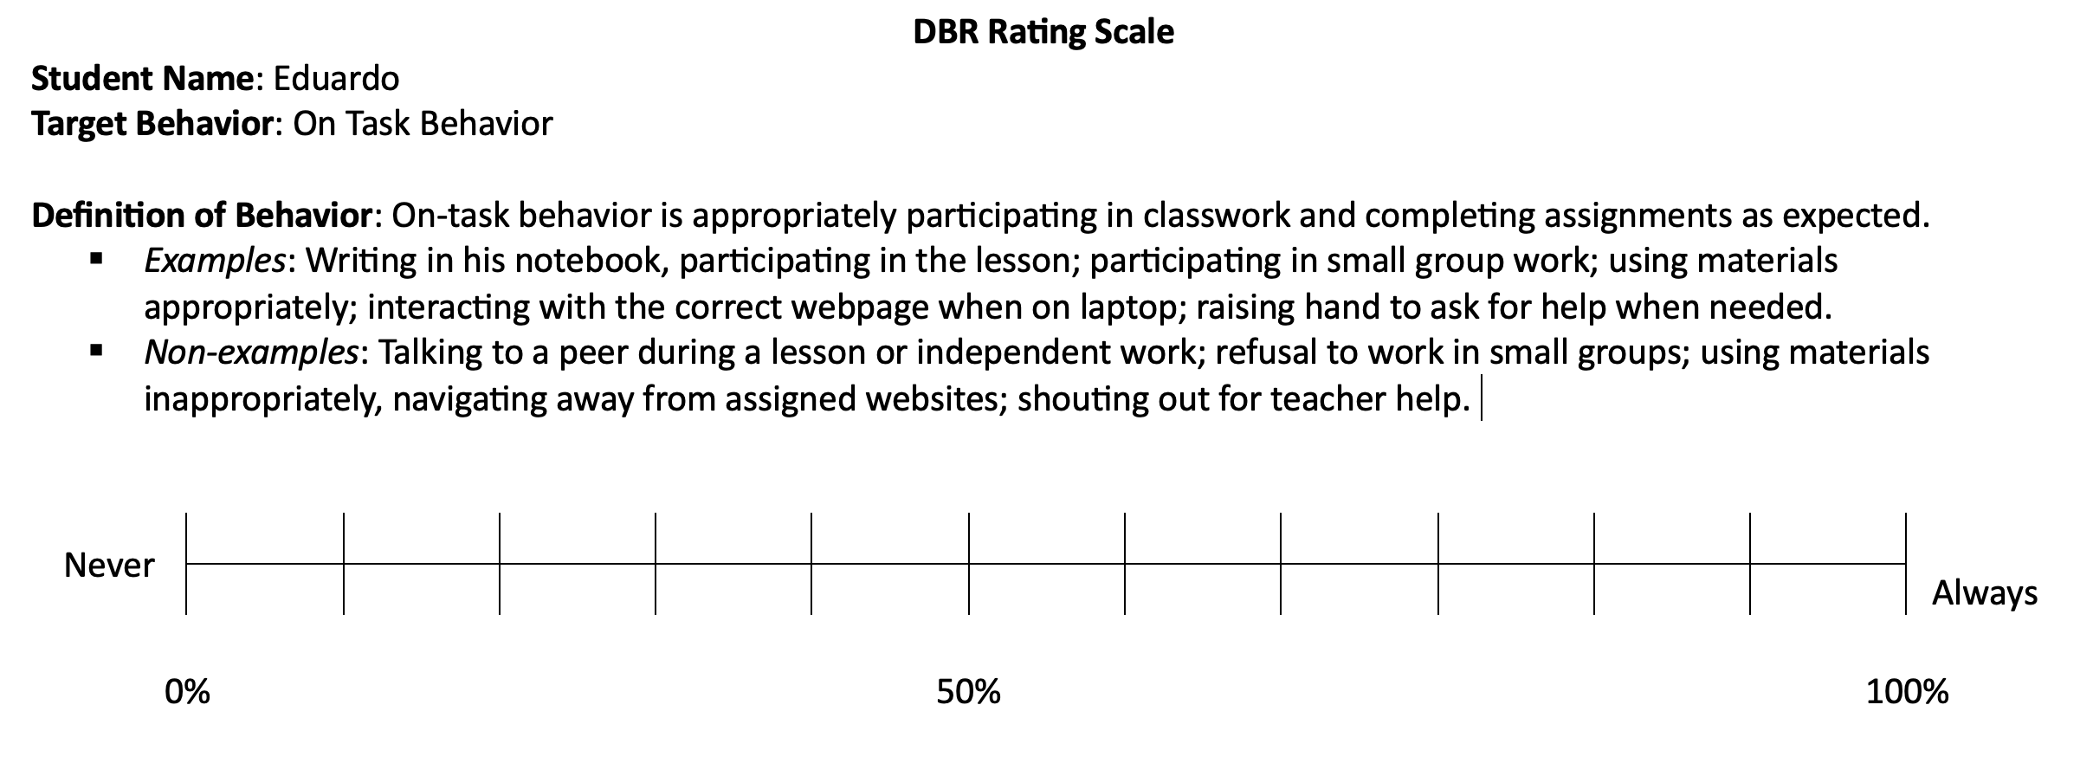
Case Study: Tool Alignment
Mr. Kim aligned DBR rating scale to show Eduardo’s target behavior.

Slide 26


Step 3: Create a Progress Monitoring Plan
  Determine frequency of data collection
  Identify a data collector
  Identify the setting for data collection
  Create a plan for data storage and graphing

Slide 27
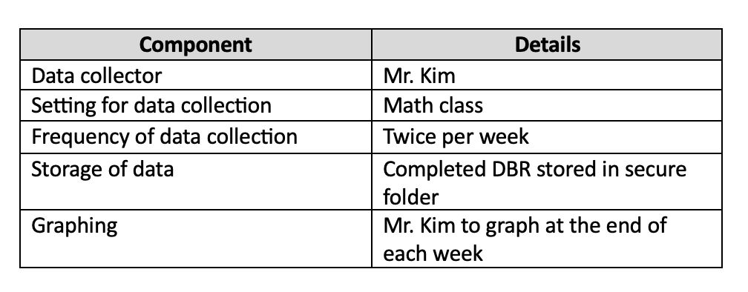
Case Study: Progress Monitoring Plan

Slide 28



Step 4: Set Goals and Decision Rules
Establish Baseline Performance
Analyze Baseline Data to Set a Goal
Create a Decision Rule

Slide 29
Establish Baseline Performance
Baseline data establish a student’s current level of performance using the selected progress monitoring tool.
Unless there is an ethical reason to begin immediate intervention, collect at least 5 data points to establish baseline performance.​
  Note: Highly variable data may suggest a need to collect additional baseline data or revisit the definitions of target behaviors.
Begin intervention after you establish baseline performance.

Slide 30
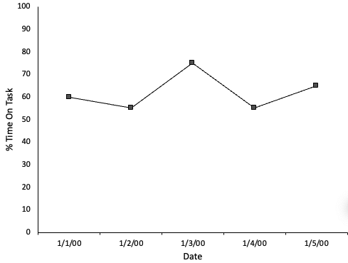
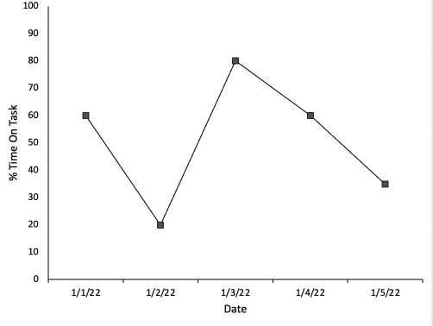
Sample Baseline Data
Example 1
5 data points.
Data are stable.
Next Steps: Set goal, begin intervention, collect PM data.
Example 2
5 data points.
Data are variable.
Next Step: Continue collecting data to see if behavior stabilizes.

Slide 31
Analyze Baseline Data to Set a Goal
Goal should be based on baseline performance.
  Aim for a goal higher than average performance across baseline.
  Consider how you would expect a typical student to perform.
Make goals ambitious, but feasible to obtain.

Slide 32

Create a Decision Rule
Regardless of the PM tool you use, be sure there are clear decision rules.
Sample decision rule:
  Jacob is considered responsive to the intervention if his DBR rating for verbal aggression in math class averages less than 5 for a one-month period.
32

Slide 33
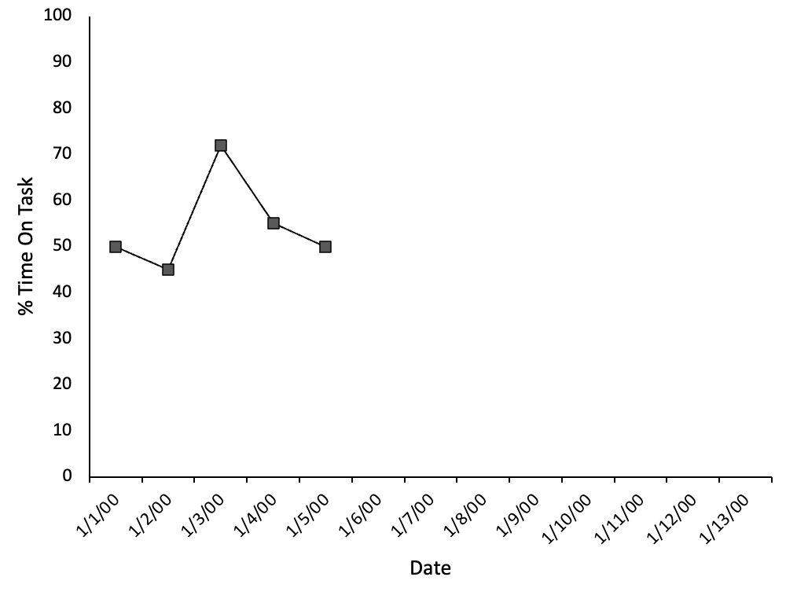
Case Study: Establish Baseline Performance
Used DBR to collect baseline data prior to starting intervention.
Collected 5 data points.
Data look fairly stable, so Mr. Kim and the interventionist proceed with goal setting and intervention.

Slide 34
Case Study: Set a Goal
Goal Line
Average across all sessions = 54% time on task.
Goal = 70%.
  Team determined it was ambitious, but attainable, because Eduardo hit this rating one time during baseline.
  Can increase goal over time as needed.
Average = 54%

Slide 35
Case Study: Create Decision Rule
The team will consider Eduardo responsive to intervention if he meets or exceeds his goal (70% on task on DBR) for 5 data points in a row.

Slide 36

Step 5: Collect, Graph, and Analyze Data
Collect PM data in the same manner you used to establish baseline performance.
Graph data on a regular basis to ensure:
    Data do not get misplaced.
    Teachers can easily access to data to make decisions about responsiveness.

Slide 37


Analyzing Graphed Data
After setting a goal, collecting progress monitoring data, and graphing progress monitoring data, ask the following questions to determine if a change is needed.
Is the student’s performance improving?
Is the student’s performance improving sufficiently to meet their goal?

Slide 38
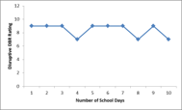
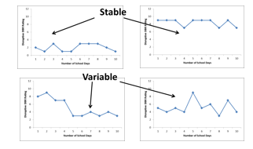
Methods and Features of Data Analysis​
Level
Trend
Trend
ASCENDING
DESCENDING
LEVEL

Slide 39
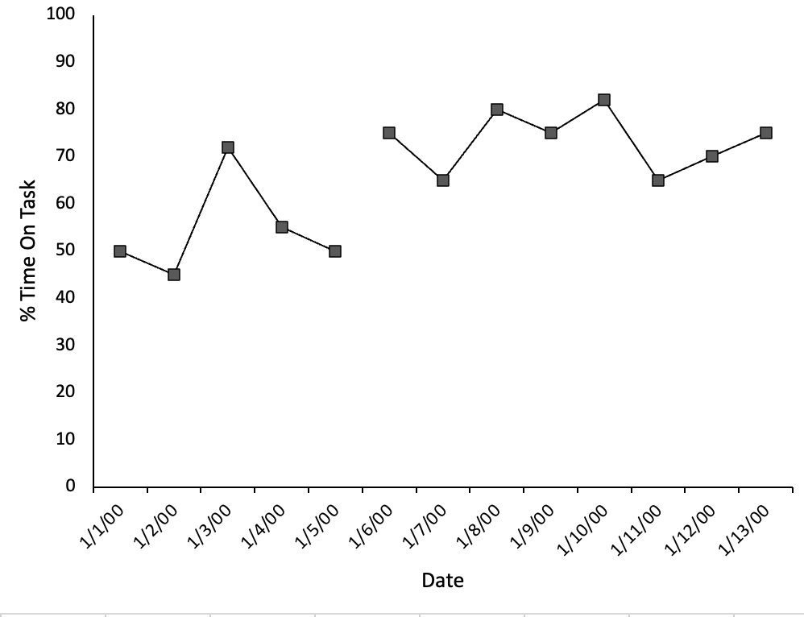
Case Study: Analyze Data
Goal
The team will consider Eduardo as responsive to intervention if he meets or exceeds his goal (70% on task on DBR) for 5 data points in a row.

Slide 40
Making Instructional Decisions with BPM Data

Slide 41
We Have BPM Data, Now What?
Review data with team.
Determine if student met their goal.
  If goal is exceeded: Prepare a plan for fading intervention and maintenance of skills.
  If goal is met: Continue with intervention and collect a few more PM data points. Next, prepare a plan for fading intervention and maintenance of skills.
  If goal is not met: Continue with intervention and PM data collection. Reevaluate with team during next data review cycle.

Slide 42
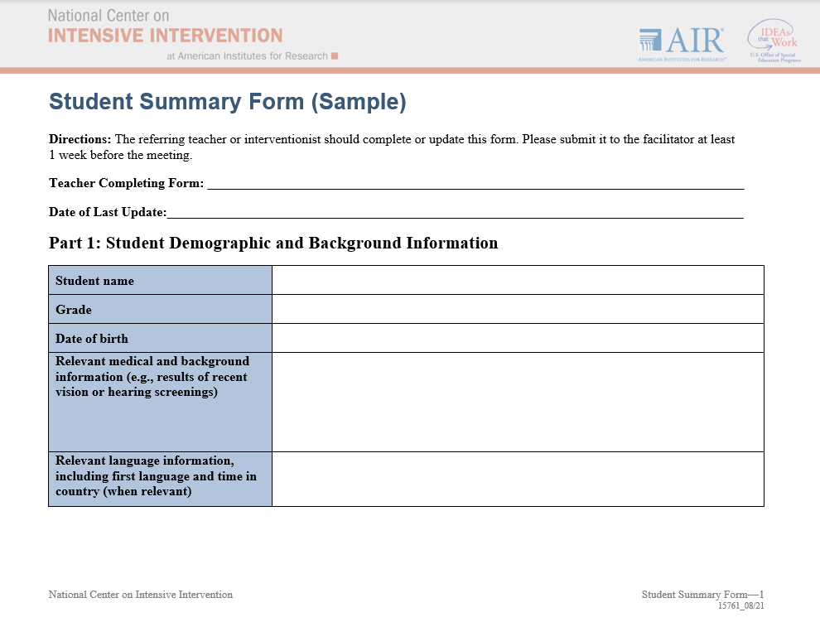
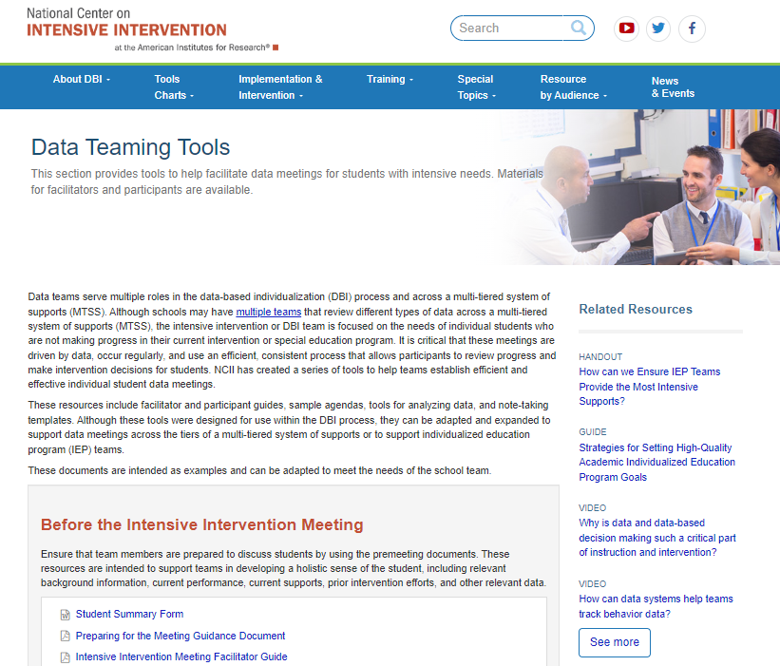
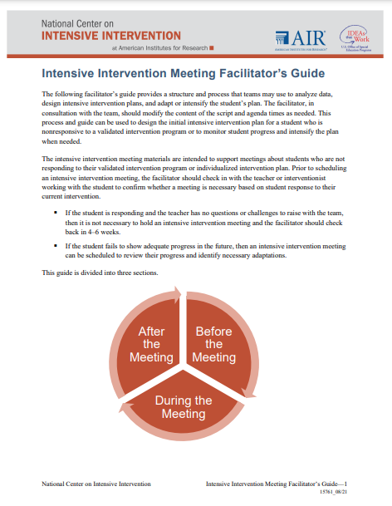
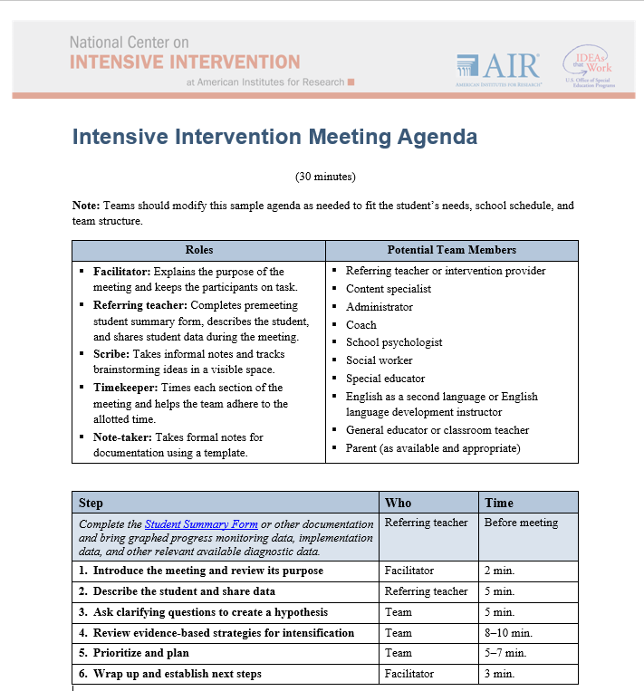
Facilitating Meetings to Review Data
Data Teaming Tools

Slide 43

Case Study: Make a Decision
What decision do we make?

Slide 44
Case Study: Make a Decision 2
Goal is not met yet.
Continue intervention and PM data collection.

Slide 45
Additional Resources

Slide 46

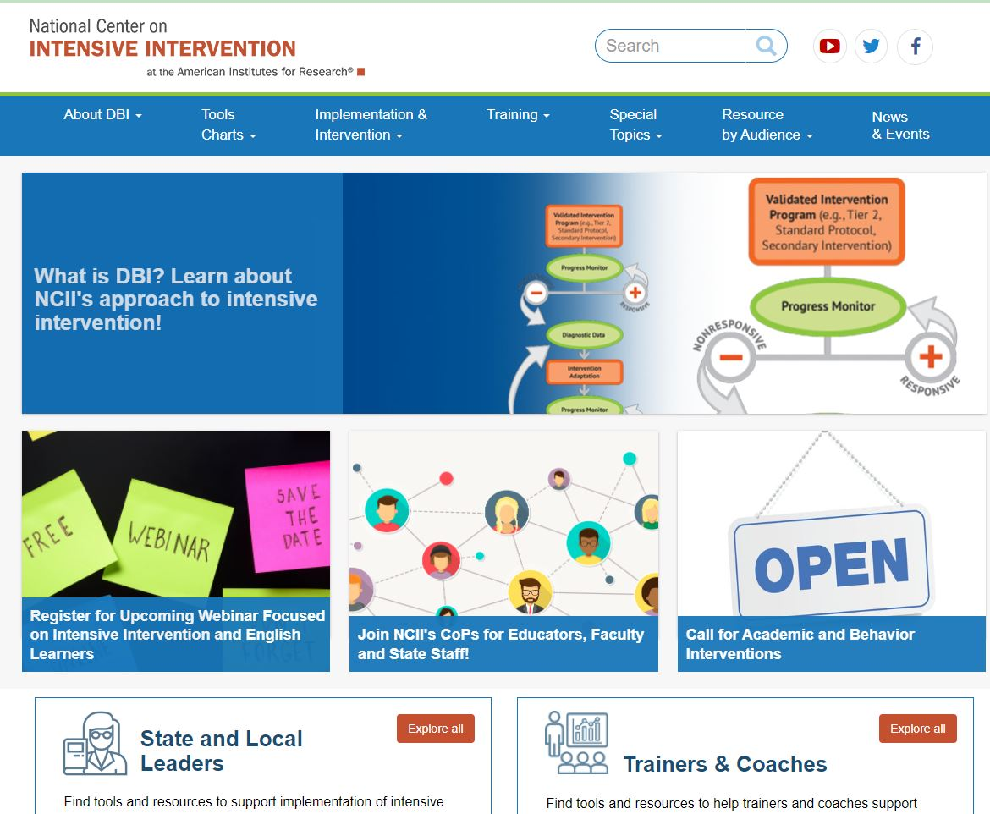
Resources to Learn More
NCII’s website www.intensiveintervention.org has a wealth of resources to support this process!

Slide 47
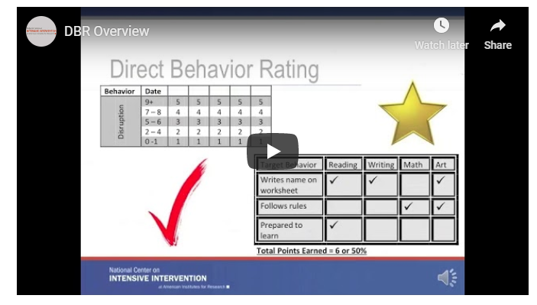
Learn More About DBR
NCII Resource:
https://intensiveintervention.org/resource/direct-behavior-rating-overview

Slide 48
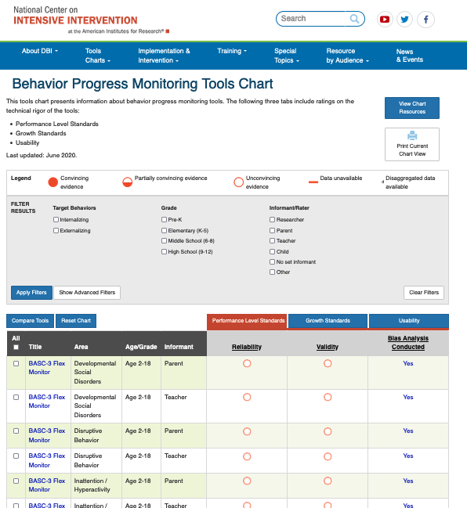
NCII BPM Tools Chart
https://charts.intensiveintervention.org/bprogressmonitoring

Slide 49
Facilitating Meetings to Review Data 2
Data Teaming Tools

Slide 50
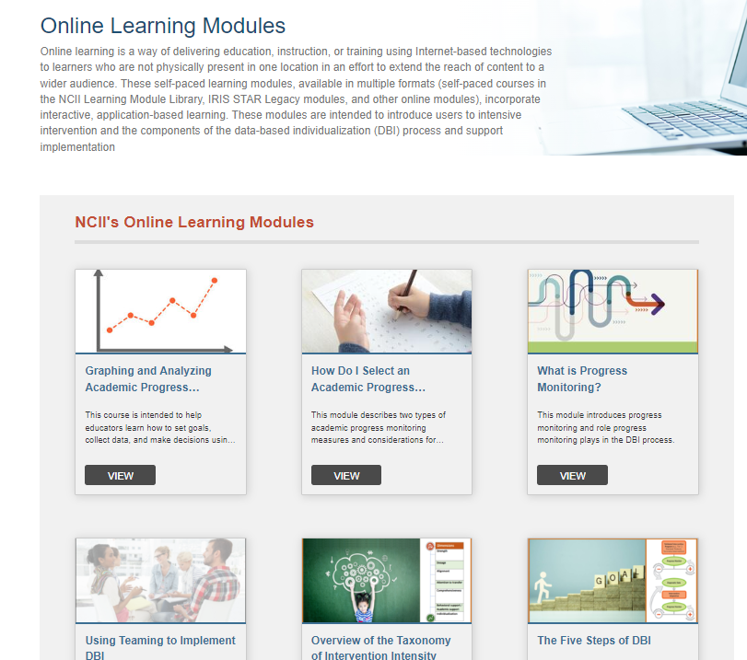
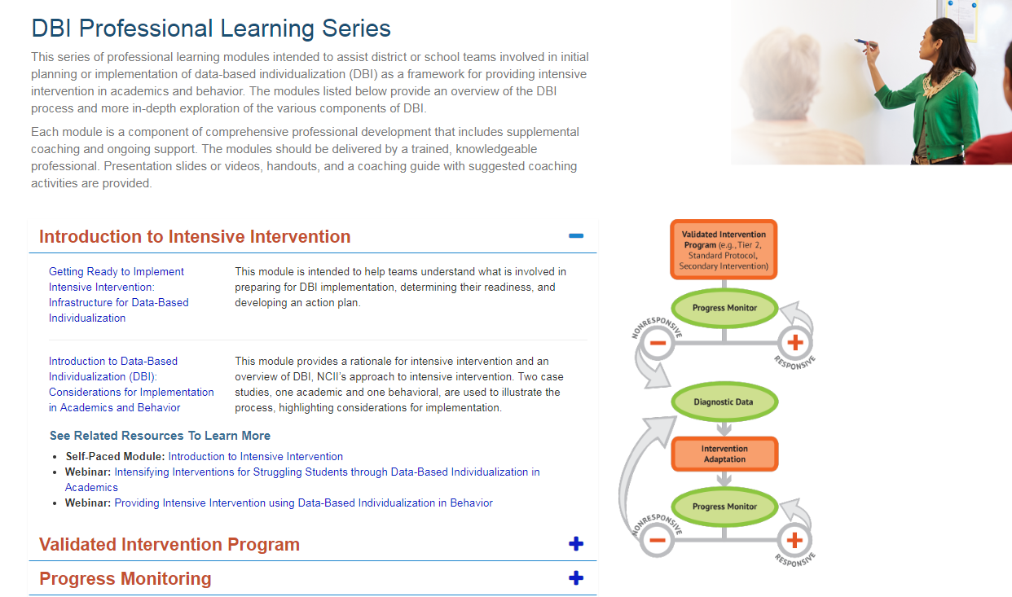
Professional Learning Resources
DBI Training Series
Online Learning Modules

Slide 51

NCII Information

Slide 52
NCII Disclaimer
This presentation was produced under the U.S. Department of Education, Office of Special Education Programs, Award No. H326Q260001. Celia Rosenquist serves as the project officer. The views expressed herein do not necessarily represent the positions or policies of the U.S. Department of Education. No official endorsement by the U.S. Department of Education of any product, commodity, service, or enterprise mentioned in this resource is intended or should be inferred.

